Slide 1

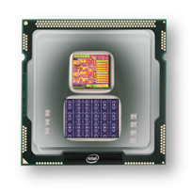
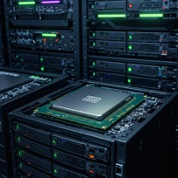

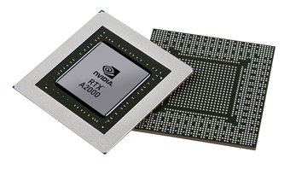


Christof Teuscher
ECE 410/510: Hardware for AI and ML
Codefest #10: Hello doc(umentation)!
Portland State University
Department of Electrical and Computer Engineering (ECE)
www.teuscher-lab.com
teuscher@pdx.edu

Slide 2

UCIe (Universal Chiplet Interconnect Express) is an open industry standard for connecting chiplets within a multi-die package
https://semiengineering.com/connecting-ai-accelerators

Slide 3
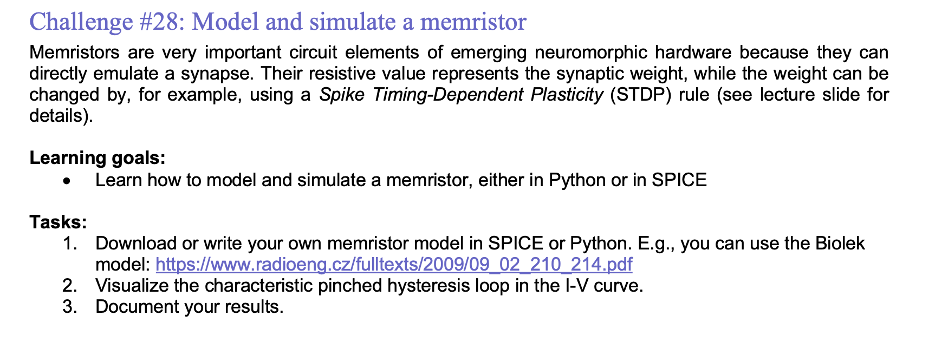
Weekly challenges

Slide 4
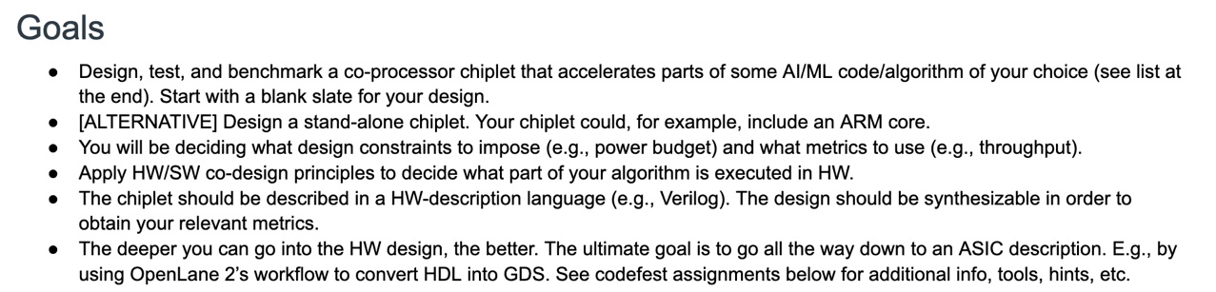
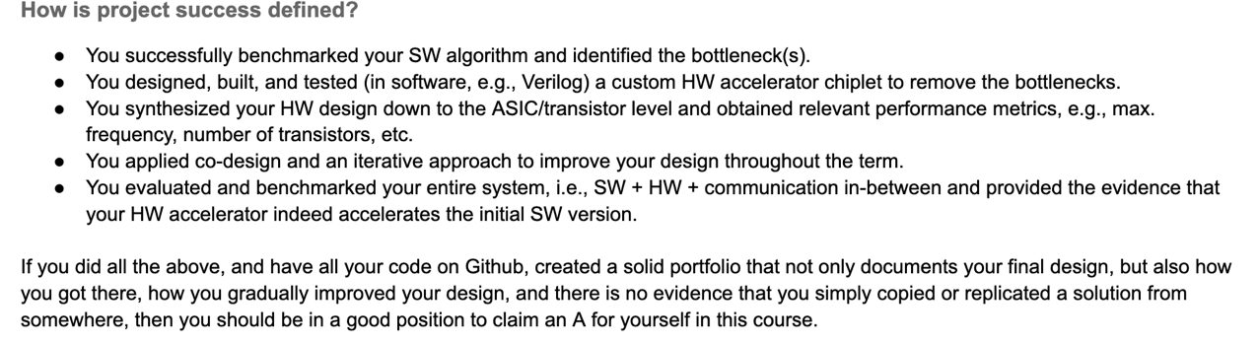
Project success reminders

Slide 5
Dos (only a selection)
Project overview, architecture diagram, quick-start guide.
Distinct SW/HW documentation. All files should have headers.
All design decisions must be justified thoroughly. Explain alternatives and trade-offs you considered. I want to understand how you ended at your final solution.
Include AI prompts and acknowledge the use of AI.
Document testing and verification scenarios.
Include performance metrics (e.g., max. clock frequency, latency, throughput, etc.), resource utilization (e.g., number of transistors, power consumption, etc.), and comparisons to baseline implementations (i.e., your software implementation) or published results where possible.

Slide 6
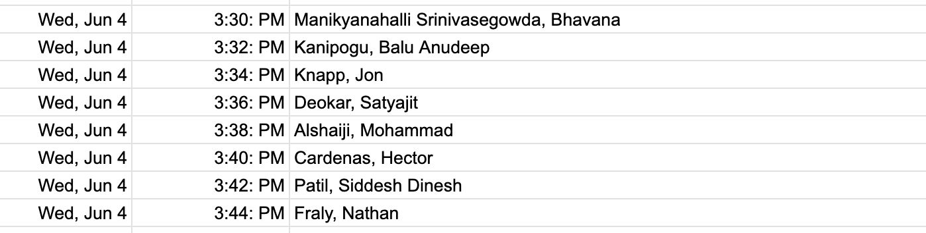
Today’s presentations
1 slide, 1 minute. Strict!

