Slide 1
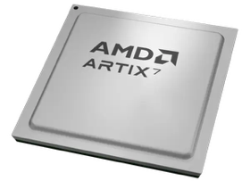
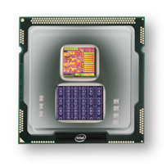
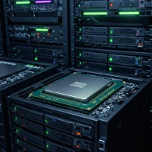
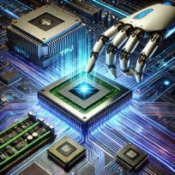
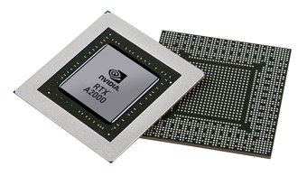


Christof Teuscher
ECE 410/510: Hardware for AI and ML
Codefest #1
Portland State University
Department of Electrical and Computer Engineering (ECE)
www.teuscher-lab.com
teuscher@pdx.edu

Slide 2
Codefest
A codefest (a.k.a hackathon) is a collaborative event where participants, often in teams, work intensively on a project within a short timeframe to solve a problem or create a prototype.

Slide 3
Codefest goals
Rapid prototyping, solve problems, and create complex designs using “vibe coding.”
Learn how to use LLMs efficiently to create complex design we couldn’t create without.
Use LLMs to learn and to gain a deeper understanding of the subject matter.
Collaborate, share and learn from each other.
Present, document, communicate.
Motivate you to go home and brings things to the next level.

Slide 4
Today: Warm-up
Explore “vibe coding”
Install tools and get used to the workflow.
Lay some groundwork for co-design.
Start with high-level languages.
Use profiling of different workloads to understand where CPU cycles are burnt and where the bottlenecks are.

Slide 5

Show your work
Volunteer to show what you’ve got (whether it works or not)
Google Meet link in Slack.

