Slide 1
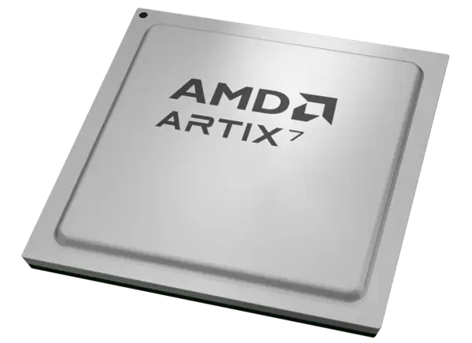
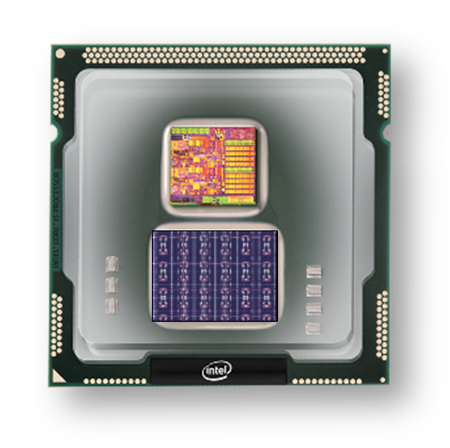
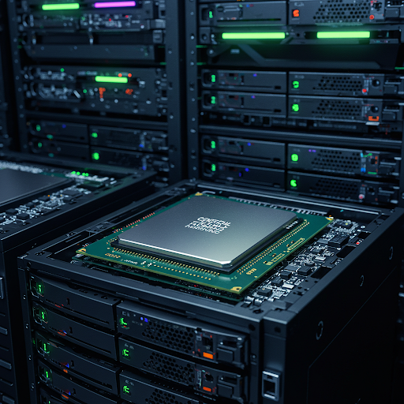
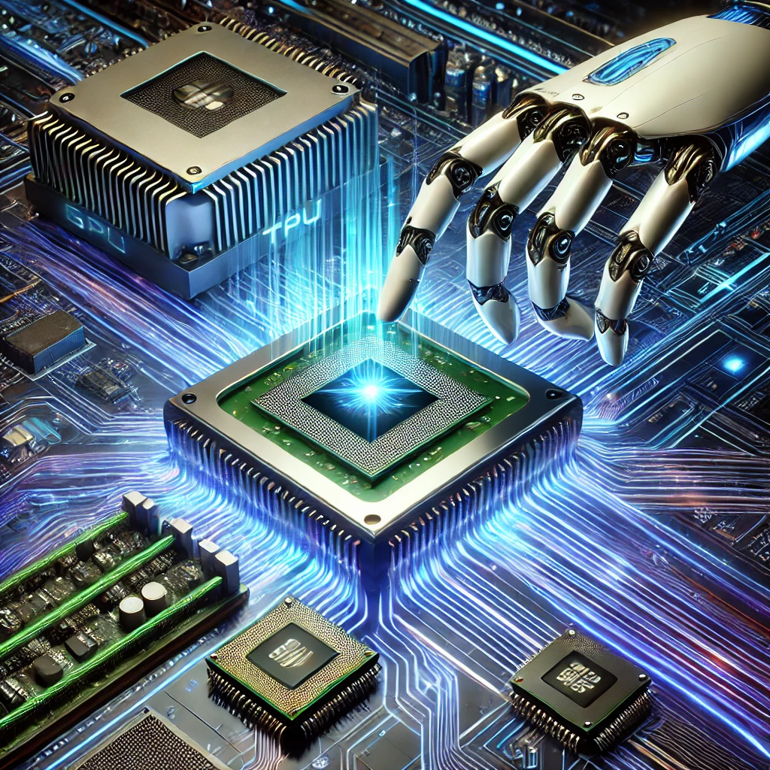
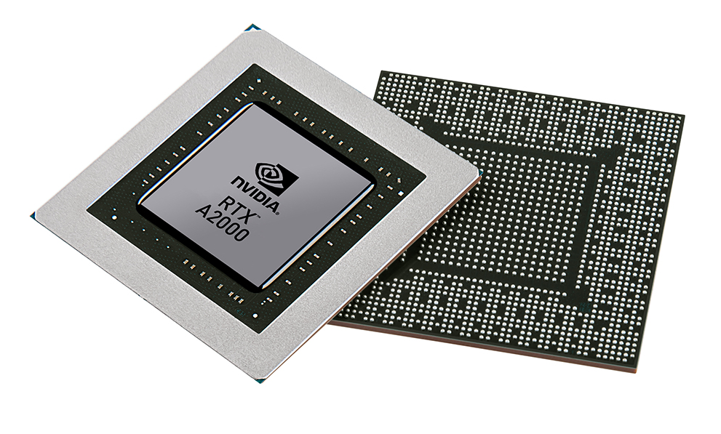


Christof Teuscher
ECE 410/510: Hardware for AI and ML
Recap and reminders
Portland State University
Department of Electrical and Computer Engineering (ECE)
www.teuscher-lab.com
teuscher@pdx.edu

Slide 2
This is not your regular class…
And that’s by design!

Slide 3
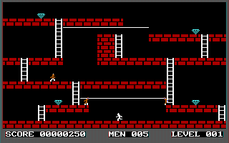
Analogy: Collecting diamonds

Slide 4
The things you should do
Keep track of everything you accomplished. Create a portfolio of your work that you can showcase.
Solve at least one challenge per week.
Complete the main project.
Show up.
Engage
It’s easy to get answers in these days.
It’s hard to ask the right questions.

Slide 5
What if you are…
…taking the easy route.
…taking shortcuts (a.k.a. “cheating”).
…not showing up.
…not putting in the work.
…unwilling to learn and to be challenged.
Then perhaps this class is not for you.

Slide 6
Create a portfolio of your work
Github
A platform of your choice:
Blog (e.g., Wix, Wordpress, Squarespace, GoogleSites)
Technical reports on Github
Github wiki
A weekly medium article
…
Everything needs to be public
Goal: impress your future employer!

Slide 7
I see my role as…
…providing a framework to learn (and fail).
…providing plenty of opportunities to shine.
…helping you to be successful, not just in this class, but in your career.
…guiding you on your educational journey.
…nurturing your curiosity.
…being a role model.

Slide 8
“Vibe coding”
“Vibe coding is an AI-dependent programming technique where a person describes a problem in a few sentences as a prompt to a large language model (LLM) tuned for coding.
The LLM generates software, shifting the programmer's role from manual coding to guiding, testing, and refining the AI-generated source code.
Vibe coding is claimed by its advocates to allow even amateur programmers to produce software without the extensive training and skills required for software engineering.
The term was introduced by Andrej Karpathy in February 2025.”
Karpathy: “The hottest new programming language is English."
https://en.wikipedia.org/wiki/Vibe_coding

Slide 9
LLMs to design more, better, and quicker
LLM as an augmentation of our skills and knowledge
LLMs to gain a deeper understanding of the subject matter
LLMs used to increase the speed and the complexity of what we can create

Slide 10
Engineering mindset
Make things better! This is the essence of computer engineering: make things better, faster, more efficient, etc.
See what your LLM generates as a starting point.
Make it better. Use the LLM to make it better.
Make it perfect!
Use the LLM for explanations: “Explain me what happens on lines 3-10 and why”

Slide 11
A typical week
Monday
Wednesday
Monday
Codefest
Instigation
Weekly challenges
Do more…

Slide 12
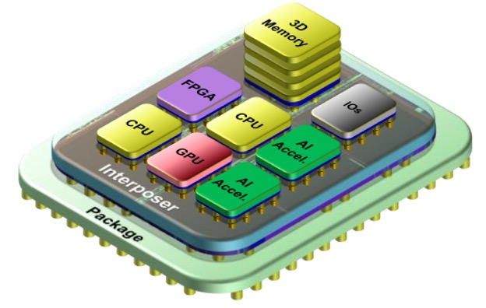
Incremental building/experimentation
Week 1
Week 1
Week 1
Week 1
Week 4

Slide 13
Participate in an educational study and publication
Now: complete an initial skills/knowledge assessment.
End of term: complete the same survey.
Agree to have your deliverables/products assessed.
Participate in a focus group at the end of the term.
Why participate?
Help to make this a better class for future students
Be part of the change
Co-author a publication?

Slide 14
Prep for next Monday
C. Guo et al., "A Survey: Collaborative Hardware and Software Design in the Era of Large Language Models," in IEEE Circuits and Systems Magazine, vol. 25, no. 1, pp. 35-57, 2025, https://doi.org/10.1109/MCAS.2024.3476008
[OPTIONAL] G. De Michell and R. K. Gupta, "Hardware/software co-design," in Proceedings of the IEEE, vol. 85, no. 3, pp. 349-365, March 1997, https://doi.org/10.1109/5.558708

