Slide 1

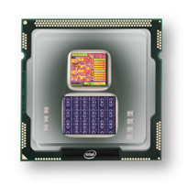
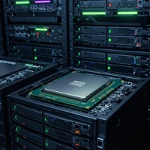
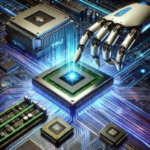
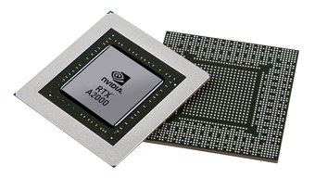


Christof Teuscher
ECE 410/510: Hardware for AI and ML
Week 2: Recap, outlook, and reminders
Portland State University
Department of Electrical and Computer Engineering (ECE)
www.teuscher-lab.com
teuscher@pdx.edu

Slide 2
What did you learn last week?

Slide 3
What does industry tell you?
Two common answers:
We can’t tell you anything.
There are no good/mature tools and approaches. Improvise and use whatever works for you.

Slide 4
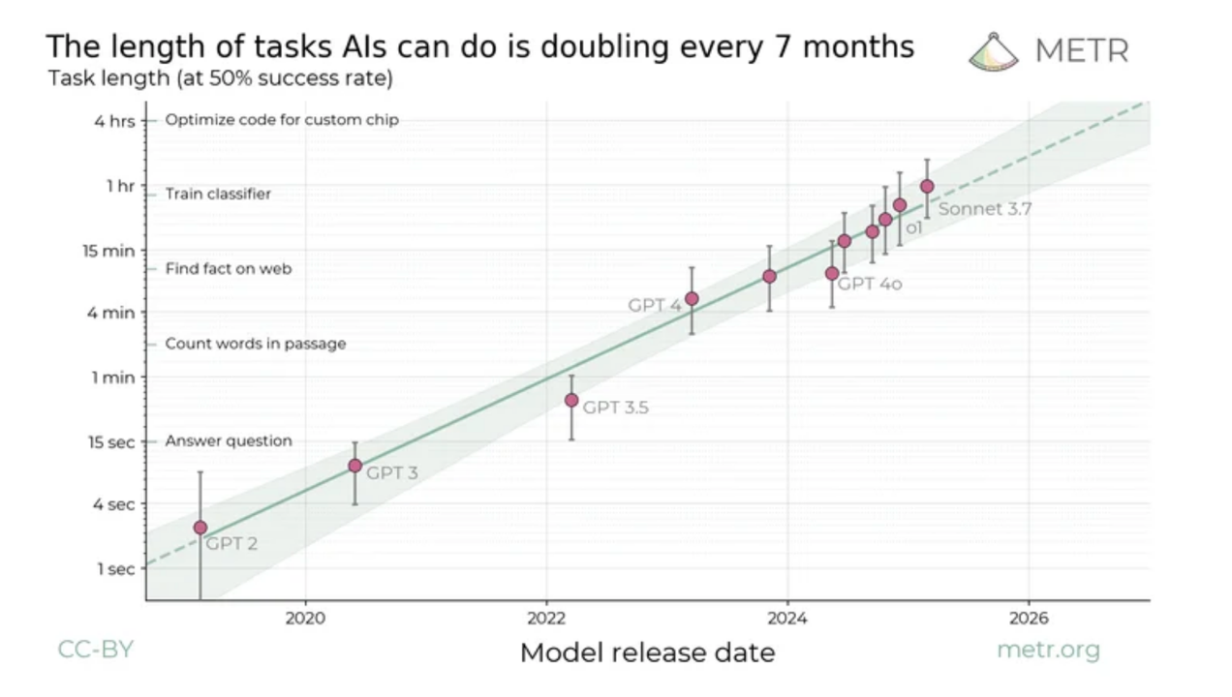
https://arxiv.org/abs/2503.14499

Slide 5
Currently in the works…
Reading list
Selected solutions to challenges.
Feedback on documentation.

Slide 6
REMINDER: Portfolio links
Submit your Github URL.
Any other platform you will use to build your “portfolio” of accomplishments in this class.
Submit it on Canvas

Slide 7
How can I earn an A in this class?
Questions to ask yourself:
How can I impress my future employer?
Would I be proud to show my portfolio to a hiring manager or future employer? If not, why not? What could I improve?
What “wow” factor, if any, does my portfolio have?
Would my portfolio be useful for a future student? Could a student learn from what I did?
Dos
Someone should be able to reproduce your steps.
Include all the LLM queries.
Include visualizations whenever possible.
Explain what worked and what didn’t work. Provide evidence for what worked.
Explain how things work. E.g., tutorial style. Writing is thinking!
Acknowledge the use of LLMs.

Slide 8
What should I do with my challenges?
They should be in the portfolio.
Include the assignments.
Post your answers on slack
#codefests
#weekly-challenges
Ask me for feedback.

Slide 9
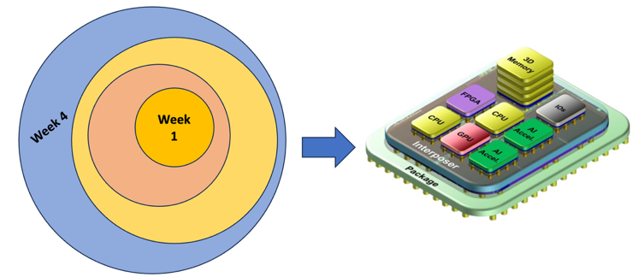
Codefest #2 preparation
Think about what AI/ML algorithm/workload you want to pick.
It should be a non-conventional workload that will benefit from specialized hardware.
Use Google Scholar to find relevant literature on current state-of-the-art
You will be designing your own accelerator chiplet for that workload.

Slide 10


