Slide 1
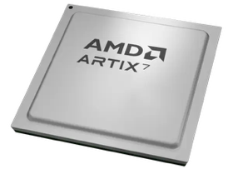
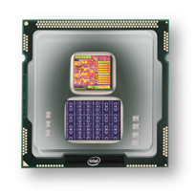
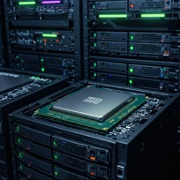

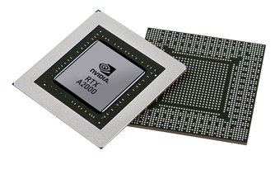


Christof Teuscher
ECE 410/510: Hardware for AI and ML
Codefest #2: Bootstrapping the final project
Portland State University
Department of Electrical and Computer Engineering (ECE)
www.teuscher-lab.com
teuscher@pdx.edu

Slide 2
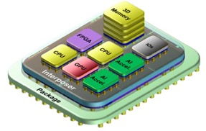

Project vision
Software
Hardware
AI/ML
algorithm
Accelerator
PCIe
USB-C
HDMI
…
General purpose processor
Chiplet
Design, test, and benchmark a co-processor chiplet that accelerates parts of some AI/ML code. Start with a blank slate for your design.
[Alternative]: design a stand-alone chiplet.

Slide 3
Compute stack
Start with the algorithm
Algorithms
Architecture
Circuit
Device
…
Material/Physics

Slide 4
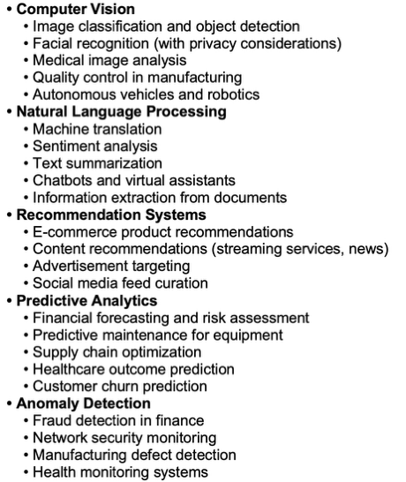
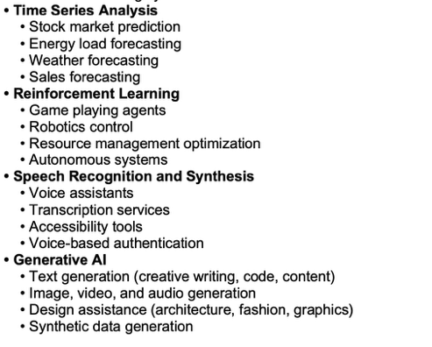
Example AI/ML applications

Slide 5
What is a chiplet?
A chiplet is a small, specialized piece of silicon that can be combined with other chiplets to form a complete integrated circuit (IC) or system-on-chip (SoC).
Instead of manufacturing one large monolithic chip, the chiplet approach breaks down complex processor designs into smaller functional blocks that can be manufactured separately and then integrated together using advanced packaging technologies.
Chiplets are connected using high-speed, short-range communication interfaces that enable them to work together as if they were on a single piece of silicon.
This modular approach has been widely adopted by companies like AMD, Intel, and TSMC to create more efficient and powerful processors while overcoming the limitations of traditional monolithic chip design

Slide 6
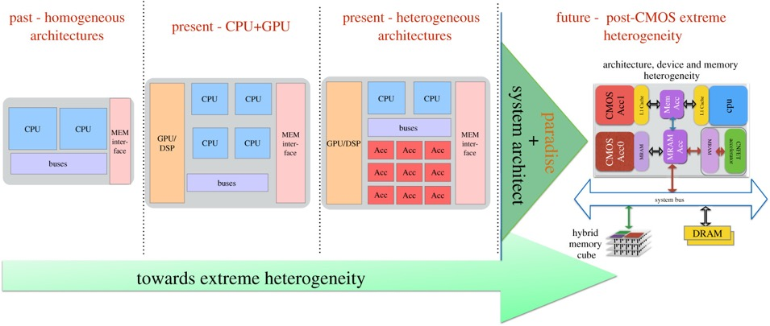

What is a chiplet?
The key benefits of chiplets include:
Improved manufacturing yields, as smaller dies have fewer defects
Better scalability for different performance and power requirements
The ability to mix and match process technologies optimized for specific functions
Reduced costs by reusing proven IP blocks across different products

Slide 7
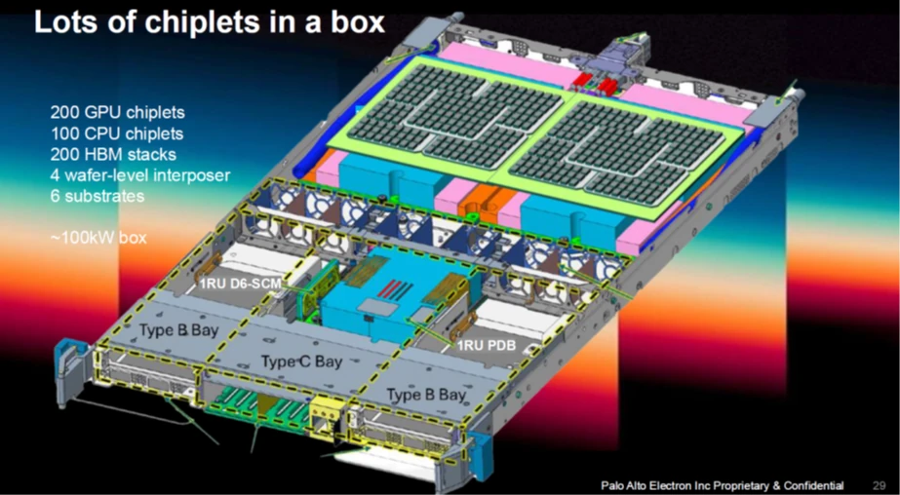
HBM = High Bandwidth Memory stack is a 3D-stacked DRAM (Dynamic Random Access Memory)
Wafer interposer = intermediate layer in semiconductor packaging
https://semiengineering.com/chiplets-where-are-we-today

Slide 8
Communication interfaces
Advanced Interface Bus (AIB): Developed by Intel, AIB is an open-source, die-to-die interconnect technology that enables high-bandwidth, low-power communication between chiplets. It supports both parallel and serial communication modes.
Universal Chiplet Interconnect Express (UCIe): An industry-standard specification backed by major companies like AMD, Intel, Arm, and TSMC. UCIe aims to establish an open ecosystem for chiplet integration with standardized physical interfaces, protocols, and power management.
High Bandwidth Memory (HBM) Interface: While primarily for connecting memory chiplets, this interface uses through-silicon vias (TSVs) and microbumps to achieve very high bandwidth connections.
Bunch of Wires (BoW): A simpler, more cost-effective interface for medium-bandwidth connections between chiplets, developed through the Open Compute Project.
TSMC's Integrated Fan-Out (InFO) and Chip-on-Wafer-on-Substrate (CoWoS): These are packaging technologies that include specific interconnect interfaces for connecting multiple chiplets.
Unclear of IP is available for any of these…

Slide 9
How to pick a project
Dos
Pick something exciting, at the forefront of technology
Pick something that challenges you
Failure should be an option
Something new that you want to learn
Start with a blank slate, but it’s OK to draw inspiration from existing architectures.
Dont’s
No relying on current accelerators, e.g., GPUs
No traditional CPUs.
No cache algorithms, no branch predictors, etc.!
No teamwork allowed. You must have your own project. If several want to work on the same problem, you’d be competing with each other (in a friendly way!).

Slide 10
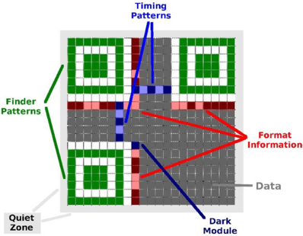
Example
QR code recognizer for an edge device.
Must be fast and ultra low-power.

Slide 11
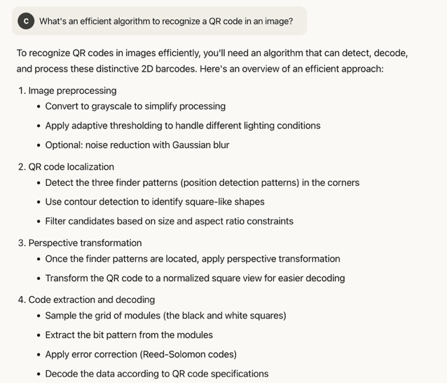
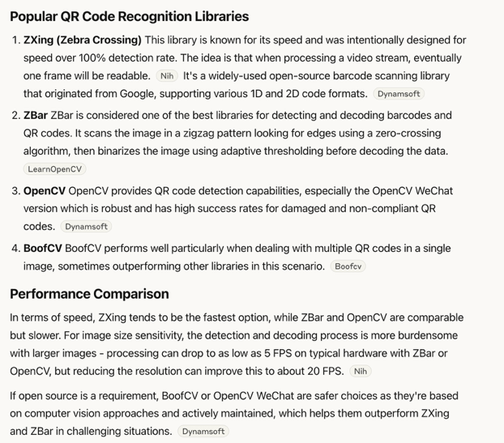
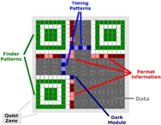

Slide 12
Heilmeier questions
What are you trying to do? Articulate your objectives using absolutely no jargon.
How is it done today, and what are the limits of current practice?
What is new in your approach and why do you think it will be successful?
Who cares? If you are successful, what difference will it make?
What are the risks?
How much will it cost?
How long will it take?
What are the mid-term and final “exams” to check for success?
https://www.darpa.mil/about/heilmeier-catechism

Slide 13
Week | Monday | Wednesday (Codefest)
2 | HW/AI/ML overview + codesign overview | Start main project: pick workload, start analysis, benchmark, …
3 | GPU architecture and programming for AI | Drafting a HW architecture, creating a model
4 | Deep neural networks on GPUs | Coding HW description
5 | Transformers & transformers on GPUs | First simulation + refinement
6 | In-memory computation | Improving initial design
7 | Neuromorphic chips: TrueNorth, Loihi, Akida | Simulation + refinement
8 | Neuromorphic computing with mem-devices | Synthesizing design + benchmarking
9 | Hardware accelerators for embedded systems | Final improvements
10 | Emerging technologies and future directions | Final tests, validation, verification, benchmarking

Slide 14
Codefest goals
Rapid prototyping, solve problems, and create complex designs using “vibe coding.”
Learn how to use LLMs efficiently to create complex design we couldn’t create without.
Use LLMs to learn and to gain a deeper understanding of the subject matter.
Collaborate, share and learn from each other.
Present, document, communicate.
Motivate you to go home and brings things to the next level.

