Slide 1
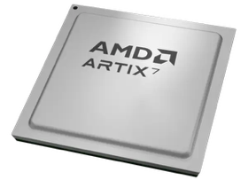
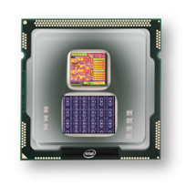


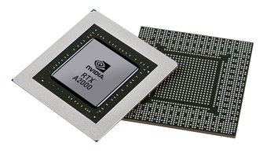


Christof Teuscher
ECE 410/510: Hardware for AI and ML
Codefest #3: Decide the SW/HW boundary,
pick tools, code toy example
Portland State University
Department of Electrical and Computer Engineering (ECE)
www.teuscher-lab.com
teuscher@pdx.edu

Slide 2
Next week
Monday
CUDA
Mapping deep neural nets (CNN) on GPUs
TPUs
Wednesday
No in-person codefest. Individual project time instead.
Work from home or get together somewhere in small working groups.

Slide 3
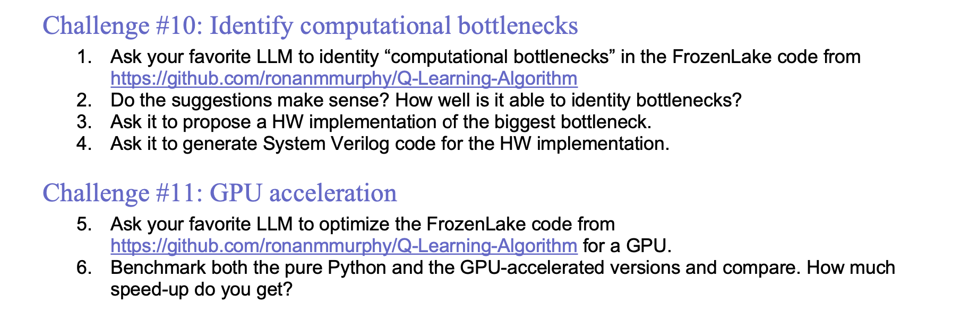
Week 3 challenges

Slide 4
Project page
Link on Canvas:
https://docs.google.com/document/d/1_HSDXhJEF1F2Qu76zJOlygvPm_F9NqX5VZ0f8CGXI34

Slide 5
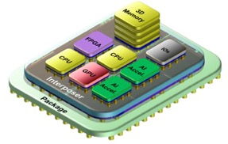

Project vision
Software
Hardware
AI/ML
algorithm
Accelerator
PCIe
USB-C
HDMI
…
General purpose processor
Chiplet
Design, test, and benchmark a co-processor chiplet that accelerates parts of some AI/ML code. Start with a blank slate for your design.
[Alternative]: design a stand-alone chiplet.

Slide 6
Compute stack
Start with the algorithm
Algorithms
Architecture
Circuit
Device
…
Material/Physics

Slide 7
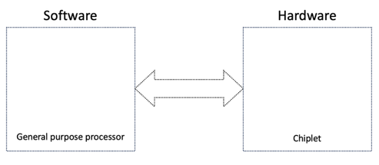
Main goals for today
Pick a HW/SW boundary
Pick a workflow/toolchain
PyMTL (Mamba)
PyRTL
Cocotb
MyHDL
pyUVM
yosys
…
Candence
Synopsis

Slide 8
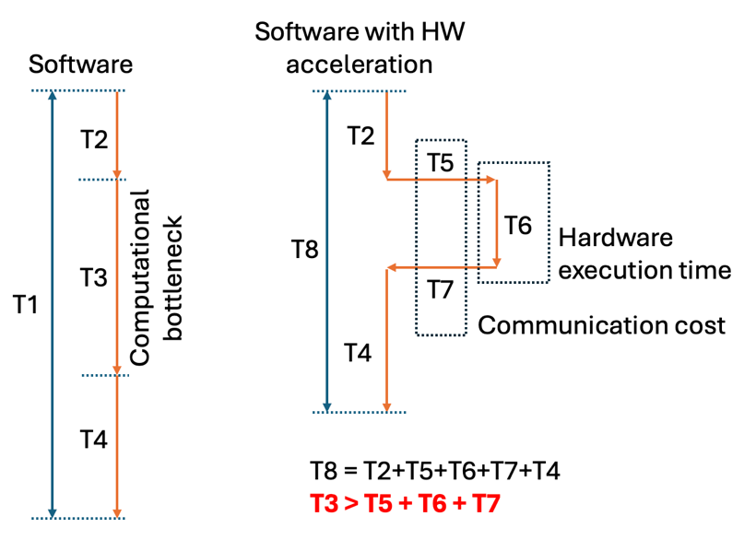
Back-of-the-envelope estimate

Slide 9
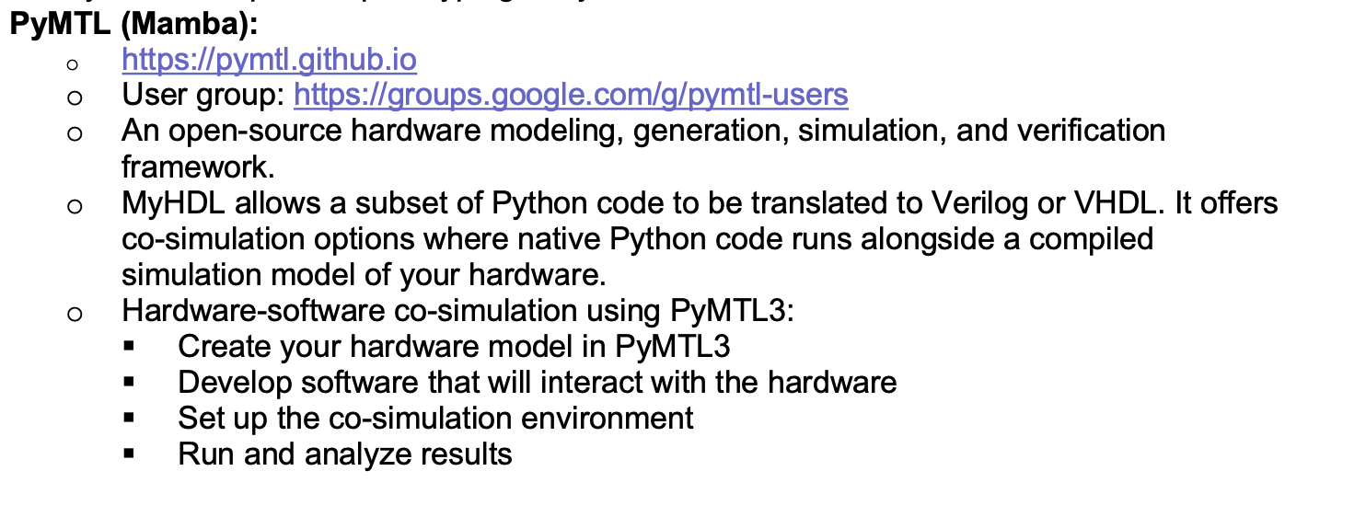
Workflow/toolchain (1)

Slide 10
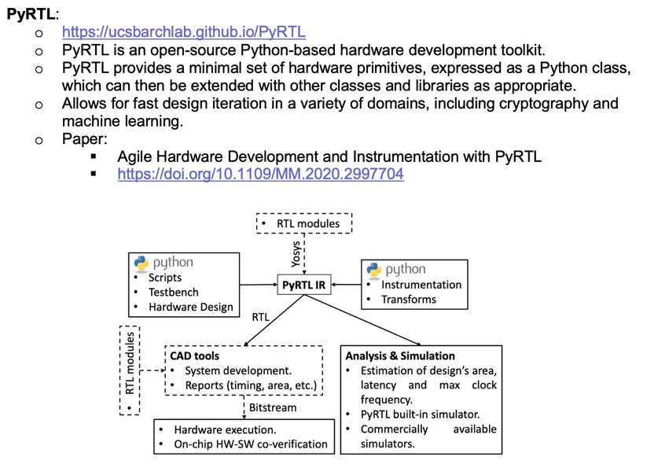
Workflow/toolchain (2)

Slide 11
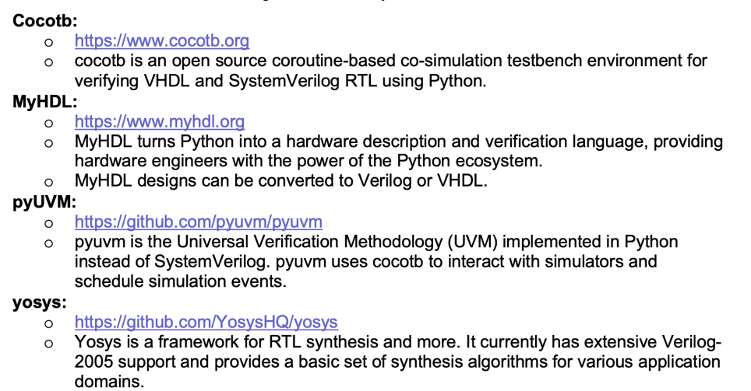
Workflow/toolchain (3)

Slide 12
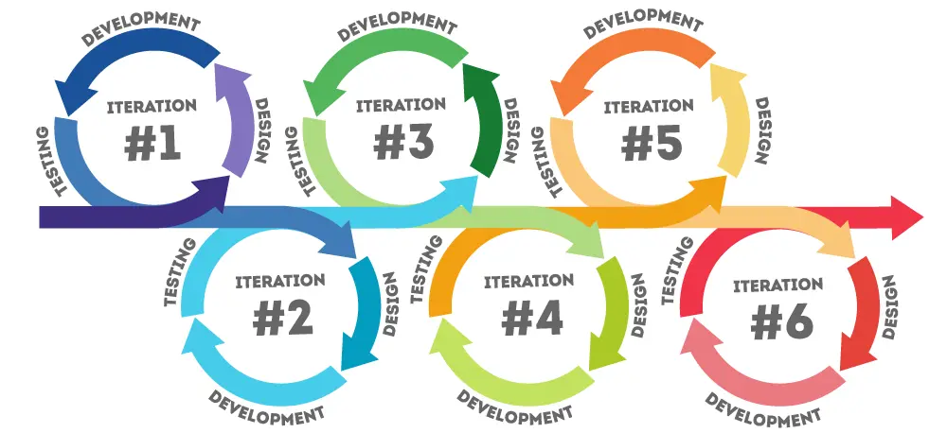
Iterative, rapid prototyping codesign process
https://www.pacific-research.com/iterative-product-development

Slide 13
Communication interfaces
Advanced Interface Bus (AIB): Developed by Intel, AIB is an open-source, die-to-die interconnect technology that enables high-bandwidth, low-power communication between chiplets. It supports both parallel and serial communication modes.
Universal Chiplet Interconnect Express (UCIe): An industry-standard specification backed by major companies like AMD, Intel, Arm, and TSMC. UCIe aims to establish an open ecosystem for chiplet integration with standardized physical interfaces, protocols, and power management.
High Bandwidth Memory (HBM) Interface: While primarily for connecting memory chiplets, this interface uses through-silicon vias (TSVs) and microbumps to achieve very high bandwidth connections.
Bunch of Wires (BoW): A simpler, more cost-effective interface for medium-bandwidth connections between chiplets, developed through the Open Compute Project.
TSMC's Integrated Fan-Out (InFO) and Chip-on-Wafer-on-Substrate (CoWoS): These are packaging technologies that include specific interconnect interfaces for connecting multiple chiplets.
Unclear of IP is available for any of these…

