Slide 1
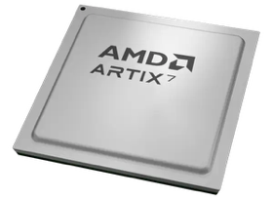
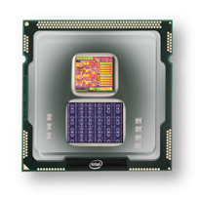
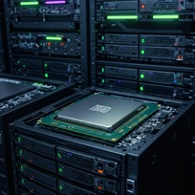
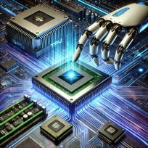
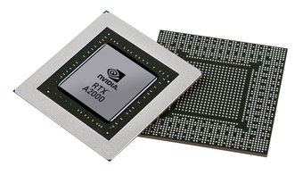


Christof Teuscher
ECE 410/510: Hardware for AI and ML
Week 4: Recap, outlook, and reminders
Portland State University
Department of Electrical and Computer Engineering (ECE)
www.teuscher-lab.com
teuscher@pdx.edu

Slide 2
What did you learn last week?

Slide 3
Week | Monday | Wednesday (Codefest)
2 | HW/AI/ML overview + codesign overview | Start main project: pick workload, start analysis, benchmark, …
3 | GPU architecture and programming for AI | Drafting a HW architecture, creating a model
4 | Deep neural networks on GPUs | Coding HW description
5 | Transformers on GPUs | First simulation + refinement
6 | In-memory computation | Improving initial design
7 | Neuromorphic chips: TrueNorth, Loihi, Akida | Simulation + refinement
8 | Neuromorphic computing with mem-devices | Synthesizing design + benchmarking
9 | Hardware accelerators for embedded systems | Final improvements
10 | Emerging technologies and future directions | Final tests, validation, verification, benchmarking

Slide 4
This week
Monday
CUDA
Mapping deep neural nets (CNN) on GPUs
TPUs
Wednesday
No in-person codefest. Individual project time instead.
Work from home or get together somewhere in small working groups.

Slide 5
In the works
Week 4 challenges
Week 4 codefest
Guidance on progress and self-grading

Slide 6
Github and portfolio
Update at least weekly.
Push codes out, even if not working or finished yet. Show steady progress and good work ethic.
Organize your Github/portfolio somewhat logically. Your work should be easy to find.
Someone should be able to replicate what you did.
See (upcoming) self-evaluation guidelines for more dos and don’ts

Slide 7
Industry news
Intel will sell 51% of Altera to investment firm Silver Lake in a deal that values the FPGA maker at $8.75 billion. Intel will retain the remaining 49% stake. Intel acquired Altera in 2015 for $16.7 billion. Raghib Hussain, previously president of products and technologies at Marvell, will take over as Altera’s new CEO. The deal is expected to close in the second half of 2025.

