Slide 1
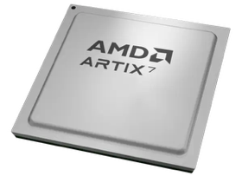
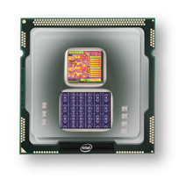
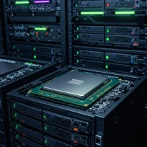
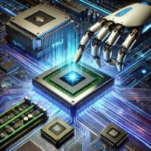
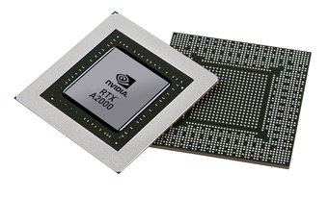


Christof Teuscher
ECE 410/510: Hardware for AI and ML
Week 5: Recap, outlook, and reminders
Portland State University
Department of Electrical and Computer Engineering (ECE)
www.teuscher-lab.com
teuscher@pdx.edu

Slide 2
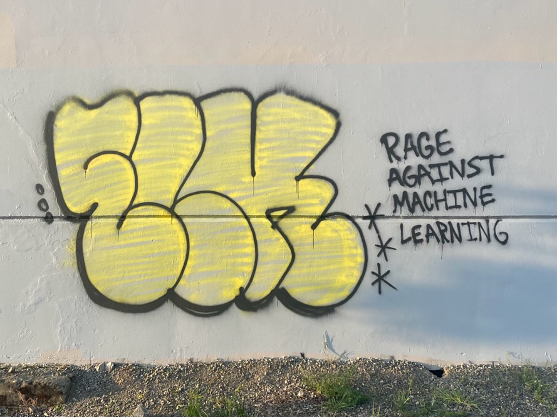

Slide 3
What did you learn last week?

Slide 4
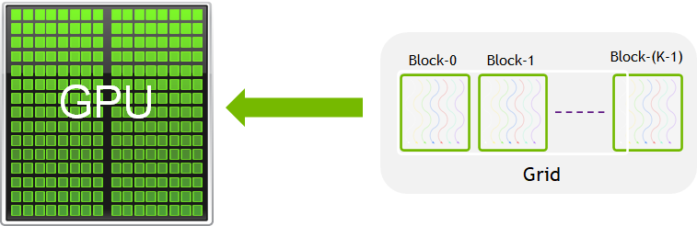
Recap
GPU execution model: SIMT (Single Instruction, Multiple Threads)
GPU overhead:
Malloc
Copy data to GPU
Free
A CUDA kernel is a function that runs on the GPU.
Warp (32 threads, SIMD), thread block, kernel grid
Parallelism is not always easy to find
kernel<<M,T>>: The kernel launches with a grid of M thread blocks. Each thread block has T parallel threads.

Slide 5
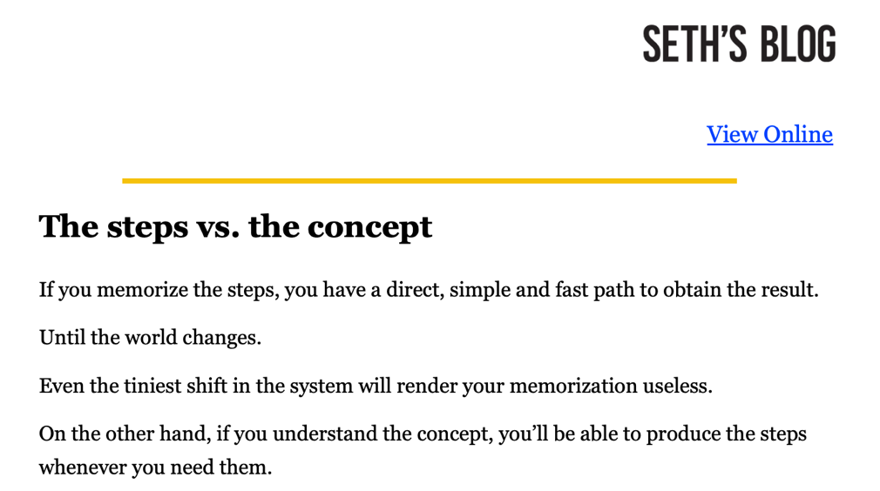

Slide 6
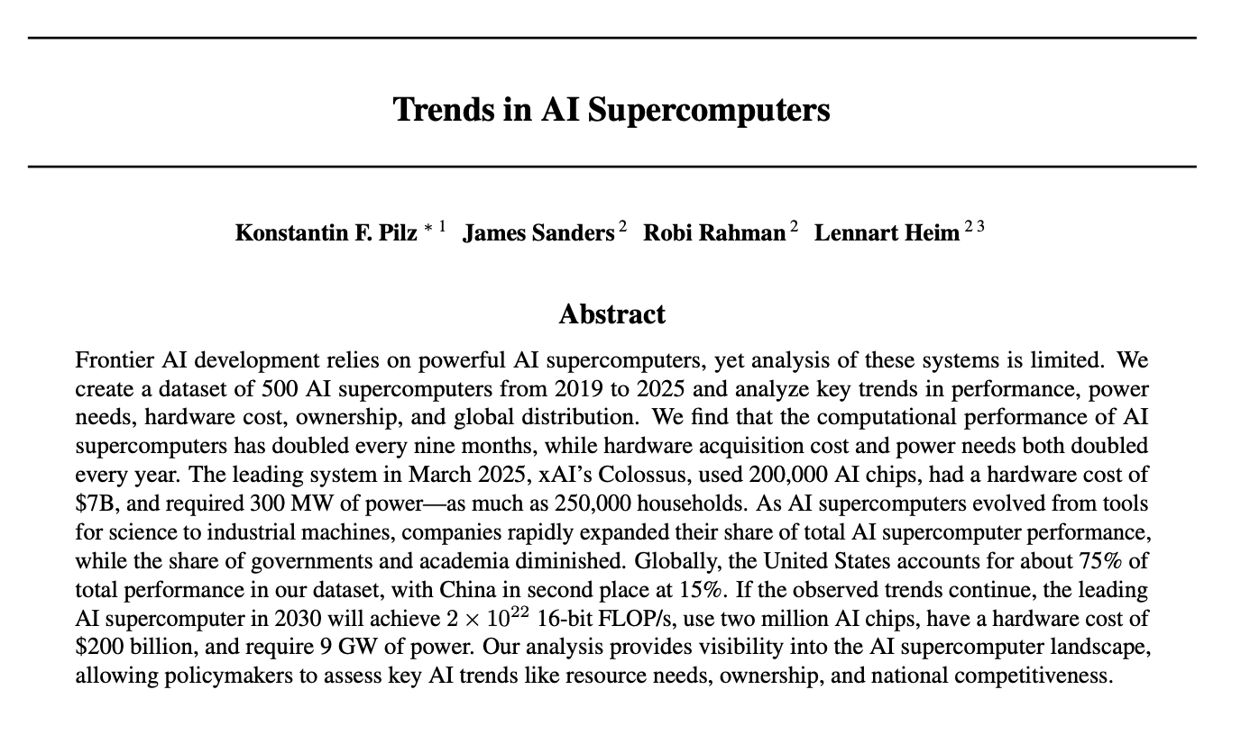
https://arxiv.org/pdf/2504.16026

Slide 7
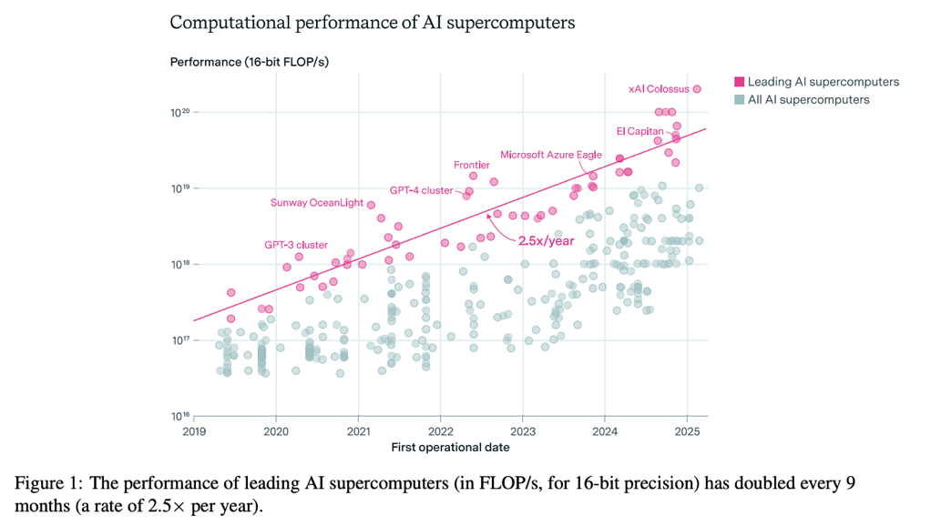
https://arxiv.org/pdf/2504.16026

Slide 8
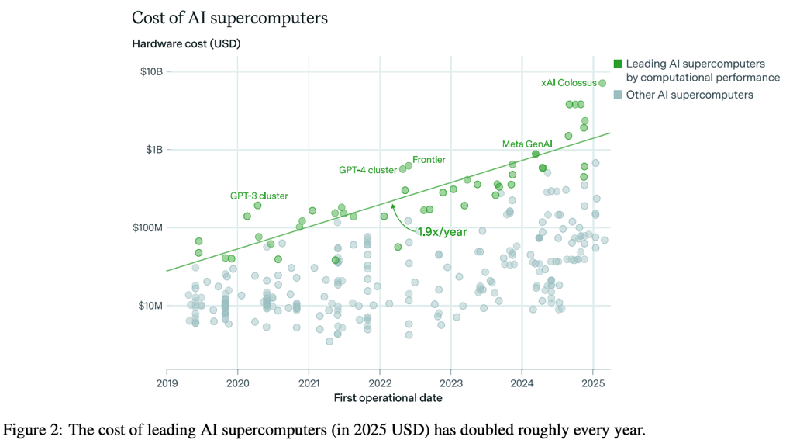
https://arxiv.org/pdf/2504.16026

Slide 9
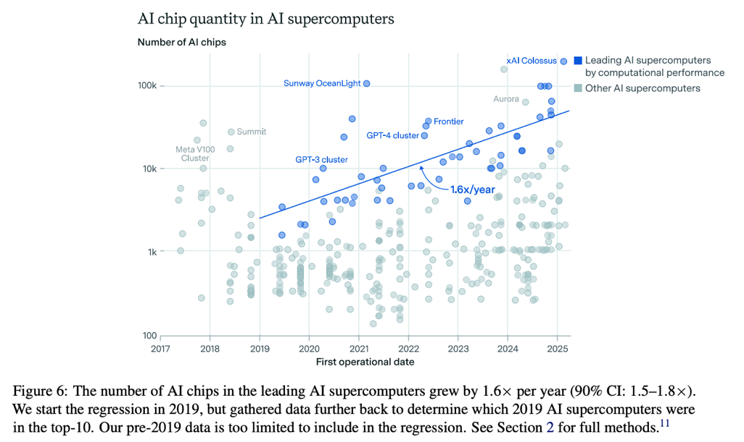
https://arxiv.org/pdf/2504.16026

Slide 10
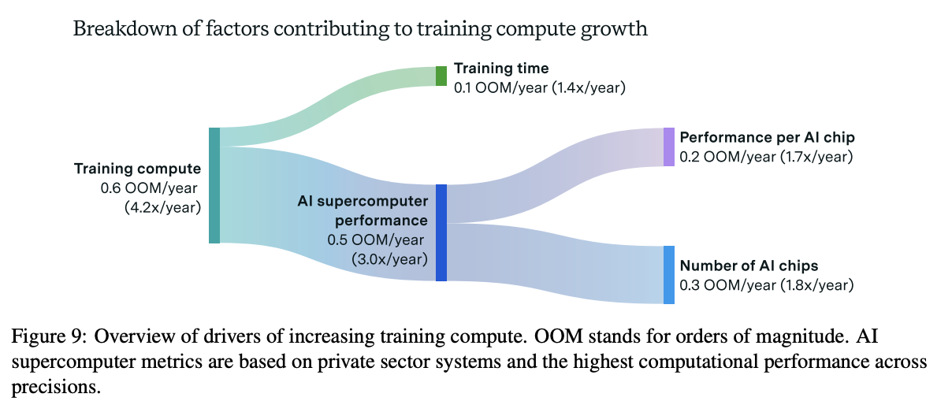
https://arxiv.org/pdf/2504.16026

Slide 11
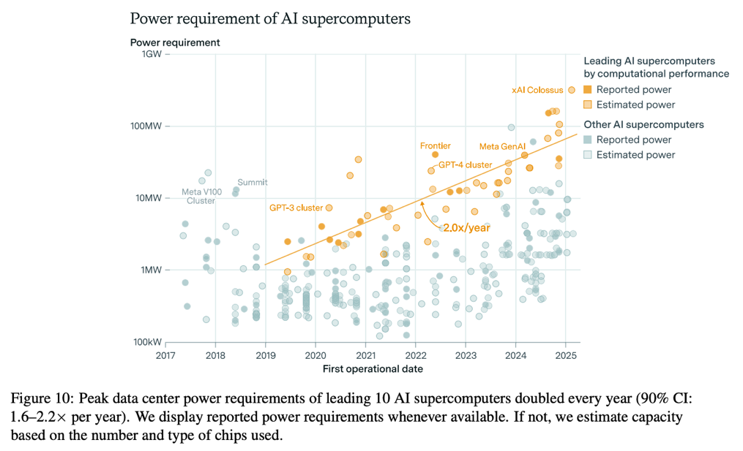
https://arxiv.org/pdf/2504.16026

Slide 12
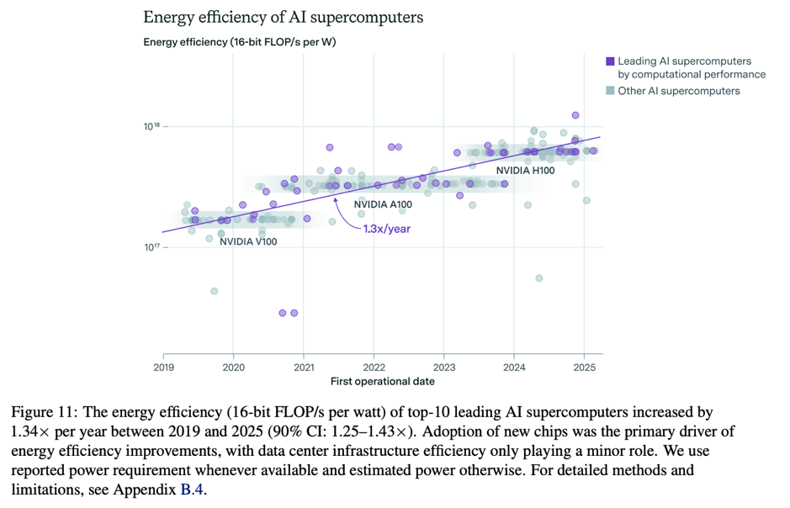
https://arxiv.org/pdf/2504.16026

Slide 13
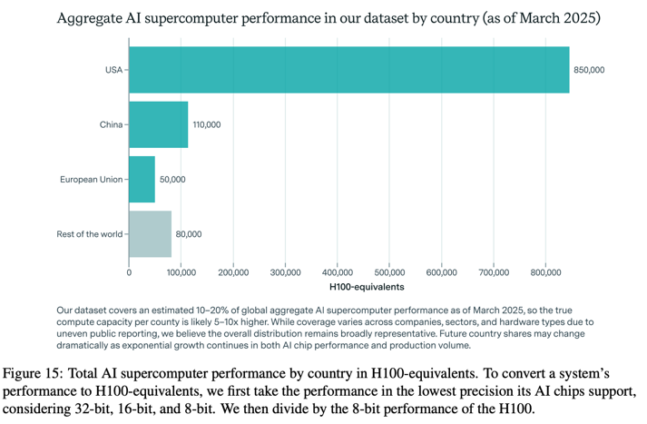
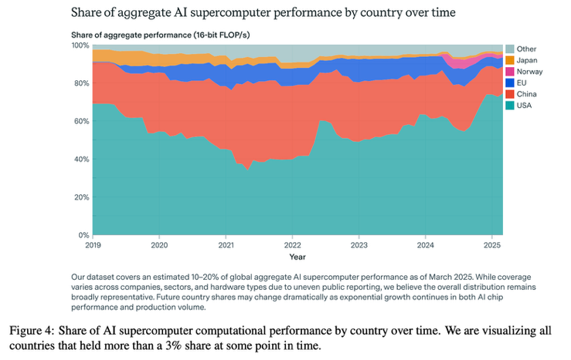
https://arxiv.org/pdf/2504.16026

Slide 14
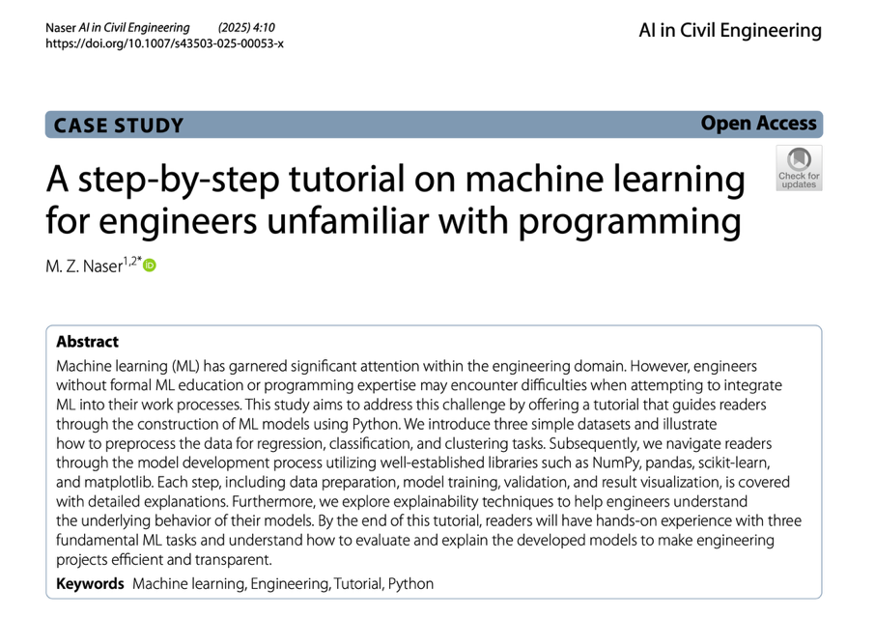
https://doi.org/10.1007/s43503-025-00053-x

Slide 15
Week | Monday | Wednesday (Codefest)
2 | HW/AI/ML overview + codesign overview | Start main project: pick workload, start analysis, benchmark, …
3 | GPU architecture and programming for AI | Drafting a HW architecture, creating a model
4 | Deep neural networks on GPUs | Coding HW description
5 | Transformers on GPUs | First simulation + refinement
6 | In-memory computation | Improving initial design
7 | Neuromorphic chips: TrueNorth, Loihi, Akida | Simulation + refinement
8 | Neuromorphic computing with mem-devices | Synthesizing design + benchmarking
9 | Hardware accelerators for embedded systems | Final improvements
10 | Emerging technologies and future directions | Final tests, validation, verification, benchmarking
Memorial Day

Slide 16
This week
Monday
CUDA
Mapping deep neural nets (DNN/CNN) on GPUs
TPUs
Transformers on GPUs
Wednesday
Codefest #5
Going to the gate level
Getting first performance numbers

