Slide 1
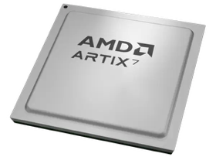
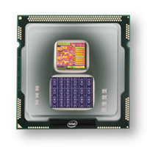
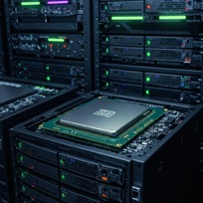
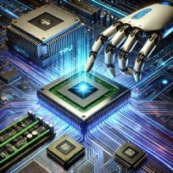
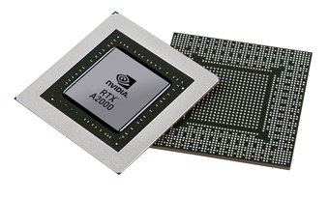


Christof Teuscher
ECE 410/510: Hardware for AI and ML
Codefest #5: Going down to physical/transistors (or CLBs) level
Portland State University
Department of Electrical and Computer Engineering (ECE)
www.teuscher-lab.com
teuscher@pdx.edu

Slide 2
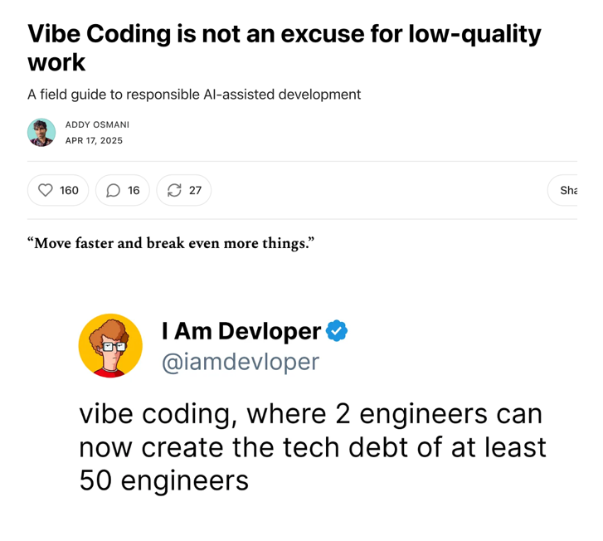
https://addyo.substack.com/p/vibe-coding-is-not-an-excuse-for

Slide 3
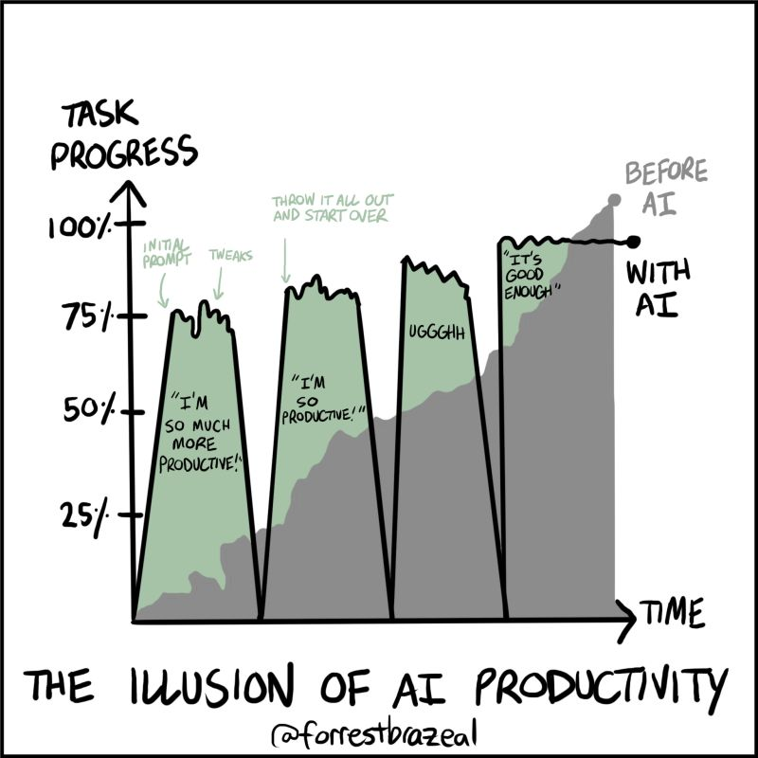
Vibe coding

Slide 4
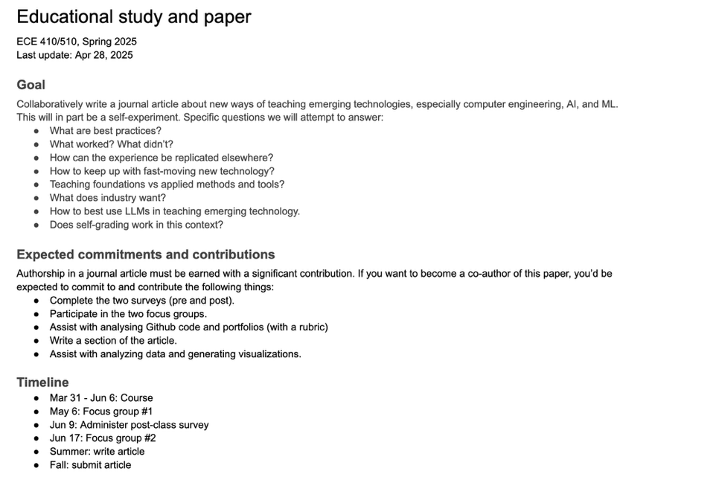
Announcement to be
shared…stay tuned

Slide 5
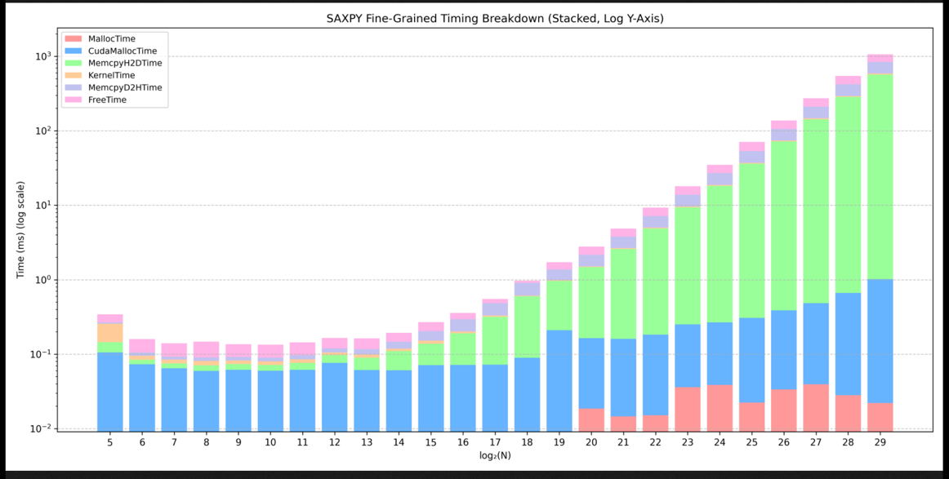
Week 4 challenges
Source: Stephen Weeks

Slide 6
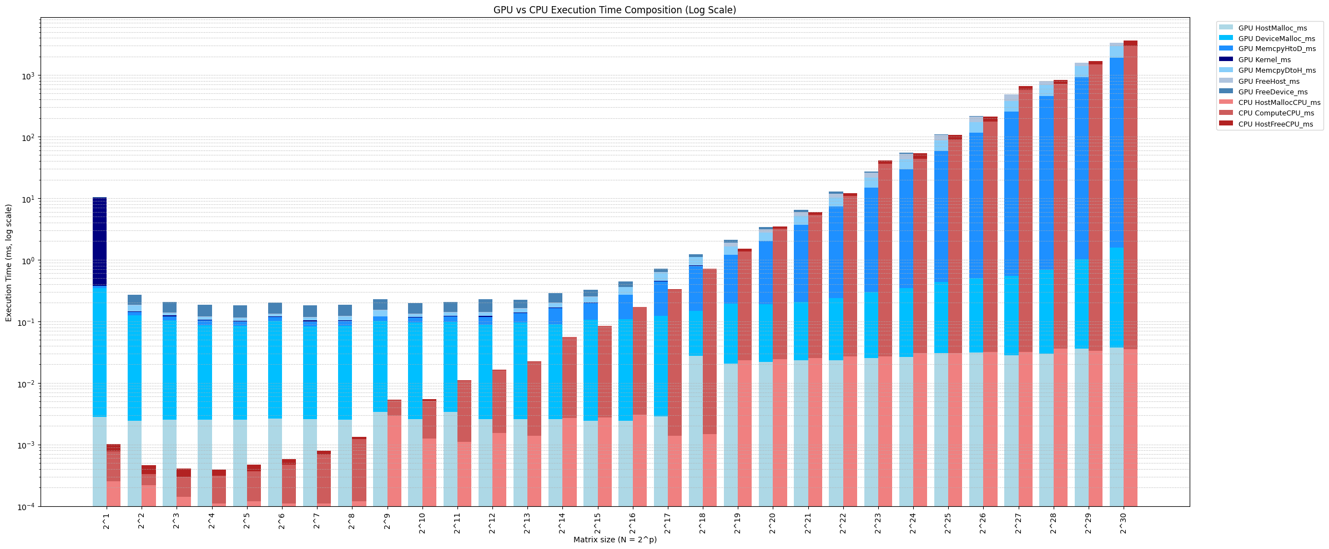
Week 4 challenges
Source: Eric Zhou

Slide 7
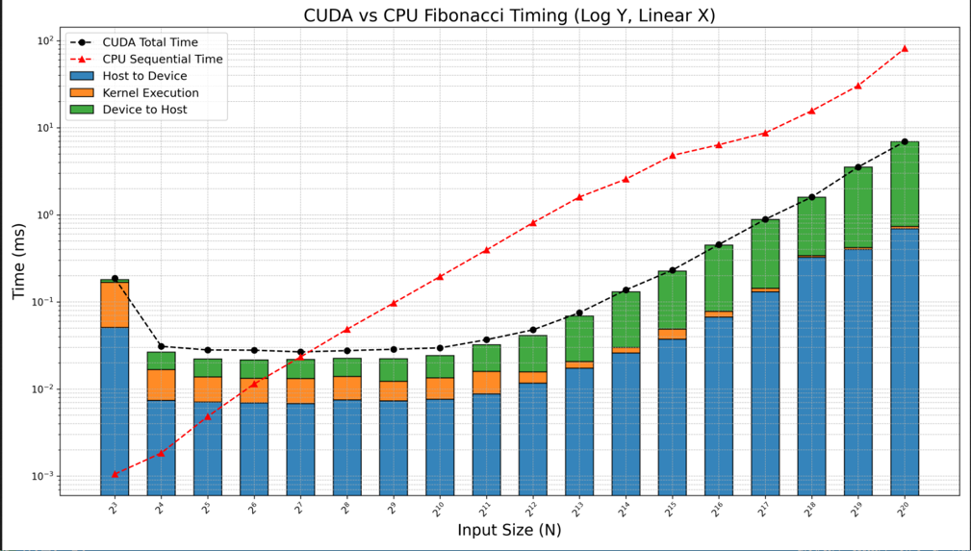
Week 4 challenges
Source: Stephen Weeks

Slide 8
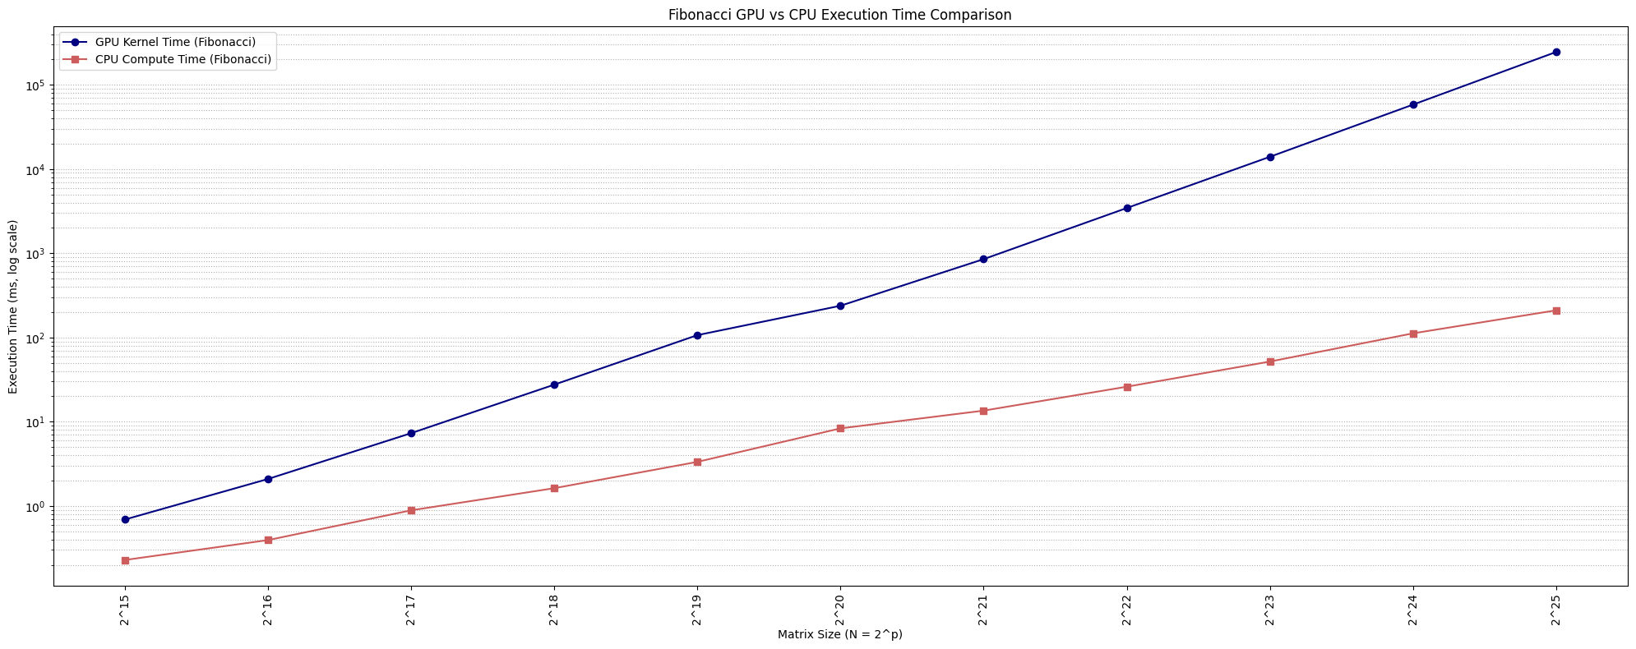
Week 4 challenges
Source: Eric Zhou

Slide 9
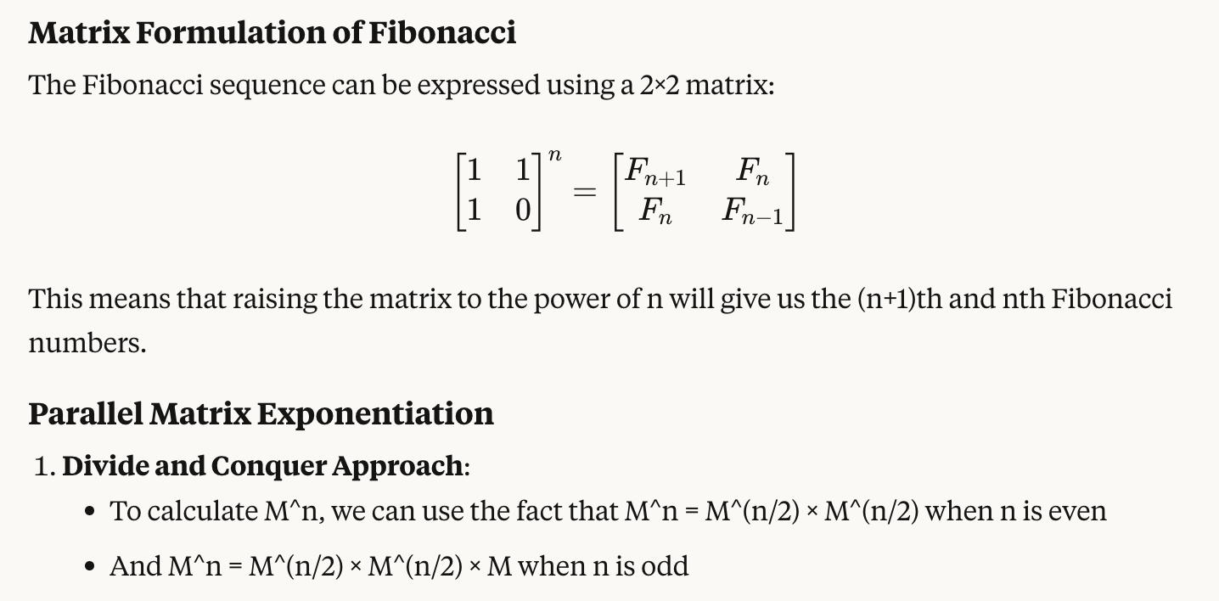
Fibonacci

Slide 10
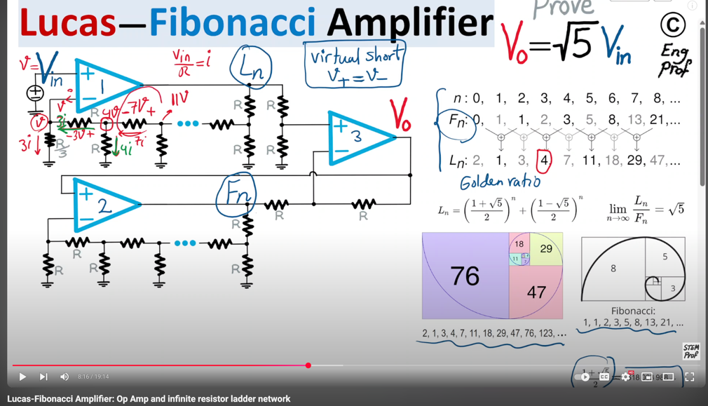
https://www.youtube.com/watch?v=jd_tWsTeLMY

Slide 11
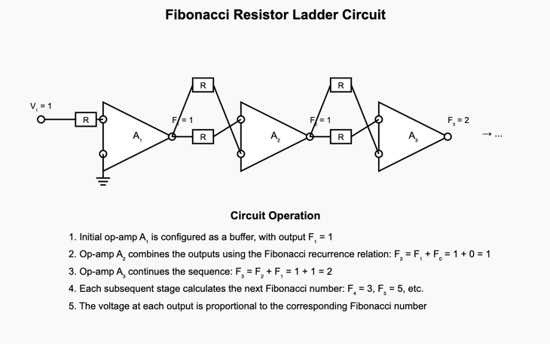
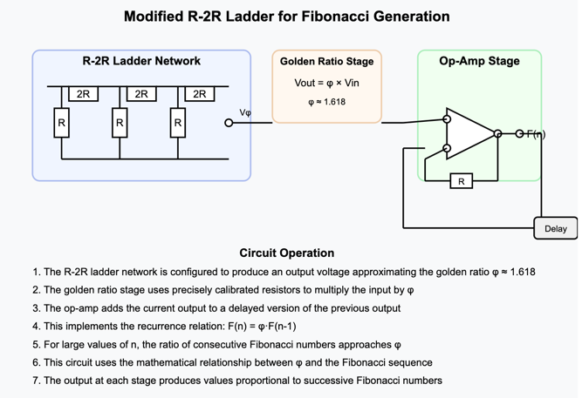
Thanks Claude…

Slide 12
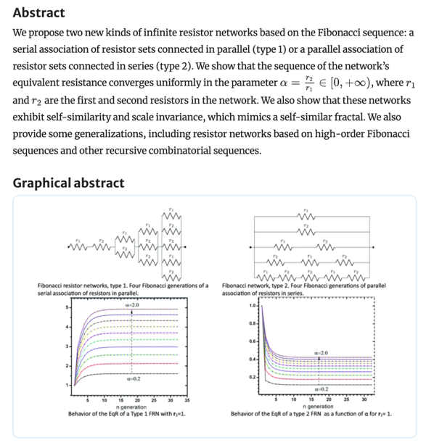


Slide 13
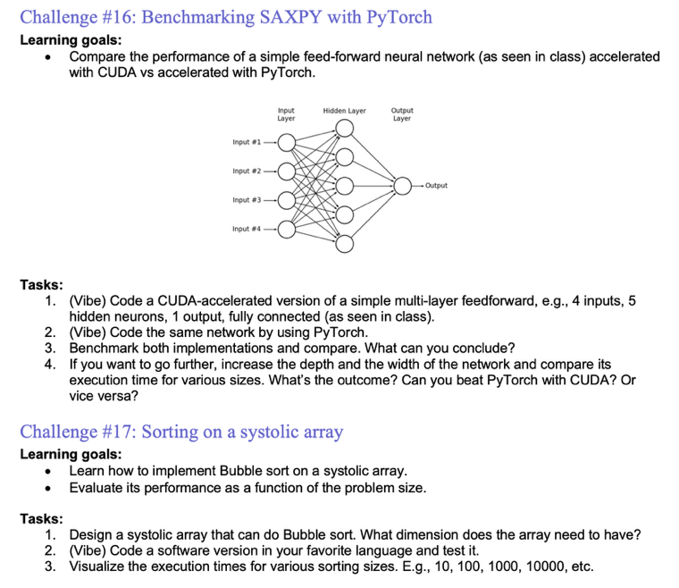

Slide 14
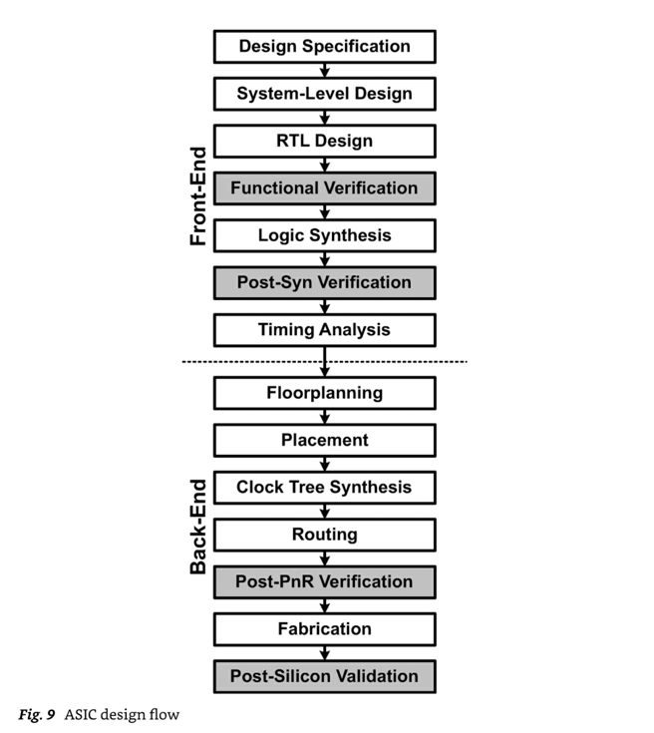
ASIC design flow
Python
Verilog/SystemVerilog/VHDL
logic and architecture designs
physical design
Max. frequency, # transistors, etc.
Mishra, Ashutosh; Cha, Jaekwang; Park, Hyunbin; Kim, Shiho. Artificial Intelligence and Hardware Accelerators.

Slide 15
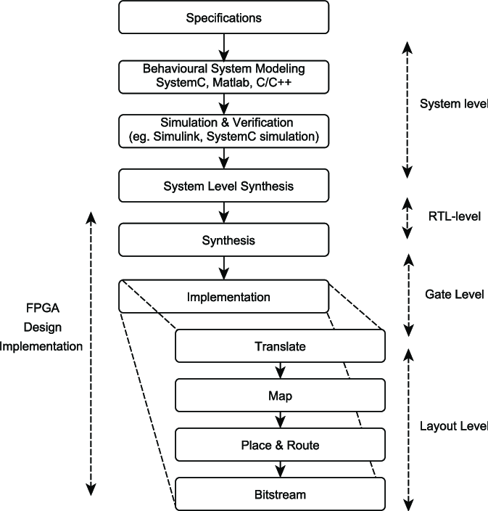
FPGA design flow
Max. frequency, # CLBs, etc

Slide 16
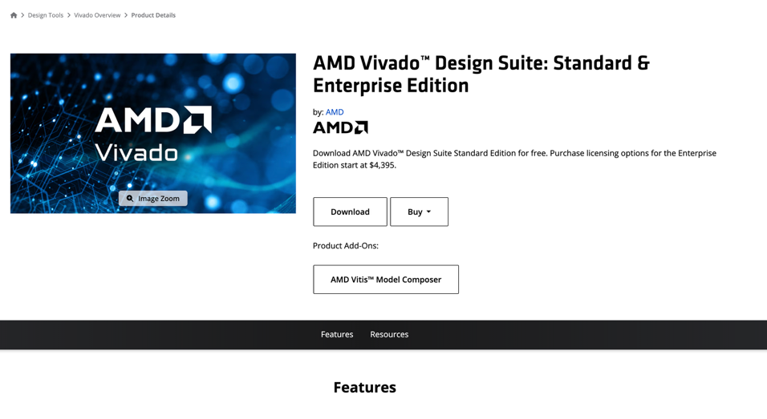
https://www.amd.com/en/products/software/adaptive-socs-and-fpgas/vivado/vivado-buy.html

Slide 17
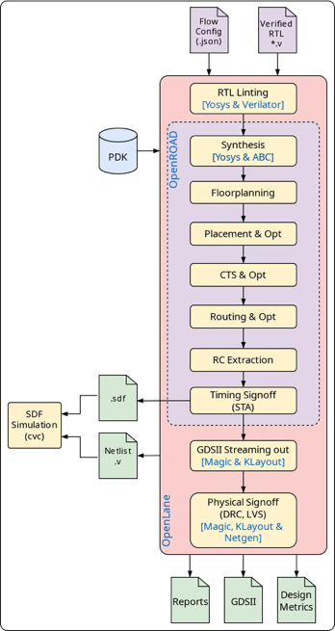
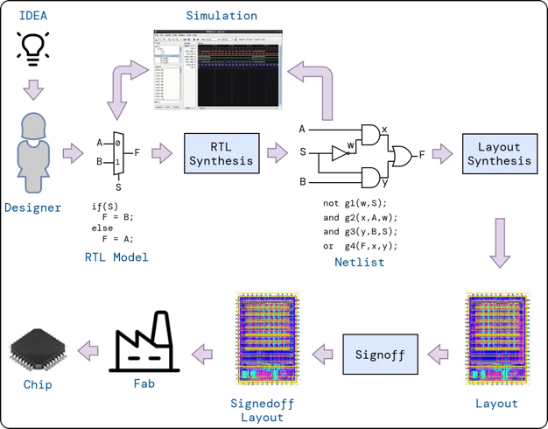
OpenLane 2 tools
https://efabless.com/openlane
https://github.com/efabless/openlane2
https://openlane2.readthedocs.io/en/latest/getting_started/newcomers/index.html

Slide 18
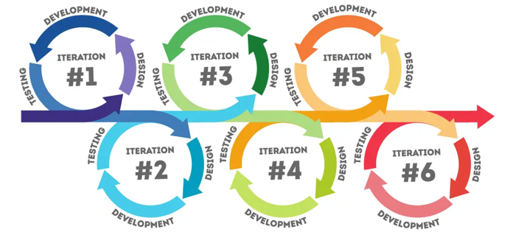
Main goals for today
Check out the OpenLane 2 tools.
Go to the physical level with a sample design (vibe-generated) or your own initial HW design.
Ready yourself for design iterations & rapid prototyping.
https://www.pacific-research.com/iterative-product-development

Slide 19
Getting started with OpenLane 2
To check out an example of an OpenLane 2-based flow right in your browser, try the Google Colab™ notebook at https://colab.research.google.com/github/efabless/openlane2/blob/main/notebook.ipynb
To set up OpenLane 2 on your computer, check out the Getting Started guide at the following link: https://openlane2.readthedocs.io/en/latest/getting_started/index.html

Slide 20
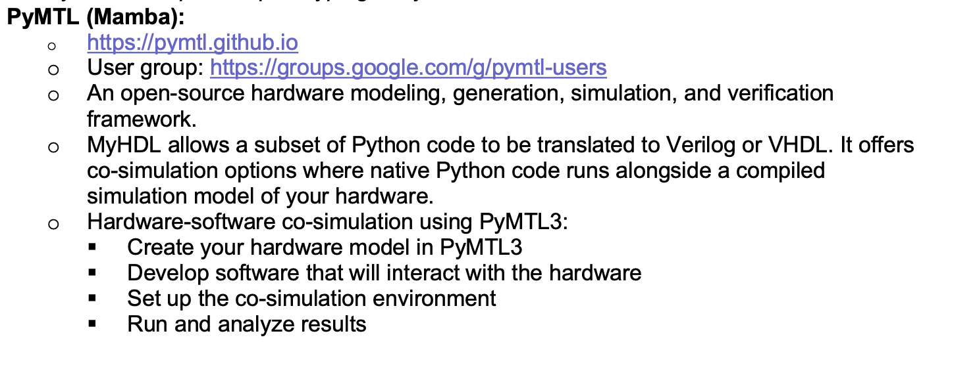
Workflow/toolchain (1)

Slide 21
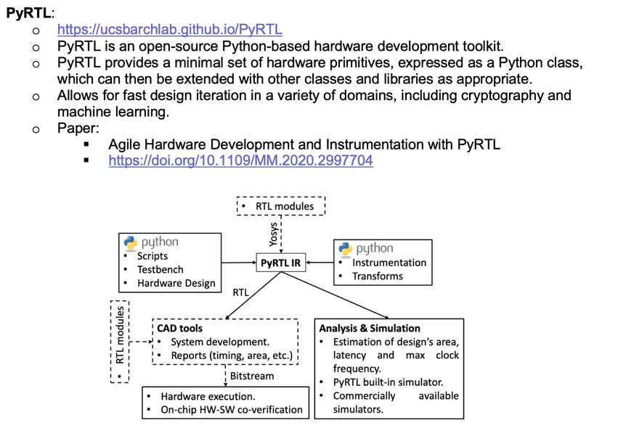
Workflow/toolchain (2)

Slide 22
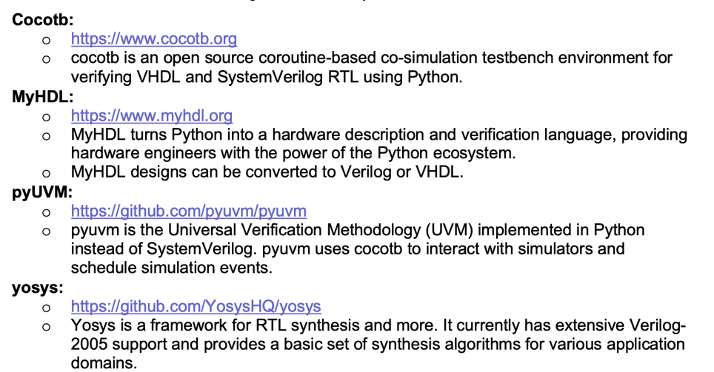
Workflow/toolchain (3)

