Slide 1
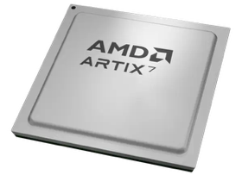
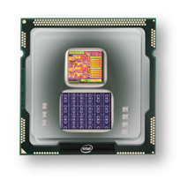
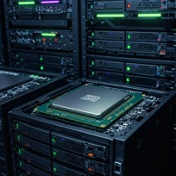
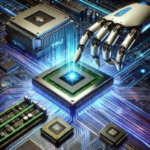
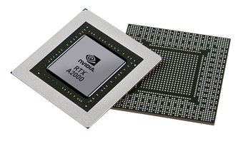


Christof Teuscher
ECE 410/510: Hardware for AI and ML
Codefest #7: Rethinking, reorienting, scaling back?
Portland State University
Department of Electrical and Computer Engineering (ECE)
www.teuscher-lab.com
teuscher@pdx.edu

Slide 2
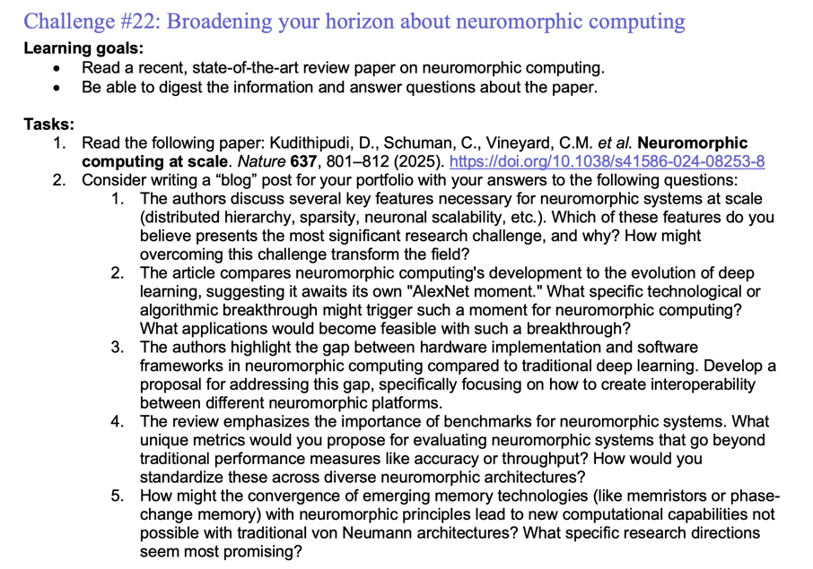
Weekly challenges

Slide 3
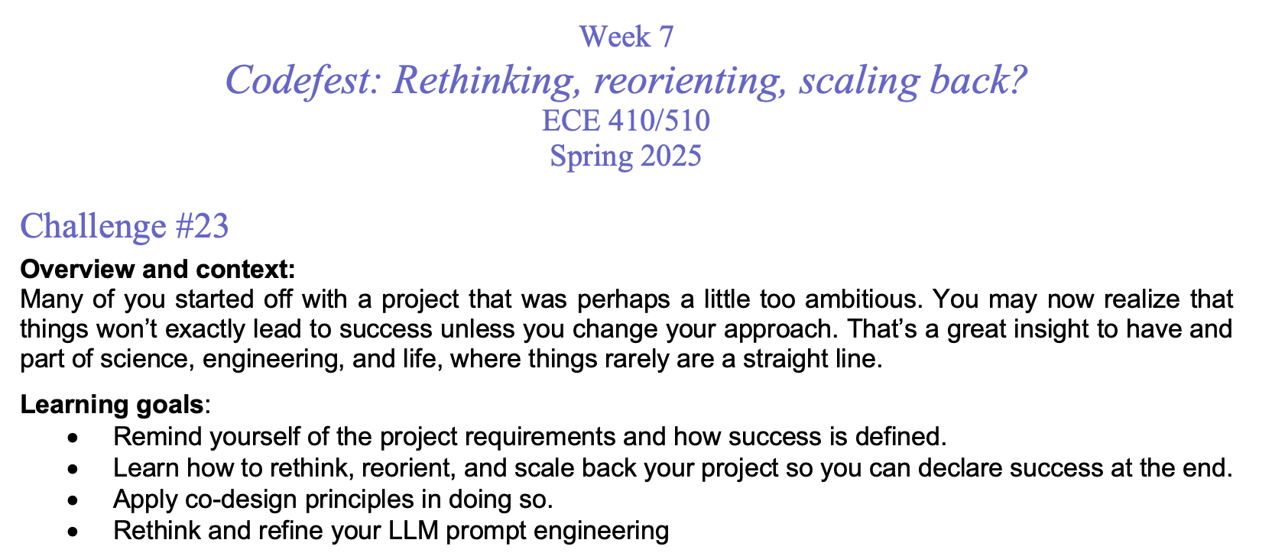

Slide 4
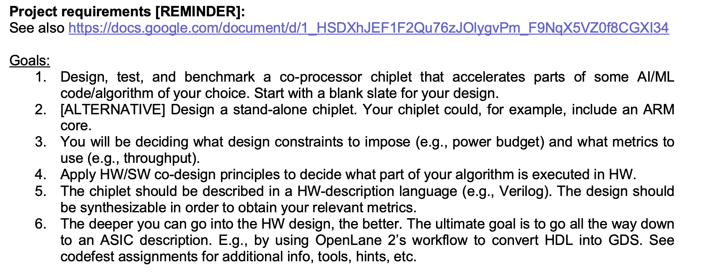
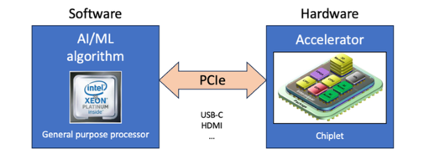
Project goals

Slide 5
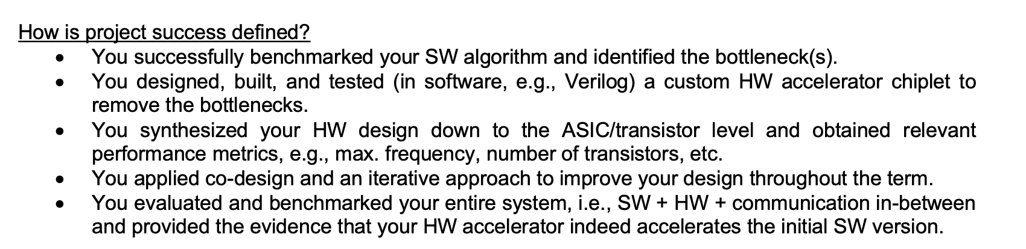
How is success defined?

Slide 6
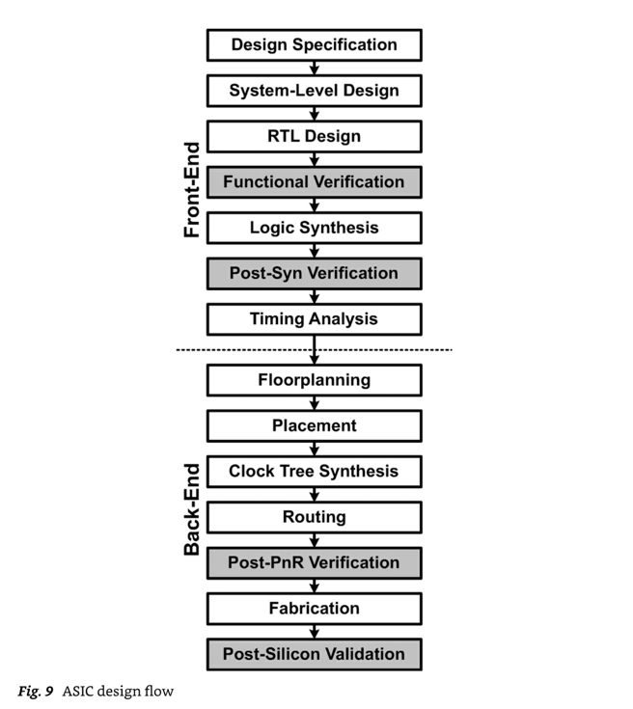
ASIC design flow
Python
Verilog/SystemVerilog/VHDL
logic and architecture designs
physical design
Max. frequency, # transistors, etc.
Mishra, Ashutosh; Cha, Jaekwang; Park, Hyunbin; Kim, Shiho. Artificial Intelligence and Hardware Accelerators.

Slide 7
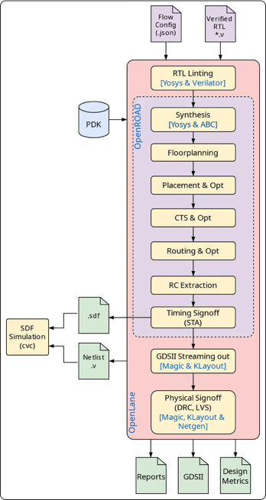
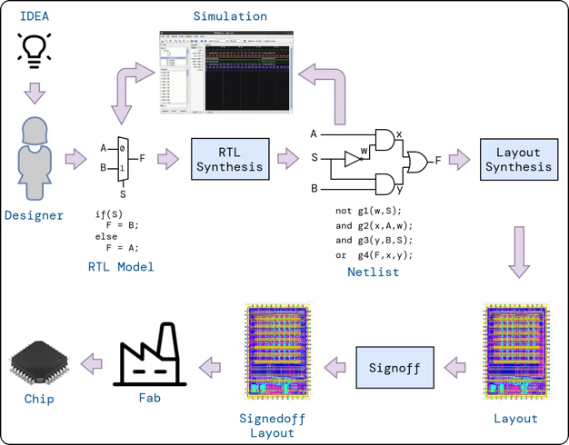
OpenLane 2 tools
https://efabless.com/openlane
https://github.com/efabless/openlane2
https://openlane2.readthedocs.io/en/latest/getting_started/newcomers/index.html

Slide 8
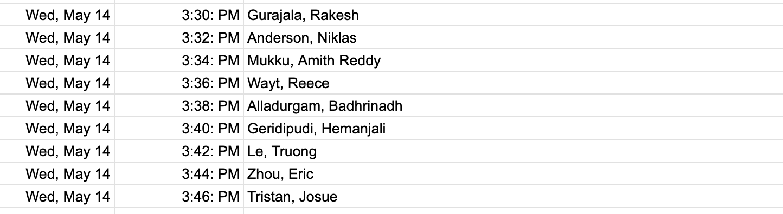
Today’s presentations
1 slide, 1 minute. Strict!

