Slide 1
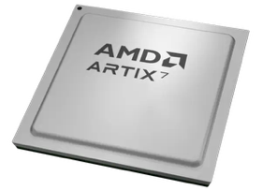
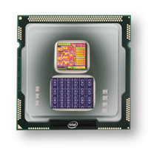
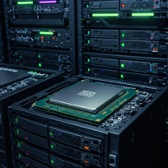
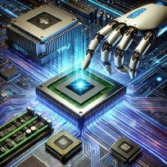
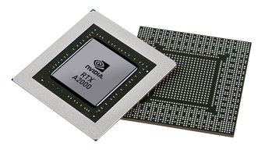


Christof Teuscher
ECE 410/510: Hardware for AI and ML
Week 8: Recap, outlook, and reminders
Portland State University
Department of Electrical and Computer Engineering (ECE)
www.teuscher-lab.com
teuscher@pdx.edu

Slide 2
What did you learn last week?

Slide 3
Recap
…

Slide 4
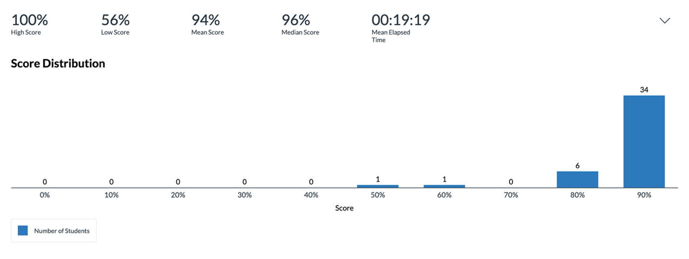
Mid-term assessment

Slide 5
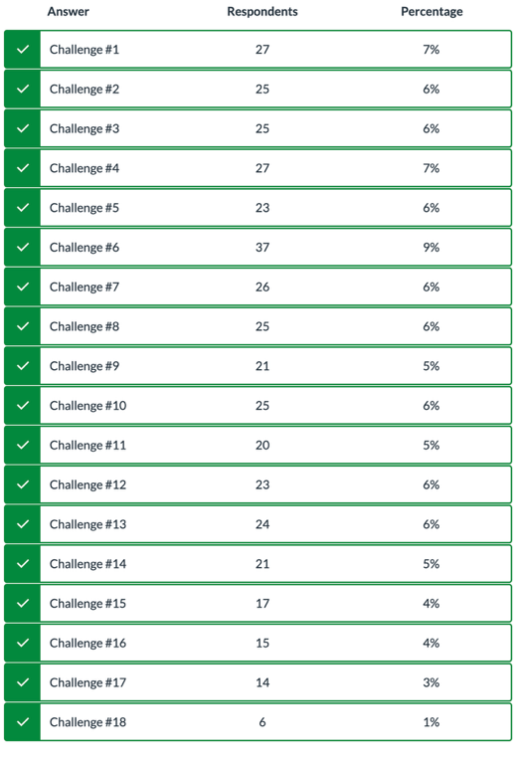

Slide 6
Week | Monday | Wednesday (Codefest)
2 | HW/AI/ML overview + codesign overview | Start main project: pick workload, start analysis, benchmark, …
3 | GPU architecture and programming for AI | Drafting a HW architecture, creating a model
4 | Deep neural networks on GPUs | Coding HW description
5 | Transformers on GPUs | First simulation + refinement
6 | In-memory computation | Improving initial design
7 | Neuromorphic chips (1): TrueNorth, Loihi, Akida | Simulation + refinement
8 | Neuromorphic chips (2) + mem devices | Synthesizing design + benchmarking
9 | Memorial Day | Final improvements
10 | Emerging technologies and future directions | Final tests, validation, verification, benchmarking

Slide 7
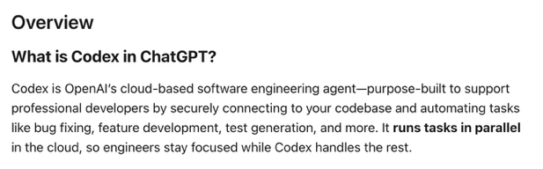
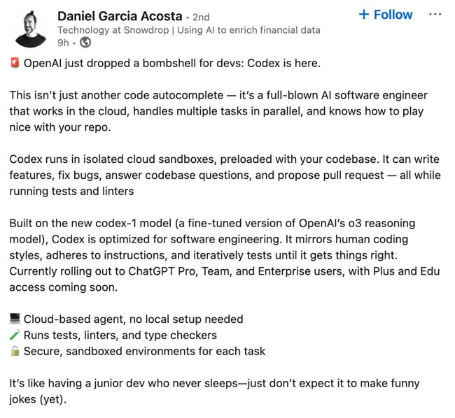
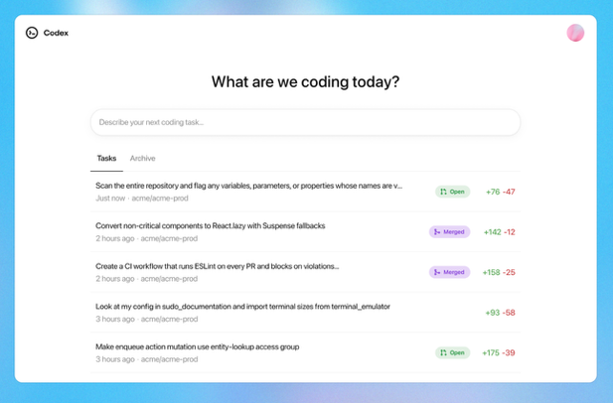
https://openai.com/index/introducing-codex

Slide 8
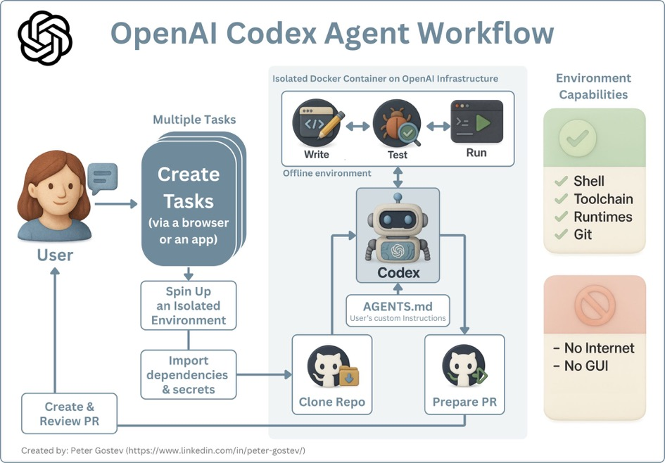

Slide 9
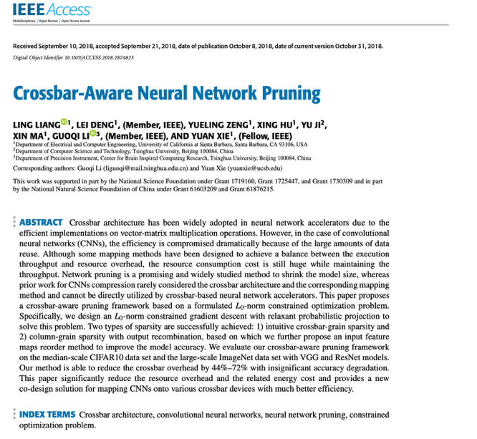
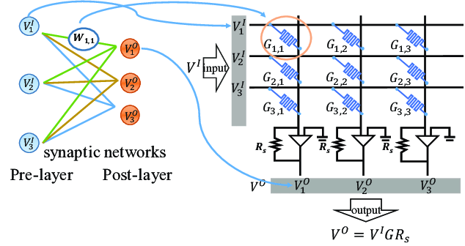
https://ieeexplore.ieee.org/abstract/document/8485680

Slide 10
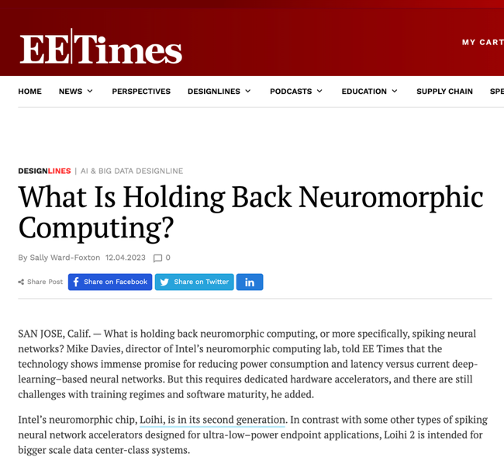
https://www.eetimes.com/what-is-holding-back-neuromorphic-computing/

Slide 11
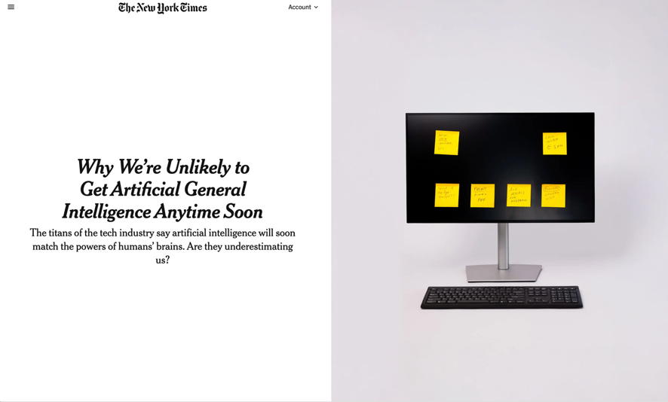
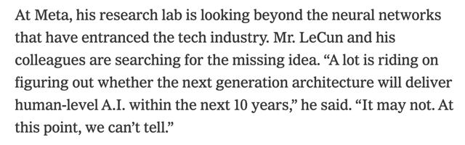
https://www.nytimes.com/2025/05/16/technology/what-is-agi.html

Slide 12
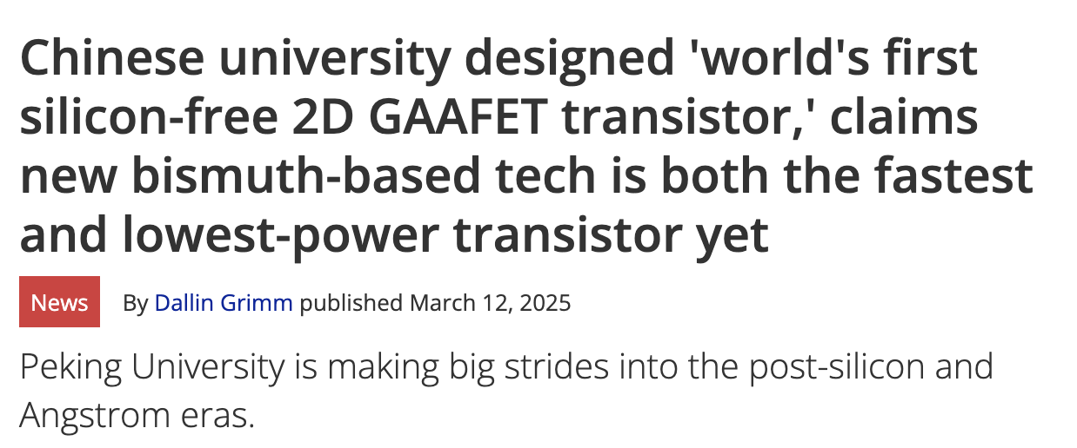
https://www.tomshardware.com/pc-components/cpus/chinese-university-designed-worlds-first-silicon-free-2d-gaafet-transistor-new-bismuth-based-tech-is-both-the-fastest-and-lowest-power-transistor-yet

