Slide 1

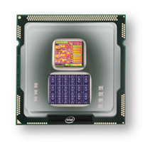
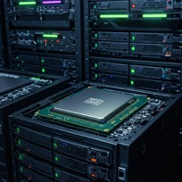
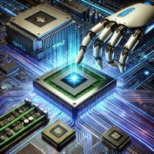
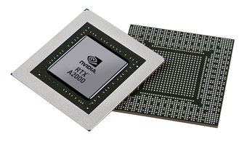


Christof Teuscher
ECE 410/510: Hardware for AI and ML
Codefest #8: Coding and co-simulating an SPI
Portland State University
Department of Electrical and Computer Engineering (ECE)
www.teuscher-lab.com
teuscher@pdx.edu

Slide 2


Slide 3
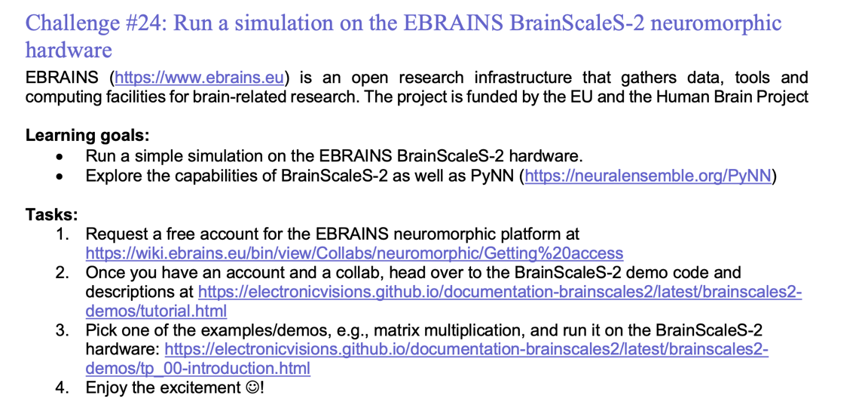
Weekly challenges

Slide 4
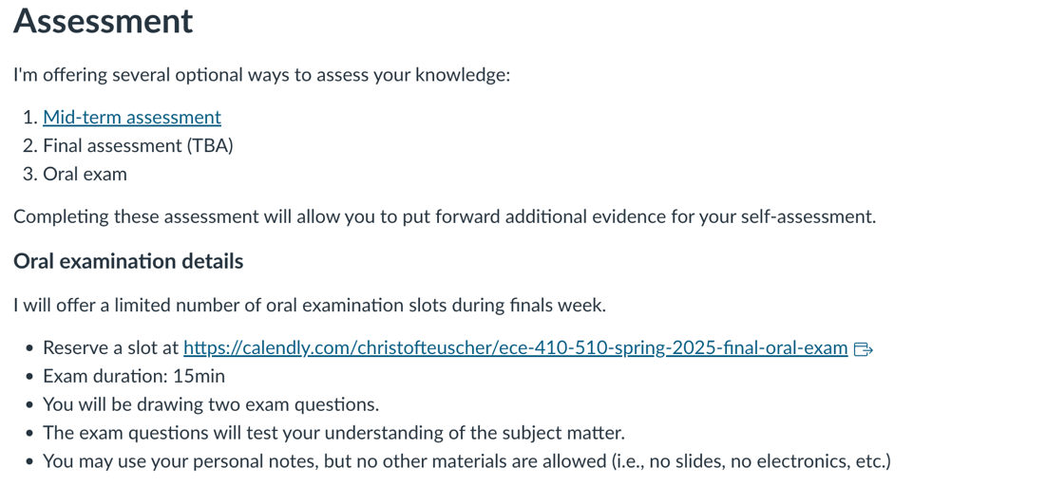
Optional oral exam

Slide 5
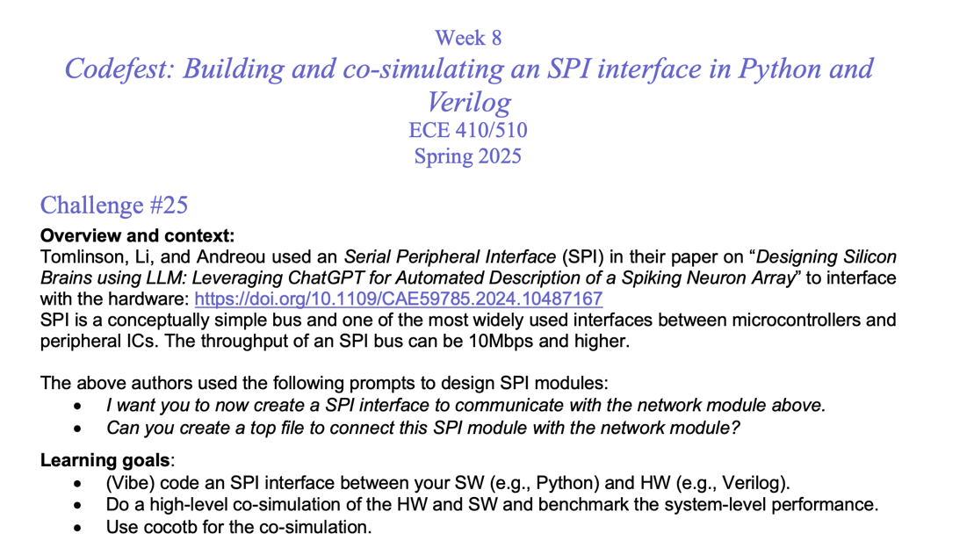

Slide 6
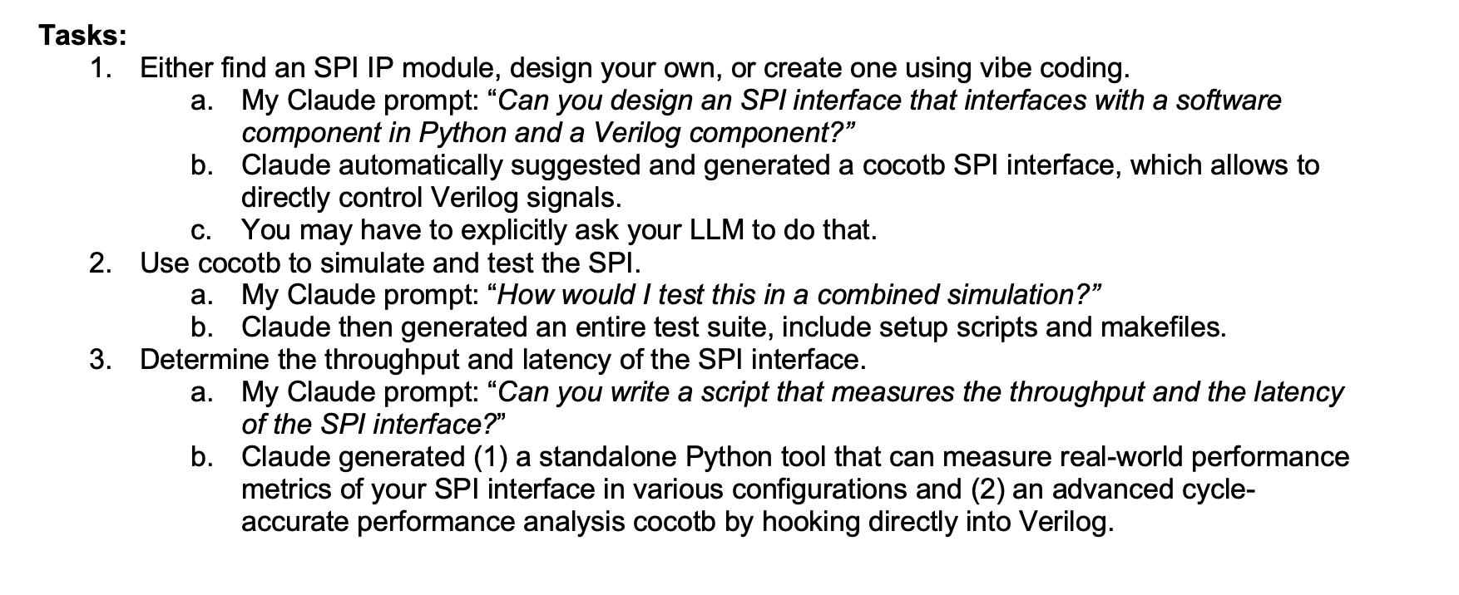

Slide 7
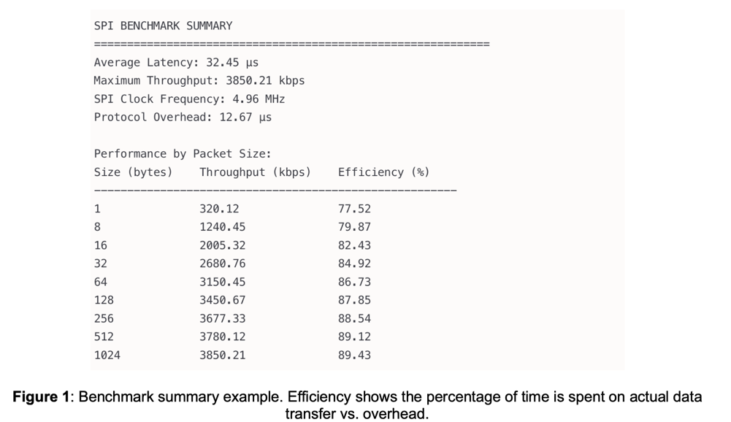

Slide 8
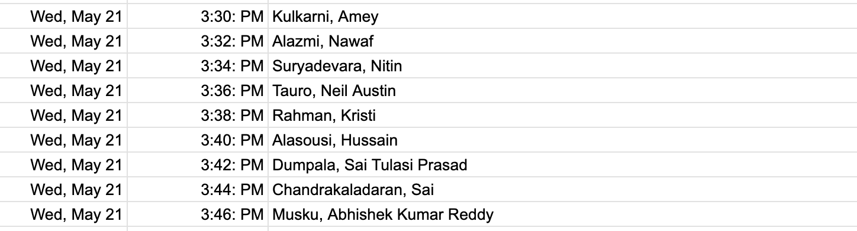
Today’s presentations
1 slide, 1 minute. Strict!

