Slide 1
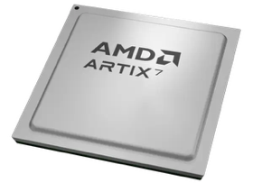
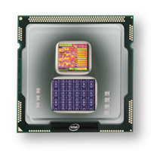
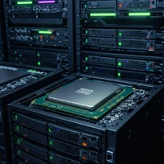
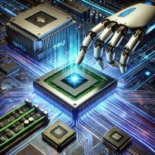
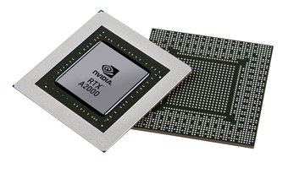


Christof Teuscher
ECE 410/510: Hardware for AI and ML
Codefest #9: Test, verify, and benchmark
Portland State University
Department of Electrical and Computer Engineering (ECE)
www.teuscher-lab.com
teuscher@pdx.edu

Slide 2
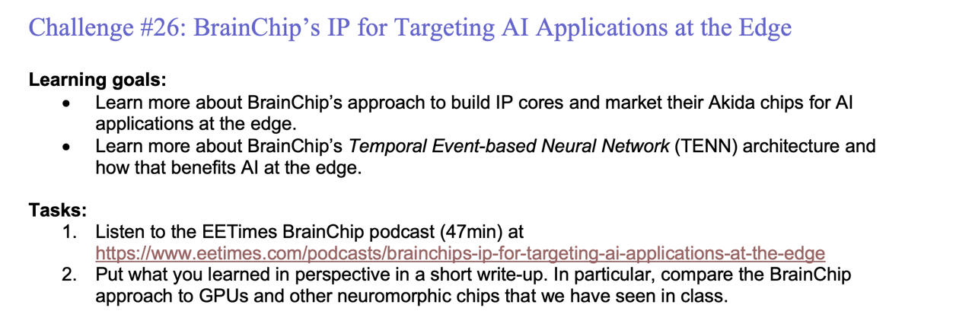
Weekly challenges

Slide 3
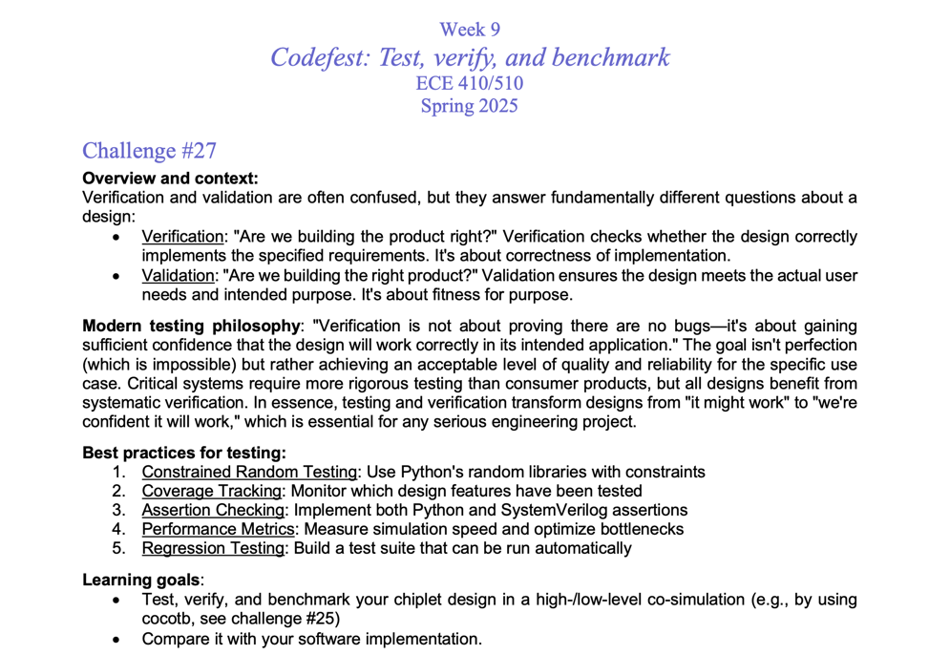

Slide 4
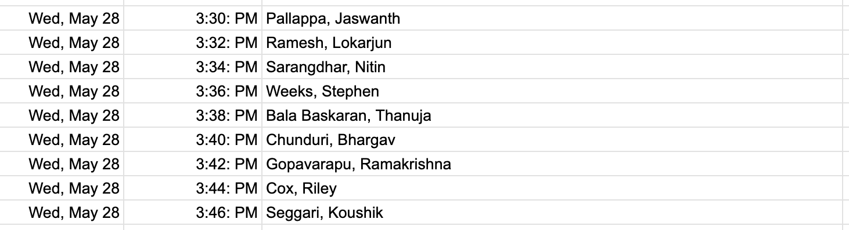
Today’s presentations
1 slide, 1 minute. Strict!

