Slide 1
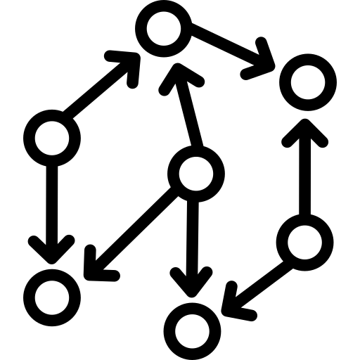



Arbitrage Simulation Pipeline
Single-Chain Paths
1
3
Path Builder
Path Simulator
Single-Chain
Arbitrage
Top Uniswap V2/V3 Pools
Cross-Chain Paths
Cross-Chain
Arbitrage
2
Event Processor
Uniswap V2 Events
Transaction Fees
Pool Updates
Uniswap V3 Events
Token Prices

