Slide 1
a
b
c
Notes:
12/06/19 Fig. 1

Slide 2
a
b
c
Notes:
02/24/20 Fig. 1

Slide 3
a
b
c
Notes:
05/27/20 Fig. 1

Slide 4
a
b
c
Notes:
06/09/20 Fig. 1

Slide 5
a
b
c
(P2) All colonies have the same mean behavior
(P3) Mixed colonies show behavioral amplification
(P1) Mixed colonies have more pronounced DOL
Notes:
05/24/20 Fig. 1

Slide 6
a
b
(P1) Mixed colonies have more pronounced DOL
c
(P2) All colonies have the same mean behavior
(P3) Mixed colonies show behavioral amplification
Notes:
05/24/20 Fig. 1

Slide 7
 |  | Pure colonies |  | Mixed colonies |  | Behavioral change from pure to mixed colonies
 |  | Mean task performance | Division of labor (DOL) | Mean task performance | Division of labor (DOL)
 |  | Identical across colonies of different ant types (P1) | Exhibits DOL | Identical to pure colonies (P1) | Higher DOL than in pure colonies (P2) | Behavioral amplification only (P3)
 |  | Different across colonies of different ant types (P4) | Exhibits DOL | Different from pure colonies (P4) | Higher DOL than in pure colonies (P2) | Behavioral contagion, amplification, or neither (P5)
Simple FTM
(with variation in mean response threshold only)
Type of Fixed Threshold Model (FTM)
Extended FTM (with variation in other biologically relevant params)
 | = experiments agree with prediction
 | = experiments disagree with prediction

Slide 8
a
b
c
d
Notes:
12/06/19 Fig. 4

Slide 9
d
Amplification
c
No effect
a
Downward contagion
b
Upward contagion
Notes:
12/06/19 Fig. 4, v2

Slide 10
a
Downward contagion
b
Upward contagion
d
Amplification
𝛼^{X} = 6
𝛼^{Y} = 2
c
No effect
Notes:
12/06/19 Fig. 4, v3

Slide 11
a
Downward contagion
b
Upward contagion
𝛼^{X} = 6
𝛼^{Y} = 2
d
Amplification
c
No effect
e
X becomes less sensitive to stimuli relative to Y
Y
X becomes more efficient relative to Y
Notes:
12/06/19 Fig. 4, v4

Slide 12
a
Downward contagion
d
Amplification
𝛿 = 0.6
e
X
X
X
X becomes more efficient relative to Y
b
Upward contagion
c
No effect
Y
X becomes less sensitive to stimuli relative to Y
𝛿 = 1.5
Notes:
12/06/19 Fig. 4, v5

Slide 13
X becomes less sensitive to stimuli relative to Y
Y
X becomes more efficient relative to Y
Notes:
12/06/19 Fig. 5

Slide 14
a
Downward contagion
b
Upward contagion
𝛿 = 0.6
e
𝛿 = 1.3
X
Individuals become more efficient
X
Y
c
No effect
X
d
Amplification
Individuals become less sensitive to stimuli
Notes:
1/22/20 Fig. 4, updated with new panels

Slide 15
a
Downward contagion
b
Upward contagion
𝛿 = 0.6
e
𝛿 = 1.3
X
Individuals become more efficient
X
c
No effect
Y
d
Amplification
X
Individuals become less sensitive to stimuli
Notes:
1/22/20 Fig. 4, updated with new panels – tentative v2 with mu = 7.5

Slide 16
a
Downward contagion
b
Upward contagion
𝛿 = 0.6
e
𝛿 = 1.3
X₁
Individuals become more efficient
X₃
c
Y
d
No effect
Amplification
X₂
Individuals become less sensitive to stimuli
Notes:
2/2/20 Fig. 4, updated with new colors

Slide 17
a
Downward contagion
b
Upward contagion
𝛿 = 0.6
e
𝛿 = 1.3
X₁
Individuals become more efficient
X₃
c
Y
d
No effect
Amplification
X₂
Individuals become less sensitive to stimuli
Notes:
2/2/20 Fig. 4, updated with new colors

Slide 18
a
Downward contagion
b
Upward contagion
𝛿 = 0.6
e
𝛿 = 1.3
X₁
Individuals become more efficient
X₃
c
Y
d
No effect
Amplification
X₂
Individuals become less sensitive to stimuli
Notes:
3/1/20 Fig. 4, updated axis labels

Slide 19
a
Downward contagion
b
Upward contagion
𝛿 = 0.6
c
𝛿 = 1.3
X₁
Individuals become more efficient
X₃
d
Y
e
No effect
Amplification
X₂
Individuals become less sensitive to stimuli
Notes:
5/24/20 Fig. 3, updated panels a and b (including location of X1) + panel order

Slide 20
a
Upward contagion
b
Downward contagion
𝛿 = 0.6
c
𝛿 = 1.3
X₁
Individuals become more efficient
X₃
e
No effect
d
Amplification
Y
X₂
Individuals become less sensitive to stimuli
Notes:
5/27/20 Fig. 3, updated panel order and panel labels

Slide 21
a
b
c
d
e
f
Notes:
12/06/19 Fig. S2

Slide 22
a
b
Notes:
2/14/20 Fig. S2

Slide 23
Notes:
5/24/20 Fig. S1

Slide 24
Notes:
5/27/20 Fig. S1

Slide 25
a
b
c
d
Notes:
12/06/19 Fig. S4

Slide 26
a
b
c
d
Notes:
1/23/20 Fig. S4

Slide 27
a
b
c
d
Notes:
2/8/20 Fig. S4 – tentative v2 with mu = 7.5

Slide 28
a
b
c
d
Notes:
5/24/20 – Updated Fig. S5 with new panels a and b

Slide 29
a
b
c
d
Notes:
5/27/20 – Updated Fig. S5 with new panels a and b, panel order flipped

Slide 30
a
b
c
d
Notes:
1/23/20 Fig. S5

Slide 31
a
b
c
d
Notes:
1/23/20 Fig. S5 – tentative v2 with mu = 7.5

Slide 32
a
b
c
d
Notes:
2/26/20 Fig. S5 – v3 without type-specific lines in the mixed colonies

Slide 33
a
b
c
d
Notes:
5/24/20 – Fig. S4 with updated panels a and b

Slide 34
a
b
c
d
Notes:
5/27/20 – Fig. S4 with updated panels a and b, order flipped

Slide 35
a
No effect
b
Downward contagion
c
Upward contagion
d
Amplification
--- Null H₀
(linear mixing)
Notes:
12/06/19 Fig. 5

Slide 36
a
No effect
b
Downward contagion
c
Upward contagion
d
Amplification
--- Null H₀
(linear mixing)
Notes:
01/27/20 Fig. 5 – updated with new params, soon to add a new panel for complex mixes

Slide 37
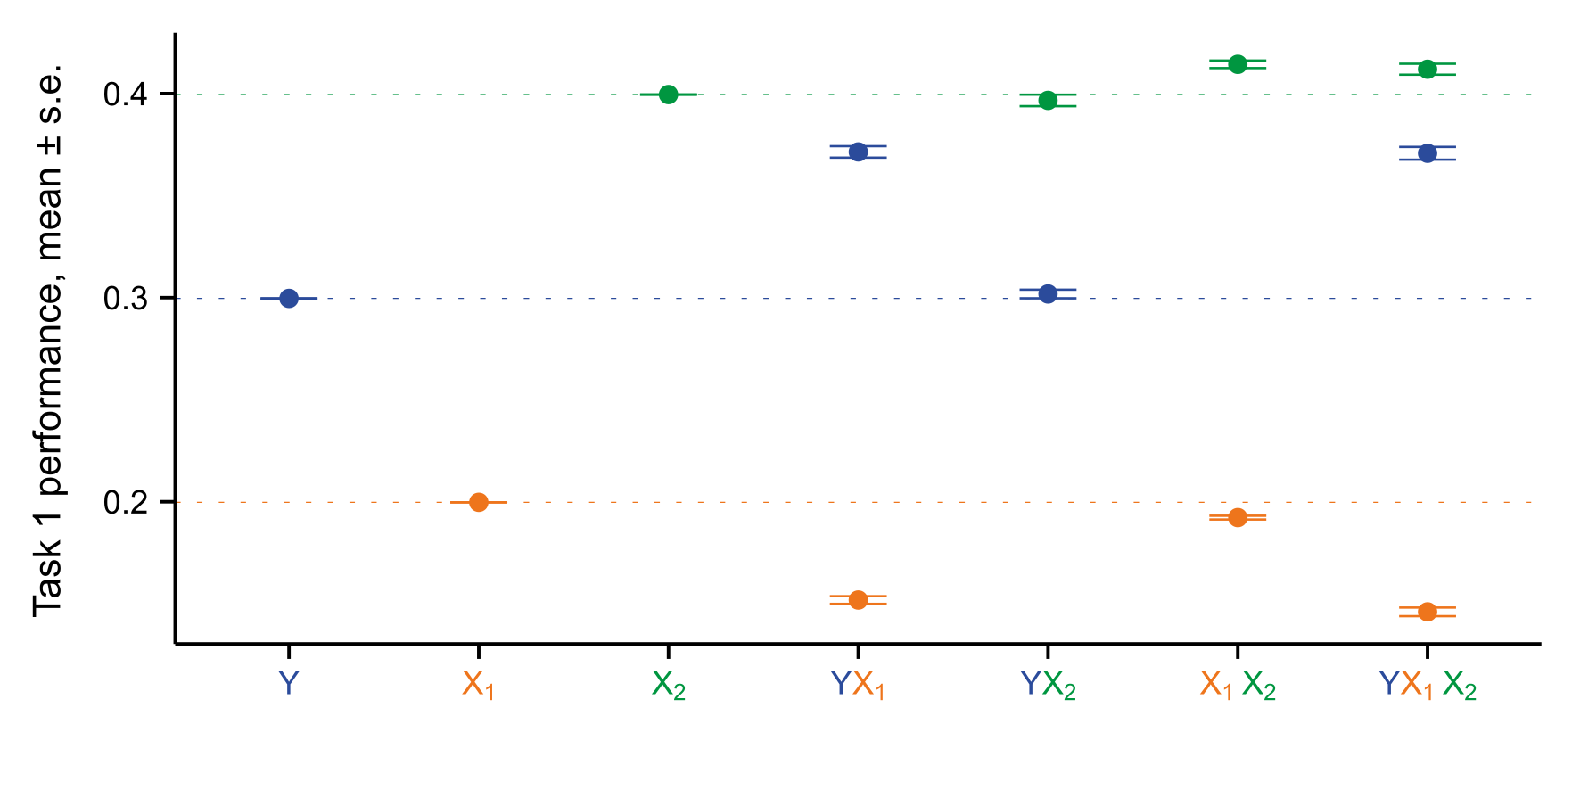
a
No effect
b
Downward contagion
c
Upward contagion
d
Amplification
--- Null H₀
(linear mixing)
e
Notes:
01/27/20 Fig. 5 – updated with new params, soon to add a new panel for complex mixes

Slide 38
a
No effect
b
Downward contagion
2
1
--- Null H₀
(linear mixing)
--- Null H₀
(linear mixing)
c
Upward contagion
d
Amplification
1
3
--- Null H₀
(linear mixing)
--- Null H₀
(linear mixing)
--- Null H₀
(linear mixing)
e
Notes:
2/3/20 Fig. 5 – updated with new params, soon to add a new panel for complex mixes

Slide 39
a
No effect
b
Downward contagion
2
1
--- Null H₀
(linear mixing)
--- Null H₀
(linear mixing)
c
Upward contagion
d
Amplification
1
3
--- Null H₀
(linear mixing)
--- Null H₀
(linear mixing)
Notes:
2/3/20 Fig. 5 – updated with new params, soon to add a new panel for complex mixes

Slide 40
a
b
No effect
Downward contagion
2
1
--- Null H₀
(linear mixing)
--- Null H₀
(linear mixing)
c
d
Upward contagion
Amplification
1
3
--- Null H₀
(linear mixing)
--- Null H₀
(linear mixing)
Notes:
3/1/20 Fig. 5 – updated with larger labels

Slide 41
a
b
No effect
Downward contagion
2
1
--- Null H₀
(linear mixing)
--- Null H₀
(linear mixing)
c
d
Upward contagion
Amplification
1
3
--- Null H₀
(linear mixing)
--- Null H₀
(linear mixing)
Notes:
5/27/20 Fig. S6 – updated with new fig labels, new order, and new params for a-b

Slide 42
a
b

Slide 43
a
b

