Slide 1


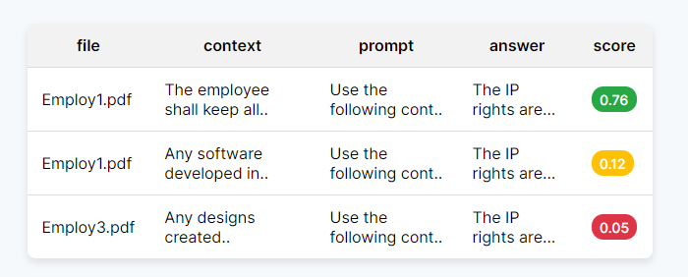
Vector DB
Query
Data Request: IP clause of employment contracts
Hybrid Search
Questioning: Assessment of IP security
Parameters: per file, global, semantic weight

Slide 2
Audit Queries
CONTEXT
Request: …
Reasoning
Questioning: …
Parameters: …

Slide 3
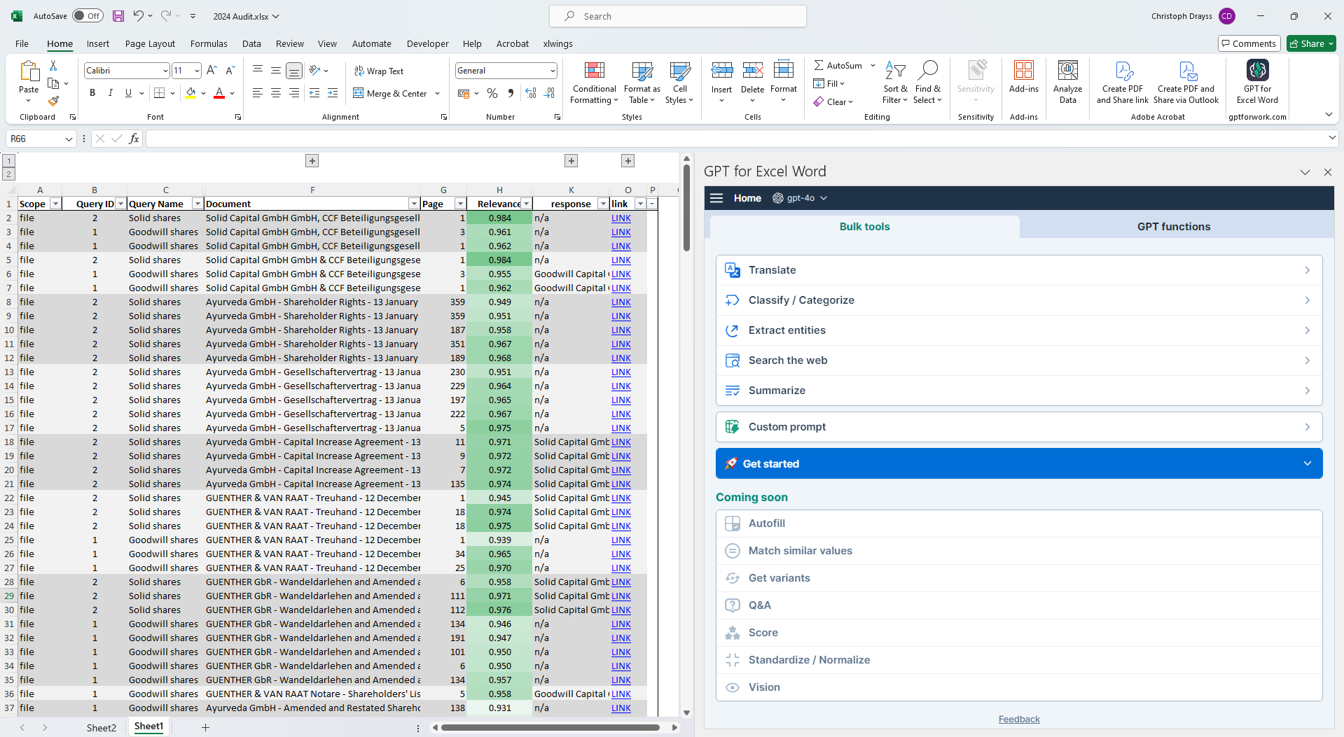
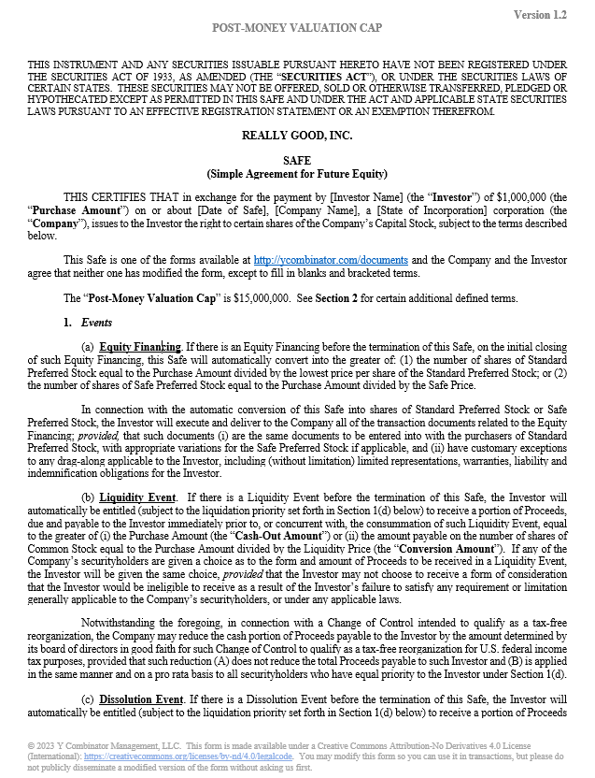
Docupulse
Text Highlight
x
Reasoning
x
Go To Folder
Go To Knowledge Base

Slide 4
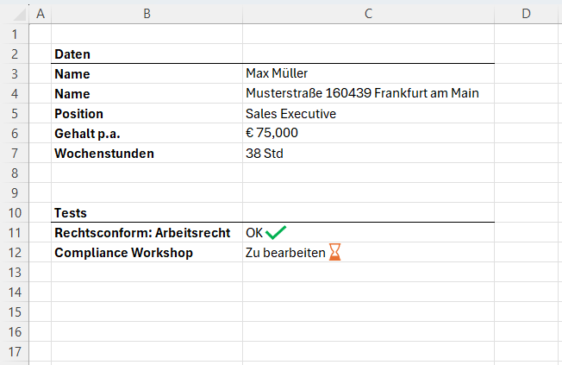
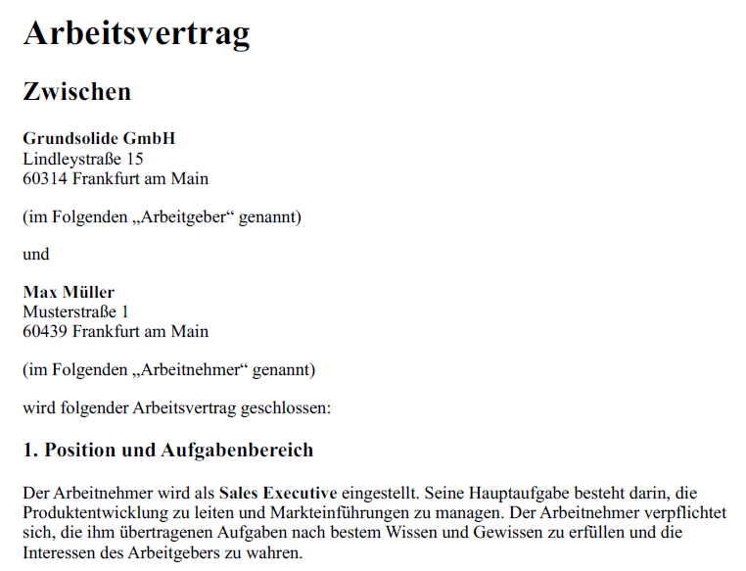

Slide 5
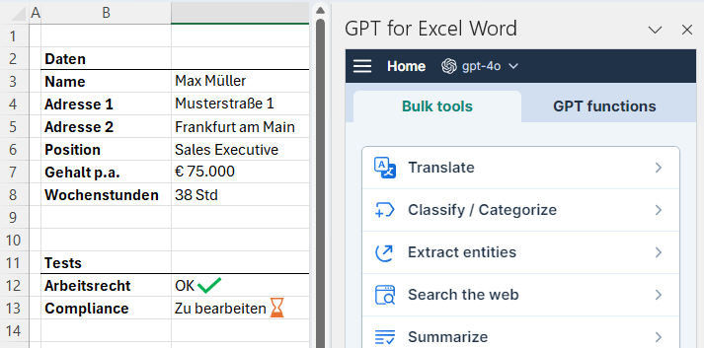

Slide 6
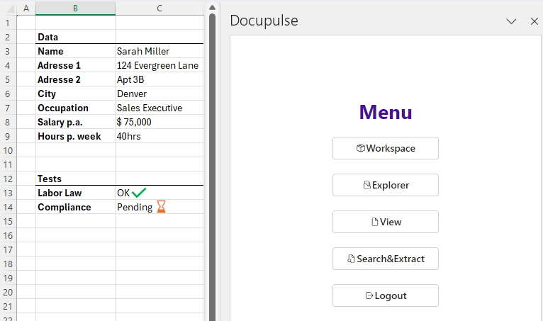
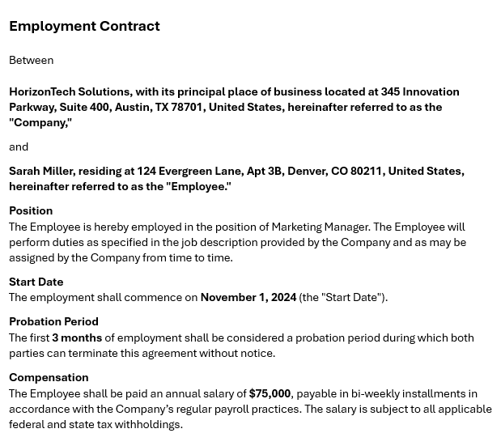

Slide 7
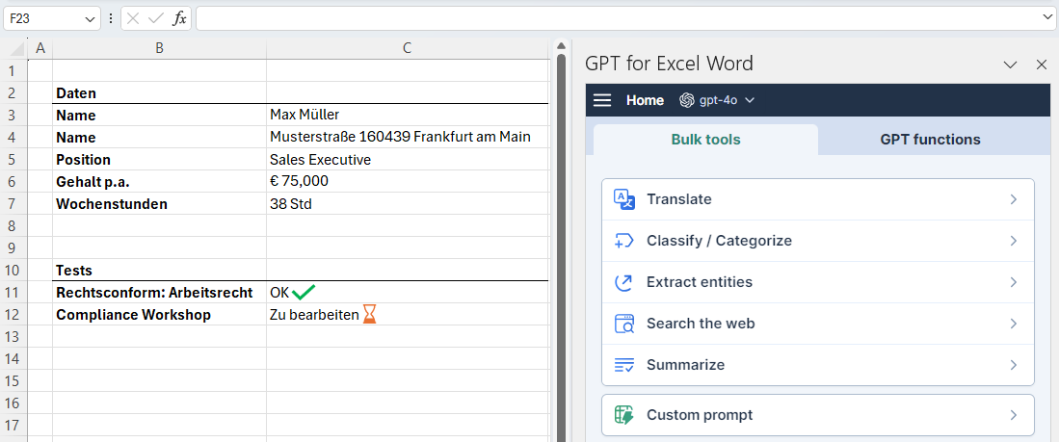

Slide 8
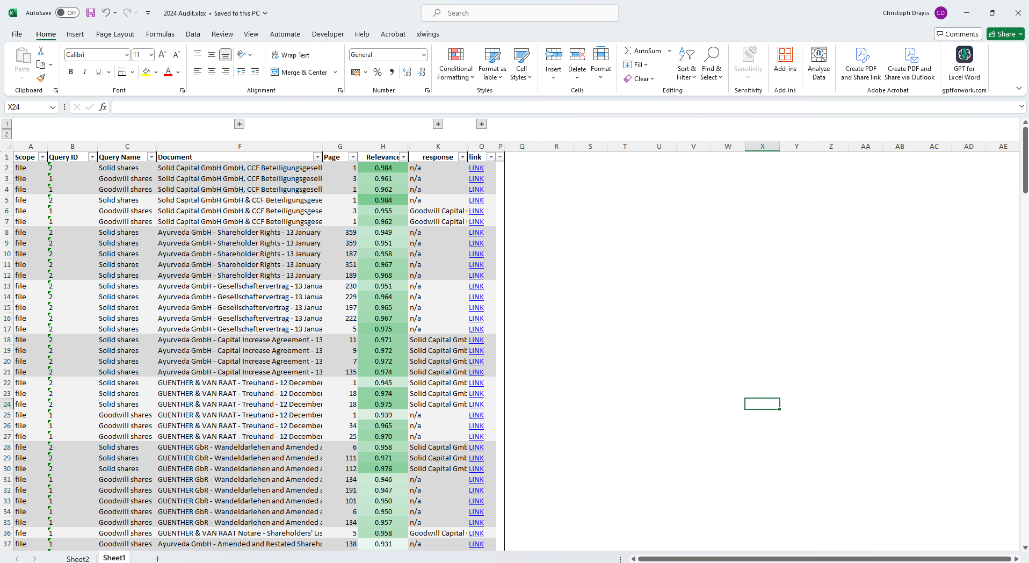

Slide 9




Slide 10
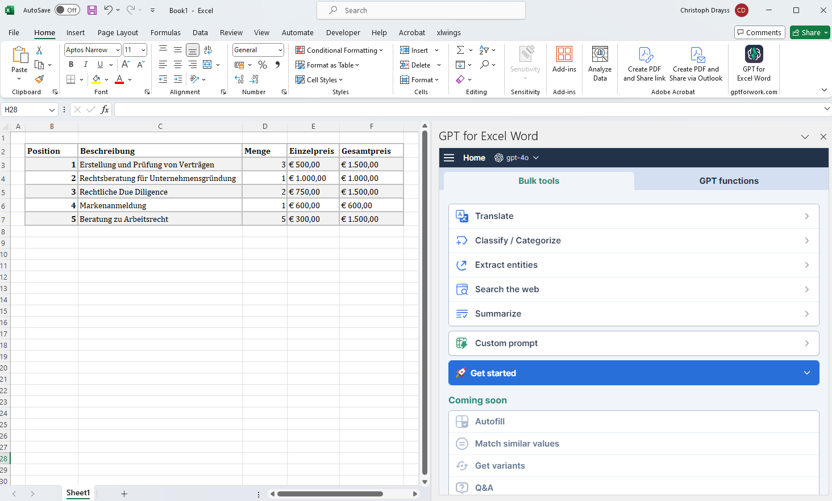
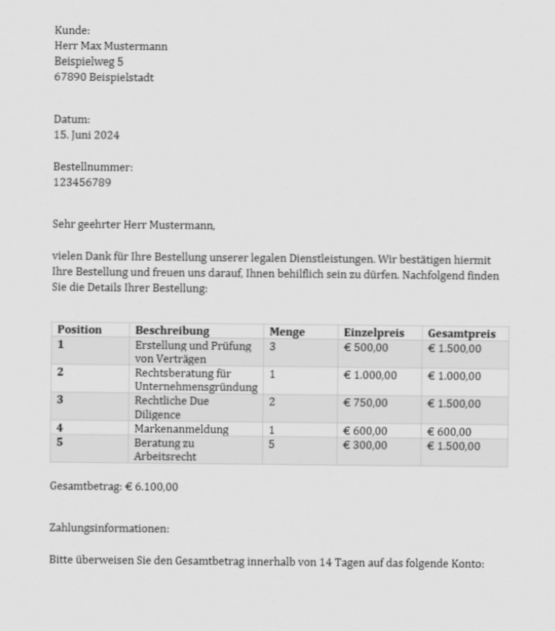

Docupulse

