Slide 1
HDR UK Computable Knowledge Collaborathon 10th December 2020
Team 2: CQL expression of NICE Recommendations for detecting acute kidney injury (AKI)
Christophe Stevens | Imperial College
Liz Elliott | NHS Lothian
Facilitator: Charlie McCay

Slide 2
Background
Acute kidney injury (AKI)
Common in critically ill patients; high mortality rate.
Can develop during ECMO; used to treat severely ill patients with COVID-19
Uses of CQL expression output
Clinical: Flag at-risk patients for immediate intervention.
Research: Investigate outcomes in patients identified as being at risk.
Notes:
An AKI alert could be used to notify clinicians of at-risk patients via an EPR system or direct messaging.
At a population level, patient records flagged with the alert could be analysed in terms of alert accuracy, outcomes, additional predictors etc.

Slide 3
Context and Generalizability
The narrative NICE guidelines are open to interpretation
They do not define assumptions regarding source data, thresholds, specific estimates used etc.
Some SNOMED-CT codes are open to interpretation
e.g. Codes for AKI risk and warning are not tied to a specific risk criteria.
Notes:
The narrative NICE guidelines are open to interpretation
Age threshold not defined (adult versus children/young people)
Measurement window not clearly defined (e.g. “within 48 hours” does not provide a start/end point)
Serum creatinine monitoring frequency “should vary according to clinical need”.
Some SNOMED-CT codes are open to interpretation
SNOMED-CT has codes for risk of AKI, and warning of AKI, but these are not tied to a specific risk criteria/interpretation.
At risk of acute kidney injury (finding) SCTID: 938911000000100
Acute kidney injury warning stage (observable entity) SCTID: 1007921000000107
Estimated Glomerular Filtration Rate (eGFR) can be estimated in various different ways. Do the NICE guidelines support these being used interchangeably?
SNOMED-CT has codes for multiple different estimations.
1107411000000104 | Estimated glomerular filtration rate by laboratory calculation (observable entity)
857971000000104 | Estimated glomerular filtration rate using Chronic Kidney Disease Epidemiology Collaboration formula (observable entity)
963601000000106 | Estimated glomerular filtration rate using cystatin C Chronic Kidney Disease Epidemiology Collaboration equation (observable entity)
Generalizability:
If assumptions regarding source data, thresholds, specific estimates used etc. are not defined in the NICE guidelines then the CQL expression cannot be assumed to work with different datasets.

Slide 4
Our Assumptions
The dataset will be clean and complete (!)
The dataset will include one creatinine reading per patient per calendar day.
The threshold between adult/child will be 18 years.
The eGFR values will be estimated by laboratory calculation (SCTID: 1107411000000104).
Notes:
In order to generate a working CQL expression, the following assumptions were made:
The dataset will be clean and complete.
The dataset will include one creatinine reading per patient per calendar day.
The threshold between adult/child will be 18 years.
The eGFR values will be estimated by laboratory calculation (SCTID: 1107411000000104).

Slide 5
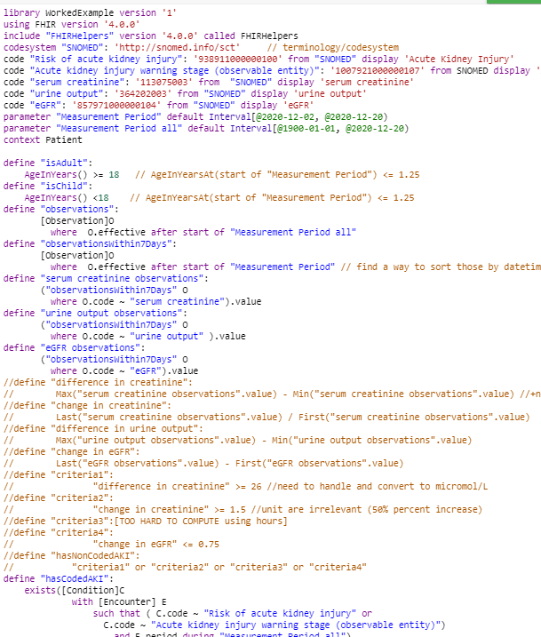

Slide 6
CQL and FHIR Challenges
Comparing values across time intervals
User documentation not very user-friendly
CQL is also used to refer to the Cassandra Query Language; searches need to specify HL7 CQL.
Availability of suitable test data
Would be useful to have some standard synthetic datasets to work with.

Slide 7
Data Challenges
Real world patient data can be messy and incomplete…
Lab results (e.g. creatinine) are not always accurately timestamped.
Creatinine assays may vary between labs.
Notes:
Real world clinical data can be messy and incomplete in ways that are not easy to fix computationally. Addressing such problems at the data collection stage is challenging.

Slide 8
Summary
CQL expressions have the potential to improve patient care when integrated into patient management systems.
A better CQL test environment would facilitate broader adoption.
Many of the barriers to implementation are not technical:
Clinicians and support staff need to adopt working practices that result in robust datasets.

Slide 9
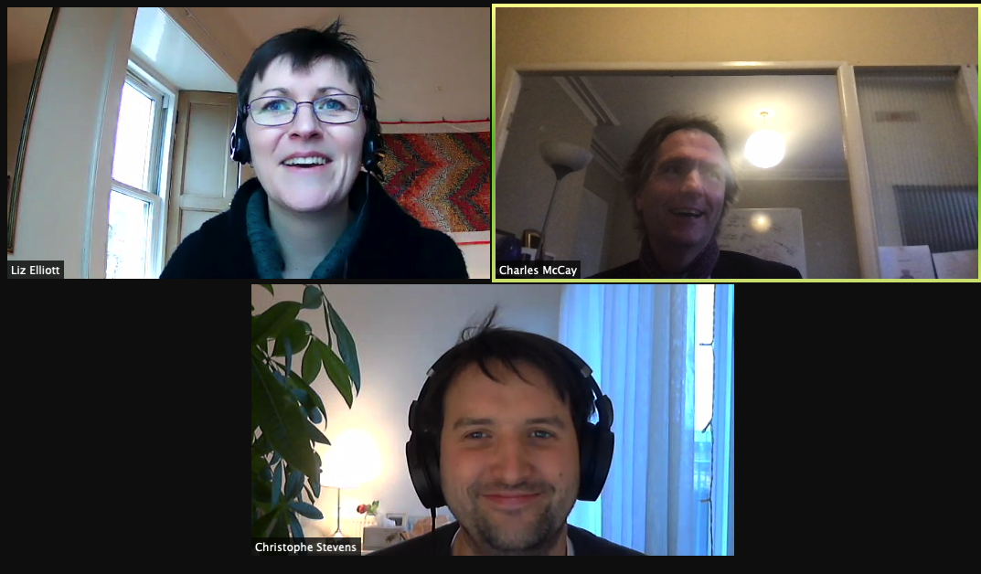

Slide 10
References
NICE recommendations | https://www.nice.org.uk/guidance/ng148/chapter/Recommendations#detecting-acute-kidney-injury
Normative eGFR values | https://www.kidney.org/atoz/content/gfr
eGFR values (paeds) | https://cjasn.asnjournals.org/content/6/8/1810
Normative creatinine values (adult) | https://www.nbt.nhs.uk/severn-pathology/requesting/test-information/creatinine
Normative creatinine values (paed) | https://www.nbt.nhs.uk/sites/default/files/Paediatric%20reference%20ranges%20-%20Biochemistry.pdf
SNOMED-CT Browser | https://termbrowser.nhs.uk

