Slide 1
Python with Rasberry Pi

Slide 2
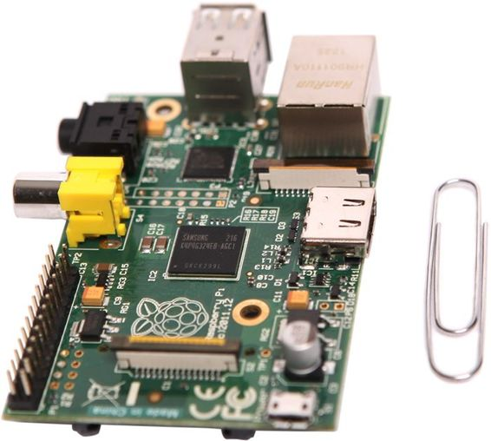
What is a Raspberry Pi ?
A Raspberry Pi is a very inexpensive, fully programmable computer that is small enough to fit into the palm of your hand.
The Raspberry Pi is small in size but mighty in potential. It can be used as a regular desktop computer or you can create super-cool projects with it, like games.

Slide 3
Raspberry Pi History
The Raspberry Pi is still a fairly young device. It was created in the United Kingdom by Eben Upton and a few colleagues.
The first commercial version, Model A, was officially offered for sale in early 2012 at the low price of $25.
There are other different names given to the Raspberry Pi such as Rpi and just Pi.
More on Raspberry Pi can be found on the Raspberry Pi foundation's website
Raspberry Pi website

Slide 4
Why Learn to program Python on a Raspberry Pi ?
Python allows a Raspberry Pi owner to increase the field of project possibilities to an incredible size.
The Raspberry Pi offers an incredibly cheap development platform for Python programming. Though Python can be considered “educational” because it is easy to learn, by no means is Python wimpy.
You can write games in Python and run them on gaming consoles controlled by your Raspberry Pi.
Armed with Python and Pi, your only limit is your imagination.

Slide 5
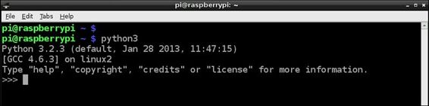
Python Interactive Shell
To enter the interactive Python shell, type in the command “python3” (for python version3) and “python2” (for python version2) at the command line and press enter.
You simply enter a Python statement and press Enter. The Python interpreter checks the statement’s syntax. If the syntax is correct, the statement is translated into binary code and executed.

Slide 6
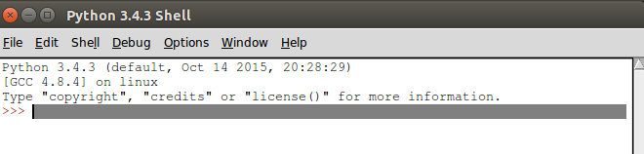
Python Development Environment Shell (IDLE)
IDLE stands for Interactive DeveLopment Environment.
This development environment provides a built-in text editor and many features that assist in the creation and testing of Python scripts.
To start up IDLE you just double-click the IDLE 3 icon on the desktop. You can also find it under the LXDE Programs Menu icon. The figure below shows the IDLE shell for Python v3.

Slide 7

Creating Python Scripts
You can create whole files of Python statements and then run them. These whole files of Python statements are called Python scripts.
Python scripts can be run from either the Python interactive shell of from IDLE.
Python scripts always end with .py, like hello.py
Use any Text Editor to create a python script
This is how you run a python script :
python3 script.py
where script.py is the file containing your python code

Slide 8
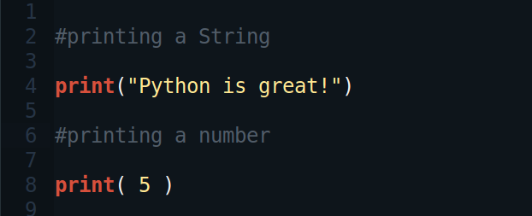
print()
print() is used to print anything on the screen.
print() can print numbers and strings.

Slide 9
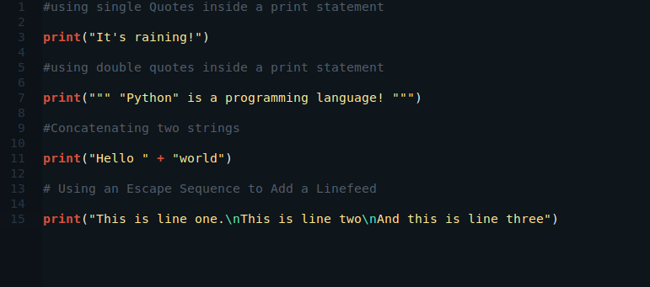
print()

Slide 10
Escape sequences
\' → Displays a single quote
\” → Displays a double quote in output
\\ → Displays a single backslash in output
\a → produces a “bell” sound with output
\f → Inserts a formfeed into the output
\n → Inserts a linefeed into the output
\t → Inserts a horizontal tab into the output

Slide 11
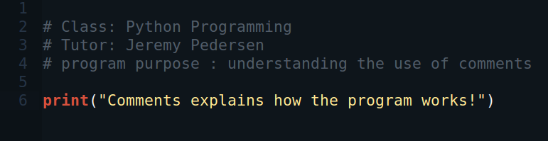
Comments
A comment’s purpose is to provide understanding of the script’s syntax and logic.
To add a comment to a script, you precede it with the pound or hash symbol (#). The Python interpreter ignores anything that follows the hash symbol.

Slide 12
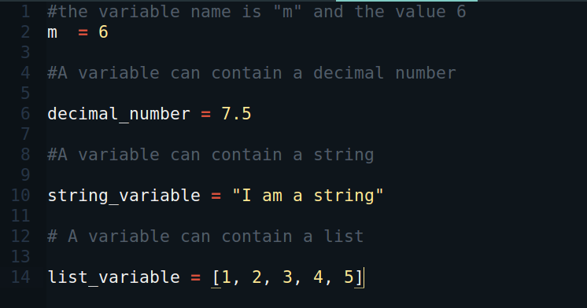
Variables
A variable is a name that stores a value for later use in a script.
A variable can store a number, a string, a list, etc...

Slide 13
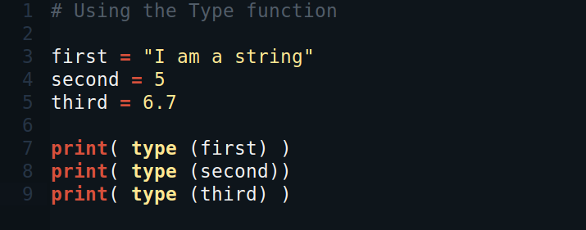
Python Data Types
You can determine what data type Python has assigned to a variable by using the type function.

Slide 14
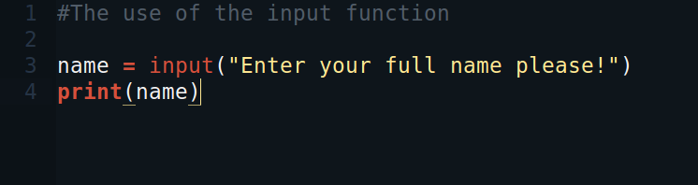
input()
There will be times that you need your program to stop and ask for help from a human. The input function is a built-in function you can use for this, and it has the following syntax:
variable = input(user prompt)

Slide 15
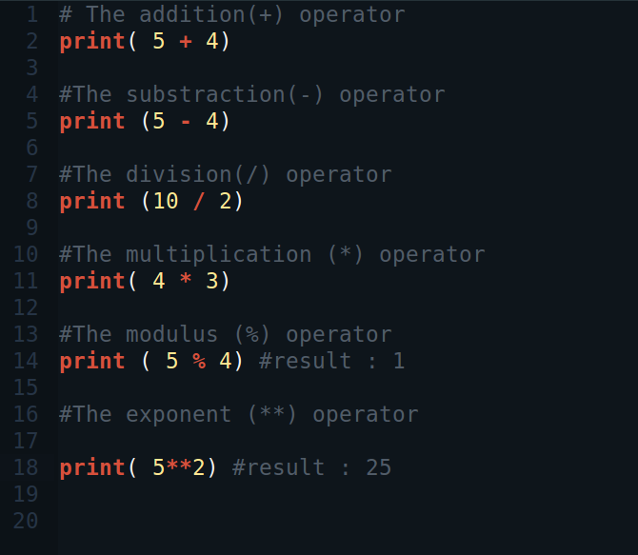
Arithmetic operators

