Slide 1
D3.js and d3pie
Christophe Limpalair
Scaleyourcode.com

Slide 2
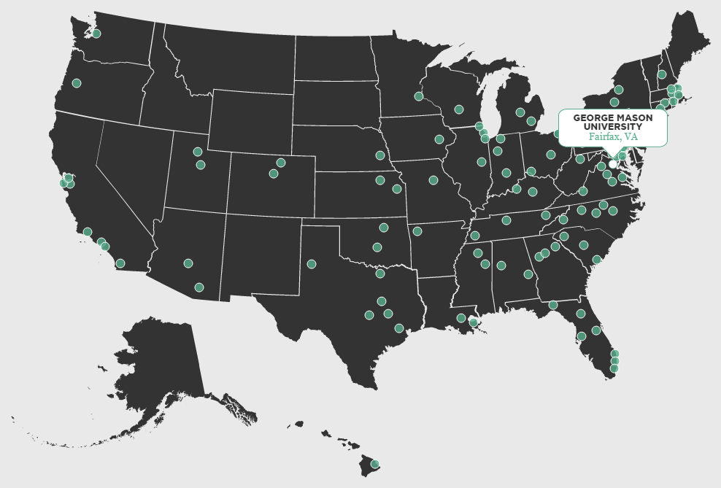
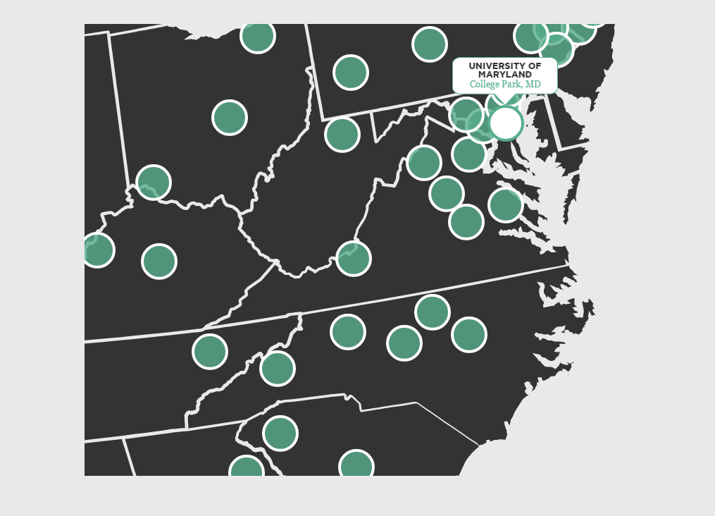
What is D3.js?
Open Source JavaScript library
Brings data to life
Uses HTML, SVG, and CSS

Slide 3
More Examples
http://www.nytimes.com/interactive/2014/09/19/nyregion/stop-and-frisk-map.html?_r=0
http://bl.ocks.org/rcmoore38/9f2908455355c0589619

Slide 4
How do you get started?
All you need is the D3 library
(incl. jQuery… Optional but makes life easier)
<!DOCTYPE html>
<html>
<head>
<script src="http://code.jquery.com/jquery-2.1.3.min.js"></script>
<script src="https://cdnjs.cloudflare.com/ajax/libs/d3/3.5.6/d3.min.js" charset="utf-8"></script>
</head>
<body></body>
</html>

Slide 5
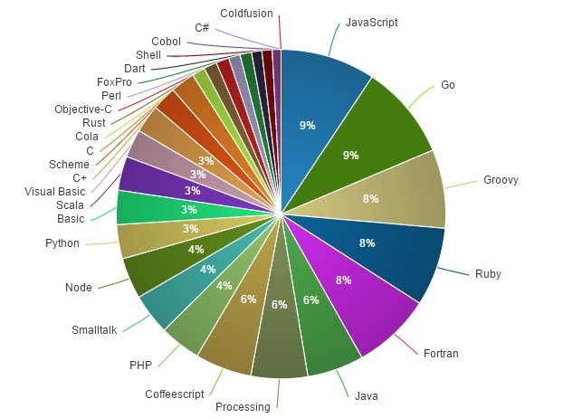
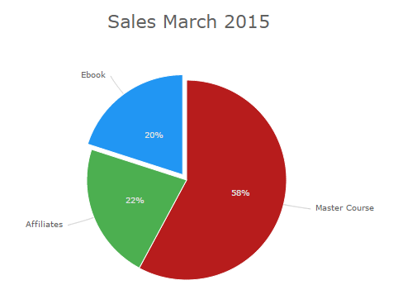
Include d3pie
http://d3pie.org/#download
<script src="d3pie.min.js"></script>
Will save you hours of manual work

Slide 6
Your First Pie Chart
We need a placeholder for D3 to find in the DOM and manipulate with our script
<body>
<div id="pieChart"></div>
</body>
Initialize D3 Pie
<script>
$(function() { var pie = new d3pie("pieChart", { });
}); </script>

Slide 7
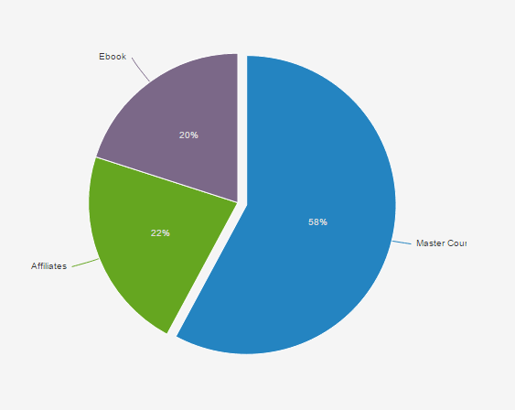
<script> var pie = new d3pie("pieChart", { "data": { "content": [ {"label":"Master Course","value": 2807}, {"label":"Affiliates", "value": 1072}, {"label":"Ebook", "value": 972} ]
} }); </script>

Slide 8
Dynamic Content
Use AJAX to fetch content
$.ajax({
method: "POST",
data: { command: "command sent to job server with k value" },
url: "/path/to/data",
dataType: "json",
success: function (json) {
// magic here
}
});
data
[
{"cluster":0,"label":"Smurf","count":280790, "color":"green"},
{"cluster":0,"label":"Neptune","count":107201, "color":"red"},
{"cluster":0,"label":"Normal","count":97278, "color":"black"},
{"cluster":0,"label":"Back","count":2203, "color":"blue"}
]

Slide 9
success: function (json) {
// initialize empty array
var cluster = [];
for (var i = 0; i < json.length; i++) {
cluster.push({
cluster: json[i].cluster,
label: json[i].label,
value: json[i].count,
color: json[i].color
});
}
var pie = new d3pie("pieChart", {
"data": {
"content": cluster
}

Slide 10
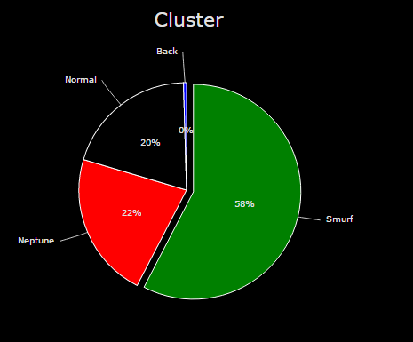
data
[
{"cluster":0,"label":"Smurf","count":280790, "color":"green"},
{"cluster":0,"label":"Neptune","count":107201, "color":"red"},
{"cluster":0,"label":"Normal","count":97278, "color":"black"},
{"cluster":0,"label":"Back","count":2203, "color":"blue"}
]

Slide 11
Full Source Code
https://github.com/christophelimpalair/d3-spark-ajax
Learn More
https://scaleyourcode.com/blog/article/9

