Slide 1
Grid Layout Deep Dive

Slide 2
Recap
Grid Layout is the new layout model for CSS that provides a mechanism to divide a webpage into rows and columns using a set of predictable sizing behavior.
It offers the ability to precisely position and size the building blocks of a webpage with great flexibility and control without requiring markup changes.

Slide 3


Grid layout vs Flex layout
Grid layout optimized for 2-dimensional layouts: those in which alignment of content is desired in both dimensions.
Flex layout focuses on space distribution within a single-axis

Slide 4
Grid layout vs Flex layout
Grid layout is not meant to replace flex layout but they are used together to build complex layout

Slide 5
Grid line, Grid track, Grid cell
Grid line: A line that exists on each side of a row and a column
Grid track: The space between 2 grid lines. A grid track can either be a row or a column
Grid cell: The space between 2 vertical grid lines and 2 horizontal grid lines

Slide 6
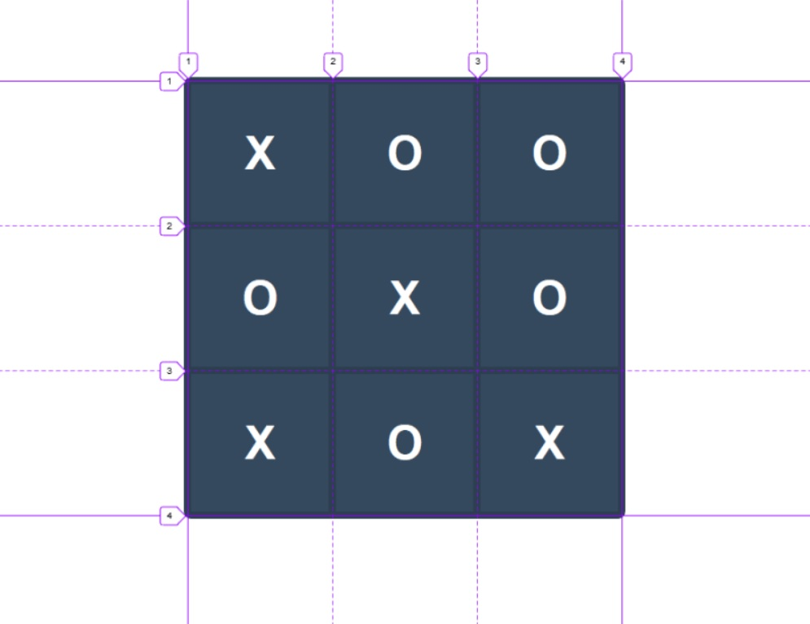

Slide 7
Grid Layout Examples
Web Flow: https://webflow.com/blog/build-css-grid-layouts-visually-in-webflow

