Slide 1
Requirements, Development, Install, and Test for Installer Configuration Folder backups and Tracking History
Define Requirements - VAI 385 - Configuration Requirements for Install, Update, and Uninstall for VIX and CVIX – had several meetings and additional discussion via email.
Development – VAI 423 - Incorporate configuration folder backups into installer
Development – VAI 424 - Create tracking/version history as part of installer to track installs
Integration – VAI 426 - Integration Test for configuration folder backups and tracking history
Test – VAI 427 - Build/Install and Regression Test for Installer Configuration Folder backups and Tracking History

Slide 2
Configuration Requirements for Install, Update, and Uninstall for VIX and CVIX
Different Installation Types to Account for:
New Installation (i.e. server that has never had P254 or any prior PXXX ever installed)
Uninstallation (i.e. removing P254) [The uninstallation normally occurs immediately before the other installation types below].
Upgrade/Update Installation (i.e. server that is upgrading from P249 to P254)
Reconfigure Installation/ Other (Not Standard New or Upgrade Installation) (i.e. server that is having P254 reconfigured on top of existing P254)
Backout Installation (i.e. server downgrade from P254 to P249)

Slide 3
Configuration Requirements for Install, Update, and Uninstall for VIX and CVIX
Overall theme for configuration files – When the installer automates restoring configuration files from prior installs, it should only do so if the settings within that configuration file do not differ from the default settings.
There are rare exceptions to this rule but any such exception should be mutually agreed upon. This becomes more complicated when the default setting begins to change when multiple builds for the same Patch release have occurred.
When considering when to make an exception, one should think through, from the standpoint of an admin doing the install, the question of “Should I be changing this file manually after the install is complete?” If you were to answer with, “I already had this change in the configuration file to begin with, and how could the install process know that wasn’t how I wanted it?” then you should not be making an exception to this rule.

Slide 4
New Installation
The installation creates configuration files needed for the VIX or CVIX Tomcat/Java and .NET web app and services to execute.
If any config values are left TO DO, display a message (such as via the installer wizard/PowerShell pop-up) to inform the user to edit those files and values.
Document in installation guide(s) as a manual step to perform and add any additional details to guide the user how the config value must be edited and how to accomplish this.
Note that if certain configuration files are missing for Tomcat/Java, these files can be created when the particular web app that uses it needs them.

Slide 5
Uninstallation
The installation must back up each configuration file folder (except skip specific subfolders if identified within each configuration file folder), with the date and time in its name, into a folder within a patch version specific folder, prior to uninstalling VIX or CVIX.
This back up includes all configuration file folders needed for the VIX or CVIX Tomcat/Java and .NET web app and services to execute.
The backup is patch specific, i.e. uninstalling P269, the back up is created in C:\VIXbackup\P269.
Note: The uninstallation is normally part of an upgrade/update installation, but can occur on its own by canceling out of the installer wizard after the uninstall is complete and not continuing.

Slide 6
Uninstallation - Configuration File Folder Backups – P269
The following is the list of configuration file folders to backup:
C:\DCF_RunTime_x64\cfg [exclude the folders: apps, components, procs]
C:\Program Files\Apache Software Foundation\Tomcat 9.0\conf
C:\Program Files\VistA\Imaging\VIX.Config
C:\VixCertStore\
C:\VixConfig\ [exclude the folders: logs, ROI, thumbnailMaker, images]

Slide 7
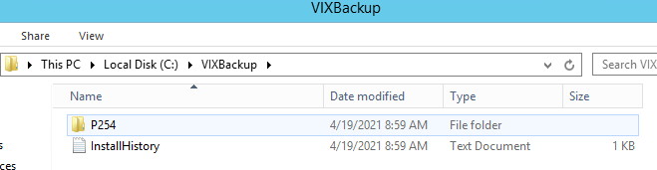
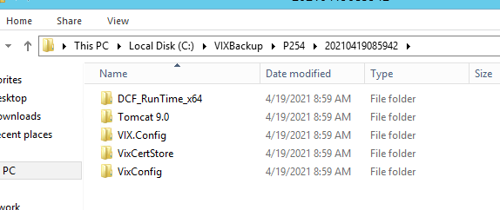
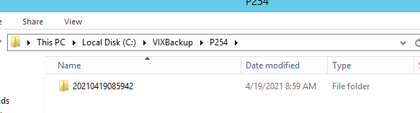
Uninstallation - Configuration File Folder Backups – P269
For example, a backup would occur to C:\ C:\VIXbackup\PXXX\20210419085942.
Inside C:\VIXbackup\PXXX\20210419085942 is DCF_RunTime_x64\cfg, Tomcat 9.0\conf, VIX.Config, VixCertStore, VixConfig.

Slide 8
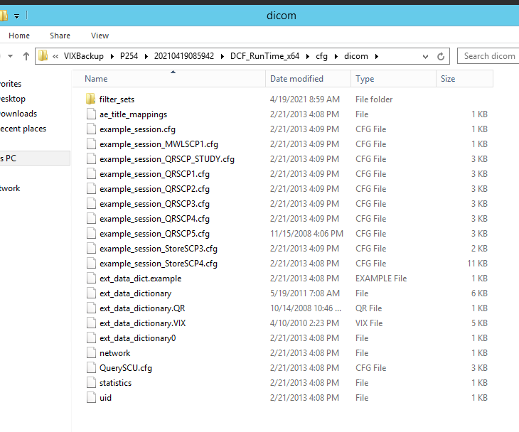
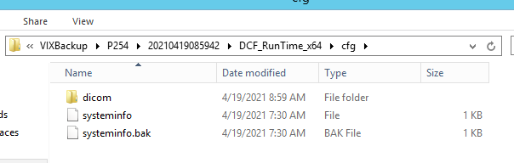
Uninstallation - Configuration File Folder Backups – P269
Inside C:\VIXbackup\PXXX\20210419085942 is DCF_RunTime_x64\cfg, Tomcat 9.0\conf, VIX.Config, VixCertStore, VixConfig.
Note: The important files backed up in DCF_RunTime_x64\cfg are the DicomScpConfig file in C:\DCF_RunTime_x64\cfg\ and the ae_title_mappings file in C:\DCF_RunTime_x64\cfg\dicom.
Note: The DicomScpConfig file is introduced in P269 and thus does not exist in P254 backups.

Slide 9
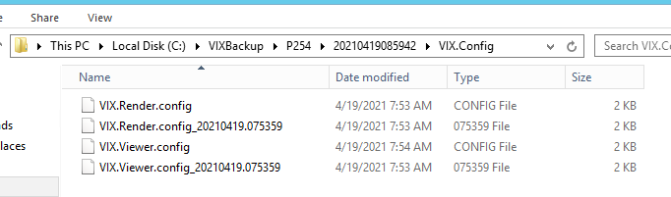
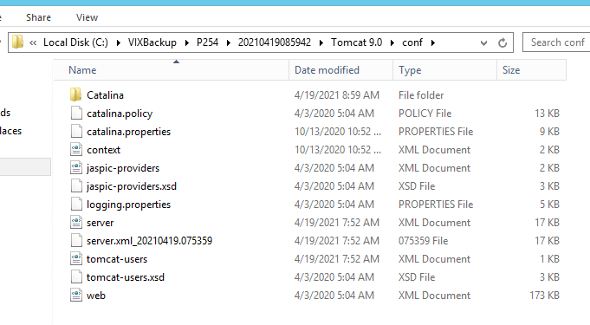
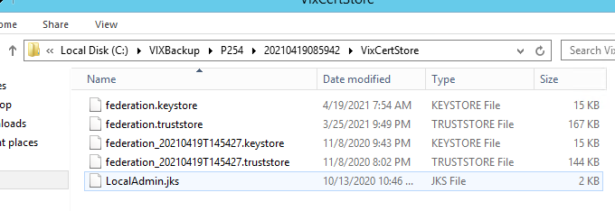
Uninstallation - Configuration File Folder Backups – P269
Inside C:\VIXbackup\PXXX\20210419085942 is DCF_RunTime_x64\cfg, Tomcat 9.0\conf, VIX.Config, VixCertStore, VixConfig.

Slide 10
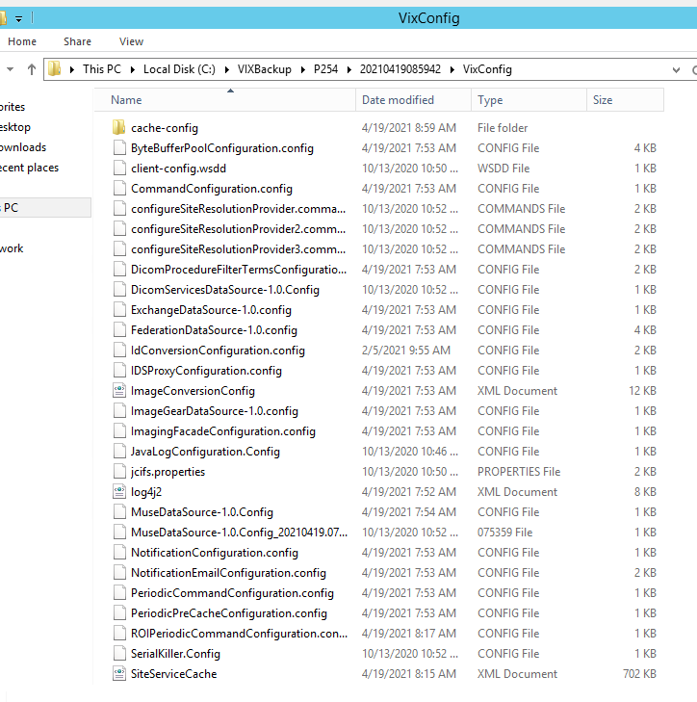
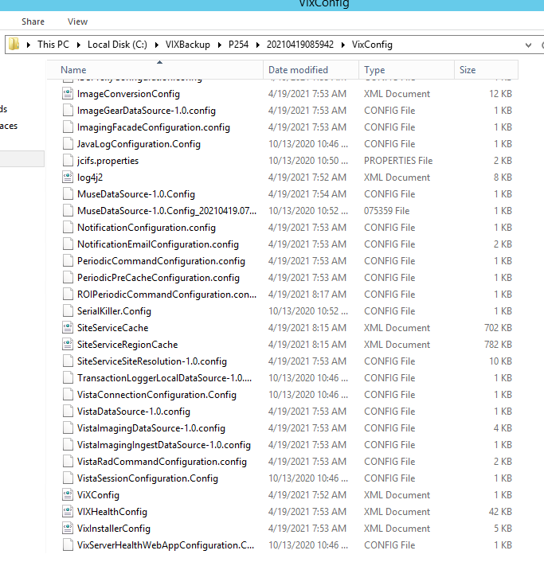
Uninstallation - Configuration File Folder Backups – P269
Inside C:\VIXbackup\PXXX\20210419085942 is DCF_RunTime_x64\cfg, Tomcat 9.0\conf, VIX.Config, VixCertStore, VixConfig.
Note: This is shown for a VIX, the contents of the VixConfig folder is different for a VIX versus a CVIX.

Slide 11
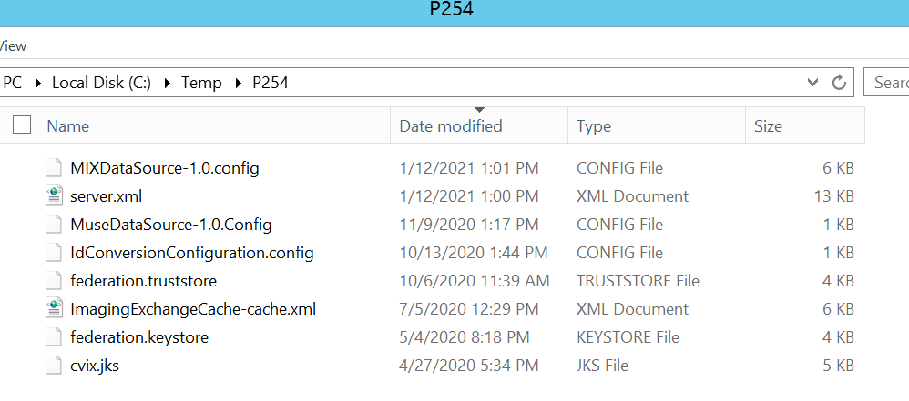
Uninstallation - Configuration File Backups – P254
Note: P254 was handled differently than P269. Instead of configuration file folder backups, specific configuration files were backed up.
For P254, this backup occurred in C:\temp\PXXX

Slide 12
Upgrade/Update Installation
The installation must back up each configuration file folder (except skip specific subfolders if identified within each configuration file folder), with the date and time in its name, into a folder within a patch version specific folder, prior to installing VIX or CVIX.
This back up includes all configuration file folders needed for the VIX or CVIX Tomcat/Java and .NET web app and services to execute.
The backup is patch specific, i.e. upgrading from P254 to P269, the back up is created in C:\VIXbackup\P254.
Note: The upgrade/update installation occurs immediately after an uninstallation, so all bullets above can be thought of as occurring in the uninstallation step for an upgrade/update installation.

Slide 13
Reconfigure Installation/ Other
The same as to what is detailed for the upgrade/update installation, except is able to correctly back-up the right version of the configuration file folder (if a difference is needed).
For example, C:\Program Files\Apache Software Foundation\Tomcat 9.0\conf is backed up into C:\VIXbackup\P254\ 20210201103500\Tomcat 9.0\conf\ for P254 instead of C:\Program Files\Apache Software Foundation\Tomcat 8.0\conf being backed up into C:\VIXbackup\P249\20210201103500\Tomcat 8.0.
Note: This example above is hypothetical and not actually in reality since the configuration file folder backups was not implemented in P254.
Note: The reconfigure installation occurs immediately after an uninstallation, so all bullets above can be thought of as occurring in the uninstallation step for a reconfigure installation.

Slide 14
Backout Installation
In the case of a rollback or backout, perform the uninstallation of Patch BBB. Then perform the installation of Patch AAA. (Note BBB is greater in number than AAA).
The backups for a rollback or backout are not handled automatically. The user must manually place the configuration files in place after Patch AAA is installed again after the rollback/backout is complete, that were previously saved and in place when Patch AAA was last used.
Note these configuration files that were last used with Patch AAA should have been backed up during the installation of Patch BBB when Patch AAA was uninstalled as part of that installation, located in C:\VIXbackup\PAAA and within each configuration file folder with the date and time in its name that corresponds.

Slide 15
Distinguish Patch Number from Configuration Files/Folders that are Backed Up and Track
Log the patch number (i.e. P254) the configuration file folders correspond to.
Put the patch number in the name of the folder that contains the configuration file folders that are backed C:\VIXbackup\PXXX.
Creates a tracking/version history each time an installation occurs.
Creates a text file under C:\VIXbackup that contains the tracking/version history. Each time an installation occurs, append one line in this text file to describe what occurred (i.e. Uninstalled P249. Upgrade Install of P254).
This line also includes the date and time and user account.
This is useful so we can see what patches were applied or not applied, and how many times this occurred, more readily for troubleshooting.

Slide 16
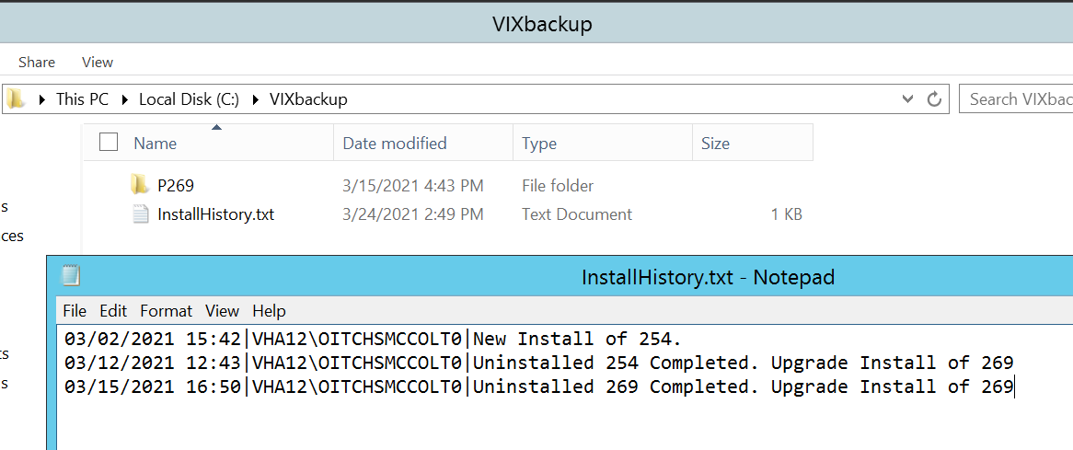
Distinguish Patch Number from Configuration Files/Folders that are Backed Up and Track
Create a tracking/version history each time an installation occurs.
New Install indicated as “New Install of XXX”.
Upgrade/Update Installation or Reconfigure Install indicated as “Uninstalled XXX Completed. Upgrade Install of XXX”

Slide 17
Deletion of Configuration File Folder Backups and Tracking History
The tracking history text file is not to be deleted.
The configuration file folder backups are to be maintained for a period of time.
After a certain time period (i.e. 3 years or more) (could also do number of releases) old configuration file folder backups zipped up into a .zip file can be deleted. [Currently this is manual, can be automated in the future, requires additional development.]
The tracking history text file should be kept indefinitely.

Slide 18
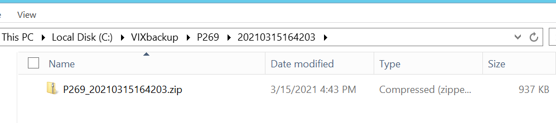
Configuration File Folder Backups Zip File – P269
Before a new backup of configuration file folders with the date and time in its name is created in the folder within a patch version specific folder such as C:\VIXbackup\P269\20210315164203, it is zipped up to a .zip file such as P269_20210315164203.zip inside C:\VIXbackup\P269\20210315164203 to preserve disk space.
This occurs when there are multiple installs of the same patch.

Slide 19
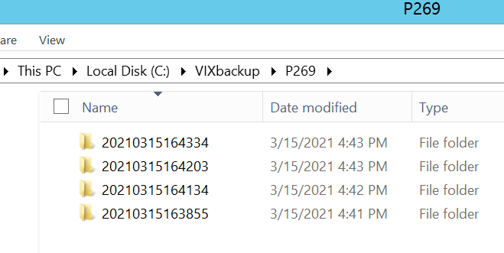
Configuration File Folder Backups Zip File – P269
If there are multiple folders with the date and time in its name, the most current folder (based on the timestamp in the filename, which can be sorted correctly by name so the most current is first) should not be zipped up, but any others if exist should be.

Slide 20
New Configuration File Introduced
If a new configuration file is introduced with the patch, a commit to the feature branch in GitHub can contain information regarding this.
Others on the Imaging Team should be aware this new configuration file is being introduced before the first build of the patch occurs.
An email and discussion about the new configuration file with others certainly can occur before the code is committed to GitHub so parallel efforts to develop can occur.

Slide 21
HDIG team coordination
If we are changing the VIX or CVIX (such as PowerShell script changes or C# changes in VIX Installer), normally we do not have to coordinate with the HDIG team.
HDIG team creates their own patch number after we release PXXX and merges the changes in.
If we have a substantial change to our process, such as no longer just providing a single MSI file for installation, then we need to coordinate with HDIG team.

Slide 22
Install and Test for Installer Configuration Folder backups and Tracking History
Plan Forward to Test?
Additional Thoughts?
Questions?

