Slide 1
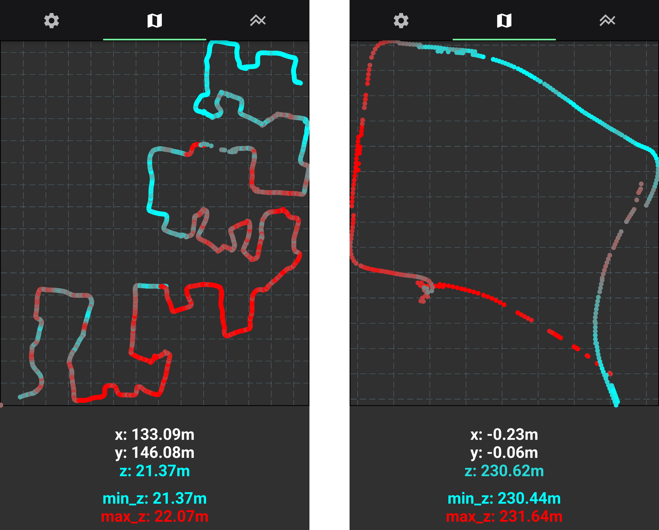
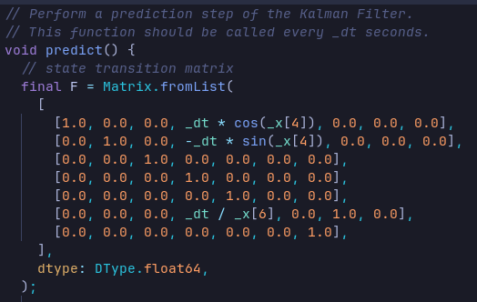
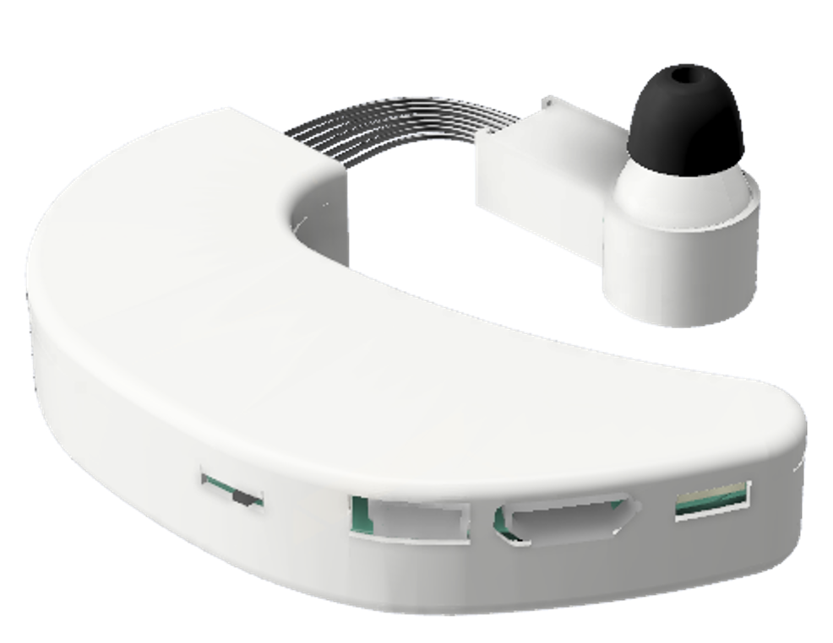
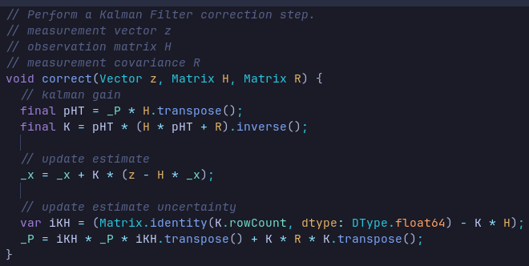
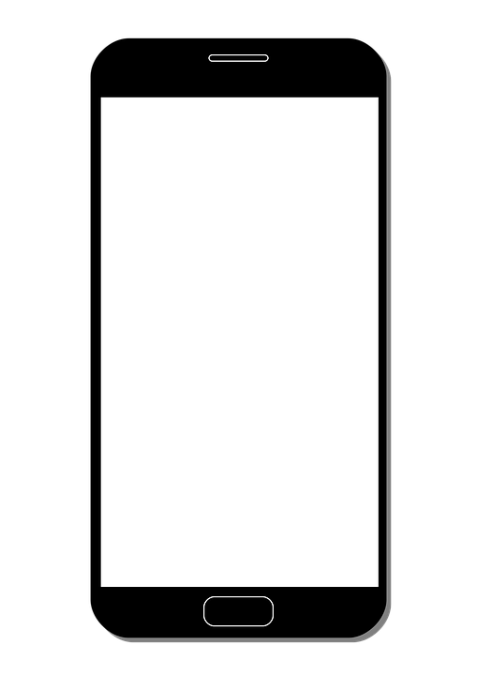
Matrikelnummer: 1234567
Christopher Besch
earable_pdr
Map your walked path without GPS
Earable → heading
Phone in pocket → walking pace
Examples
Kalman Filter
Old
System State
Prediction Step
New
System State
Earable
Correction Step
IKEA
Square
Phone

