Slide 1
Why Not Everything Needs to Be a Class
Christopher Bolger – 3rd Year Computer Science – Game Development
Notes:
Intro self
Name, course
Like games & programming
Senior Mentor here to deliver workshop

Slide 2

Resources
Slides available to download:
https://github.com/christopher-bolger/OOPWorkshop
Notes:
https://github.com/christopher-bolger/OOPWorkshop
Saw people struggle with the translation between brief and something that can actually be implemented in code
Throw questions at me

Slide 3
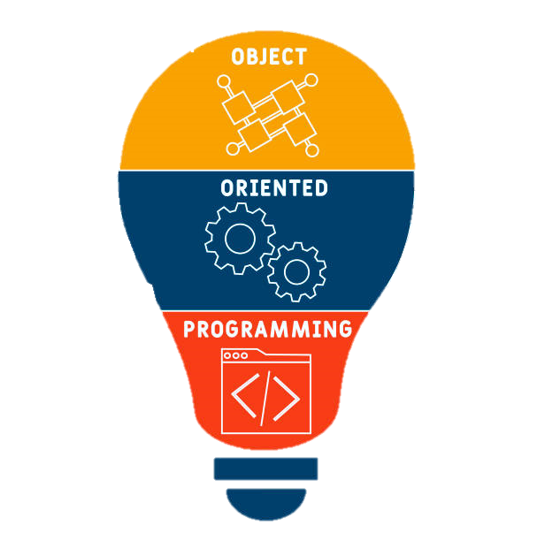
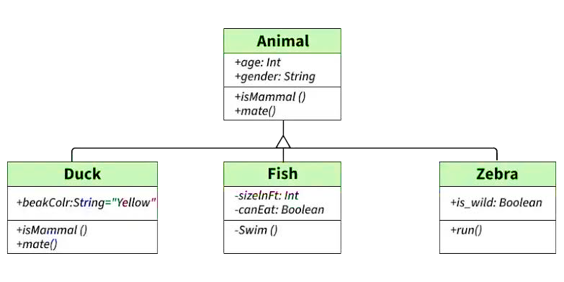
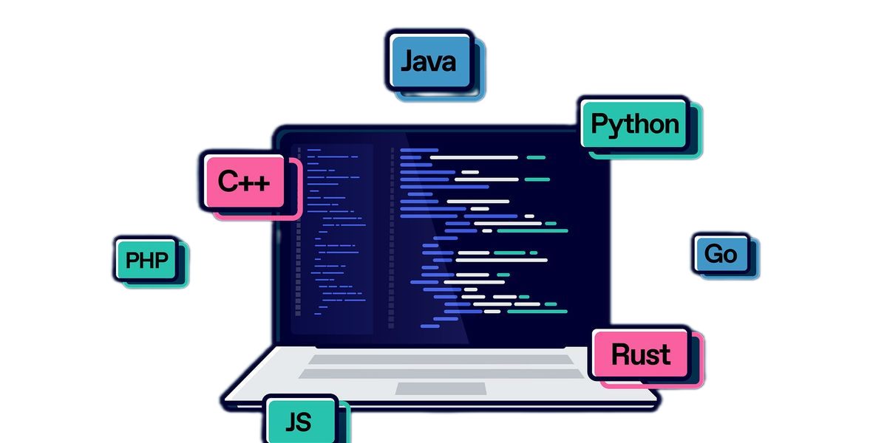
Workshop Aim
Identify Classes
Create relationships between objects
Designing around requirements
Notes:
Does everyone have something they can write on or take a quick note with? One small class exercise.

Slide 4
What is OOP?
Object-Orientated Programming
Notes:
Q: Anyone know what it is or means?
Structure? Class/Method/Attribute/Object
Principles? Encapsulation/Abstraction/Inheritance/Polymorphism

Slide 5




Object-Orientated Structure
Class
Object
Method
Attribute
Notes:
Q: Can anyone describe what a Class/Object/Method/Attribute is?
Can you give an example of one?

Slide 6
Object-Orientated Structure
Class
Object
Method
Attribute
Blueprint for an item
The specific item
An item's function(s)
An item’s description
Notes:
Alternative descriptions (Class -> Attribute -> Method -> Object)
Class:
The defining structure for any item
Attribute:
The characteristics that define an instance of a class (size, weight etc.)
Method:
How that instance will act, when called upon (e.g. stomach rumbles -> think I'm hungry [Input -> output])
Object:
Person is a class, Christopher (me) is an object

Slide 7
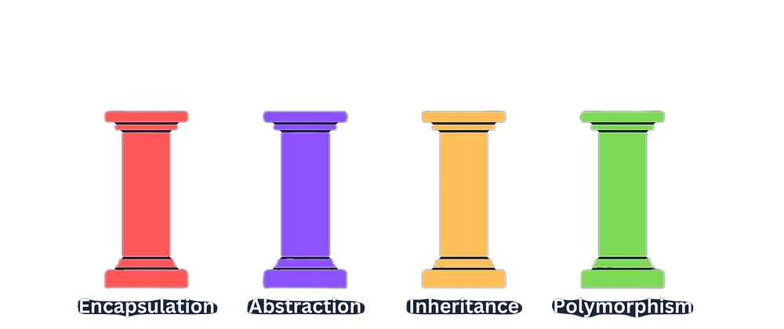
Object-Orientated Principles
Very very briefly…
Encapsulation:
Private data should stay private; It should only be manipulated by the object that owns it (calling getter/setter methods).
Abstraction:
Inner workings should remain hidden. The end user should only see the result of the work done, not the process.
Inheritance:
Prevents repetition by allowing an object to inherit its features, properties and methods from another while building additional functionality
Polymorphism
Allows child classes to override or overload parent features, attributes or functionality.
Notes:
Relatable example:
Encapsulation:
Your thoughts are private to you
Can’t put a thought into another person
Nor can you remove one
Cannot directly access someone else’s thoughts
Abstraction:
You don’t add 5 + 5 out loud
You know how to use addition without needing to know how a CPU performs addition
Inheritance:
You’ve inherited characteristics from your parents.
Eye colour, height, genetic dispositions etc.
Polymorphism:
If I asked a person to introduce themselves, every person I ask would do it differently.

Slide 8

Why is OOP useful?
Makes translating the real world easier
Most things are built layer-by-layer
Things have functions - your phone sends and receives calls, texts as well as calculates sums, keeps time etc etc.
Humans naturally think about the world in terms of objects and responsibilities
  You don’t try to make a call from your hand - because your hand does not have that function (duh).
  Similarly, you don’t try to pick up a knife and fork with your phone.
Engines have engine blocks, pistons, pipes, pumps, belts, gears, screws. Each of these things added one on top of the other creates the whole.
Houses have foundations, block/timber framing, rafters/trusses, plaster, tiles etc etc
  But things are done in a specific order
OOP emulates that physical order in a programmatic way
Notes:
Draw to board:
(Simple example)
Die Roller program:
A program that rolls a specified number of user-defined die and stores list of previous rolls for each player on the table,
DICE / ROLL / DIEROLLER / PLAYER / GAMEMANAGER
Class Q’s:
Name possible classes
Name possible attributes of class
Name possible methods of class
Dice class
minNum
maxNum
Roll()
Roll class
Saves output of any roll into an integer array representing the result of each roll
Get()
getMinimum()
getMaximum();
isGreaterThan(int thrshld, String “MIN/MAX/AVG”);
isLessThan(int thrshld, String “MIN/MAX/AVG”);
DieRoller
Dice list
newRoll()
getDice()
setDice()
GameManager
Player list
DieRoller
roundNum
Map<Player, List<Roll>>
getRound(int)
newRound()
Main
Handle I/O
(new game / game output / history fetch)

Slide 9
Modelling Exercise
Notes:
Notice we've ended up with several classes that each have a specific responsibility.
The next exercise we're about to do follows exactly the same process, only in a different context.

Slide 10

Custom Car Dealership
A custom car dealership allows customers to build a car by choosing an engine, body style, color and wheels. You are tasked with building this system.
Notes:
CLASS EXERCISE – 2 Minutes to think about what Objects are identified in the brief
- Tip: Look for nouns – words that name something concrete
What possible objects are identified in the brief? (WRITE ALL DOWN ON BOARD)
Which of these should be classes?
(Dealership, Customer, Order, Car, Engine, Body and Wheel)
2 More minutes to think of a couple of methods for any of the given objects
- What function does each object serve?
1 More minute to think of object attributes after we have listed our objects & methods
Which attributes belong to x/y/z – why?

Slide 11

The Artist’s Mannequin
How many individual components can you see?
Who is it aimed towards?
  What might they want to do with it?
Does it have all the same components as you?
  Or is it just a representation of your shape?
Design around the responsibilities you need to fulfill, not around every detail/function that is possible.
Notes:
Head, neck, torso sections, arm sections, leg sections
Aimed at artists
Practice composing / drawing humanoid shapes
It doesn’t have eyes, organs etc
Implementing these would be time and effort, and an order of magnitude more work
But it does have joints and rotatable sections
Implementing these will aid in its usage
Advice: Think only within the bounds of the requirements but go to town on them.

Slide 12
Custom Car Dealership
A custom car dealership allows customers to build a car by choosing an engine, body style, color and wheels. You are tasked with building this system.
Notes:
Use new perspective to see what we could cut
Link classes logically to create a flow for the program
Open IntelliJ with code if I have time (and maybe add suggested method/function)
Wrap up and summarize what we’ve just done
Speak about the order in which we did things
1: Read the brief and picked out nouns
2: Decided what kind of methods those classes would have that serve the purposes of the brief
3: derived the attributes of each class based on the function that it was designed for
4: created concrete definitions and logical order to the classes and systems
We’ve also had a quick look at OOP and its definitions.
With this stuff together, we have now successfully translated a client brief into an object-orientated design that can now be implemented programmatically.

Slide 13
Why Not Everything Needs to Be a Class
Christopher Bolger – 3rd Year Computer Science – Game Development
Notes:
Thanks for time
Take pic of board on way out for github

Slide 14
Sources
https://codeinstitute.net/global/blog/object-oriented-programming/
https://medium.com/free-code-camp/object-oriented-programming-concepts-21bb035f7260

Slide 15

Resources
Demo Code available to download:
https://github.com/christopher-bolger/CarDealership

