Slide 1
From Idea to Implementation
Christopher Bolger
3rd Year Computer Science
Game Development
Notes:
Intro self
Name, course
Like games & programming
Senior Mentor here to deliver workshop

Slide 2

Resources
Slides available to download:
https://github.com/christopher-bolger/UMLWorkshop
Notes:
https://github.com/christopher-bolger/OOPWorkshop
Saw people struggle with the translation between brief and something that can be implemented in code
Throw questions at me

Slide 3
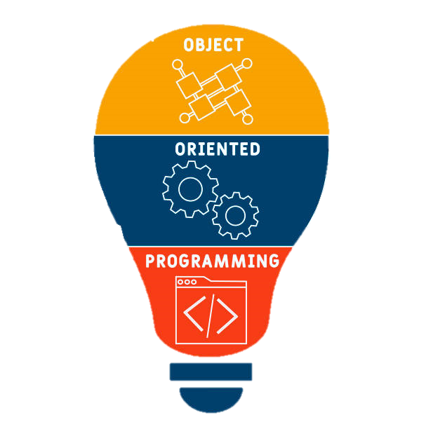
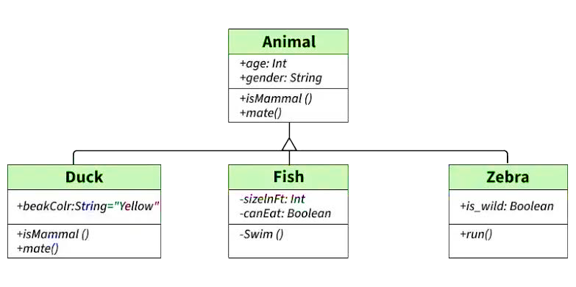
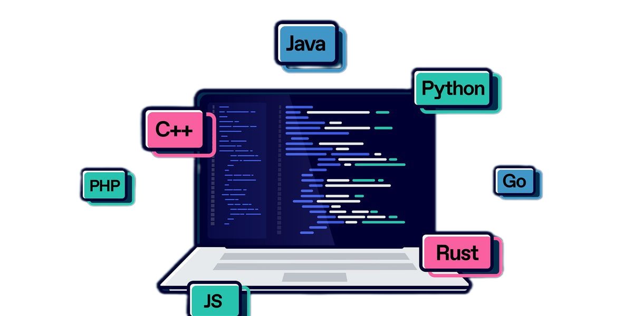
Workshop Aim
Identify requirements from a brief
Create objects and relationships
Design within the requirements
Notes:
- Help you deconstruct program requirements into implementable classes in any OOP language
Does everyone have something they can write on or take a quick note with? One small class exercise.

Slide 4
What is OOP?
Object-Orientated Programming
Notes:
Q: Anyone know what it is or means?
Structure? Class/Method/Attribute/Object
Principles? Encapsulation/Abstraction/Inheritance/Polymorphism

Slide 5




Object-Orientated Structure
Class
Object
Method
Attribute
Blueprint for an item
The specific item
An item's function(s)
An item’s description
Notes:
Q: Can anyone describe what a Class/Object/Method/Attribute is?
Can you give an example of one?

Slide 6

Why is OOP useful?
Makes translating the real world easier
Most things are built layer-by-layer
Humans naturally think about the world in terms of objects and responsibilities
  You don’t try to make a call from your hand - because your hand does not have that function.
Engines have engine blocks, pistons, pipes, pumps, belts, gears, screws. Each of these things added one on top of the other creates the whole.
Notes:
So why do you need to know this?
Because we’re going to try deconstruct a couple of problems down to their basic objects and relationships

Slide 7
Worked Example
Notes:
Draw to board:
(Simple example)
Die Roller program:
A game rolls a specified number of die and stores previous rolls for each player on the table
DICE / ROLL / DIEROLLER / PLAYER / GAMEMANAGER
Class Q’s:
Name possible classes
Name possible attributes of class
Name possible methods of class
Dice class
minNum
maxNum
Roll()
Roll class
Saves output of any roll into an integer array representing the result of each roll
Get()
getMinimum()
getMaximum();
isGreaterThan(int thrshld, String “MIN/MAX/AVG”);
isLessThan(int thrshld, String “MIN/MAX/AVG”);
Player
Name
Balance
DieRoller
Dice list
newRoll()
getDice()
setDice()
GameManager
DieRoller
roundNum
Map<Player, List<Roll>>
getRound(int)
newRound()
Main
Handle I/O
(new game / game output / history fetch)

Slide 8
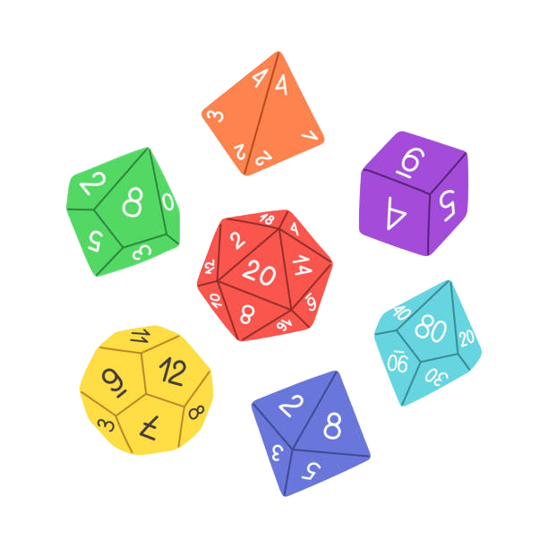
Dice Roller Game
A client wants us to create a die roller game. They want to roll a given number of dice for a given number of players, record the rolls & want the ability to see who rolled the highest & lowest.
Notes:
How to deconstruct? Line by line, looking for things like nouns and responsibilities

Slide 9
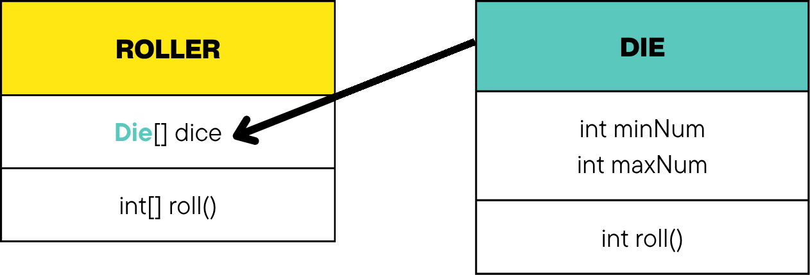
Dice Roller Game
“They want to roll a given number of dice”
Notes:
Roll a single die requires nothing other than the die – to roll multiple it’s normal to have some container to roll them with, be it even your hands

Slide 10
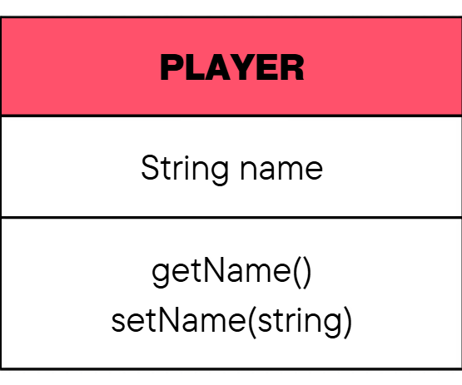
Dice Roller Game
“for a given number of players”
Notes:
Nothing really specific needed

Slide 11
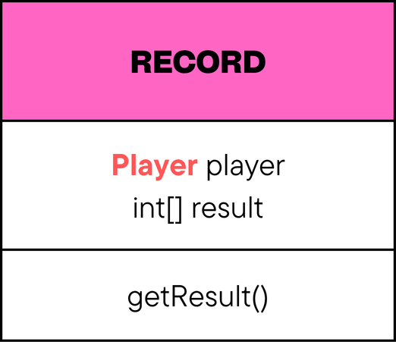
Dice Roller Game
“record the rolls”
Notes:
To record a roll we need to know two things – whose roll it was and what the result of that roll was
We might eventually need to know what round it was, but that’s not clear now so we won’t include it.

Slide 12
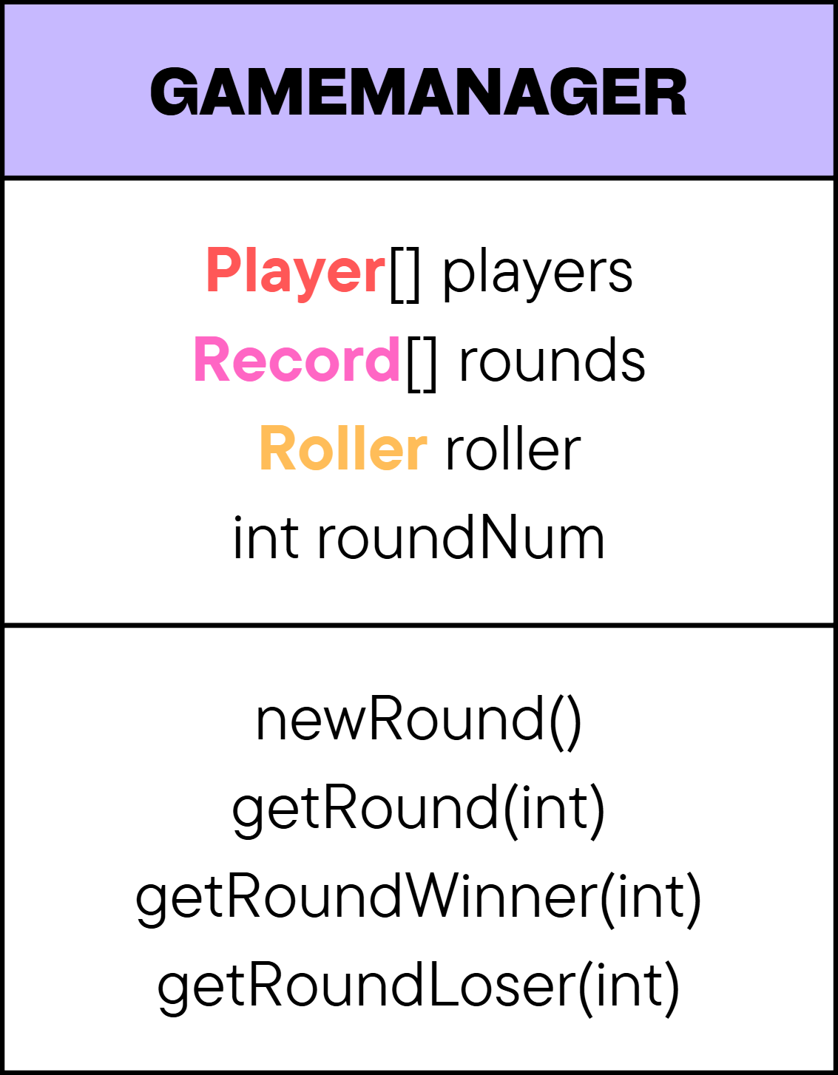
Dice Roller Game
“who rolled the highest & lowest”
Notes:
Something needs to know who wins and loses?
Since this is a game maybe this is a suitable name
Also suitable place to store other relevant information related to what the client wants

Slide 13
Dice Roller Game
A client wants us to create a die roller game. They want to roll a given number of dice for a given number of players, record the rolls & want the ability to see who rolled the highest & lowest.
Notes:
Go over highlighted pieces to demonstrate how we extracted the information

Slide 14
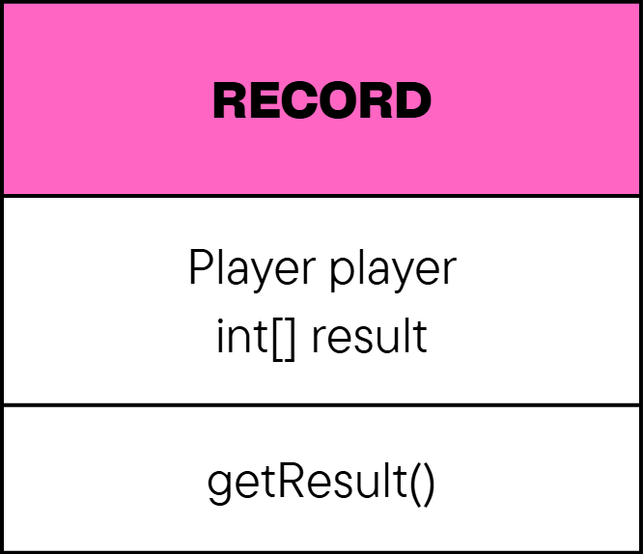
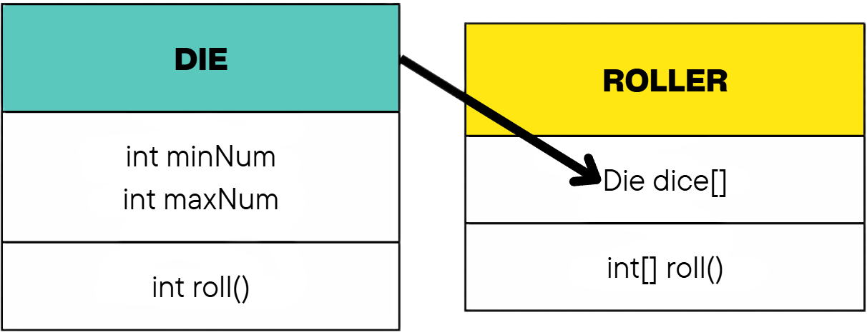
Dice Roller Game
Notes:
So we now have all these pieces, how do we link them together and where should they go?

Slide 15
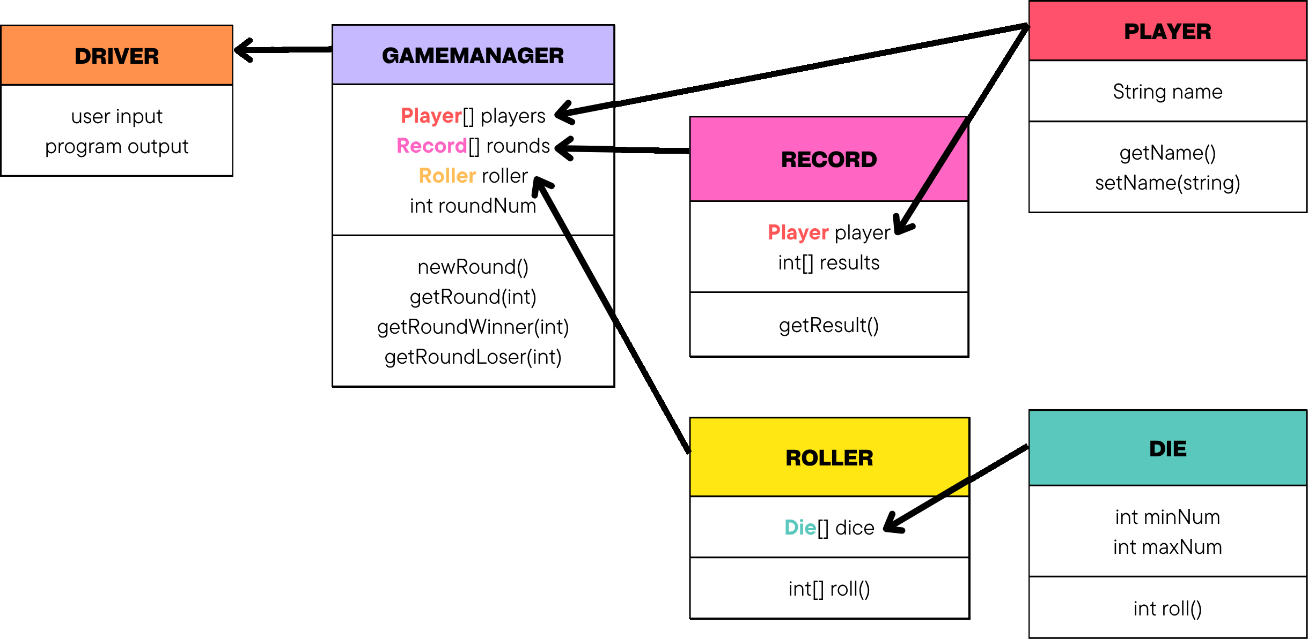
Putting Everything Together
Notes:
Notice we've ended up with several classes that each have a specific responsibility.
The next exercise we're about to do follows exactly the same process, only in a different context.

Slide 16
Class Exercise
Groups of 3-4
Notes:
Q: Anyone know what it is or means?
Structure? Class/Method/Attribute/Object
Principles? Encapsulation/Abstraction/Inheritance/Polymorphism

Slide 17

Custom Car Dealership
A custom car dealership allows customers to build a car by making an order: choosing an engine, body type, colour and wheels. The dealership wants you to build this system.
Notes:
CLASS EXERCISE – 2 Minutes to think about what Objects are identified in the brief
- Tip: Look for nouns – words that name something concrete
What possible objects are identified in the brief? (WRITE ALL DOWN ON BOARD)
Which of these should be classes?
(Dealership, Customer, Order, Car, Engine, Body and Wheel)
2 More minutes to think of a couple of methods for any of the given objects
- What function does each object serve?
1 More minute to think of object attributes after we have listed our objects & methods
Which attributes belong to x/y/z – why?
1 or 2 more minutes to think about how these things relate
Customer places Order contains Car has Engine/Body/Wheels
Store in CarDealership
Use new perspective to see what we could cut
Link classes logically to create a flow for the program
Open IntelliJ with code if I have time (and maybe add suggested method/function)
Wrap up and summarize what we’ve just done
Speak about the order in which we did things
1: Read the brief and picked out nouns
2: Decided what kind of methods those classes would have that serve the purposes of the brief
3: derived the attributes of each class based on the function that it was designed for
4: created concrete definitions and logical order to the classes and systems
We’ve also had a quick look at OOP and its definitions.
With this stuff together, we have now successfully translated a client brief into an object-orientated design that can now be implemented programmatically.

Slide 18
Custom Car Dealership
A custom car dealership allows customers to build a car by making an order: choosing an engine, body type, colour and wheels. The dealership wants you to build this system.
Notes:
CLASS EXERCISE – 2 Minutes to think about what Objects are identified in the brief
- Tip: Look for nouns and responsibilities
What possible objects are identified in the brief? (WRITE ALL DOWN ON BOARD)
Which of these should be classes?
(Dealership, Customer, Order, Car, Engine, Body and Wheel)
2 More minutes to think of a couple of methods for any of the given objects
- What function does each object serve?
1 More minute to think of object attributes after we have listed our objects & methods
Which attributes belong to x/y/z – why?
1 or 2 more minutes to think about how these things relate
Customer places Order contains Car has Engine/Body/Wheels
Store in CarDealership
Use new perspective to see what we could cut
Link classes logically to create a flow for the program
Open IntelliJ with code if I have time (and maybe add suggested method/function)
Wrap up and summarize what we’ve just done
Speak about the order in which we did things
1: Read the brief and picked out nouns
2: Decided what kind of methods those classes would have that serve the purposes of the brief
3: derived the attributes of each class based on the function that it was designed for
4: created concrete definitions and logical order to the classes and systems
We’ve also had a quick look at OOP and its definitions.
With this stuff together, we have now successfully translated a client brief into an object-orientated design that can now be implemented programmatically.

Slide 19
From Idea to Implementation
Christopher Bolger
3rd Year Computer Science
Game Development
Notes:
Sum up:
Aim: Identify objects & objectives, design between and around them
OOP Structure
Die Roller Game Example
Dealership Class Exercise
Better deconstruction skills
Thanks

