Slide 1
Christopher Wilke
Thomas Sowa
Ramón Diegel
Dirk Brinkmann
Microsoft Frontier Company
Hackathon FY27
FinOps for Agents

Slide 2
What’s the challenge?
Why do we need a solution for agent dedicated FinOps – what is the customer need?

Slide 3
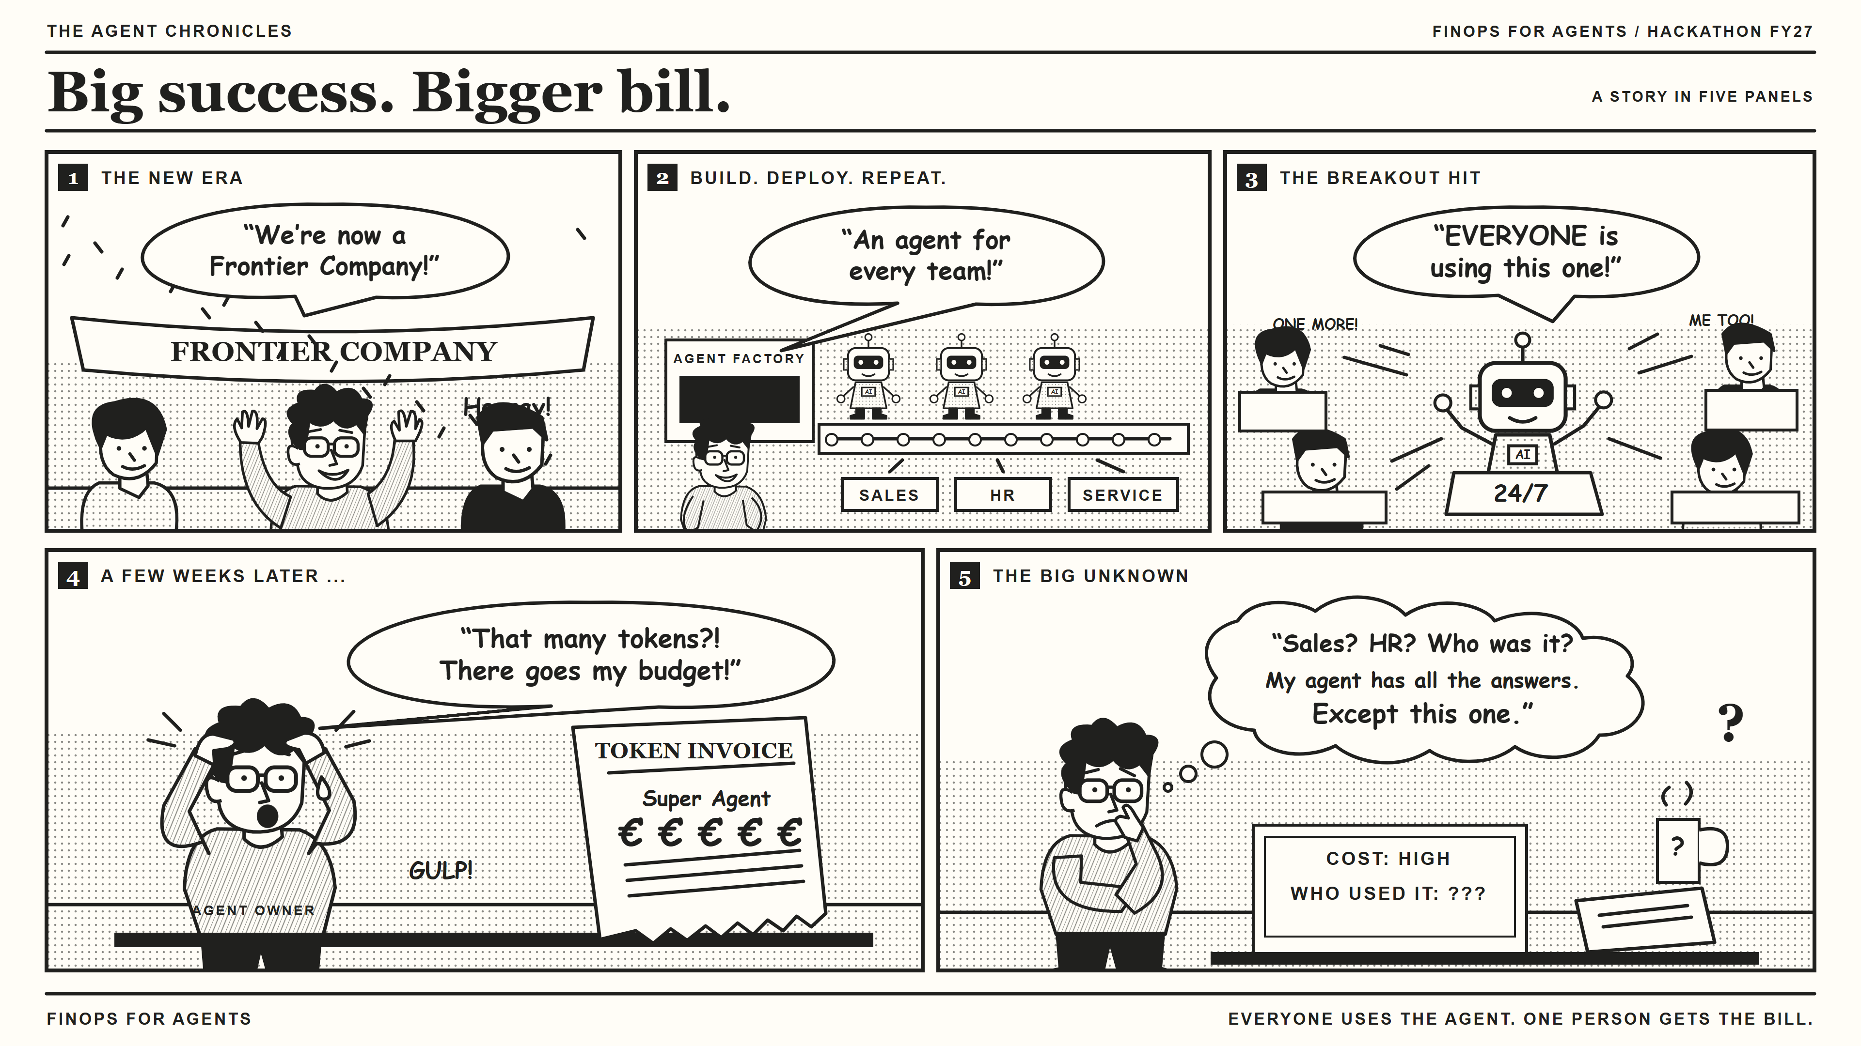
Notes:
Our story starts with a success. A company becomes a Frontier Company, teams build agents, and one of those agents becomes incredibly popular. That is exactly what we wanted.
Then the token bill arrives.
The owner knows the agent is being used—but cannot tell which teams and users are driving the cost. Suddenly, a success story becomes a financial guessing game.
Our hackathon project tackles that gap: not stopping agent adoption, but making its costs explainable.
Transition: What if the cost trail started with the interaction itself?

Slide 4
Give every agent interaction a cost trail.
FinOps for Agents
Big customers, becoming Frontier Companies, bring hundreds of agents to life. With the help of ISD and CSU, they enable the whole company to deploy, publish and use those agents. But what happens, if the agent, provided by my department causes unpredicted costs due to heavy usage?
Our customers are demanding a solution to track down the agent costs to users or departments for their internal billing.
WHO
User + department
WHAT
Agent + model + tokens
HOW MUCH
Estimated token cost
A foundation for showback, chargeback, and better decisions.
Hackathon reference implementation · Estimates, not invoice reconciliation
Notes:
FinOps for Agents connects three things that are often separated: who used an agent, what the agent consumed, and the estimated cost of that consumption.
We capture identity in the interaction flow, combine it with the usage reported by the model, and create a structured cost record.
That gives agent owners a foundation for showback and allocation discussions. It also helps them investigate usage and plan budgets.
The important distinction is that we estimate token cost. We are not replacing Azure billing or claiming invoice reconciliation.
Transition: Here is how we connect those pieces.
Source: github.com/christopher-wilke-ms/finops-for-agents (architecture, components, limitations).

Slide 5
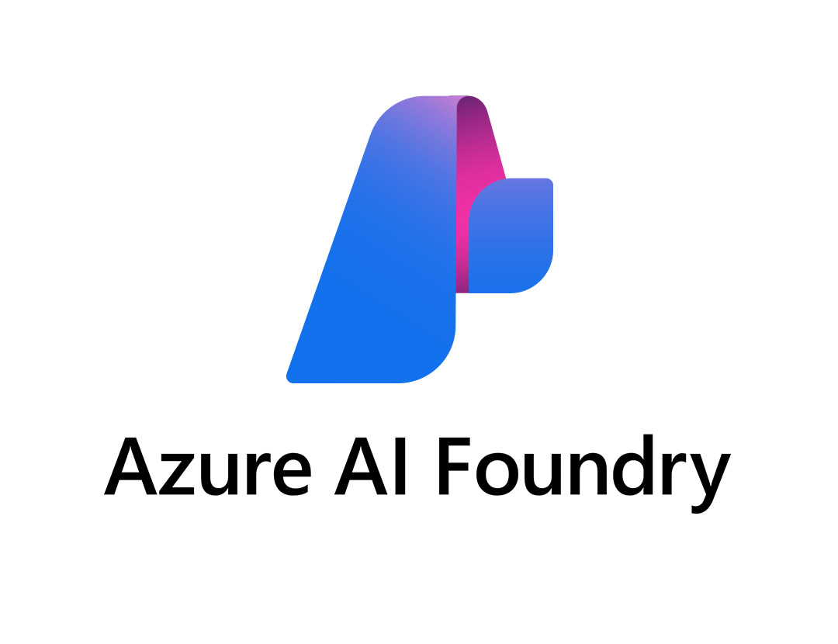
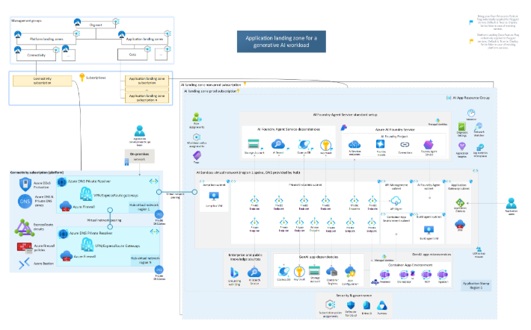

Isn’t there such a feature, yet?
FinOps for Agents
ISD Germany + Austria
AI Foundry Product Group
AI Landing Zone V-Team
Reach out to the architect's community in DE and AT, about such a solution – answers have been:
“I have not seen such a solution so far, but my customer will need that definitely!”
“My customer has already run into that issue – please let us know, if you have found a solution!”
Reach out to the Foundry Product Group about adding such a FinOps feature to Foundry?
“It is not on the roadmap, yet.”
Intense discussions about the use case itself and whether such a feature should be part of the product, the AI Landing Zone or left to the customer led to:
“Reach out to the PG and let us know, when you’ve built such thing. We definitely see the use case for that.”

Slide 6
Our solution
What have we designed and built to tackle that? How are we going to make our Agent Owner happy again?

Slide 7
Capture once. Explain it three ways.
FinOps for Agents
Teams user
Bot service
Foundry agent
We record the usage of an agent by tracking the bot service communication. We put the incoming information of the user query and the agent’s answer into Log Analytics, including the meta data about token usage and model selection.
By connecting the Azure Retail Price API and Entra/Graph, the collected meta data can be mapped to real prices and users as well as their respective departments.
usage
THREE WAYS TO READ
Microsoft Graph
Identity + usage + pricing
Visualize
Azure Workbook
Azure Retail Prices API
identity enrichment · supported-model rates
FOCUS-aligned cost record
Integrate
REST API
Azure Log Analytics
Ask
MCP tools
Current integration: Teams + Microsoft Foundry · Estimated costs
Notes:
The current implementation starts with a Teams message routed through our bot service to a Microsoft Foundry agent.
Microsoft Graph supplies organizational context, while the agent response supplies usage information. The pricing component looks up supported-model retail rates, including cached-input pricing, with a fallback when necessary.
We build and validate a FOCUS-aligned record and send the reporting fields into Azure Log Analytics.
From there, the data has three entry points: an Azure Workbook for visual analysis, a REST API for applications and scripts, and MCP tools for natural-language questions.
The reusable idea is the data pipeline. The current adapter is Teams and Foundry.
Transition: The project brings that architecture into concrete components.
Sources: pricing.py (retail-price lookup, caching, model mapping, static fallback); finops_metrics.py (record construction, Log Analytics payload).

Slide 8
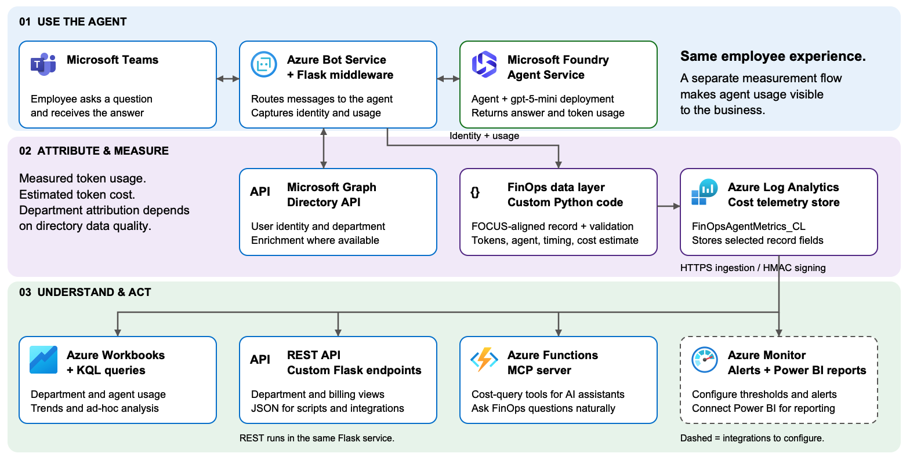
The architecture behind
FinOps for Agents

Slide 9
From a conversation to a cost breakdown.
OUR HACKATHON DELIVERABLES
“Which departments used this agent—and what did that usage cost?”
1
CAPTURE
2
ATTRIBUTE
3
EXPLORE
Teams + Foundry integration
Model-reported token usage
Identity-enriched usage records
Supported-model cost estimates
Workbook, REST API, MCP
Department and user views
Demo setup is deployed and presentation ready
Implemented in the repository · Live demo available on FDPO / Visual Studio subscription
Notes:
The implementation connects three stages.
First, capture: a Teams interaction reaches the Foundry agent, and we collect its reported token usage.
Second, attribution: we combine that usage with the user's organizational context and supported-model pricing.
Third, exploration: the Workbook gives visual breakdowns; REST exposes usage and department billing views; MCP lets an assistant query departments and top users.
That changes the conversation from 'Why is this agent expensive?' to 'Which departments and users are driving its consumption?'
These components are in the repository. A live walkthrough needs the corresponding services configured, and the numbers remain estimates rather than reconciled invoice amounts.
Optional demo (only if the environment is prepared; do not add another slide): send one ordinary request; show an ingested or previously captured record; show the department breakdown in the Workbook or REST response; ask via MCP 'Which departments used this agent in the last 30 days?'; point to the relationship between usage, department, and estimated cost. Allow for ingestion delay and say so if using a previous request; do not imply instant end-to-end updates or invent a live answer.
Transition: The hackathon also made the remaining work very clear.
Sources: repository components, REST endpoints, MCP tools; dashboards/finops-dashboard.json.

Slide 10
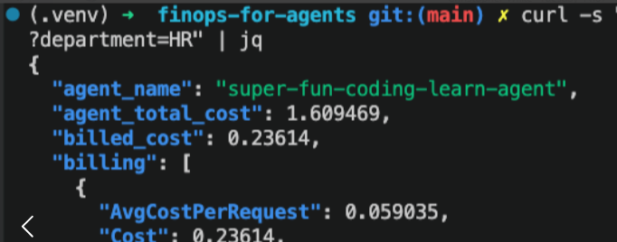
Can I get the check, please?
FinOps for Agents
Log Analytics
Billing details are stored to Log Analytics for custom views and analysis or PowerBI dashboard connection.
REST-API
Customers want to consume such information via classic
REST-API’s – we’ve implemented that quite easy:
customersAgentHub/finOpsAgent/agent/tennisCoach/billing?department=HR
Agentic Access
Provide the information via an agent itself, that connects to the Log Analytics data foundation
“How much costs have the HR department created this months by using the TennisCoach agent?”

Slide 11
What’s happening next?
How do we leverage that? Will that be shipped to all interested Agent Owners in the Foundry cosmos?

Slide 12
Learnings and Limitations
FinOps for Agents
Token Cost vs. Total Cost of Ownership (TCO)
Using the Azure Retail Price API is a nice indication but may not reflect the real costs. Customers often have discounts or PTUs in place that may differ from the public prices.
Focussing on token costs only is not enough. Agents usually rely on other services and data sources, causing another costs.
Giving the agent owner rather a distribution of the agent usage might be helpful so that he/she can calculate that against the complete TCO.

Slide 13
The foundation is built. Trust is next.
FinOps for Agents
We connected agent usage to a cost-attribution workflow.
COMPLETE THE PICTURE
MAKE IT RELIABLE
EXTEND THE REACH
DEPLOY
SPREAD THE WORD
Resolve missing attribution
Reconcile estimated costs
Secure access and resilient ingestion
Harden for production
Add non-Teams channels
Explore agent-to-agent usage
Bring the solution live to a real-world customer scenario.
First: Commerzbank (Germany)
Present the solution to Product Group, ISD & CSU teams and the AI Landing Zone V-Team
Notes:
The hackathon result is a foundation: a connected workflow from agent usage to cost attribution.
The next challenge is trust. Missing or inconsistent department information must remain visible rather than disappearing into a misleading total. Cost estimates need reconciliation before financial settlement.
We also need production-grade access controls and reliable ingestion.
Beyond that, the pattern should extend to agents used outside Teams, including agent-to-agent scenarios. That is future scope, not a completed integration.
Our recommendation is simple: validate with one real team, make attribution and reconciliation trustworthy, and then scale.
Transition: Which brings us back to our agent owner.

Slide 14
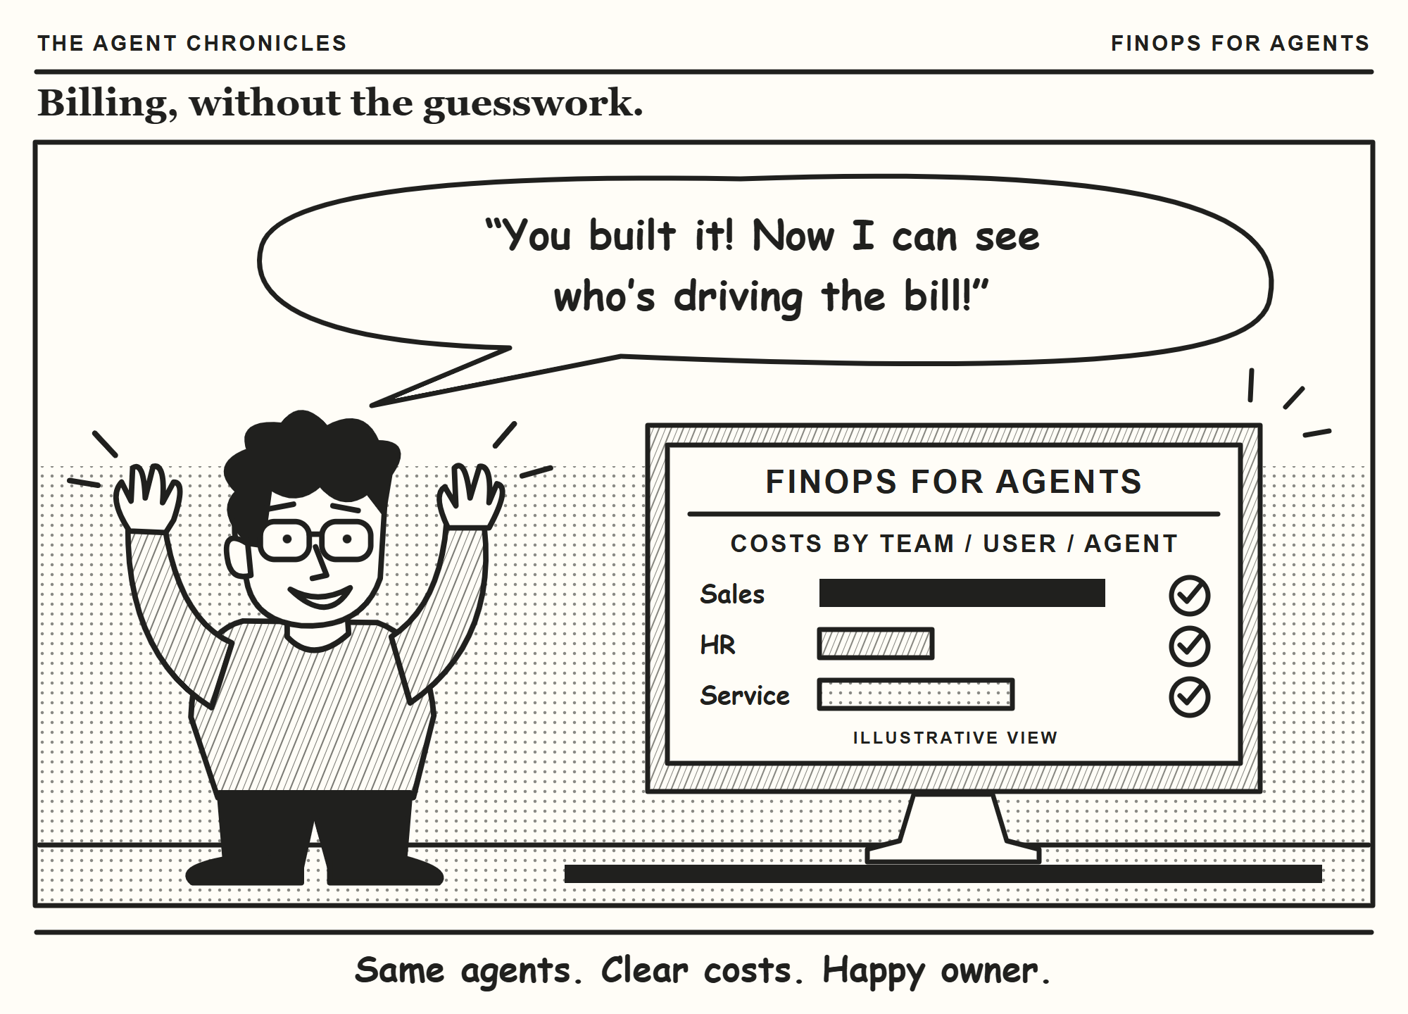
Notes:
The happy ending is not that agents stop consuming tokens.
It is that the owner has a way to understand who is driving consumption and discuss the cost with the teams creating it.
FinOps for Agents turns an unexplained bill into an explainable conversation.
Same agents. Clear costs. Happy owner.
End here and leave the comic on screen for questions.

Slide 15
THANK YOU

