Slide 1
Building a Remote Shell Server and a Remote Shell Client
By Dhruv Yadav and Chris Acker

Slide 2
Layout
We had two files that we worked on and implemented from scratch
server.cpp
client.cpp
We start up the server by typing in “server 1234” where 1234 represents the port
We connect it to the client by typing in “client localhost 1234”
We then enter as many commands as we want on the client. The server executes the command and sends the output back to the client.

Slide 3
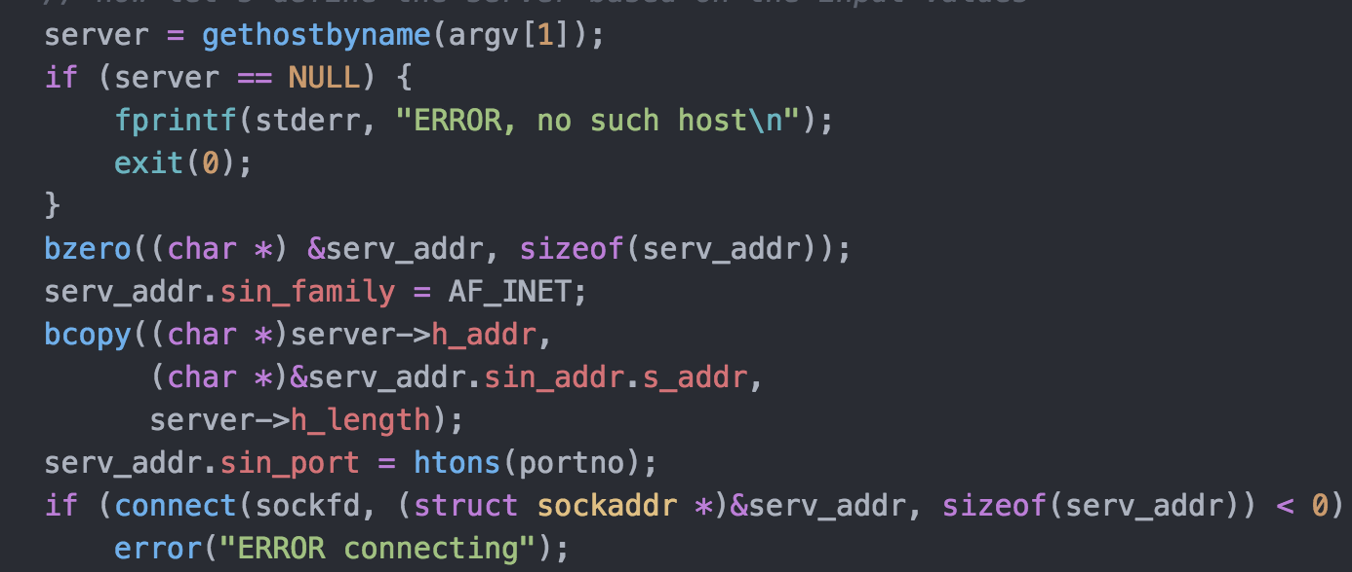
Client
We set up the file descriptor and the port number at the top of the program
We then define the server based on some input values and try connecting to the client using the code as shown here

Slide 4
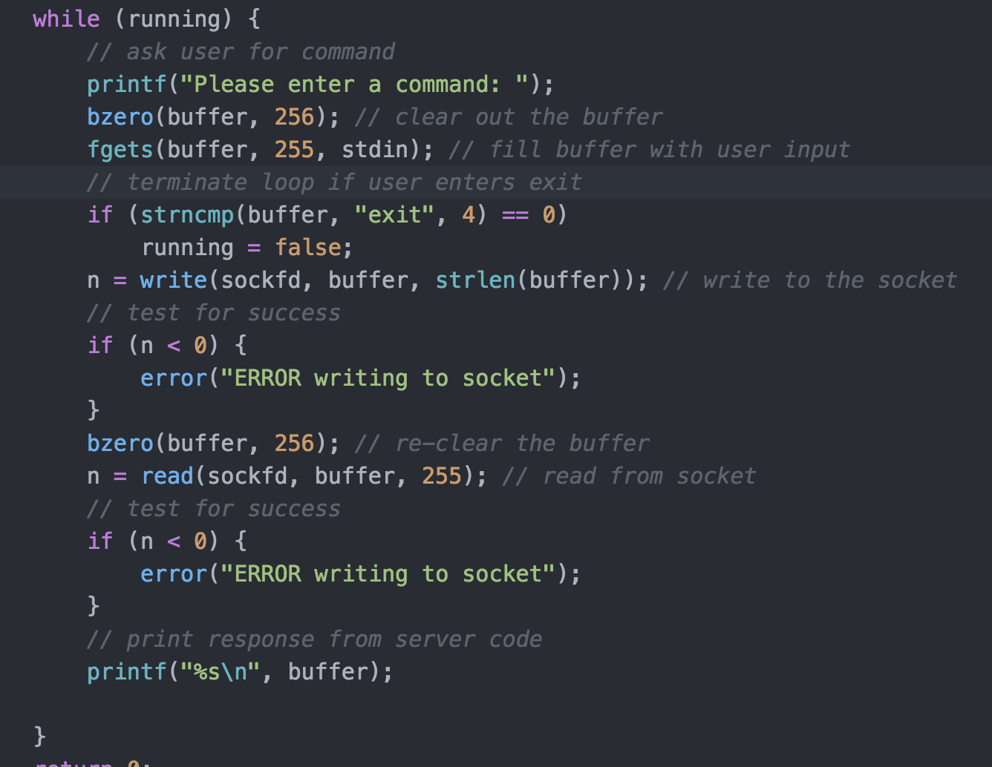
Client cont’d
Once we are connected to the client, we ask for input from the user and then “write” to the socket, as shown below

Slide 5
Server
In the server, we must fork and create a child process, and execute this process. This process is the one that actually produces the output of the command sent in from the server
We then set up the file descriptor, the port number, and set the server address values.
Finally we bind the sockets to the port number we specified and do some string processing on the user input
We grab the first token of the user input – this is the command. The rest of the user input is the arguments passed.

Slide 6
Server cont’d
We place these two arguments into an array. We call execute, passing in args[0] as the first parameter since this is the command, and args as the second parameter.
Once this processing is complete, the execute function actually executes and we now have the send the output back to client
We send this output back to client using the dup2 command.

