Slide 1
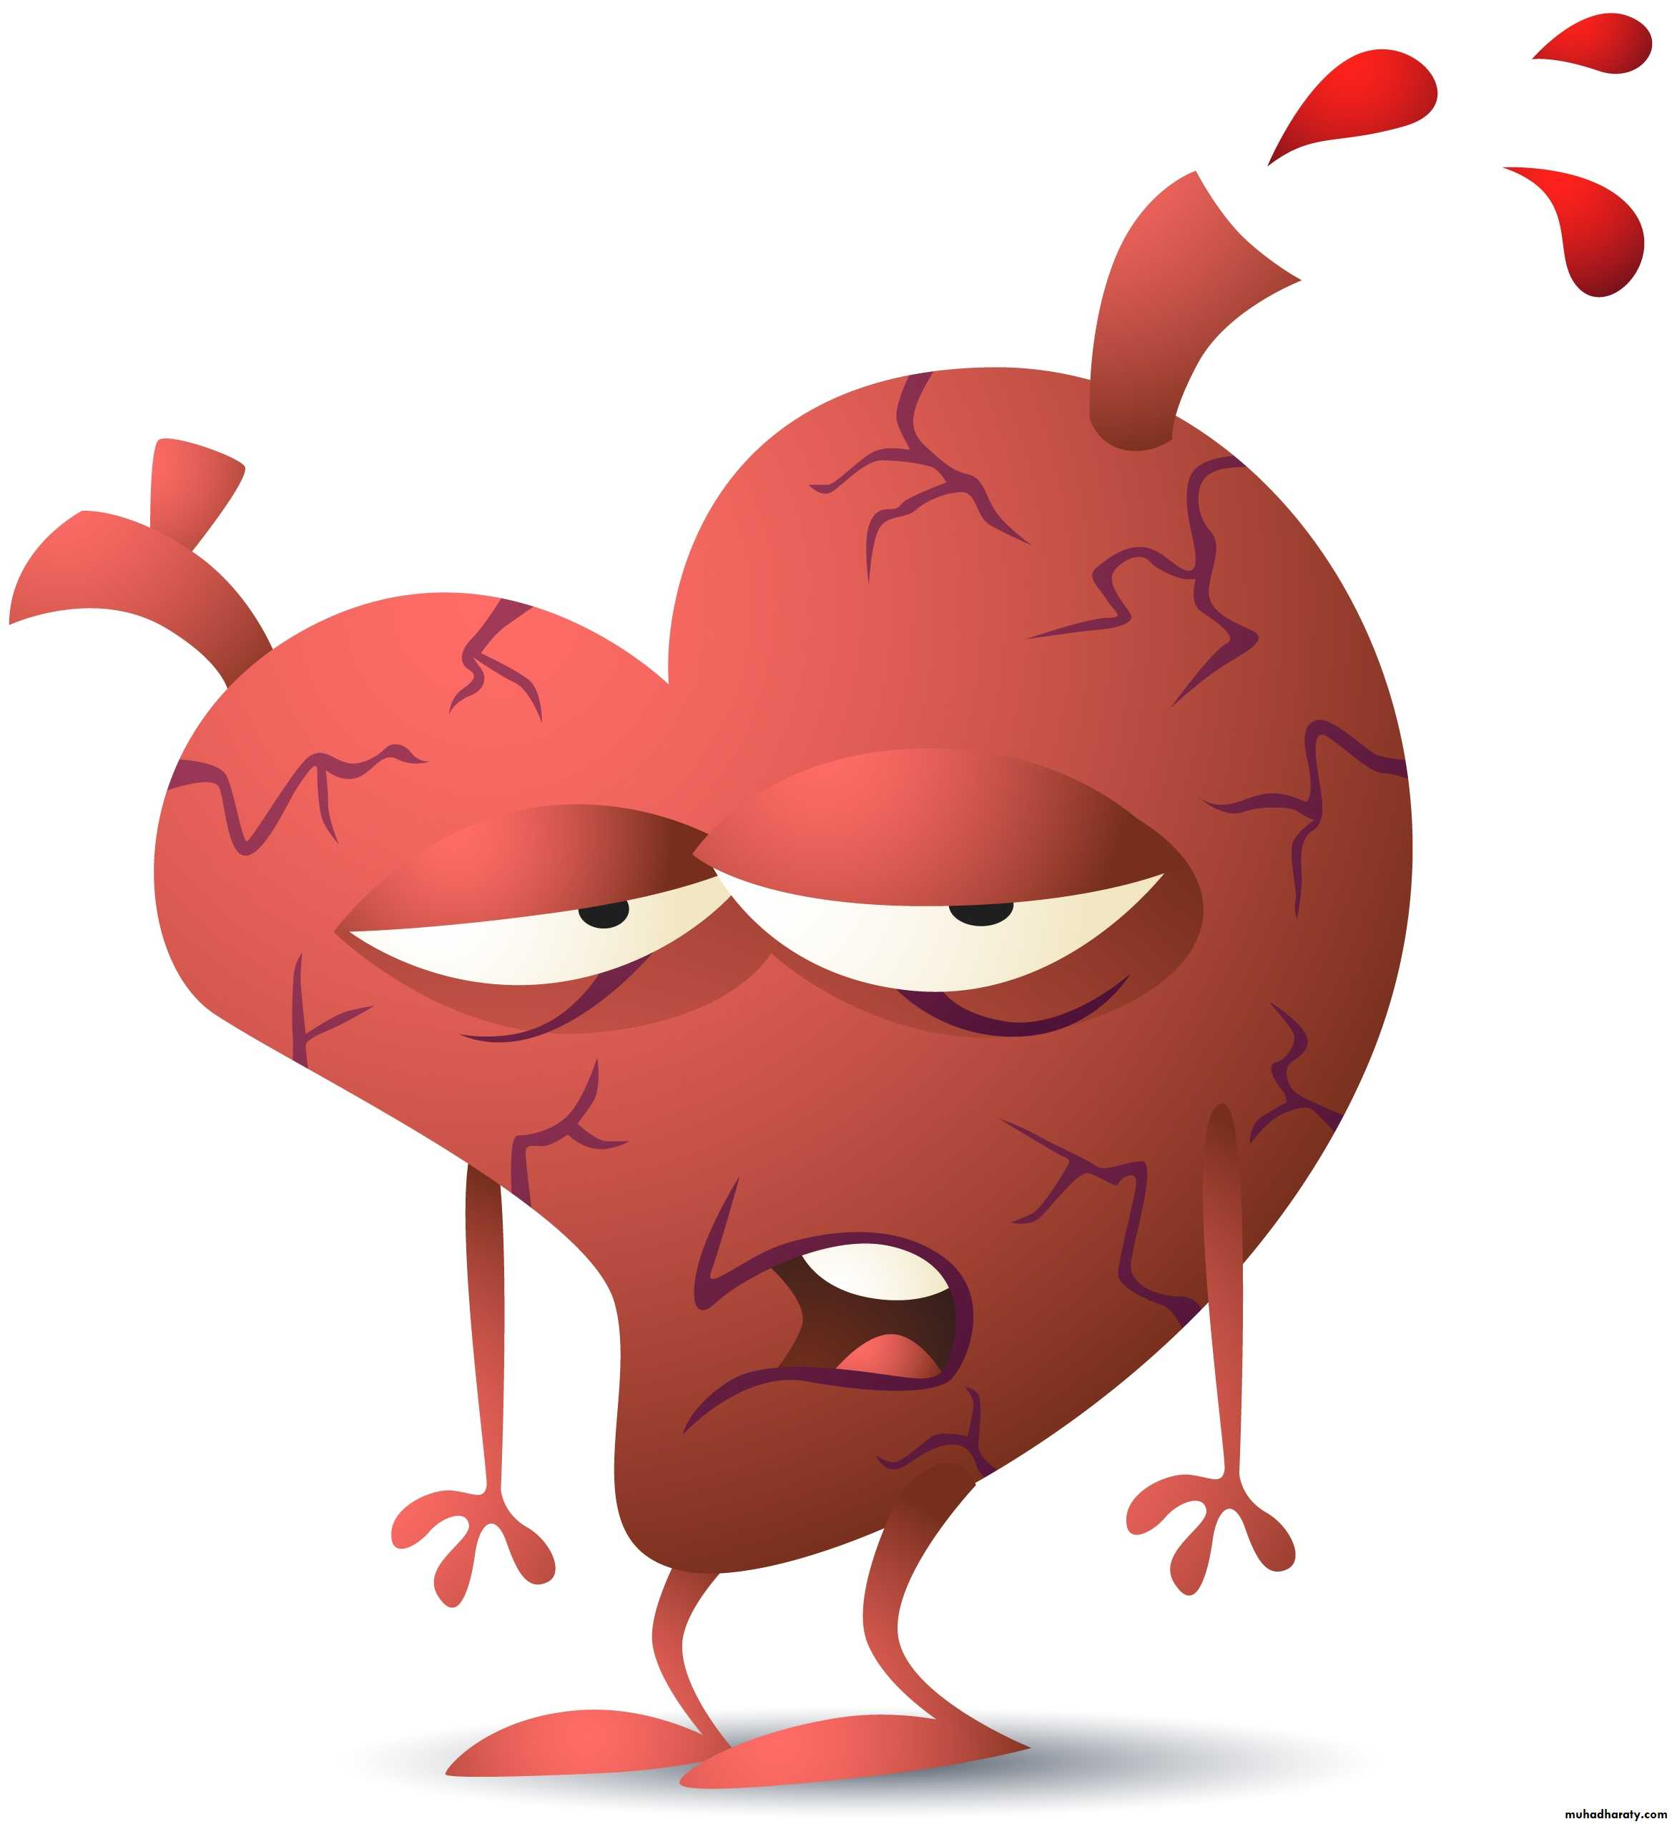
Analysis On The Factors That Contribute To Heart Disease
Heart disease is one of the leading causes of death globally and is silent and deadly killer. There are no diagnosis until the individuals experience signs or symptoms of the heart failure, heart attack or arrhythmia. The project goal and motivation are to help the doctors to identify the key factors that contribute to heart disease.
Christopher Hu
Data Science Student @ Forward School (March 2020 Cohort)
Tools/ Technologies used in this project:
Pandas, Numpy, Matplotlib, Sklearn, Seaborn, Boruta, XGBoost, Lightgbm

Slide 2
Dataset
Dataset is obtained from
https://www.kaggle.com/ronitf/heart-disease-uci
There were 76 attributes but 14 attributes will be used as the dataset.
14 Attributes: Age, Sex, Chest Pain Type, Resting Blood Pressure, Cholesterol, Fasting Blood Sugar, Rest ECG, Maximum Heart Rate, Exercise-induced Angina, ST depression, Slope of Peak Exercise, Thalassemia, Number of Major Vessels & Target.
Notes:
The dataset is obtained from kaggle.com, there are seventy six attributes but fourteen attributes will be used as the dataset. They are age, resting blood pressure, fasting blood sugar, cholesterol and many more.

Slide 3
Problem Statement
Many factors : Smoking, gender, poor diet, obesity, high blood pressure, certain drugs, age and many more.
Data analysis will be used to provide insight and machine learning will be used to solve the problem by extracting the top features that have strong relationship with the target value.
Notes:
There are many factors that contribute to heart disease. We don`t know what is the key factors that contribute to heart diseases.

Slide 4
Exploratory
Data Analysis & Fact

Slide 5
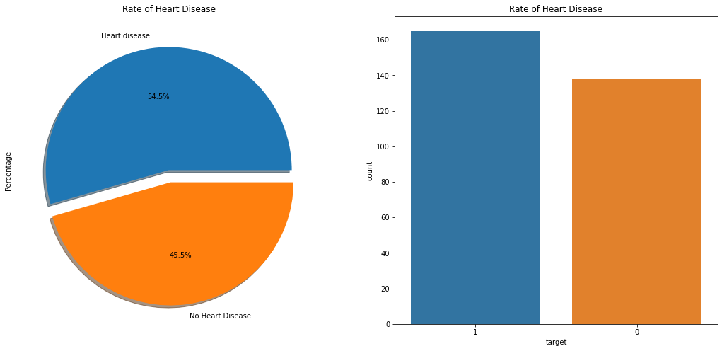
Disease Distribution
54.5% (165) of the patients have heart disease. 45.5% (138) of patients have no heart disease.
Notes:
Fifty four point five percent of the patients has heart disease and forty five point five percent of patients has no heart disease.

Slide 6
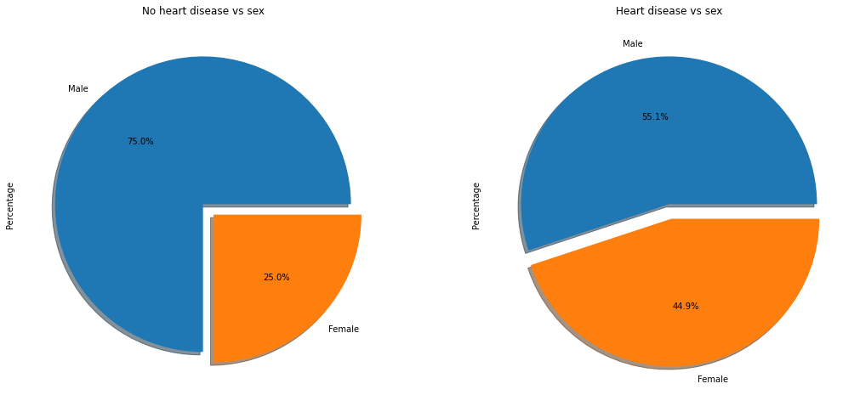
Sex vs Heart Disease
55.1% of male patient has heart disease. 44.9% of female patient has heart disease.
Male has higher chance of suffering from heart disease than female!
Hormone plays an important role for heart disease.
Notes:
1. Fifty five point one percent of male patient has heart disease. Forty four point nine percent of female patient has heart disease.
2. Male has higher chance of suffering from heart disease than female!
3. Hormone plays an important role for heart disease.

Slide 7
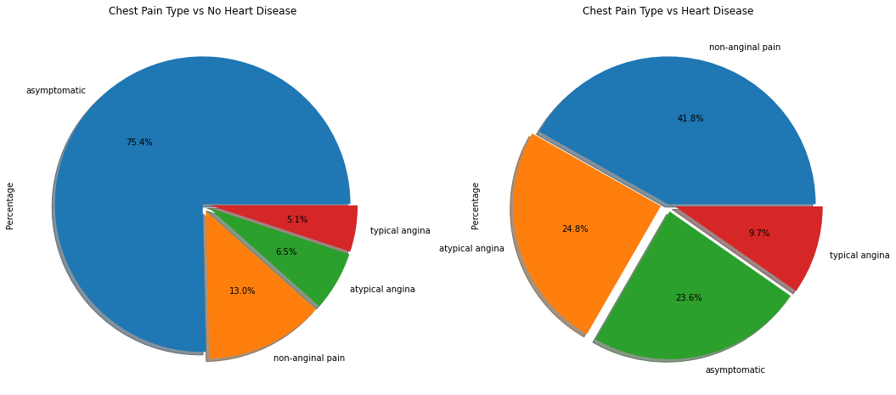
Chest Pain Type vs Heart Disease
Patients suffer from heart disease have shown most of symptom of non-anginal pain.
Notes:
Patients suffer from heart disease have shown most of symptom of non-anginal pain, it is the chest pain that caused by heart disease.

Slide 8
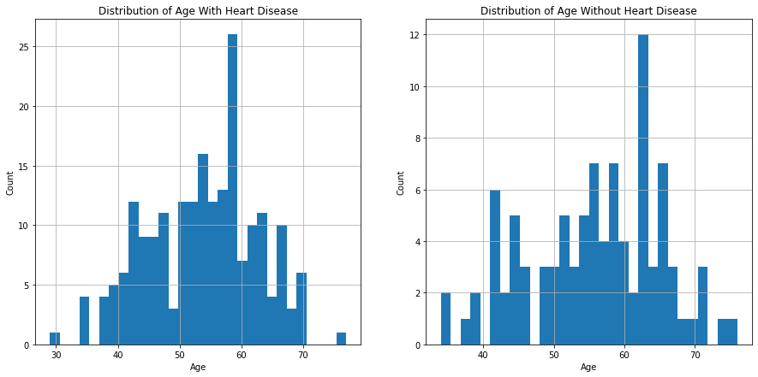
Age vs Heart Disease
Age Group 50 - 60 has more chance of Heart Disease.
Notes:
Age group between fifty and sixty years old has more chance of heart disease.

Slide 9
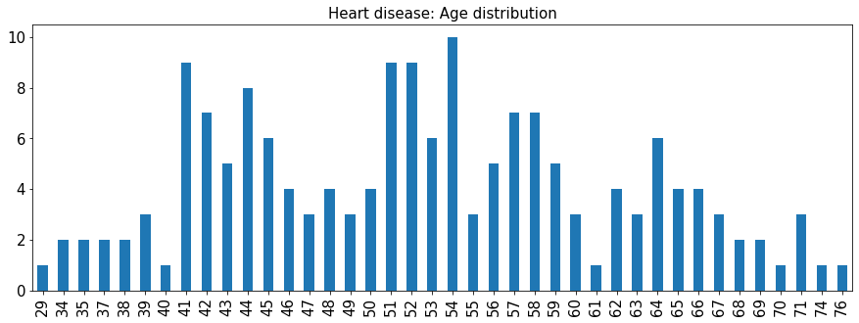
What`s the age when the heart disease starts to strike?
Above 40 years old. Below 40 years old can be misdiagnosed.
Strike irrespective of AGE !
Notes:
1. Heart attack starts to strike when the person reach above forty years old.
2. Below forty years old, heart disease can be misdiagnosed too.

Slide 10
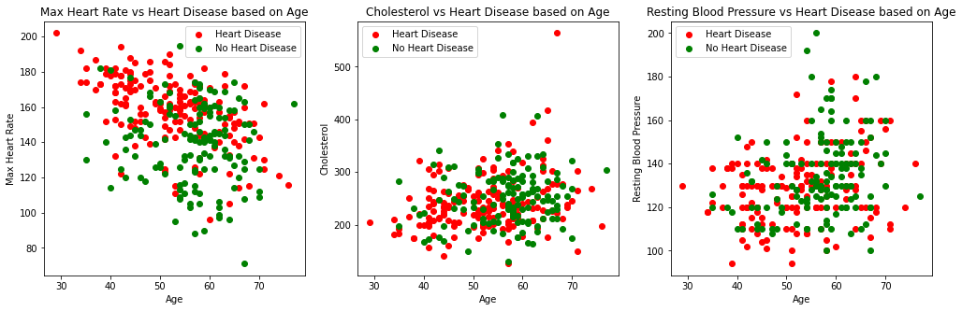
Body Parameter vs Heart Disease
High maximum heart rate at a younger age can be dangerous.
High cholesterol is dangerous irrespective of age.
No affect whether the resting blood pressure is high or low
Notes:
1. From the scatter plot, high maximum heart rate at a younger age can be dangerous.
2. High cholesterol is dangerous irrespective of age.
3. Whether the resting blood pressure is high or low, this will not influence the result.

Slide 11
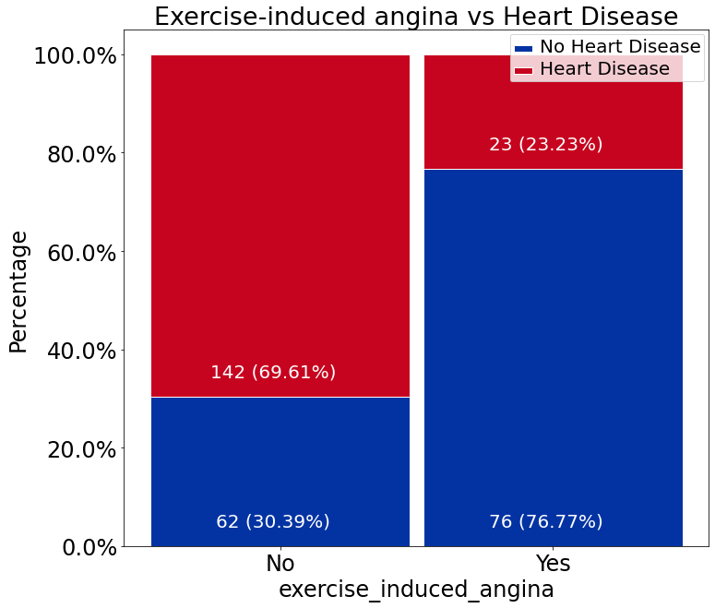
Exercise-induced Angina vs Heart Disease
69.61% patients have no exercise-induced angina.
Patients who do not exercise will be higher risk getting heart disease.
Notes:
1. Sixty nine point sixty one percent patients have no exercise-induced angina.
2. Patients who do not exercise will be at higher risk of getting heart disease.

Slide 12
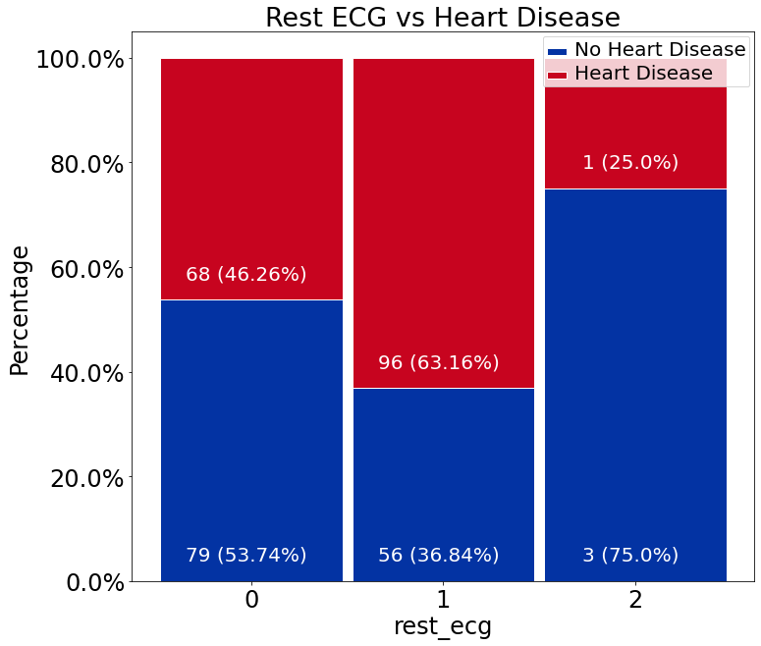
Rest ECG vs Heart Disease
0: Showing probable or definite left ventricular hypertrophy by Estes' criteria
1: Normal
2: Having ST-T wave abnormality
Patients with normal Rest ECG are prone to heart disease. This is interesting.
Notes:
Patients with normal Rest ECG likely to get heart disease.

Slide 13
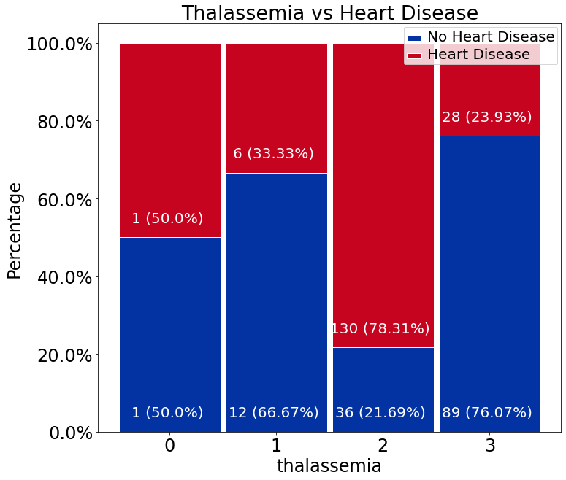
Thalassemia vs Heart Disease
0. Null
Fixed defect
Normal blood flow
Reversible detect
Patients with normal blood flow at higher risk of getting heart disease.
Notes:
Thalassemia is kind of blood disorder, patients with normal blood flow are at risk of getting heart disease.

Slide 14
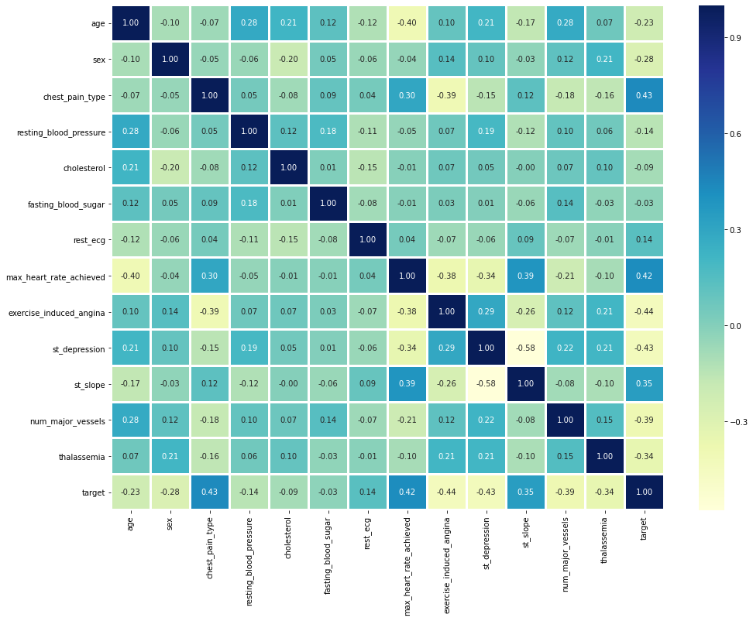
1. Correlation Matrix with Heatmap
No features with a correlation of more than 0.5 These features are poor predictors
Type of Chest Pain: 0.43
Maximum Heart Rate Achieved: 0.42
ST Slope: 0.35
Notes:
Correlation matrix with heatmap will be used to display the relationship between features and target value.
No features with a correlation of more than zero point five.
These features are poor predictors.
Type of chest pain, maximum heart rate achieved and ST slope have higher value among them.

Slide 15
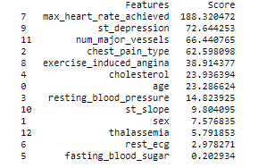
2. Univariate Selection (CHI-SQUARED)
Maximum heart rate achieved, ST depression and number of major vessels have strongest relationship with the output variable.
Notes:
Based on the output of chi squared test, maximum heart rate achieved, ST depression and number of major vessels have strongest relationship with the output variable.

Slide 16
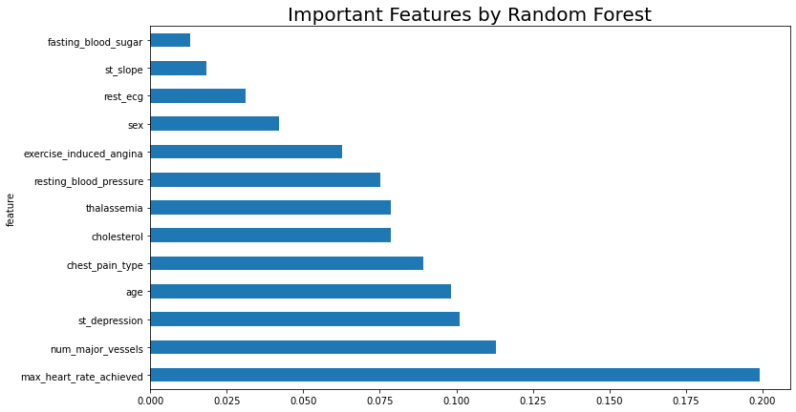
3. Machine Learning Models (Feature Importance)
Maximum Heart Rate Achieved
Number of Major Vessels
ST Depression
Notes:
From here, I will use machine learning models to extracting the important features after train the models.
Random forest draw conclusion that maximum heart rate achieved, number of major vessels and ST depression contribute the most.

Slide 17
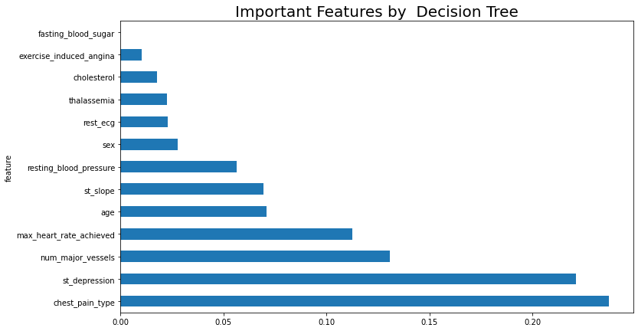
3. Machine Learning Models (Feature Importance)
Type of Chest Pain
ST Depression
Number of Major Vessels
Notes:
Second machine learning model, decision tree draw conclusion that type of chest pain, ST depression and number of major vessels contribute the most.

Slide 18
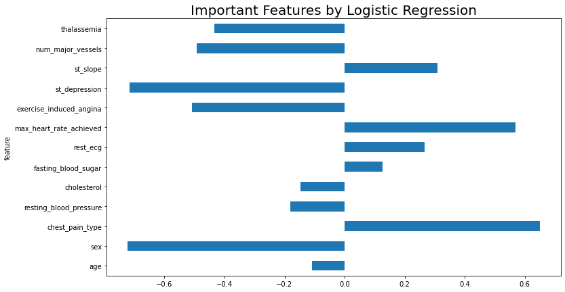
3. Machine Learning Models (Feature Importance)
Type of Chest Pain
Maximum Heart Rate Achieved
ST Slope
Notes:
Logistic regression choose type of chest pain, maximum heart rate achieved and ST slope.

Slide 19
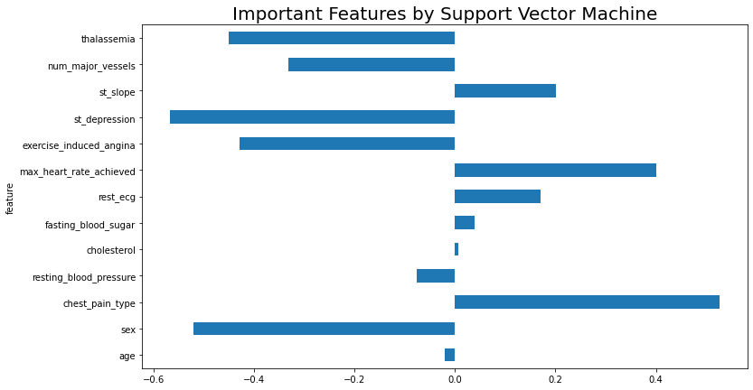
3. Machine Learning Models (Feature Importance)
Type of Chest Pain
Maximum Heart Rate Achieved
ST Slope
Notes:
SVM select type of chest pain, maximum heart rate and ST slope as most contributor.

Slide 20
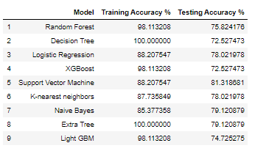
Training and Testing Accuracy
Support Vector Machine`s prediction accuracy better than the rest.
Notes:
Among the machine learning models, svm`s prediction accuracy is better.

Slide 21
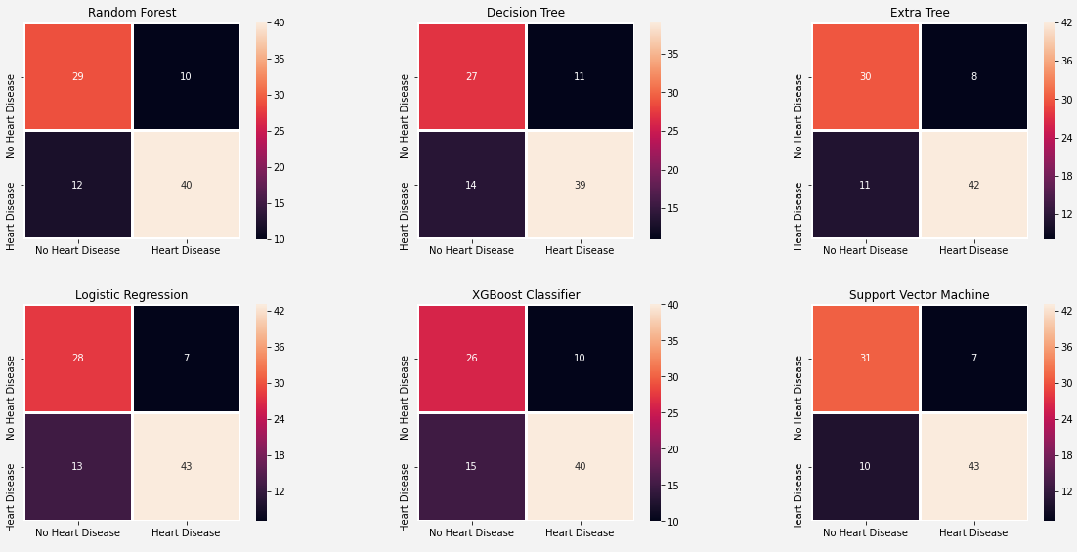
Confusion Matrix of All Models
Notes:
Confusion matrix will be used to make sure the trained machine learning models do not have many false positive (you do not have heart disease but told you to get treatment) and false negative (you have heart disease but I ask you do not go for treatment). From here, we can know these machine learning models shows better prediction.

Slide 22
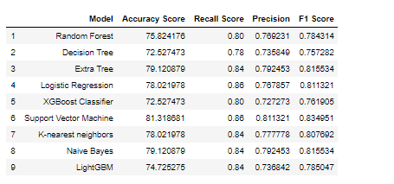
Machine Learning Models Evaluation
Notes:
Recall is important than precision because cost of false negative is high and false positive is not as much. Because the patients will die if they have heart disease but the doctors ask them don`t get the treatment. All recall score of the machine learning models is higher than precision. These machine learning models are doing good because false negative is costly.

Slide 23
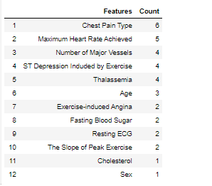
Final Finding of Heart Disease`s Factors
Notes:
Top six features will be chosen from all machine learning models to get the final result. Many people have misunderstanding and wrong concept about older people have higher risk for heart disease. Blood pressure, high cholesterol and smoking are the key factors that contribute to heart disease but after the finding, chest pain type especially non-anginal pain and atypical pain, maximum heart rate achieved are the key factors that contribute to heart disease.

Slide 24
Thank You !

Slide 25


