Slide 1
CUTe7305c Bankruptcy Classification through application of ML models
Walkthrough of the steps taken to arrive at the optimized Solution
Group Members:
Roopa V, Christopher A & Gurudutt R

Slide 2
CUTe 7305c – Classification of through Machine learning Algorithms
Understand the data: NA Values & Outliers ;
N X P ➔ 31283 N Data points; P = 64;
All Features ( Excluding ID & Target for prediction) are Numeric variables & don’t need specific type conversion.
NA Values: While most feature space had minimal NA Values, the below features had considerably higher NA value %.
NA Values: Models were built with the intent to retain features with NA values after imputing considering the different ML models would be able to build an optimal solution through effective handling of NA values( Decision Trees) .
In Retrospect: Feature Attr37 & Attr21 were removed as the model predictability improved through the same.
% outliers: None of the features had significant outliers (outside of +3 & -3 Sigma) as indicated by the % of top 5 outlier.
9 features of the given feature space are highly co-relation with one another.
The intent would be build model while retaining collinearity & without it, while trying different ML models to derive the best output ( Keeping in mind Random Forest uses sub-setting of features to arrive at the optional model!)
Feature | % NA
Attr21 | 13.59%
Attr27 | 6.41%
Attr37 | 44.02%
Attr45 | 5.01%
Attr60 | 5.02%
Feature | Outliers
Attr15 | 0.23%
Attr27 | 0.22%
Attr28 | 0.19%
Attr29 | 0.44%
Attr55 | 0.70%

Slide 3
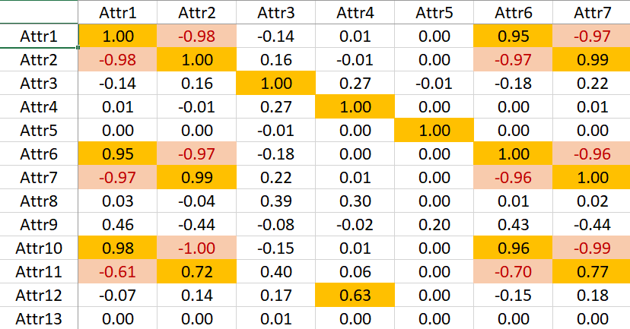
CUTe 7305c – Classification of through Machine learning Algorithms
Understand the data: Correlation Plot
Note - We’ve removed a few data points to fit the slide.
9 features of the given feature space are highly co-relation with one another.
The intent would be build model while retaining collinearity & without it, while trying different ML models to derive the best output ( Keeping in mind Random Forest uses sub-setting of features to arrive at the optional model any way!)
Feature | # of Corelation
Attr1 | 9
Attr2 | 9
Attr6 | 9
Attr7 | 9
Attr10 | 9
Attr14 | 9
Attr18 | 9
Attr25 | 9
Attr38 | 9

Slide 4
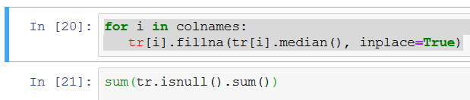
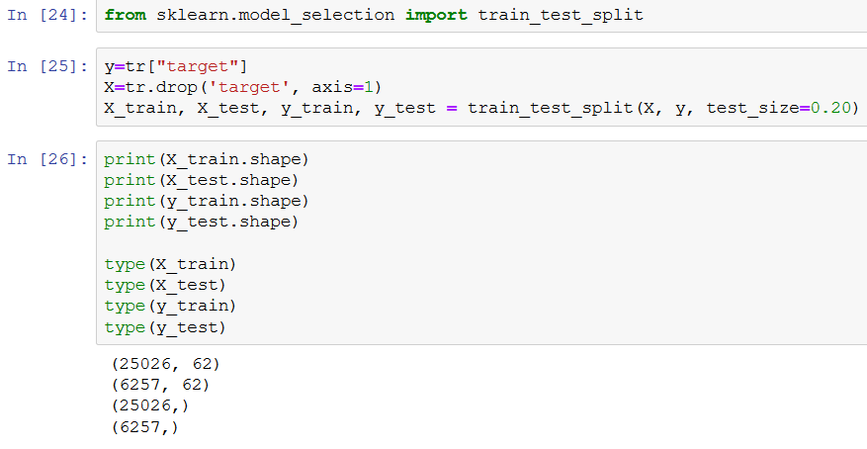
CUTe 7305c – Classification of through Machine learning Algorithms
Model Building: Missing Value Imputation & Train/Validation Split
Missing Values are imputed through median imputation
Mode imputation not required as no categorical attributes are present for prediction.

Slide 5
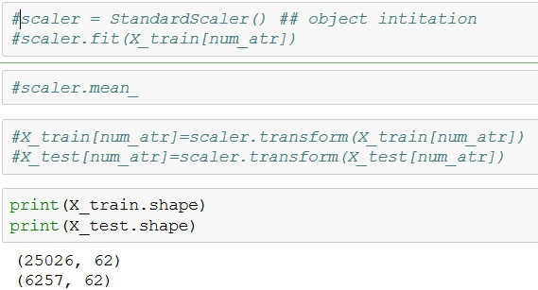
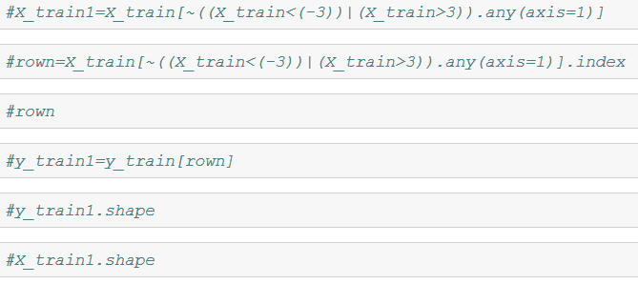
CUTe 7305c – Classification of through Machine learning Algorithms
Model Building: Standardization & Outlier Management
Standardization Attempt:
Outlier Management through 3 sigma Attempt:
In Retrospect: Standardization wasn’t used as the same impacted model predictability. Outliers weren’t treated basis the % of outliers in each attribute( Intuitively, their presence might add to the model predictability)

Slide 6
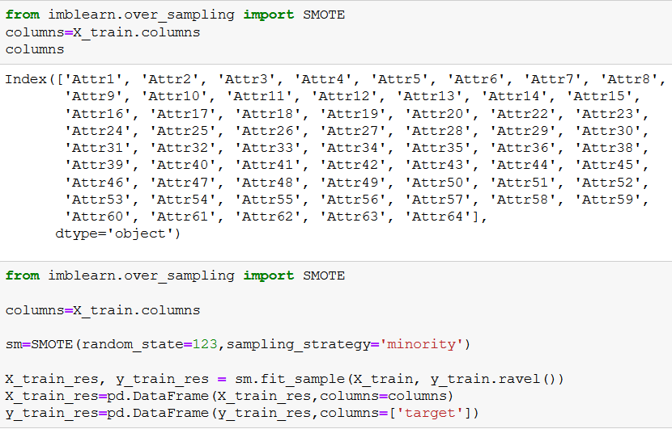
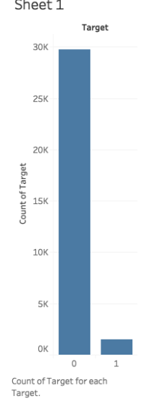
CUTe 7305c – Classification of through Machine learning Algorithms
Model Building: SMOTE function
SMOTE function used to manage class imbalance problem. Target variable split between .95 &. 05 (between not bankrupt & bankrupt) & Indicates a class imbalance problem.

Slide 7
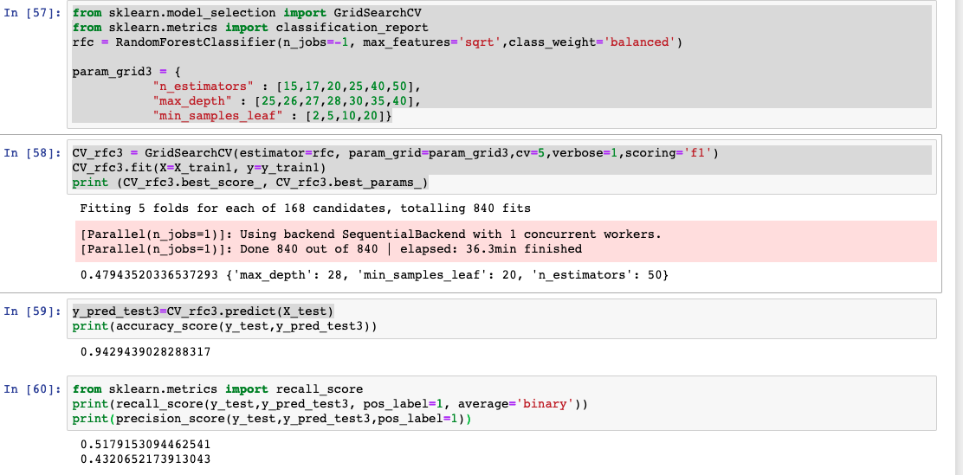
CUTe 7305c – Classification of through Machine learning Algorithms
Model Building: Random Forest
Random Forest with Grid Search: Yielded poor recall & precision scores

Slide 8
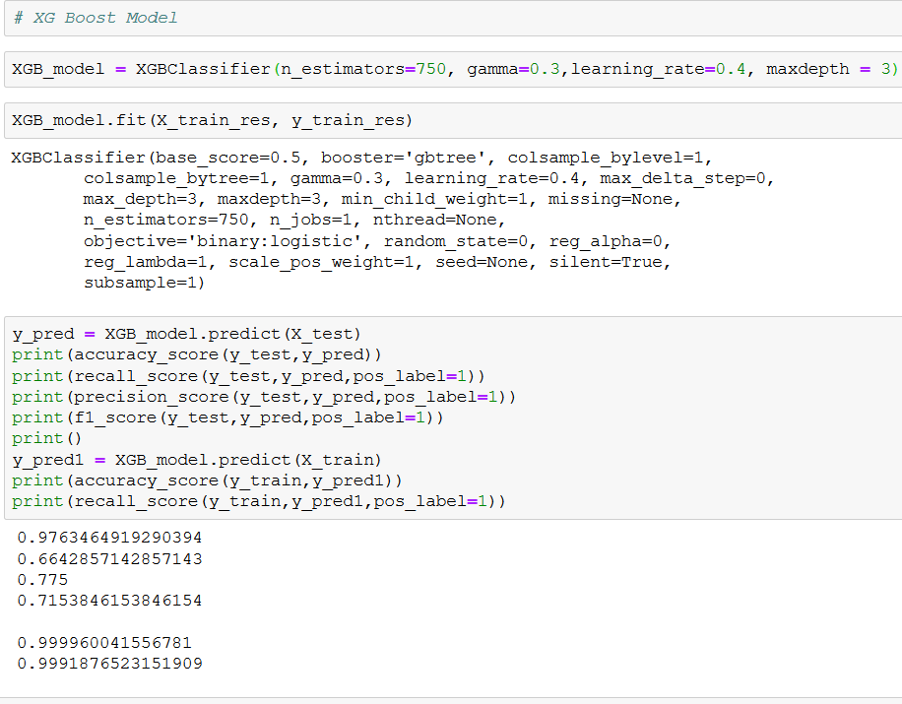
CUTe 7305c – Classification of through Machine learning Algorithms
Model Building: XGBoost
XGBoost with large # of trees with Optimal values of gamma(0.3) & learning rate (0.4)

Slide 9
CUTe 7305c – Classification of through Machine learning Algorithms
Conclusion:
XG Boost ML model returned with the maximum predictability with F1 Score of 71.5.
Final predictability at 73% (from SCT)
Thank you!

