Slide 1


Student Affect in CS1
Insights from an Easy Data Collection Tool
Dale Parsons, Krissi Wood
Notes:
We are here today discussing our current research project where we are exploring our students emotional and affective experience during the very first programming paper and looking at the ways that this impacts their performance and satisfaction. Today we are going to specifically talk about a tool that we use to try and gather that information. we are talking about an online survey tool that is easy to set up, quick to use and one which provides useful data.
http://kate.ict.op.ac.nz/~dparsons/IN510S22018/checkpoint_Tool/Staff/index.php
http://kate.ict.op.ac.nz/~dparsons/IN510CheckPointTool/Web-2-Project%20-%20Student/home.html.php
http://kate.ict.op.ac.nz/~dparsons/IN510CheckPointTool/Web-2-Project/index.html.php

Slide 2
At the end of the course we asked
Draw what programming means to you
Notes:
At the end of our very first programming course we asked students to draw what programming meant to them.
This question was on the last page of a 2 hour exam.

Slide 3
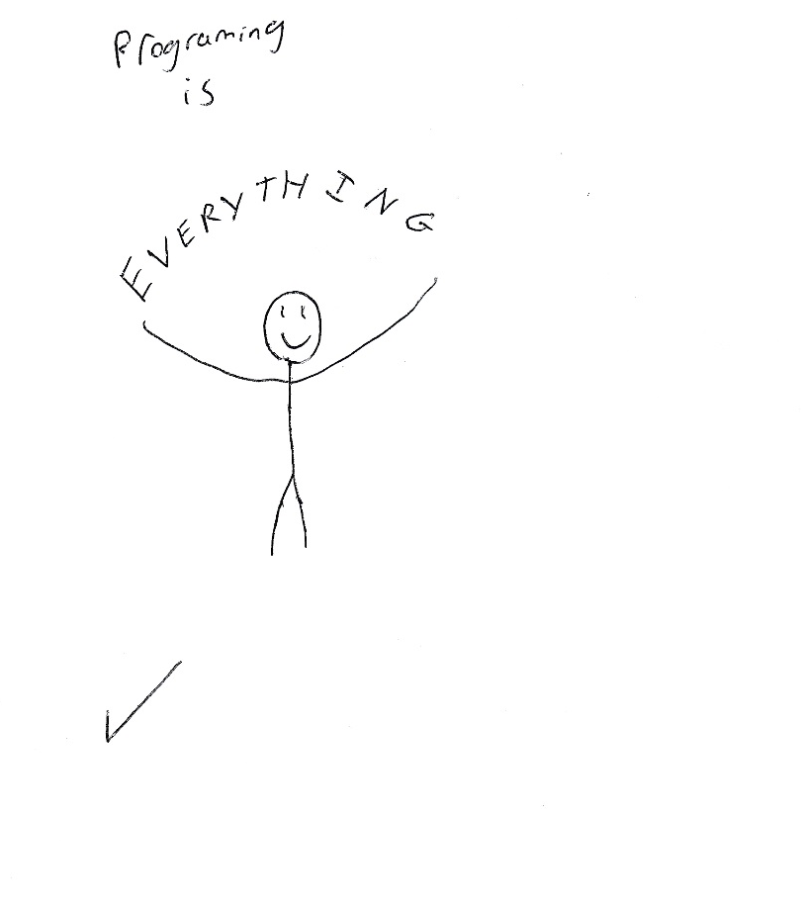
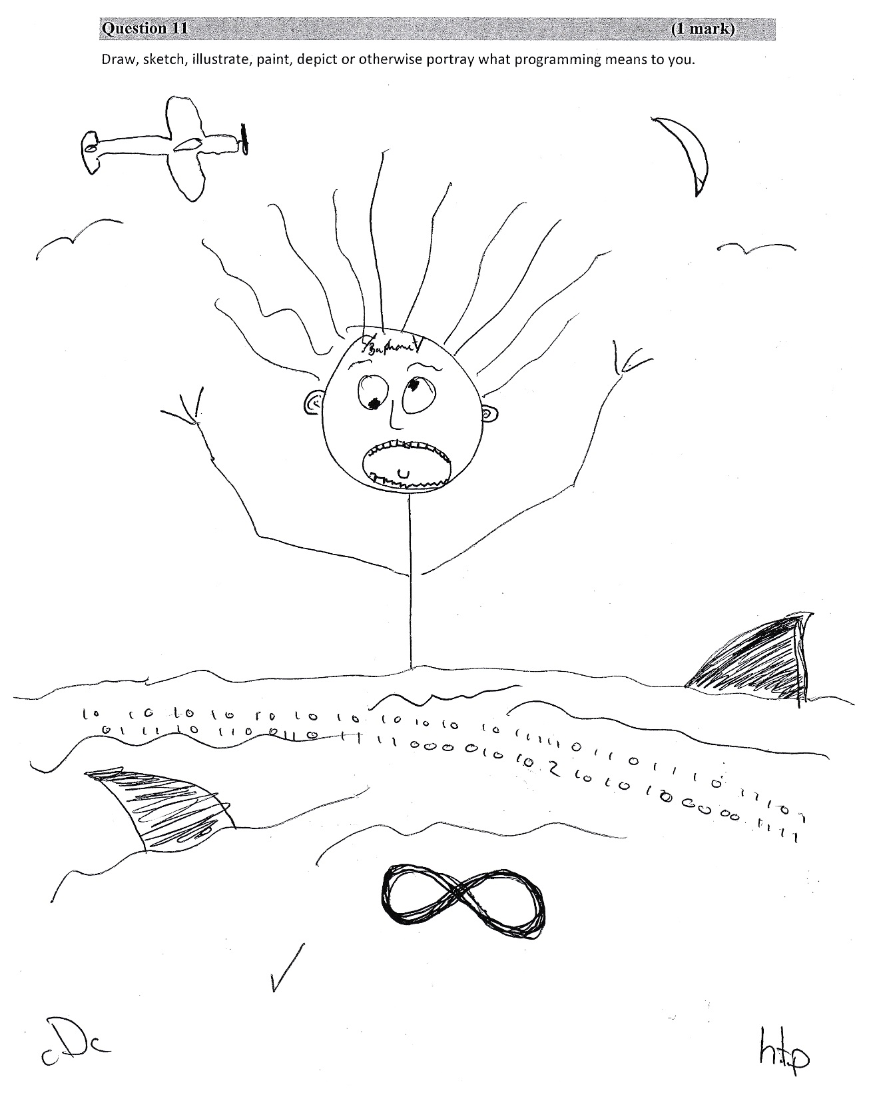
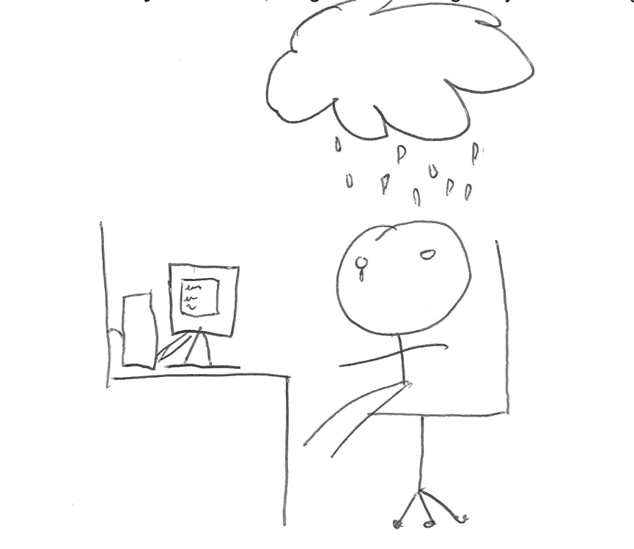
Notes:
We were surprised to find that most of their images were displaying strong and revealing emotions, we were also surprised by how elaborate the pictures were. Not only did the vast majority of students provide a drawing, many of them put a lot of effort into it, producing complex and detailed images, often with dialogue, frequently with multiple frames showing the passage of time. Most students concentrated not on technical or professional aspects, but on the emotional aspects. In a typical semester, 63% of the submitted images depict some kind of emotional state
they drew pictures like the two shown: sharks circling while binary numbers float by and clouds raining on them, these students are clearly experiencing some level of stress or frustration.
This was the motivation behind our decision to further explore the students emotional experience. Once we had seen these strong emotional responses we wondered if there was a whole dimension of student learning that we were not tapping into.

Slide 4
Research Questions
Can useful data about student affect be collected quickly and easily?
Can such data provide insight into the design of curricular materials?
Can such data identify struggling students?
Notes:
When we are talking about the student experience we are interested in states such as interest or boredom, motivation and challenge. Do they feel they are making progress or are they hopelessly lost. Can we gather this data quickly and easily?
Using this data can we assess our course material, do the students find the labs interesting? Are the labs too challenging?
Could we identify struggling at risk students early in the course, would they give honest feedback through a tool?

Slide 5
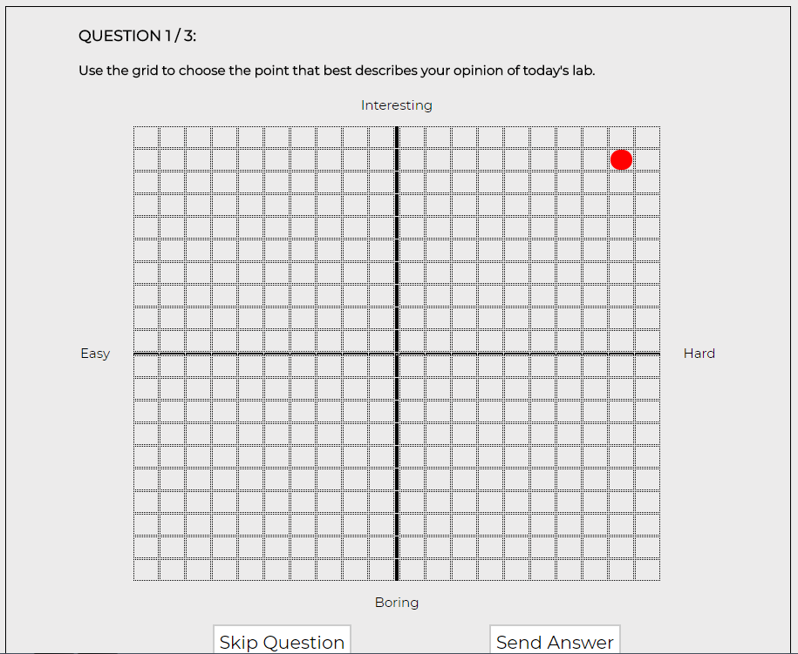
Affect Tool: Question One
Notes:
We are teaching introductory programming to year1 Bachelor of Information technology students, this data has come from 72 students over 2 semesters. There were 25 labs in the course and at the end of every session student have a checkpoint exercise that needs to be marked off. A lab is a hands on programming session performed under the supervision of the lecturer and a tutorial assistant.
The tool presents a series of two-dimensional graphs where the axes are pairs of related questions, for example, the perceived difficulty of a programming problem from hard to easy, and the level of interest in the lab from boring to interesting.
Students indicate their feelings by putting a dot in the appropriate quadrant. Here the student has graded the lab as slightly easy and interesting.
There are only three questions so the students give us three dots- its takes about 10 seconds and the students seem to enjoying giving us their dots.

Slide 6
Affect Tool Axes
 | Scale Descriptor | Scale Endpoint (-10) | Scale Endpoint (+10) | Axis
1 | Interest | Boring | Interesting | Vertical
 | Difficulty | Easy | Hard | Horizontal
2 | Plan | Didn’t know how to approach the problem | I had a clear plan | Vertical
 | Familiarity | Content was all new | Content was familiar | Horizontal
3 | Satisfaction | I feel frustrated | I feel triumphant | Vertical
 | Improvement | My programming skills have not improved | My programming skills have improved | Horizontal
Notes:
The tool presents a series of three two-dimensional graphs
The grid pairs each relate to a particular feature of programming pedagogy:
Difficulty and Interest are paired to observe the extent to which challenge is related to engagement.
Plan and Familiarity are paired to see whether students are recognizing common programming problems and their solutions.
We paired Satisfaction with Improvement as a lot of research has shown that successful learning involves the process of becoming frustrated and then moving through frustration to success and improvement
.

Slide 7
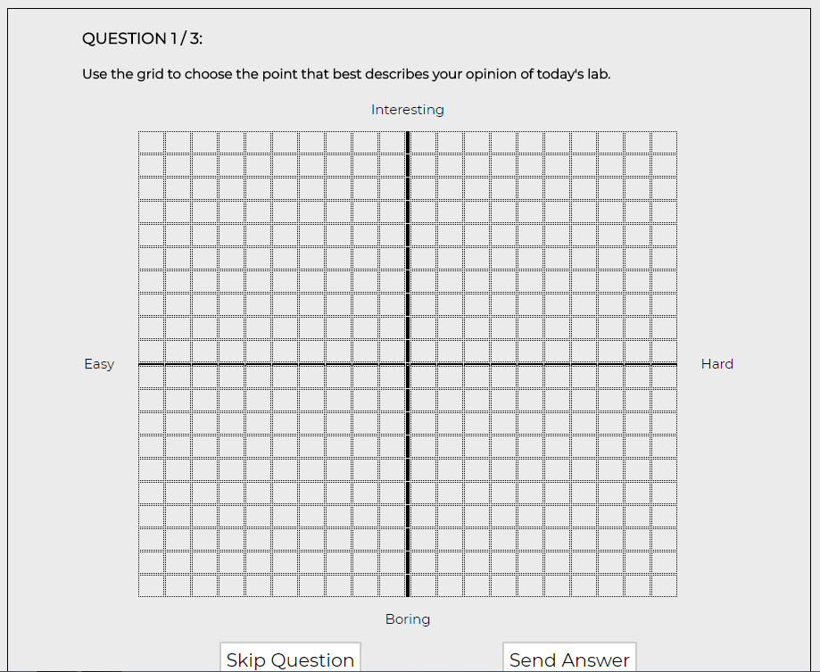
Danger Area- Boring and Hard
Notes:
For each of the questions there is a danger area. Our data show that students that place their dots in a particular quadrant tend to struggle in the course, and this pattern starts to emerge as early as two to three weeks in.
For this question the students grade the lab as Easy to Hard and Boring to Interesting. Anyone selecting the Boring and hard quadrant is probably showing disengagement.
While the hard and interesting quadrant is seen as a good challenge
the amount of challenge must be just right for optimal learning to occur. We call this the sweet spot.

Slide 8
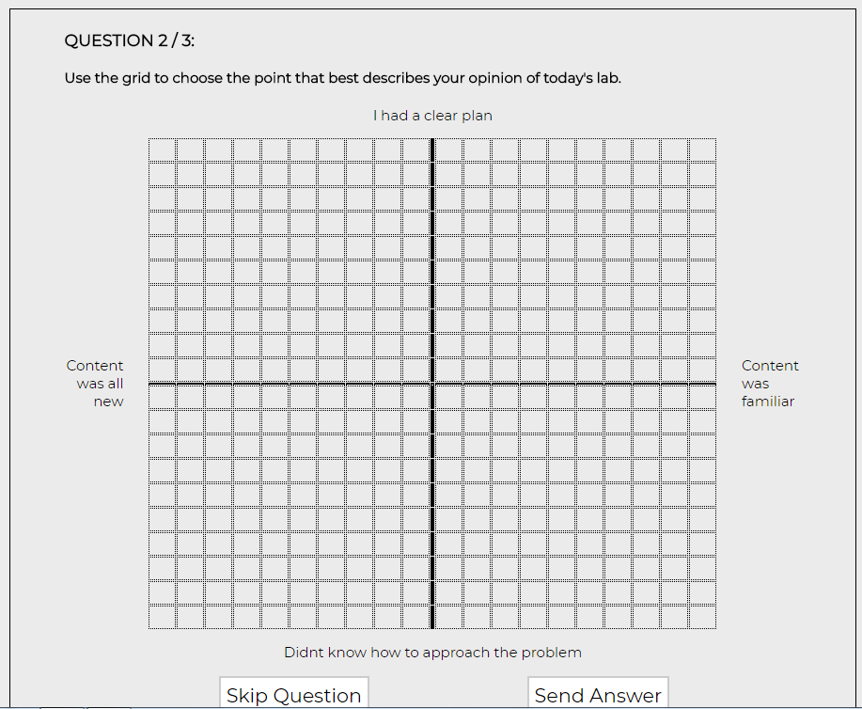
Familiarity and Planning
Notes:
Question two asked to what extent was the content familiar versus the content was all new and did they have a clear plan for the problem versus they didn’t know how to approach the problem.
We suggest that the No Plan but Familiar quadrant is another "danger cell". Students are recognizing that they have seen this type of problem before but the still don’t know to get started on it.
Even more worrying are students who report every lab as content is all new and don’t know what to do. They are not recognising any programming patterns.
Students demonstrating these response patterns may benefit from early lecturer intervention and other additional support.

Slide 9
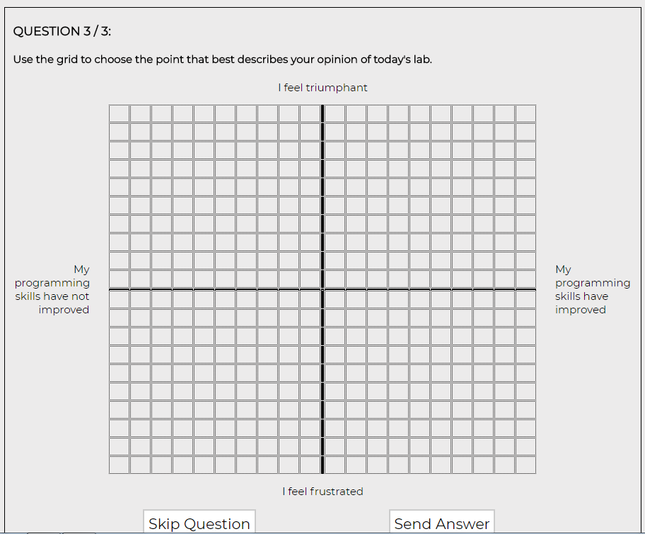
Danger cells: frustrated and not improving
Notes:
Question three asked how they felt on a scale of frustrated to triumphant and whether they felt their programming had improved or not.
In order to learn students must be challenged by new material, this can cause frustration and confusion, we need a balance of frustration and triumph.
This is like the story of Goldilocks: the amount of challenge must be just right -- neither too much nor too little -- for optimal learning to occur.
The danger zone here is students who are continually frustrated and feel they are not improving.

Slide 10
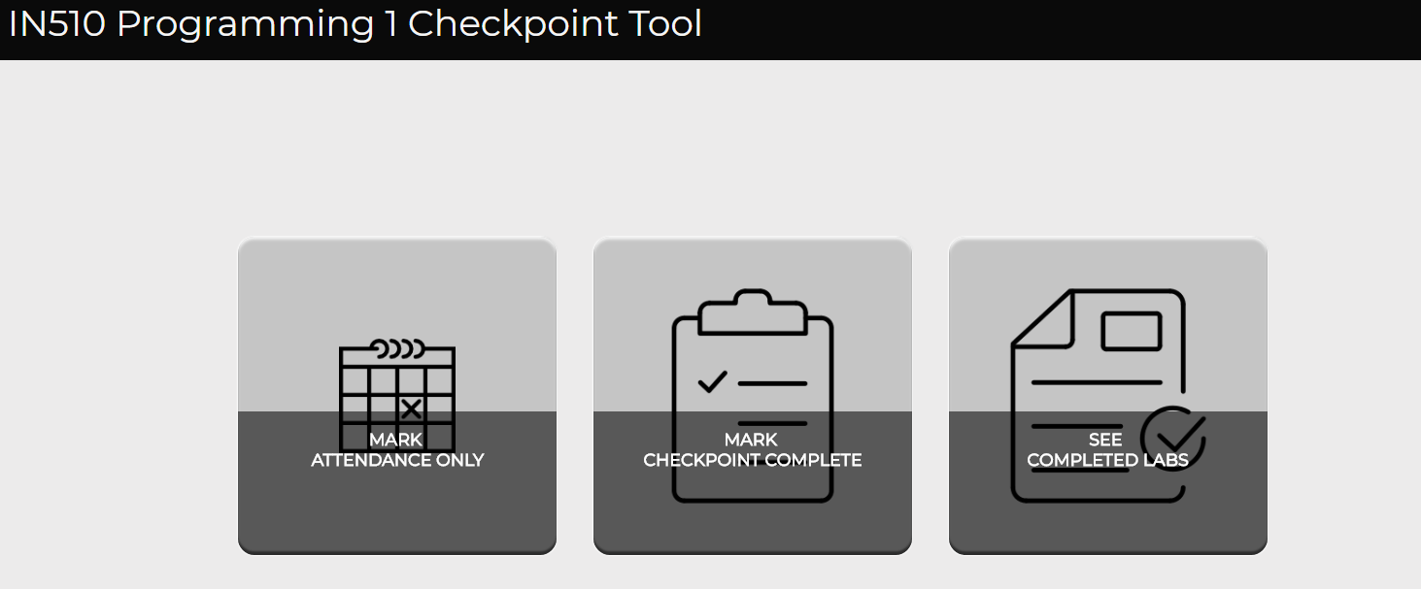
Student View
Notes:
The students only see the questions and a list of completed labs

Slide 11
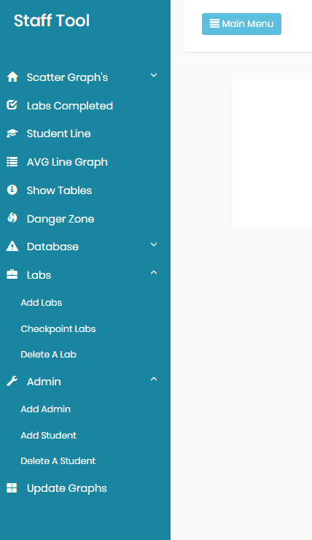
Staff View
Notes:
The staff can view a scatter graph for each individual lab per tool and a scatter graph for each individual student per tool. We can also see line graphs for each of the 6 individual questions per student or per lab.

Slide 12
Danger reports Hard and Boring
Hard and Boring
Lab ID | Name | X Value | Y Value
13 | 46 | 7 | -5
14 | 46 | 10 | -1
3 | 97 | 4 | -7
7 | 97 | 8 | -6
8 | 97 | 10 | -5
9 | 97 | 10 | -4
15 | 97 | 9 | -5
21 | 97 | 7 | -1
22 | 66 | 6 | -1
23 | 89 | 10 | -10
Notes:
In the latest version of the tool we introduced Danger reports for each of the three questions. This report would prompt us to look at individual students who appear in the danger quadrants we identified earlier.
X is hard
Y is Boring

Slide 13
Frustrated and Not Improving
Frustrated and Not improving
Lab ID | Name | X Value | Y Value
23 | 46 | -10 | -10
19 | 29 | -7 | -5
28 | 29 | -10 | -4
3 | 97 | -5 | -5
8 | 97 | -10 | -10
9 | 97 | -6 | -10
13 | 97 | -1 | -2
14 | 97 | -6 | -3
15 | 97 | -10 | -10
18 | 97 | -2 | -4
11 | 17 | -7 | -2
15 | 66 | -2 | -1
22 | 89 | -10 | -10
2 | 100 | -3 | -2
6 | 100 | -6 | -6
7 | 100 | -3 | -2
Notes:
The magnitude of the values -10, -10 and the number of times a student appears, to us this is a cry for help. Because we view this report in real time early intervention is possible, we provide extra tutorial assistance and peer tutors unfortunately not everyone is saved but at least we know who is really struggling in the classroom.
X improve
Y frustrated

Slide 14
Failure to recognise programming patterns
Content seems all new and can’t get started
Don't know how to start and Unfamiliar
Lab ID | Name | X Value | Y Value
23 | 46 | -10 | -10
2 | 74 | -3 | -3
22 | 51 | -3 | -2
6 | 77 | -9 | -5
7 | 77 | -8 | -6
24 | 77 | -5 | -3
11 | 29 | -4 | -1
19 | 29 | -5 | -5
28 | 29 | -10 | -2
3 | 97 | -7 | -6
5 | 97 | -7 | -3
7 | 97 | -10 | -6
8 | 97 | -10 | -10
9 | 97 | -10 | -10
14 | 97 | -4 | -4
15 | 97 | -10 | -10
5 | 6 | -3 | -3
10 | 6 | -5 | -2
13 | 6 | -5 | -2
15 | 6 | -7 | -2
19 | 6 | -5 | -2
9 | 34 | -10 | -4
8 | 14 | -7 | -6
20 | 14 | -6 | -1
22 | 14 | -3 | -6
23 | 14 | -6 | -4
10 | 83 | -3 | -9
14 | 17 | -9 | -1
11 | 23 | -3 | -4
19 | 23 | -5 | -5
22 | 23 | -3 | -3
5 | 40 | -6 | -1
1 | 103 | -7 | -1
2 | 66 | -9 | -1
3 | 66 | -6 | -3
5 | 66 | -6 | -3
6 | 66 | -4 | -1
7 | 66 | -5 | -4
9 | 66 | -5 | -1
Notes:
Question 2 is probably specific to our course, all the questions and labels are changeable.

Slide 15
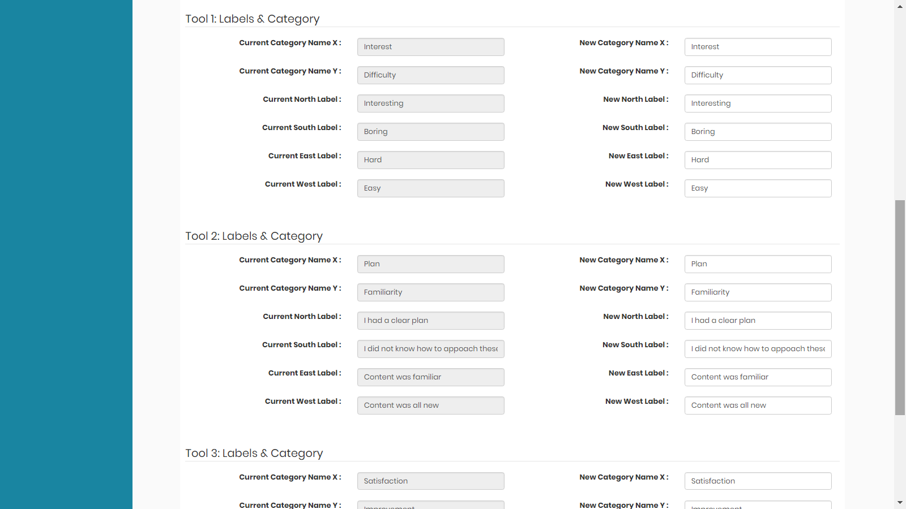
Create your own questions
Notes:
In the latest version of the tool you can edit any of the questions (limited to three questions) We don’t recommend any more than three questions.

Slide 16
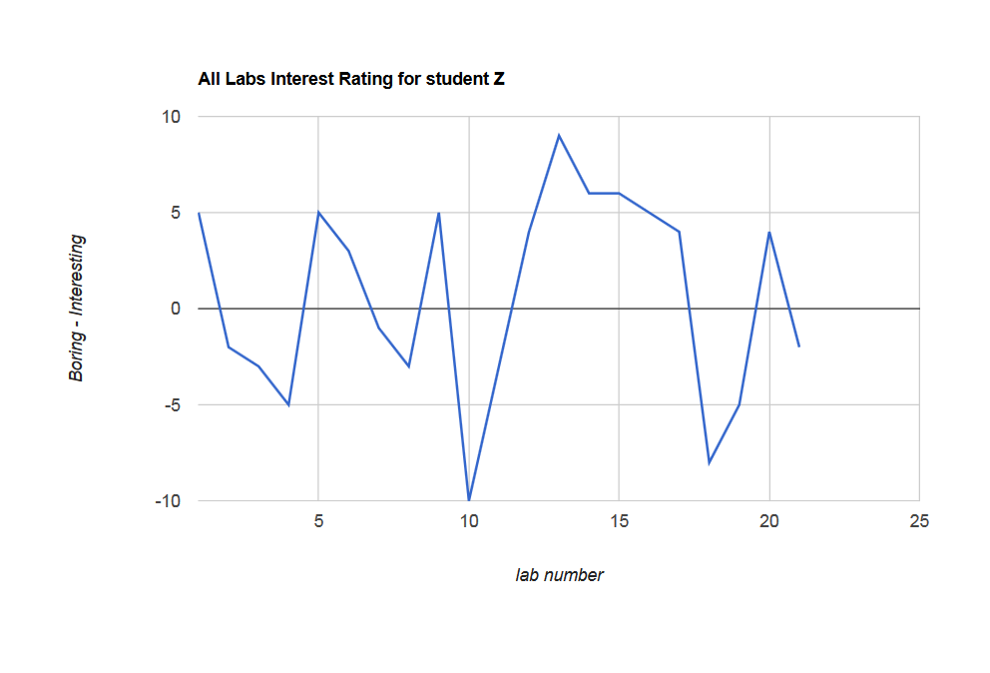
Notes:
We can look in more detail by looking at a single scale for an individual student across the labs. In this graph we are looking at the boring to interesting scale and we can see student Z reports that half the labs are on the boring side of the scale this is an unusually large number, most students report the labs as interesting. the next thing we would do with this students is check the difficulty scale and maybe his frustration levels.

Slide 17
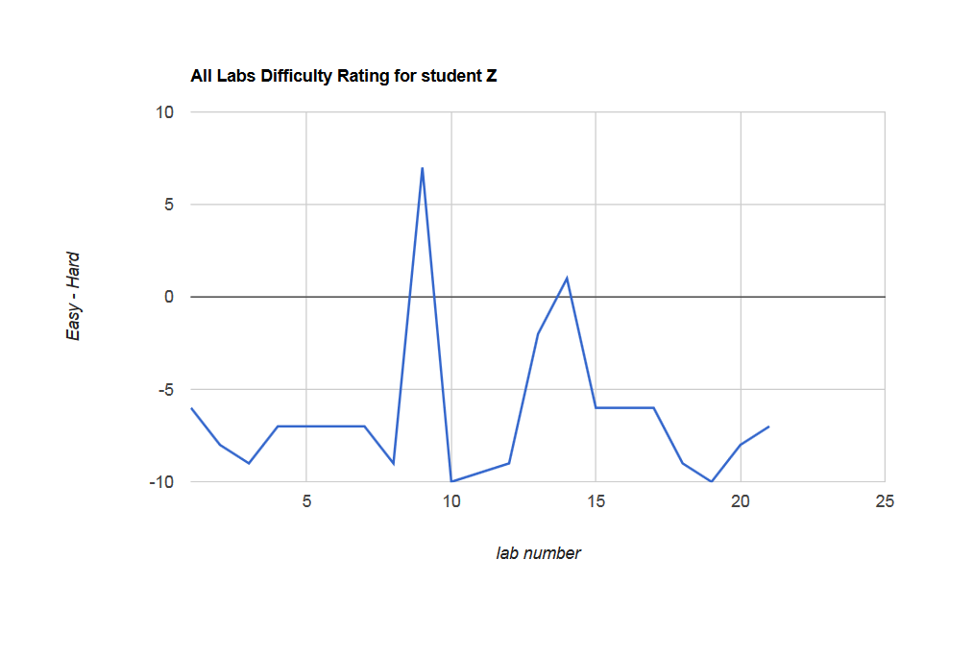
Notes:
Here we have student Z again showing the easy to hard scale, and he is actually reporting most of the labs as very easy, this student needs more challenge than the course is currently providing.

Slide 18
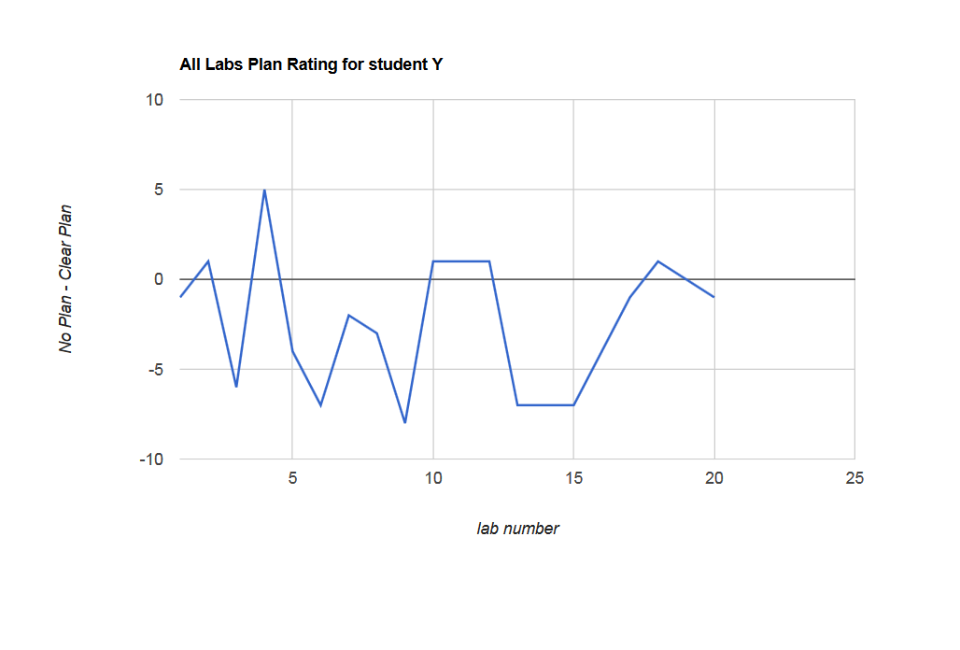
Notes:
This is the no plan clear plan scale, a negative score means this student has no idea how to approach the problem. Here we look at student Y, they seldom have a clear plan. This pattern was quite unusual because each of the labs are tied to the material that has just been presented. So the next thing we checked about this student was whether they were recognising common programming patterns

Slide 19
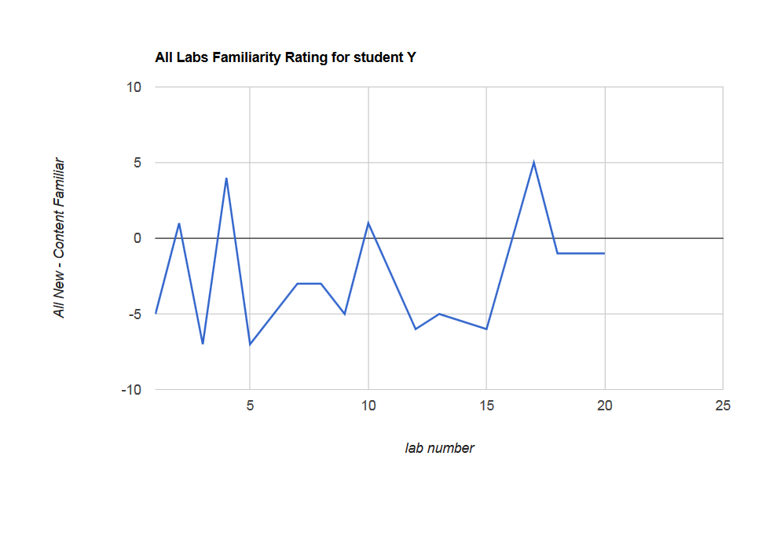
Notes:
Here we are looking at the familiarity scale where -10 means the content is all new and +10 is the content is very familiar. We can see here that student Y is occasionally recognising familiar content but most of the time they feel that the content is all new.
This is clearly a student at risk. We expect the majority of labs to be familiar as the content is all scaffolded very carefully each lab introduces a little bit of new material but incorporates the previous material.

Slide 20
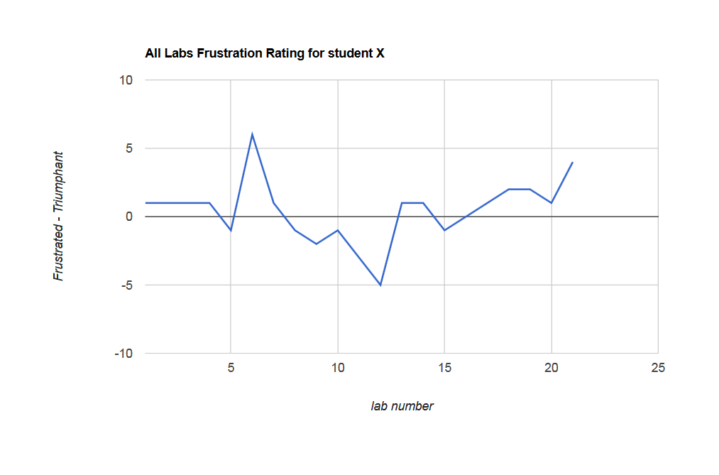
Notes:
This is the Frustrated to triumphant scale, negative numbers are frustrated. Here we see student X who had early success, a period of frustration as the course material progressed followed by a gradual climb into perceived success at the end.

Slide 21
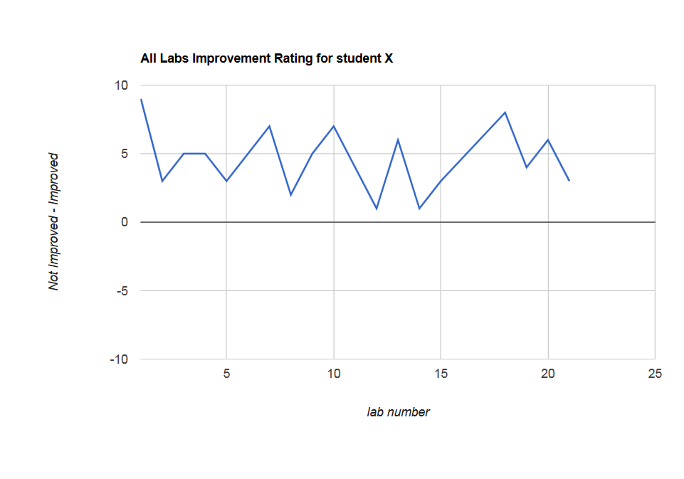
Notes:
On an even more positive note Looking at the Improvement scale This same student consistently reported that their programming skills were improving throughout the course even when they were feeling frustrated.

Slide 22
Insights into the Design of Curricular Materials
Are the labs interesting
Do they provide enough challenge
Notes:
We can also use the data to examine the course content.
Are the labs interesting
Do they provide enough challenge

Slide 23
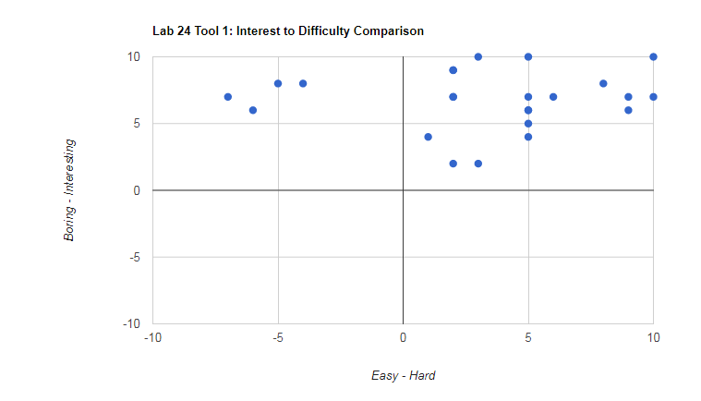
Individual lab Feedback Sorting Lab
Notes:
Here is our lab 24 for a reasonably difficult topic and we can see that the majority of the students found it hard but still interesting.

Slide 24
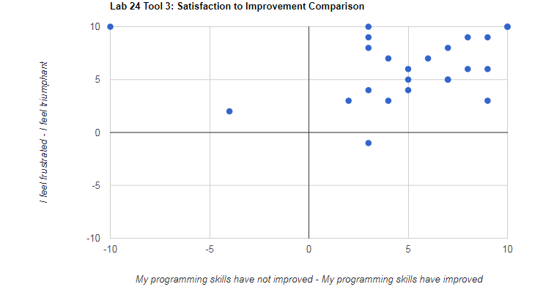
Individual lab Feedback Sorting Lab
Notes:
We are also able with tool to identify outliers, we can see that this student was feeling mildly frustrated with this lab.

Slide 25
Notes:
This graph shows all the labs and the Average Interest rating of each lab. Negative values are boring and positive values are interesting We can see from this graph that the average interest rating for all labs is always high
The average interest over all labs was 6, this is the grand mean.

Slide 26
Notes:
Looking at the difficulty graph we can see peaks when new concepts are introduced.
This is the easy hard axis we can see the strong peaks particularly at lab 5, this was their first exposure to a branching decision, lab 12 and 13 were on arrays, lab 17 was a challenging practice test.
The grand mean for difficulty came out at around one.

Slide 27
Separate analysis after the course has finished
Notes:
Once we have gathered all the data for a semester we can extract data from our database and perform further analysis on it, this is not part of the tool.

Slide 28
Notes:
Remember on the previous two graphs the grand mean for the interest scale was around six and for the difficulty scale the grand mean was around one therefore to make direct comparisons between scales, we must normalise the average responses for each lab on each scale.
This is the profile of the first lab of the semester. On the x axis we have the six different scales interest, difficulty (where easy is a negative number), satisfaction which was frustrated to triumphant, familiarity, plan and improvement. On the y axis this is the average rating for that lab collapsed across all students. The interest rating of 1.24 and the difficulty of -2.56 means the students found this lab to be interesting and easy. This lab is intended to be a gentle, introduction to the first day of the course, and therefore this pattern is appropriate.

Slide 29
Notes:
This graph shows the profile for the introduction to Data Types, and may indicate a problem with the lab's design. Students find this lab both Boring negative -1.66 in the interest scale and Frustrating -2.53 in the satisfaction scale. And although the material is not overwhelmingly seen as new, students report not knowing how to approach it -2.10 on the plan scale
Most critically, having completed it, students don't feel that they have improved
-1.36. This profile may be a signal that the course material needs reworking.

Slide 30
Notes:
Sometimes, the lab profile seems to indicate a crisis. This graph shows a lab that is seen as boring, hard and frustrating. Students don't have clear plans, and even after completing the exercise, they don't feel they have improved, this lab is the introduction to arrays. Their first complex data structure poses a significant challenge to many new programming students.

Slide 31
Notes:
Given this context, it is informative to look at the next lab -- the second in a two-part series on arrays, things have calmed down considerably. While students still don't feel they have a clear plan, they are finding the material more interesting, less difficult and less frustrating. They also feel that, compared with the previous lab, this one has improved their skills.
These sorts of analysis can be easily performed for any piece of work that the student have given dots for and the various patterns give us insight into the quality of our material

Slide 32
Scale by Final Grade Correlations
Response scale | r | Uncorrected p-value
Satisfaction | 0.421 | 0.000*
Plan | 0.305 | 0.009*
Improvement | 0.270 | 0.022*
Difficulty | -0.146 | 0.222
Familiarity | -0.101 | 0.398
Interest | 0.064 | 0.595
* significant at α= .05 by Simes
Notes:
The patterns of dots can also serve as a source of predictive data to help us identify students who are likely to do poorly in the course. We can look at the correlation between scale responses and the final grade of the students.
The Satisfaction, Plan and Improvement scales are all significantly correlated with final grade. In each case, the observed correlation is positive, meaning higher responses are associated with higher final grades. Students who feel more triumphant, have clearer plans, and feel like they are improving tend to get better grades.
Students who submit low scores on these three scales tend to perform poorly in the course, and we would suggest that educators could treat such results in their own students as a danger sign.
Responses on the Difficulty, Familiarity and Interest scales are not significantly correlated with final mark. For the familiarity and interest scales, this is not unexpected. The interest level of a lab should not be determined by one's ability to solve the problems it contains. Also, recognition of content as new or familiar should not be dependent on programming ability.
However, it is somewhat surprising that there is no evidence in our data that Difficulty responses are predictive of eventual course performance. One would expect weak students to rate labs as more difficult than strong students.

Slide 33
Notes:
This graph shows the average score for each of the scales divided up by the eventual course grades of the students so the purple line shows the average response for the students who earned As and the blue line shows the failing grades. The weakest students give relatively low scores on the Improvement, Plan, and Satisfaction scales. Moving through the grade categories, the values on these scales tend to increase with increasing final mark.

Slide 34
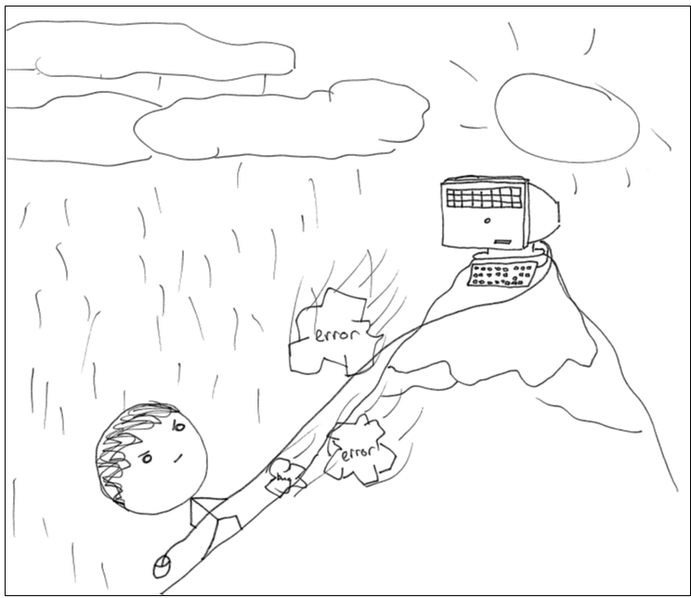
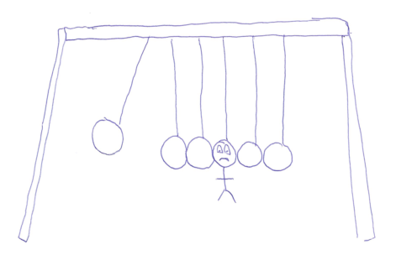
Questions
Notes:
Our students are having these very emotional experiences that we can now tap into without making anyone feel uncomfortable or taking a huge amount of time. We can use this tool to identify students at risk and evaluate our course material easily and quickly.

