Slide 1
Cellular Nucleus Image Segmentation
Christopher Bui
Notes:
hello everyone, welcome
My name is Chris, and before attending Metis, I graduated from UC San Diego with a bachelor’s in biophysics. As a result of my academic background and personal interests,
For my project, I decided to work on cellular nucleus image segmentation. In other words, my goal was to create a model that could detect the location of a biological cell’s nuclei simply by feeding it an image of cells

Slide 2
Agenda
Background
Workflow
Results
Future Work
Notes:
Before we dive deeper; I’d like to outline what I’ll be talking about today.
First, I’ll give a little background on my project
My workflow
Results
And future work to be done

Slide 3
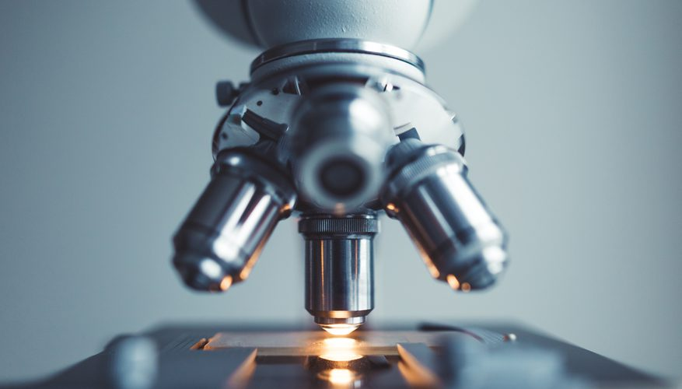
Background
Notes:
- So background. Since not everyone here might be all too familiar with biology, I’ll provide a little insight on my motivation for working on nucleus image segmentation.

Slide 4
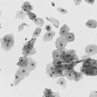
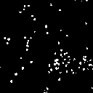
Original
Ground Truth
Notes:
- To start off, here we have an original image of a batch of cells on the left
- As a biologist, if you want to observe how a type of cell reacts to a new test drug that you have been developing, you can count to see whether the number of nuclei has increased/decreased, or also if their area has grown bigger or smaller in response to the drug.
traditionally, a biologist has to identify the nucleus with the naked eye, and then using simple software, mark their positions by hand. This can be seen here in this mask of the original image. We call it the ground truth because the white regions designate the correct location of a nucleus, and black regions for anything else that’s not a nucleus. As a reminder, each white region here was done one by one, so it was very tedious.

Slide 5
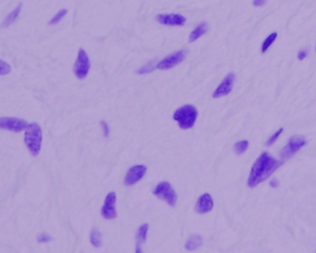

Original
Ground Truth
Current methods can’t generalize
Slow, manual task
Notes:
Now, say you have to locate and count nuclei for a different type of cell. To do so, you would still have to rely on the naked eye, but also have to adjust the settings of the software accordingly, for each different type off cell
The challenge here is that this is a a very manual task, and it can’t generalize well for cells of different types, shapes, and sizes.
To tackle this problem, i decided to build a convolutional neural network to see if it could generalize this task of locating nuclei positions in a much shorter time

Slide 6
Workflow
Get Data
Notes:
To start off, I needed to get image data so that I could train my neural network to perform the specified task

Slide 7
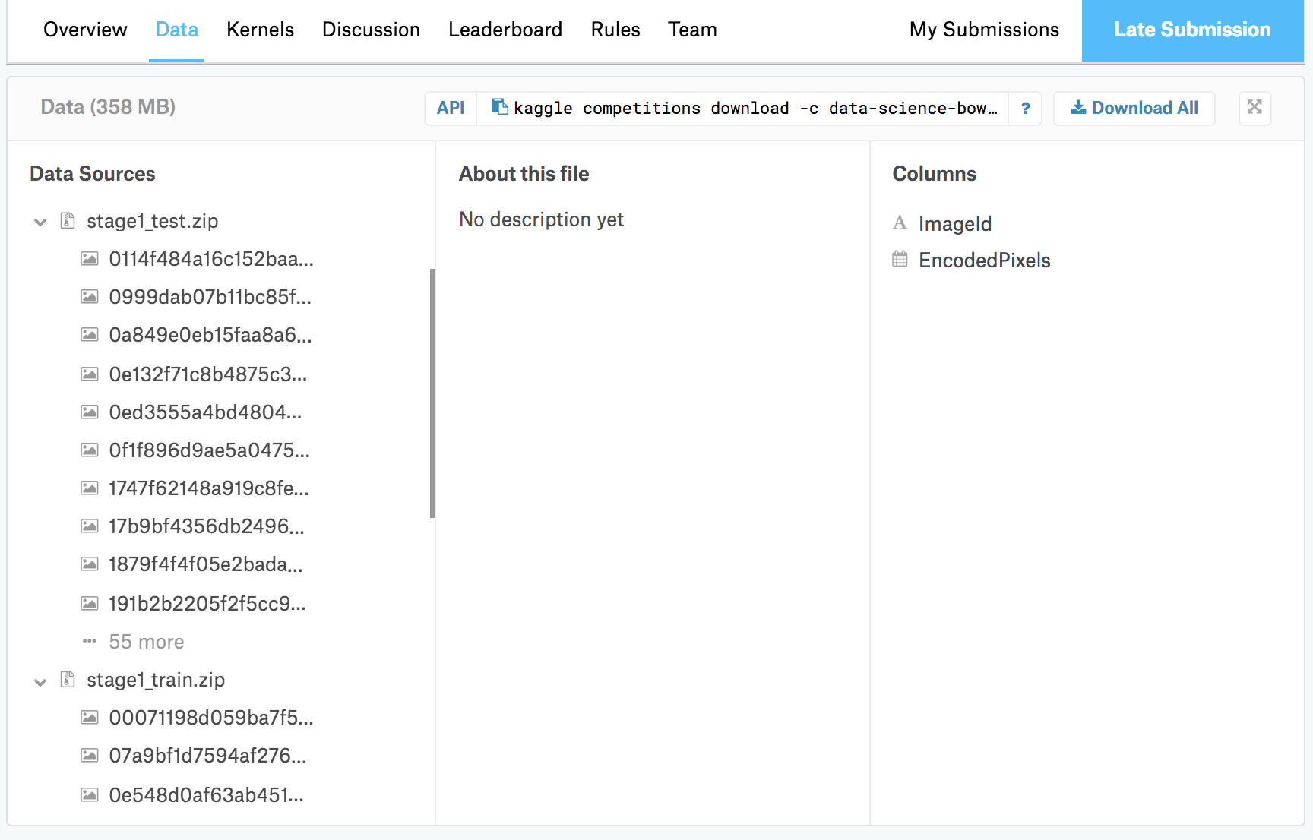
Notes:
I searched the popular data repository website, Kaggle, and I was able to acquire a dataset of 700 images of cells and their marked nuclei

Slide 8





Workflow
2
Get Data
Create Model
Notes:
Next, I processed the images using Scikit’s image library and OpenCV so that they would be in the desired size and format for the neural network.
Now, to create my model, I utilized Tensorflow and Keras to build the neural network. I designed the neural network based on the U-NET architecture.

Slide 9
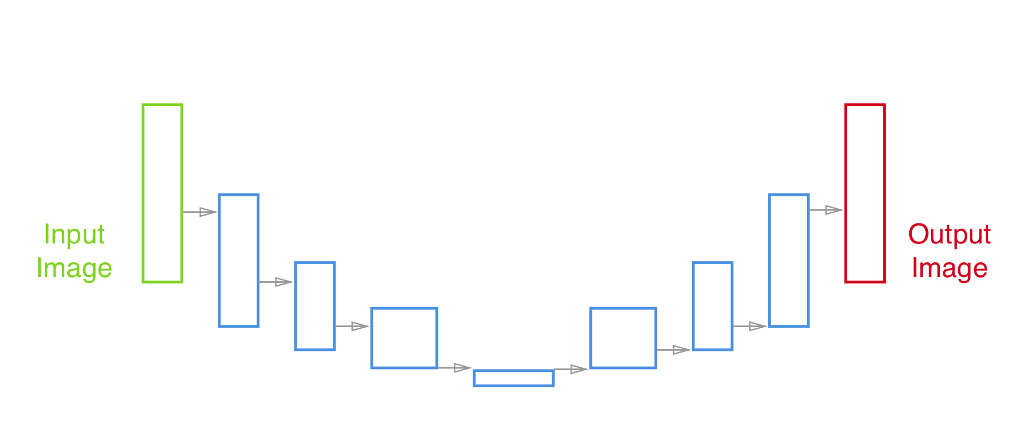
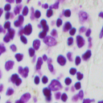
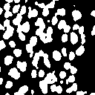
U-NET Architecture
Notes:
- Really briefly, this is the U-NET architecture for my neural network.
in essence we feed the neural network an image, and it goes through stages of processing. Through each stage, the network will learn certain features that signify what a nucleus looks like. And at the end, it will spit out an image showing regions where it thinks a nucleus is located

Slide 10


Workflow
2
3
Get Data
Create Model
Train & Analyze
Notes:
- lastly, I had to train my model. I used 630/700 images to train, and tested on the remaining 70. This task can take a couple hours if you are dealing with big image data, so I trained my model on Amazon Web Services to expidite the process.

Slide 11
Results
Notes:
- so how did we do?

Slide 12
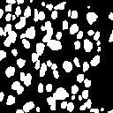
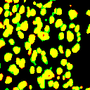
Original
Ground Truth
Predicted
Overlay
Notes:
- first i would like to show you the original image of a batch of nuclei shown on the left
Here, on the right is the ground truth mask for this image.
Then, when we feed the original image into the neural network, it gives us this predicted result.
and by overlaying the ground truth and predicted results on top of each other, we can evaluate our results

Slide 13
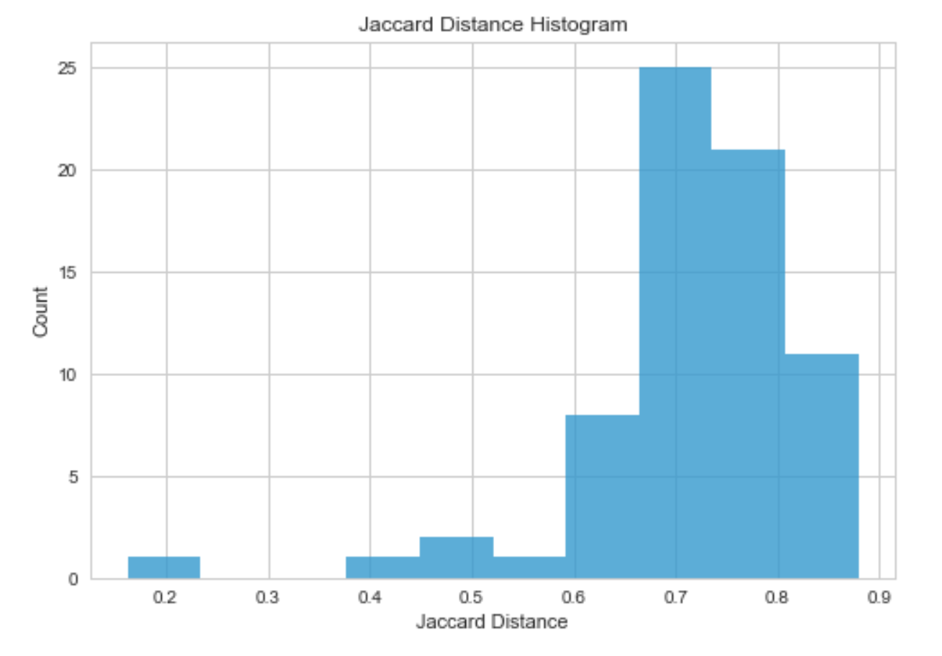
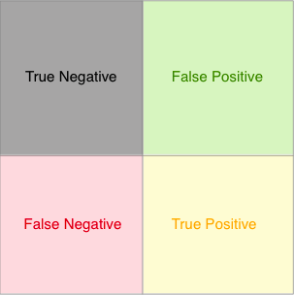
Results
Overlay
Metric:
Jaccard Distance
75% Average
Notes:
This is the same overlayed image again for reference.
Yellow regions represent a true positive meaning that the model was able to identify correctly regions of nuclei. Red represents a False Negative, meaning that the model did not pick up on these regions, and Green represents a False Positive, meaning that the model predicted incorrectly
For a biologist, although not perfect, these results are quite good. Even though there are regions of error shown in red and green, we were still able to segment out significant chunks of nuclei. For practical purposes such as counting or evaluating their size, this is a promising starting point.
to quantify these results, I evaluated my model based on the Jaccard Distance metric. This means that we take the area of the correct yellow regions divided by the total area of all 3 colors to get a percentage.
On average, I was able to get a 75% jd value, meaning it was able to segment out on average 75% of the correct regions of nuclei
Here is a histogram of jaccard distance values for my test set. We see that some did below the average, while a handful got close to 80&90% as well

Slide 14
Future Work
Enabled new analytic methods
Count number of nuclei
Calculate the size of the nuclei
Improve model
More training data
Other architectures
100 Layers Tiramisu, AlexNet
Notes:
So for future work…
- Although this model is not 100% perfect, it provides promising results
It has enabled us to apply new analytic methods when studying a cell’s response to a test drug. Since we now can detect the locations of the nucleus, we can either count the number of nuclei or calculate their size in a reasonable amount of time. Previously, such tasks were done manually and extremely time consuming. With this model, we were able to get promising results nearly instantly.
In addition, I intend to improve this model by acquiring more training data, as neural networks improve significantly with additional data and Also I plan to experiment with different neural network architectures aside from U-Net. Some architectures to try are well known ones such as 100 layers tiramisu, and AlexNet to see if I could get better results.

Slide 15

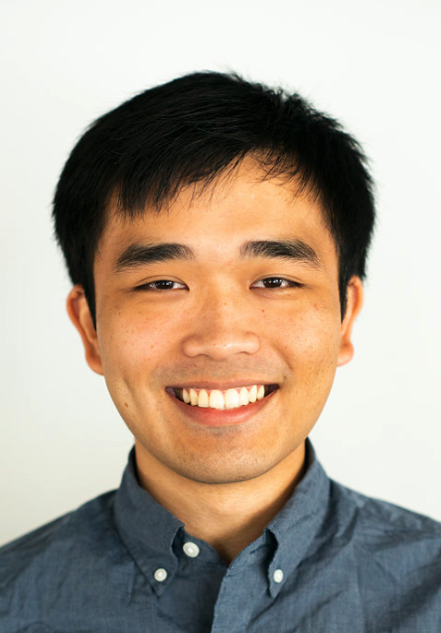





Thank You For Your Time
christopherbui@gmail.com
github.com/ChristopherBui/Metis_Projects
linkedin.com/in/chrisbui415/
medium.com/@Chris_
415-213-2805
twitter.com/chrisbui415
Notes:
This concludes my presentation, thank you for your time

