Slide 1

Industry: Financial Services
By: Victor Abril-Sanchez, Sweta Virani, Sydney Penny, Chris Cruz

Slide 2


Objective
Download a consumer complaint dataset about multiple financial products and services from financial companies
Develop an interactive dashboard with the obtained data

Slide 3

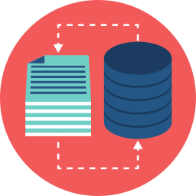
The Dataset
The dataset was downloaded as a CSV file from the Consumer Complaint Database of the Consumer Financial Protection Bureau webpage
The dataset was cleaned and processed to only include the following columns:
Date received
Product
Company
Date sent to company
Company response to consumer
Complaint ID
Notes:
Date received- The date the CFPB received the complaint. For example, “05/25/2013.”
Product - The type of product the consumer identified in the complaint. For example, “Checking or savings account” or “Student loan.”
Company - The complaint is about this company. For example, “ABC Bank.”
Date sent to company - The date the CFPB sent the complaint to the company.
Company response to consumer - This is how the company responded. For example, “Closed with explanation.”
Complaint ID - The unique identification number for a complaint.

Slide 4
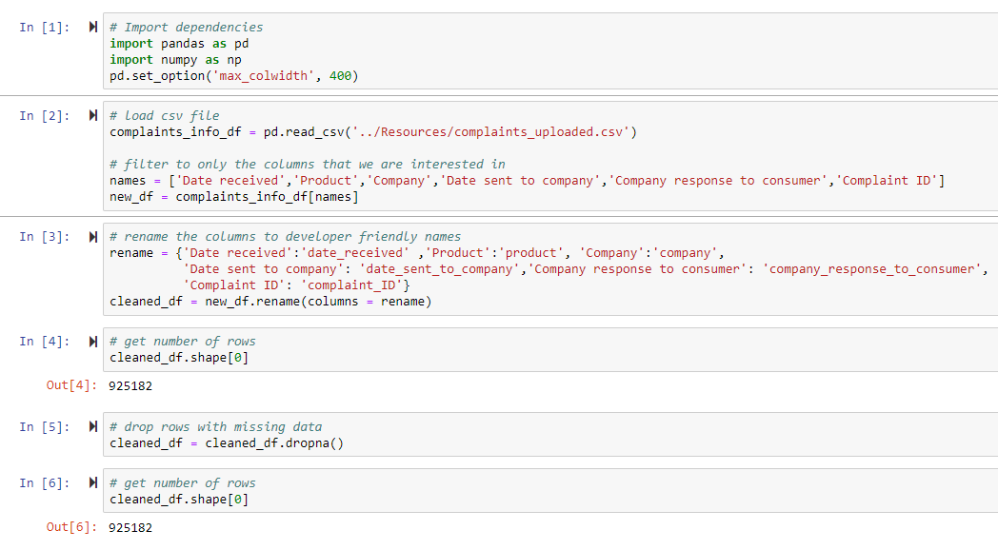
Data Cleaning
Dataset is from April 1, 2022 to March 31, 2023 consisting of 925,182 records of such complaints
Dataset in .csv file format was parsed through pandas in Python:
Filtered for required columns
Renaming columns
Checking for missing data
Updating datatypes
Sorting by dates
Cleaned dataset file is stored in Resources folder

Slide 5
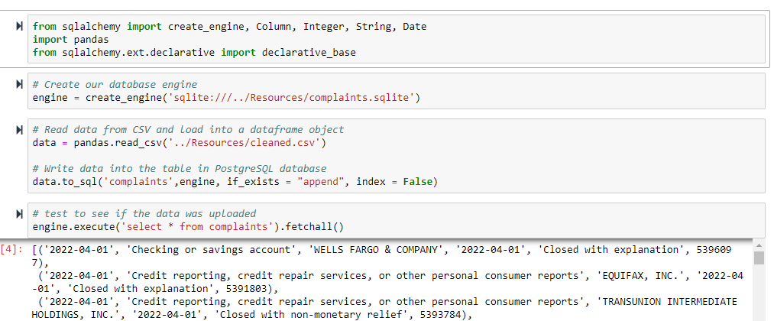
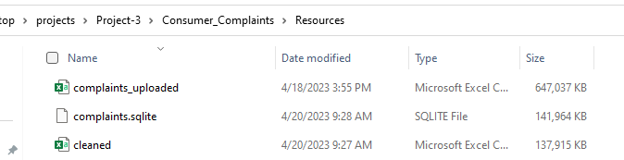
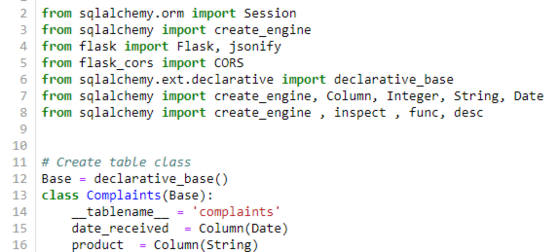
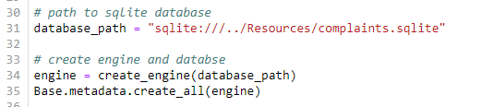
Database Creation
Python library SQLAlchmey and pandas were used :
To create SQLite Database - complaints
Read from the cleaned datafile csv and update the database
Create SQLite database file to store Resources folder
Complaints Class was created to model the SQLite Complaints database table

Slide 6
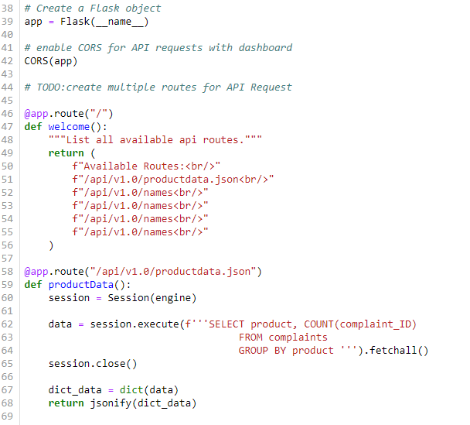
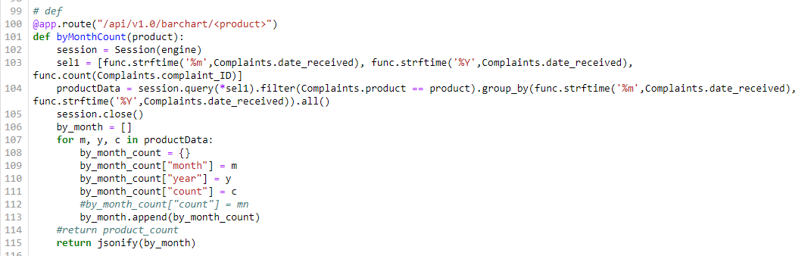
API Script Creation
Used Python Flask web framework to develop different app instances were built to query and fetch the data using :
SQL Alchemy class Complaints
Using SELECT statement
Sorting and filtering was done through FLASK object to render huge dataset seamlessly on HTML

Slide 7
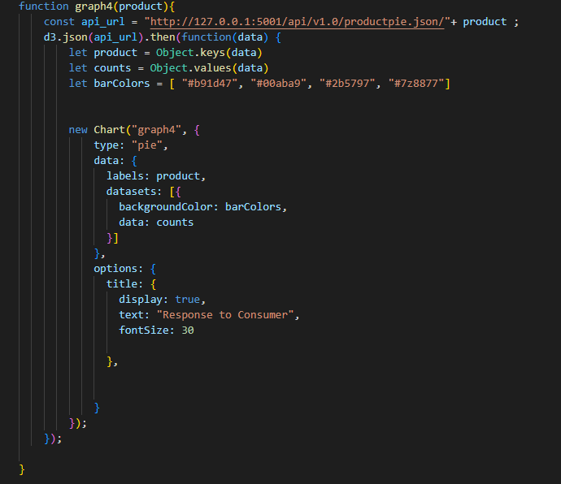
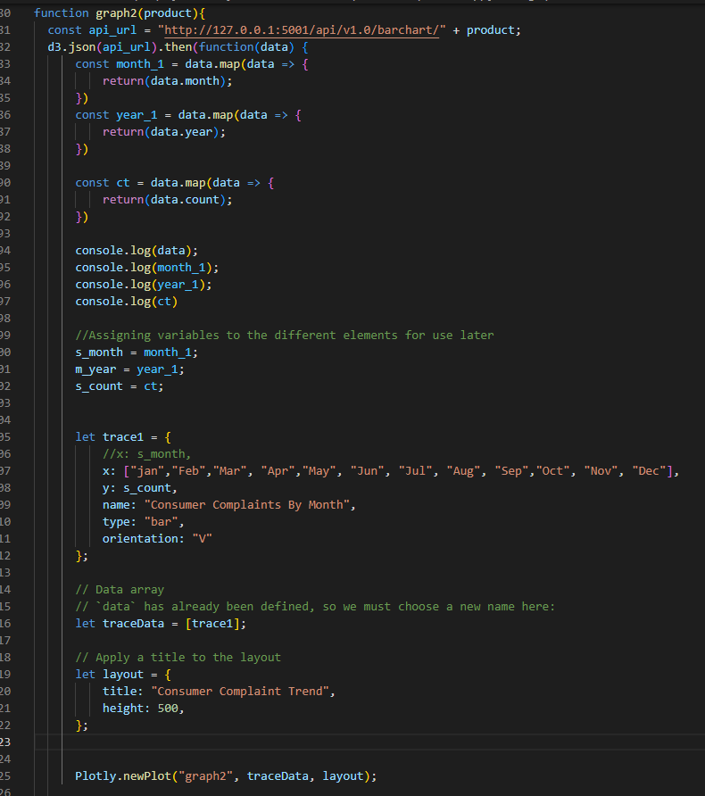
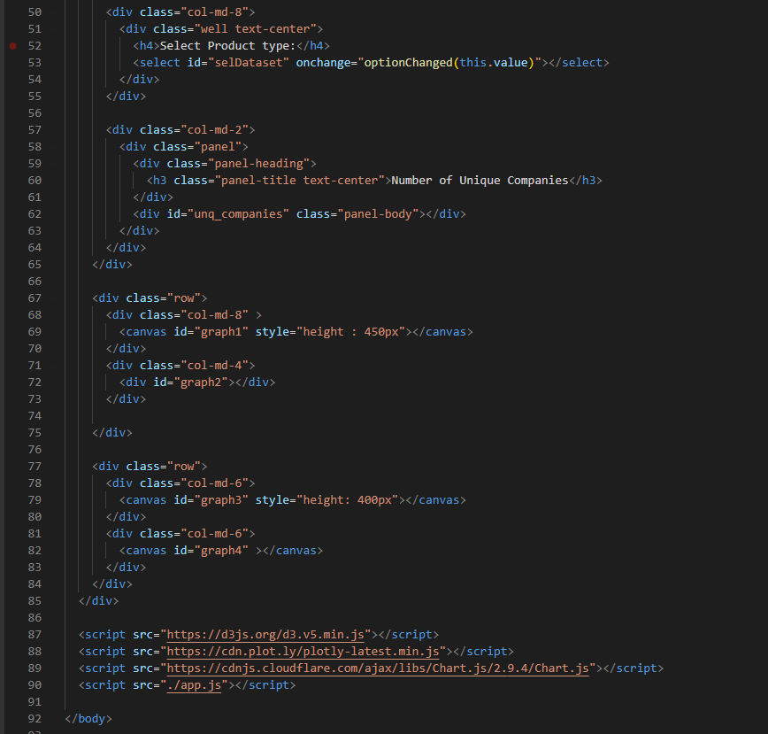
Dashboard Creation
JavaScript D3 Json library was used to render the data via api_url
Charts were prepared using :
Chart.js library
Plotly library
Rendered in HTML by div id’s utilizing plotly js

Slide 8


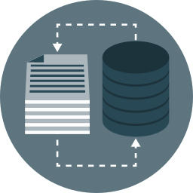




Overview of Dashboard Pipeline
Database
API
Dashboard

Slide 9
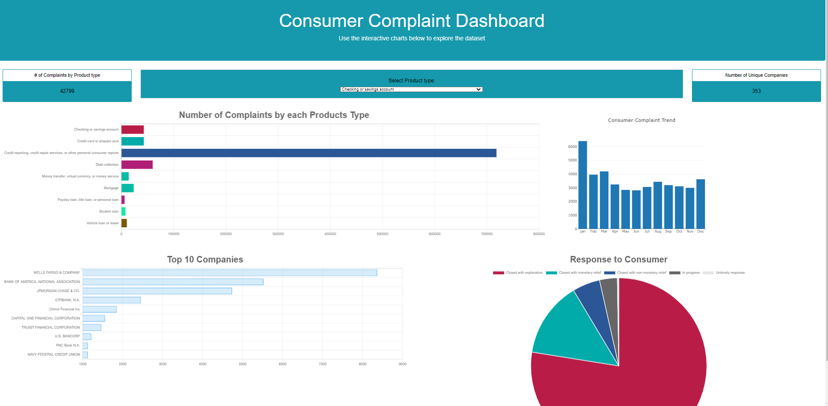
Dashboard Demo
Go to dashboard

Slide 10
Key Takeaways
Pandas was effective in cleaning the raw data in the CSV file
SQLite effectively housed the table that had the data needed
Python Flask was used to query and fetch the data
Javascript was used to create interactive charts that display and filter the data

Slide 11

The End…
Questions?

