Slide 1
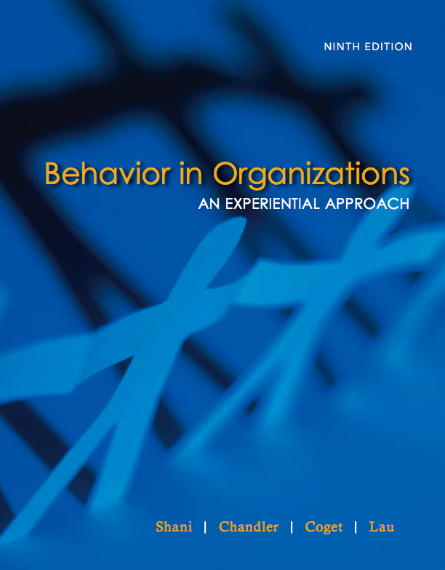
Module Three
Learning-in-Action

Slide 2
Learning-in-Action
Module begins with knowing about knowing
    Knowing as a set of inter-related operations: experience, understanding, judgment, decision/action
    Applying these to self and to behavior in organizations
    Adopting an attitude of inquiry

Slide 3
Experience
Interaction of inner and outer events
    Inner events: own thoughts, feelings, imagining, remembering….
    Outer events: what we see, hear, smell, taste, touch

Slide 4
Understanding
Search for understanding is intelligent
Questioning experience
    What was that…(noise)?
    What does this mean?
Insight
    Act of understanding
    Grasps a pattern in experience
    “I get it”

Slide 5
Judgment
Is my insight accurate/true?
    Yes?
    No?
    Maybe?
    I don’t know

Slide 6
Decision/Action
Judgment of fact – This is true/accurate
Judgment of value – this is good/bad…
Judgment of value
    Leads to decision to act

Slide 7
Table 3.1 The Operations of Human Knowing
Experience | Seeing, Hearing, smelling, Tasting, Touching, Remembering, Imagining, Feeling…
Understanding | Inquiring, Understanding, Formulating what is being understood
Judgment | Marshaling evidence, Testing, Judging
Decision/Action | Deliberating, Valuing, Deciding, Choosing, Taking action, Behaving…

Slide 8
Organizational Life
“Swampy lowlands” [Schon]
Problems [Revans]
Question is:
    What kind of knowing do we need in this setting?
    How do we develop skills in this form of knowing?

Slide 9
Revans on Puzzles and Problems
Puzzles are those difficulties for which there is a single solution and are amenable to expert advice
Problems are those difficulties where there is no single solution because people advocate different solutions, depending on their values, past experience, intended outcomes….

Slide 10
“Swampy Lowlands”
[Schon]
“High Ground” – where researchers study issues from a distance, and unimportant issues may be studied according to predetermined standards and rigour.
“Swampy Lowlands” where problems are messy, confusing and incapable of a technical solution and can only be confronted where researchers are immersed in the “swampy lowlands”.

Slide 11
The Everyday World of Organizational Life [the “swampy lowlands”]
Varies from place to place and from situation to situation
What is familiar in one setting may be unfamiliar in another; what works in one may not work in another
No two repeated situations are identical. Time has passed. Things have changed. We remember differently

Slide 12
Table 3.2
Issues and Roles of Engagement in Puzzles and Problems
 | Puzzles | Problems
Issues | Technical issues which have a single solution and are amenable to expert advice | Problems are messy, with no single solution and are not amenable to expert advice. People propose different solutions out of their own perspectives and values
Roles of Engagement | Detached observers and experts who can analyze, assess and make recommendations based on their expertise. | Engaged actors who are close to the action and who engage in experience, understanding, judgment and decision/action and collaborate with others to solve problems.

Slide 13
Knowing in the Everyday
Knowledge is always incomplete
Therefore, we need to be attentive, reflect and judge each situation in order to move from one setting to another
Learning-in-action
    What is happening in this situation?
    How do I behave?

Slide 14
Inquiry from Outside
Inquiry from Outside
    Schon’s “high ground”
    Detached Onlooker
    Applying a prior categories from textbooks
Inquiry from Inside
    Experience as actor in the setting
    Immersed in local setting, “swampy lowlands”
    Engaging in learning-in-action

Slide 15
Reflective Practice
The process of knowing-in-action, that is attending to experience, understanding and judgement is called “reflective practice”
The person doing it is a “reflective practitioner”
Learn to do this. Practice it.

Slide 16
Taking an Attitude of Inquiry
Questioning is at the core of adult learning
Inquiring into experiences of organizations
    What you see, hear…
    Be attentive to what goes on around you
    Ask yourself questions?
    Keep an open mind

Slide 17
Reflection
Stepping back from experience
Searching for insight into experience
Questioning
    Outer events – what happened?
    Inner events – what was I thinking, feeling…?

Slide 18
Four Areas of Experience
Intentionality
    Area of purpose, aims, goals, vision
Planning
    Area of plans, stratergy, tactics, ploys, schemes…
Action
    Area of action, behavior, implementation, skills, performance
Outcomes
    Area of results, consequences, outcomes, effects…

Slide 19
Purpose
Triple loop inquiry
Goals
Double loop inquiry
Actions
Single loop inquiry
Outcomes

Slide 20
Right Hand/Left Hand Column
What I Actually Say
What I am Thinking and Do Not Say

Slide 21
Keeping a Journal
Significant mechanism for developing reflective skills
Noting observations and experiences in a notebook
Creates discipline of reflection
Captures experience close to events and before time changes perception

Slide 22
Journal Keeping
Helps reflect on experience
Helps anticipate future experiences
Helps integrate information and experiences
    Reflect on reasoning process
    Reflect on emotional processes

Slide 23
ORJI
Observation
    What I experience
Reaction
    How I react emotionally
Judgment
    What I judge
Intervention
    How I act consequentally

Slide 24
ORJI
Attend to reaction. Catch the emotional response
Acknowledge feelings
Seek insight into your feelings so as not be deny them or act on them without being aware
Use journal to capture them

Slide 25
Helping Others Learn-in-Action
Process Consultation
    Work of Edgar H. Schein
    Helping people help themselves
    Helping people engage in their own reflection on experience, have their own insights make their own judgments and develop their own action strategies

Slide 26
Three Forms of Inquiry
Pure Inquiry
Exploratory Diagnostic Inquiry
Confrontive Inquiry

Slide 27
Table 3.4 Helping Others Learn-in-Action
 | Intervention | Examples
Uncovering Experience | Pure Inquiry | What is going on? What happened? Tell me the story. What did you do?
Probing for Insight | Exploratory-Diagnostic Inquiry | Why do you think that happened? What do you think is going on? How do you feel about that? What are you going to do?
Aiming for Judgment and Decision/Action | Confrontive | Have you considered…? If you read… you might find an explanation.

Slide 28
Approaches to Learning-in-Action
Experiential learning
Action research
Action Learning
Action Science
Action Inquiry
Reflective Practice
Work-Based Learning
Collaborative Research
[Appreciative Inquiry]

Slide 29
Experiential Learning
Term used in training & development
Module 2

Slide 30
Action Research
Approach to research that
    Engages in research in action
    Research with people, not on them
    Participative, democratic collaboration
    Seeks to contribute to both more effective action and to theory.

Slide 31
Action Learning
Approach to management learning and development
Components:
    Problem
    Group
    Commitment to taking action
    Commitment to learning
    Engagement in cycles of action and reflection
    Facilitator

Slide 32
Action Science
Approach that explores thinking process and how thinking affects action (“theories-in-use”)
    Assumptions we have about situations
    Inferences we make about people’s motivations, intentions and behaviors, that we do not test
    How we act on them inhibits learning and create organizational defensiveness

Slide 33
Action Inquiry
Approach developed from Action Science that explores learning-in-action in terms of stages of ego development

Slide 34
Reflective Practice
Approach that focuses on individual’s critical reflection
    Awareness your own frames for understanding situations
    Building experiences of reflection in action
    Examing episodes of practice
    Studying processes where you learn to reflect in action

Slide 35
Work-Based Learning
Hybrid of techniques from action research, action learning, action science and reflective practice for management development

Slide 36
Collaborative Research
  Collaborative Research is an effort by two or more parties,
  at least one of whom is a member of an organization or a system under study and at least one of whom is an external researcher,
  to work together in learning about how the behavior of managers, employees, management methods, or organizational arrangements affect outcomes in the system under study,
  using methods that are scientifically based and intended to reduce the likelihood of drawing false conclusions from data collected,
  with the intent of improving performance of the system and adding to the broader body of knowledge in the field of management”

