Slide 1

Module Four
A Psychodynamics
Perspective of Human
Behavior

Slide 2
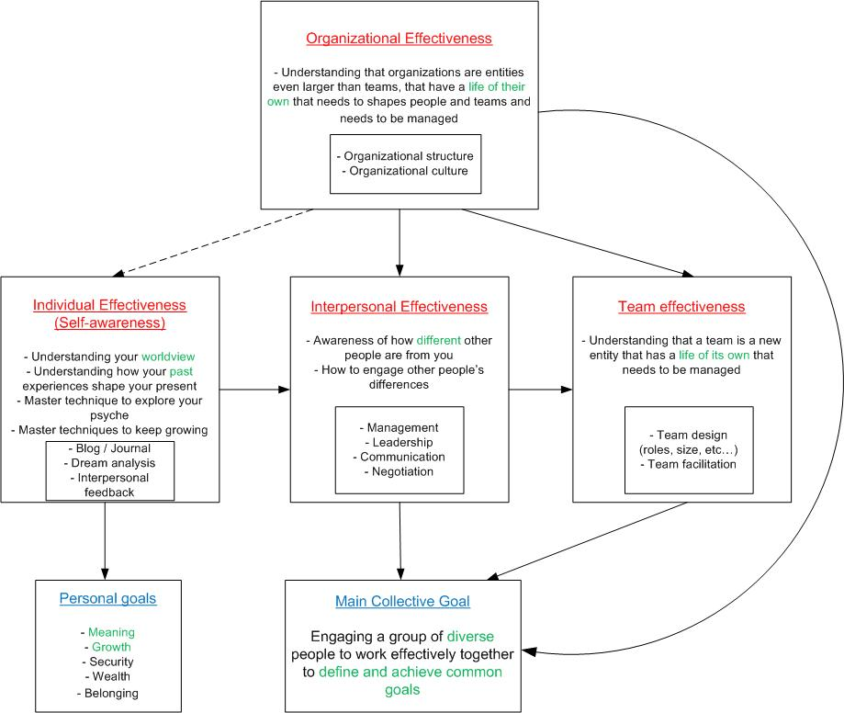

Slide 3
Agenda/Learning Goals
Fasten your seatbelts…
Reflecting on the pre-session activity
Towards a deeper level understanding of the psychodynamics of human behavior
The relevancy to work place behavior and management practice- To aid how you manage your interactions with others, including your boss, as well as how you manage yourself.

Slide 4
The Nature of Individual Differences
Cultural diversity
Ethnicity and race
Demographic diversity
  Gender diversity
  Age diversity
Personality

Slide 5
The Individual’s Work Behavior: A Partial Schematic
Individual Demographics
Gender
Age
Education
Work Experience
Cultural Backgrounds
Ethnicity & Race
Values
Beliefs
Organizational Features
Nature
Leadership
Org’l Structure
Policies
Ability and Skills
Intellectual
Physical
Work Competencies    
The Individual's Work Behavior And
Self Concept
Work Features
Nature of Work Tasks
Nature of Relationships
Physical Work Envirmt
Nature of Reward System
Personality
Nature
Structure
Family Dynamics
Marital Status
Number of Dependents
Parental Status

Slide 6
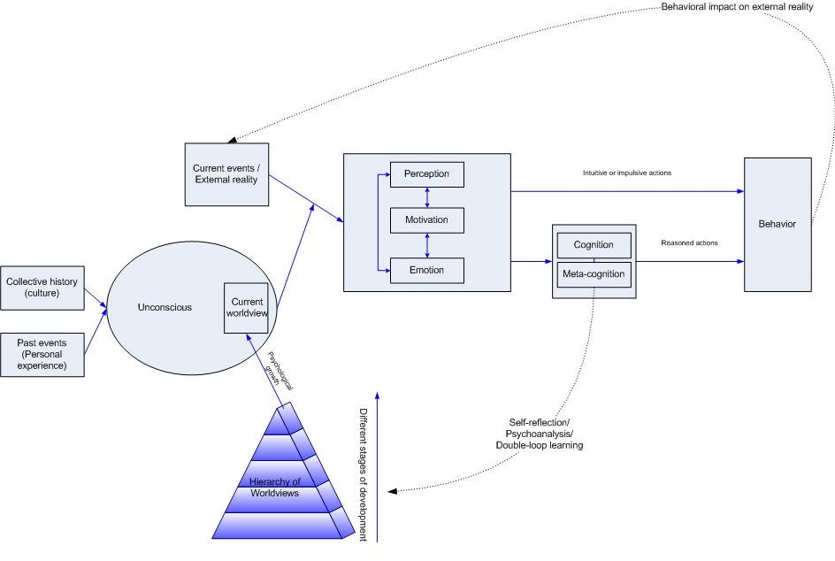
An integrative model of human psycology

Slide 7
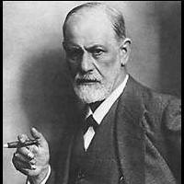
Sigmund Freud, the father of psychoanalysis
“Every normal person, in fact, is only normal on the average.
His ego approximates to that of the psychotic in some part or other and to a greater or lesser extent.”

Slide 8
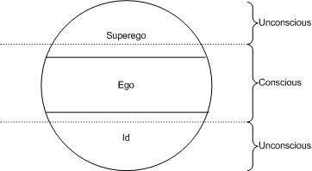
Freud: id, ego, and superego

Slide 9
Defense mechanisms
Denial
Reaction formation
Displacement
Repression
Projection
Rationalization
Sublimation

Slide 10
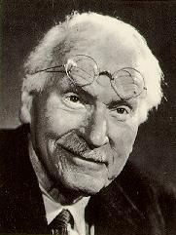
Carl Jung, the mystic
“A man who has not passed through the inferno of his passions has never overcome them.”
“Psychological insecurity . . . increases in proportion to social security.”

Slide 11
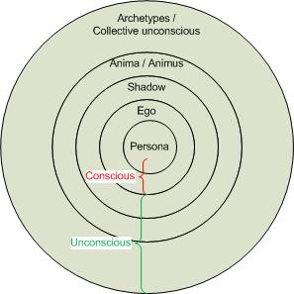
Jung’s view of the unconscious

Slide 12
Want to know more about Jung?
Robert Johnson:
  “He”
  “She”
  “We”
Carl Jung:
  “Memories, Dreams, Reflections”

Slide 13
Other important psychoanalysts
Alfred Adler:
  The inferiority complex
Carl Rogers: humanistic psychology and unconditional regard
Melanie Klein:
  The mother-child relationship
Victor Frankl:
  logotherapy
  "Man in search of meaning"
  3 sources of meaning:
    Love
    Creation
    Suffering

Slide 14
Developmental psychology
Different theories agree that psychological development happens in stages:
  Kohlberg and Gilligan’s moral development
  Piaget’s development of intelligence
  Wilber and Beck & Covan’s hierarchy
  Maslow’s need hierarchy

Slide 15
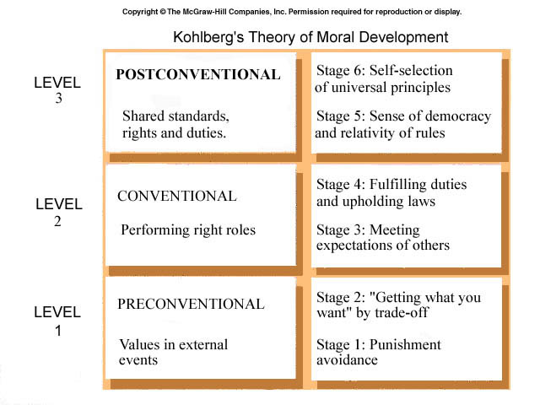
Lawrence Kohlberg’s theory of moral development

Slide 16
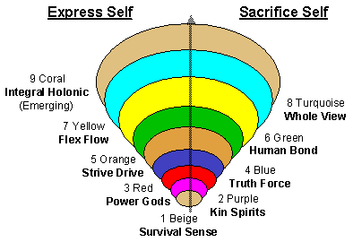
Wilber’s stage model of human development
Survival instinct
Tribal order
Power self
Absolute order
Enterprising self
Egalitarian order
Integrated self
Global order

Slide 17
How many reach the highest stages?
1% at survival self stage
10% at tribal order stage
20% at power self stage
40% at absolute order stage
20% at enterprising self stage
10% at egalitarian order stage
less than 1% at integrated self and global order stages

Slide 18
More on Ken Wilber
We can always regress to lower levels under stress
We can be unevenly developed in different arenas (intelligence, sensori-motor, psycho-sexual, relational, etc…)
To know more:
  Read the article I put on blackboard
  Read "A brief history of everything", Wilber

Slide 19
Myers-Briggs Type Indicator (MBTI)

Slide 20
Myers-Briggs Type Inventory
Preferences: What are the eight preferences? What does preference mean?
What does MBTI help me to understand?
  Your own preferences
  Preferences of others with whom you interact
Why is that important?
  Greater understanding of others
  Can lead to better communication, greater effectiveness, better team work, fewer conflicts, etc.

Slide 21
The Four Pairs of Preferences Based on the Myers-Briggs Type Indicator (MBTI)
Ways of
Gaining Energy
Ways of Taking in Information
Ways of Making Decisions
Ways of Living in The World
Introversion Extraversion
Intuition Sensing
Thinking Feeling
Judging Perceiving

Slide 22
* Sources developed from:
P.J. Howard, P.L. Media, and J.M. Howard, The Big Five Locator: A Quick Assessment Tool for Consultants & Trainers, in J.W. Pfeiffer (ED.) The 1996 Annual: Volume 1, Training (San Diego, CA; Pfeiffer & Company) PP. 107-122. and
D. Hellrigel, J.W. Slocum, Jr., R.W. Woodman, Organization Behavior (South Western Publishing, 8th Edition) PP. 46.
The Five Factor Model of Personality - The Big Five*

Slide 23
The Five Factor Model of Personality -
The Big Five*
Secure, Unflappable
Rational,
Unresponsive, Guilt Free
Adjustment
Excitable, Worrying
Reactive, High Strung,
Alert
Extraversion
Private, Independent
Work Alone, Reserved
Assertive, Sociable
Warm, Optimistic
Openness
Imaginative, Curious
Original
Unimaginative, Dull
Literal Minded
Agreeableness
Skeptical, Questioning,
Tough, Rude
Tactful, Trusting
Humble
Conscientiousness
Planful, Neat
Dependable
Impulsive, Careless,
Irresponsible

Slide 24
For Reflection & Discussion
In your opinion, does nature or nurture best account for variations in people’s personalities?
Think of a few of your personality traits. What influenced the formation of those traits (e.g., I got my outgoing nature from my mom; I get my temper from my mom)?
Can people’s personalities change? If so, when and why?
Do you believe that the MBTI does NOT reflect your personality?
Do you resent being summed up by a survey test or, in particular, the MBTI test?

Slide 25
How To and Not To Think About Your MBTI Results
Do:
Realize that you prefer behaving in certain ways based on your MBTI results
Don’t:
Use the MBTI as a “crutch”: This is just how I am, so don’t expect me to behave differently.”
Consider the MBTI the only measure of personality.
  There are other means of measurement
  Personalities are very complex – surveys can only capture certain facets of personalities

Slide 26
Introversion/Extroversion
What is it like to be in your category?
What do you think it’s like to be in the opposite category?
What are some positive and puzzling (even negative) things about people in the opposite category?
What questions would you like to ask someone in the other group?
Notes:
Divide up class – Need Is to leave classroom, strong Is in one group – moderate or slight in another group
Divide up Es in the classroom by strength on the dimension. Appoint scribes! – Especially get the Is to write things down! Take their papers!
Discuss these three questions – everyone write down some things you find to be positive about the other group, and some things you find puzzling. Questions.
What happens if you ask an E a question? What about asking an I a question?
(Is need 10 seconds to collect their thoughts – Es start talking before they finish thinking)
Brain studies – Is think first then talk; Es talk first, then think
Positron Emission Tomography – can scan brains to watch what happens when you think – when ask Es a question, the talking part of the brain lights up, then few seconds later the thinking part lights up. For the Is, the thinking part lights up before the talking part!
Ever had professor ask, Any questions? Great. This is so people will think we care but no one will actually have time to come up with a question. The Is are sitting there pondering.
Meetings – what’s it like to be in a meeting with an introvert? An extrovert? –
Ever had experience where sitting in team meeting and 3 people are doing all the talking? Others say nothing? What is that like? If you’re the talker? The listeners? Why is that happening? What can be done? Can’t just expect Is to interrupt because like telling Es to just be quiet. Techniques – count to 10, ask all and wait for answers, assign someone to draw out the Is.Pay attention to structure of meeting so all can be heard.
Meeting agendas: Imagine headed to team meeting. Es show up wanting to think out loud about where the meeting should go. Is might show up having already thought through a tentative agenda, but they don’t want to be too presumptuous, so may not share it. Ever happened? May want to start meetings by hearing from Is who like to see information in advance and think a bit first.
Is prefer to read information beforehand – want to process mentally by themselves – don’t want to edit with someone
Es prefer to have things explained out loud – need an audience to think aloud – verbal brainstorming
Can’t always tell if someone is I or E – handwriting example – Is can act extroverted, but it’s just more difficult for them
Is charge their batteries by being alone
Es get energized by being with other people
If you’re an I, what personality type would you want for a boyfriend/girlfriend/spouse?

Slide 27
Where do you get your energy?
How we relate to others
The Extroverted Attitude (E)
Attention flows out to objects and people in the environment
Essential stimulation is from the environment
Focus is on the outer world of people and things
The Introverted Attitude (I)
Energy is drawn from the environment, and consolidated within one’s position
Essential stimulation is from within
Focus is on the inner world of thoughts and reflections

Slide 28
Characteristics of the E/I Attitude
Extroverts
Tend to be energized by other people or external experiences
Rely on the environment for stimulation and guidance
Tend to have an action-oriented, sometimes impulsive way of meeting life
Tend to enjoy social situations & relationships
Introverts
Tend to be energized by the internal world of ideas and thoughts
Rely on enduring concepts more than on transitory external events
Tend to have a thoughtful, contemplative approach to meeting life
Tend to enjoy solitude & privacy

Slide 29
Characteristics of the E/I Attitude
Extroverts
May have multiple friendships
Have broader interests
Think best when talking with people
Prefer to act, THEN (maybe) reflect
Tend to be easy to get to know
E’s may seem shallow to I’s
Introverts
May have close relationships
Have deeper interests
Think best alone - share when ideas are clear
Prefer to reflect, THEN (maybe) act
Tend to be hard to get to know
I’s may seem withdrawn to E’s

Slide 30
Sensing / I(N)tuitive Preference
Separate into two major groups: S / N
N’s will stay in the room, S’s across the hallway
A scribe for each group should take copious notes. Be attentive to getting down what people say accurately.

Slide 31
Short Assignment
“Tell me everything that comes to mind as you describe the baseball.”

Slide 32
S/N: Ways of Focusing Attention
How we process information
I(N)tuitive Types
Perceive possibilities via the unconscious
Focus attention on meanings and possibilities beyond the five senses.
See relationship to an object based on insight encompassing a wide range of experiences with that object, associations to the object
Saw this as an imaginative exercise: “everything that comes to mind”

Slide 33
“Strength of Preference”
Hypothetical examples:
1. Jim – ENFP 100 89 1 22
2. Lou – ENFP 64 22 1 100
1 – roughly 25 represent a “slight” preference
26-67 represent a “moderate” preference
68- 100 represent a “strong” preference
The stronger the preference, the more likely your behavior “fits” with behaviors typically related to that preference

Slide 34
S/N: Ways of Focusing Attention
Sensing Types
Perceive and observe through the five senses: Sight, Sound, Touch, Taste and Smell
Focus attention on reality and what exists in the environment
See relationship to an object based on the last experience with that object
Saw this as a descriptive exercise: “describe the baseball”

Slide 35
Characteristics of the S / N Function
Sensing Types:
Have a realistic or practical orientation
Appreciate facts, details, specifics
Appreciate communication that is literal and concrete
Focus on specific parts or pieces
S’s may seem too detail-oriented and literal-minded to N’s
Intuitive Types:
Have an imaginative or theoretical orientation
Appreciate meaning, big picture and patterns
Appreciate communication that is figurative and abstract
Focus on patterns or relationships
N’s may seem fickle or impractical to S’s

Slide 36
Thinking/Feeling
How people make decisions
Rational, analytical, follow the rules
Jump to logic in times of crisis
Want to hear EXAMPLES of negative feedback
More impersonal
Worry about how everyone is coping
Monitor emotions, help solve conflicts, encourage others
May not want to give negative feedback
Focus decisions on underlying values
Notes:
Thinking types – wonder why everyone is crying
Feeling types – make decisions based on VALUES/emotions
Soccer coach – having a stroke – immediately into thinking mode – how could that happen, he’s too young, how did it affect him, where was he, what will happen to his family, to him, why, why, why – feelers – what would your immediate reaction be?
If you get sick or injured, which type would you want caring for you?
(Aunt Cheryl – always willing to fetch food, put arm around you, that must be so hard for you, you’re doing such a great job. . .)
Team relevance: What does a person who is a clear feeling type contribute to team interactions?
(harmonizers, monitor emotions of the team, good at managing conflict) – may not like to give feedback as much because it will be more personal – worry more about the person’s reactions
How do thinking types contribute best to teamwork? – rational, logical, follow the rules, concrete, look for examples, good at keeping emotions out of work – maybe better at giving hard feedback
Thinkers want to know the specific concrete examples if getting feedback. For them, the devil is in the details. Feelers may not want to bring up specifics because they want to make sure everyone’s feelings are OK. They may assume Thinkers see what they see – that they’re uncomfortable because they got quiet or their body language shifted. Whereas, the thinkers might be assuming- if you have a problem, just tell me!

Slide 37
Judging/Perceiving
How people relate to time/deadlines
Have you ever handed anything in “early”?
What time would you arrive to a 12:00 p.m. flight?
Have you ever worked with someone who likes to have everything scheduled down to the minute?
How about the team member who just can’t stand to be tied to a rigid schedule?
Notes:
P & J stuck in traffic. What’s happening in the car?
Js – ever handed in something early? How about Ps?
Do you Ps like the pressure of a deadline? They really do! Js tend to fall apart if the deadline is getting too close.
Js make deadlines, but may turn something in on time at the expense of quality – more important to make the deadline than to make it perfect.
You’re from South America, - invited to dinner at 7 p.m. – what time should you show up? In U.S. – other countries?
What kind of orientation does SMG reward?

Slide 38
Judging Perceiving
Plan ahead, handle deadlines
Well-organized in attitude and action
Enjoy making decisions, coming to closure or reaching conclusions
Like to have life under control
May seem demanding, rigid and uptight to Ps
Are spontaneous in attitude & action
Keep options open for as long as possible
Meet deadlines by a last minute rush
Are often late
May seem disorganized, messy or irresponsible to Js

Slide 39
What are the Implications of E/I for Teams?
Often, introverts assume if you don’t ask, you don’t want to know (Introvert ideas may not be heard)
Also often, extroverts assume if you don’t speak up, you don’t have an opinion (Extrovert domination of discussion)
Willingness to support a decision is highly correlated with the degree to which an individual’s voice is heard
Notes:
Es – If someone doesn’t offer an opinion, what do you assume? Is – If teammates don’t ask you for your opinion, what do you assume?
Is have A LOT to say – it just takes them longer to think of it and ways to frame it
Relevance to teamwork: Surveys of people’s willingness to support a decision – look at agreement and whether they had input into the decision
If they agree with the decision - almost no correlation with whether they support the decision
If they had input – almost perfect correlation –
If you want people to support a decision – ask for their input
Easy to assume if they don’t speak, they have nothing to say
Establish positive team norms now – ask introverts – what do you think?
Give people information ahead of time if possible!
Goal – not to pigeon hole people – people can actually change –
There’s a huge difference between your inclination and your actual behavior – just because it isn’t easy to raise my hand and talk doesn’t mean I can’t do it
You’ll find the introverts are sometimes the biggest contributors in discussions ( they like small groups better)
Do some cultures encourage extroversion more than introversion? Vice versa?

Slide 40
What are the Implications of E/I for Teams?
Introverts will enjoy seeing data, ideas, or an agenda on paper (or via e-mail) before a meeting, thus allowing them time to digest the material.
Extroverts may come to a meeting to flush out ideas/the agenda through brainstorming.
* Different ways of approaching the task at hand

Slide 41
What are the Implications of S/N for Teams?
Who is more likely to focus on the details?
Who will enable the group to see the big picture?
Implications for teamwork:
  Proofreading (?)
  Details of assignment (?)
  Keep overall focus of project (?)
Notes:
Description Activity:
Divide class into highest Ss and highest Ns, and keep groups less than 5. Send Ns into hallway and follow them with notepaper.
Instructions:
Make a list of everything that comes to mind in describing this baseball.
Ns see big picture, and details bore them – give them overviews and make it relevant to them
Ss like to approach things step by step – need facts, details, real tangible
Who would you prefer to do proofreading at end of project?
Who would you like to have do some brainstorming at the beginning – or to assist in getting the overall vision of the project?
There is virtually ALWAYS conflict between Ss and Ns -
Team Relevance: Ever been in a team meeting – one person at the keyboard typing – trying to edit and can’t agree on the sentence – someone says – Just let’s move on – skip this part
Sensors – is that hard to move on? Those details are HUGE!
Example of team conflict over creating presentation – can’t do presentation without looking at details of each slide. No, need the whole vision first.
When an N reads the assignment – may tend to get a feel for the assignment and plunge ahead. Might miss the fact that you’re actually supposed to include RECOMMENDATIONS!!! Might be useful to rely on the Ss to actually read the assignment – look at the specific details and make sure they’re all covered.
Need to take advantage of both types of skills to do best work on team!
This combination can definitely be greater than the sum of its parts

Slide 42
Writing and Analytical Styles
Extroverts and Introverts
E’s often have difficulty writing, prefer to write with little planning and benefit from discussing their drafts.
I’s tend to have less difficulty writing, prefer to write alone and are often reluctant to share their thoughts in draft form.
Sensing and Intuition
S’s like to start with factual, verifiable data and what they have learned. Their difficulty lies in sorting the irrelevant facts from the relevant.
N’s like to start with their interpretation of the meaning of complex events. Their difficulty may lie in having overlooked details essential to the reader’s understanding.

Slide 43
Writing Styles (Cont.)
Thinking and Feeling
T’s are more likely to organize their writing into clear categories, and focus on clarity to the point that they forget to interest the audience.
F’s are less likely to follow such an organized approach, but are more likely to overstate their points for emphasis.

Slide 44
Writing Styles (Continued…)
Judgers and Perceivers
J’s tend to set goals and deadlines for their material to which they rigidly adhere. In writing, J’s may focus their efforts too soon (i.e., cut short the data collection phase or cut too much in a revision.)
P’s tend to gather information indefinitely and have trouble adhering to any deadlines. In writing, P’s may produce lengthy drafts requiring focus and consolidation for the final product.

Slide 45
Emotional Intelligence

Slide 46
The Nature of Emotional Intelligence
Emotional Intelligence (EI), unlike cognitive intelligence (which more or less measure how smart a person is) integrates dimensions of intelligence and personality
EI refers to the competencies to manage one’s own feelings as well as the feelings of others.
Two sets of capabilities are associated with EI:
  Personal Competence – These capabilities determine how we manage ourselves
  Social Competence – These capabilities determine how we manage relationships

Slide 47
Emotional Intelligence Domains and Associated Competencies
Personal Competence
  Self Awareness: Emotional self-awareness; Accurate self-assessment; self-confidence
  Self Management: Emotional self-control; Transparency; Adaptability; Achievement; Initiative
Social Competence
  Social Awareness: Empathy; Org’l-awareness; Service
  Relationship Management: Inspirational leadership; Influence; Developing others; Change catalyst; Conflict management; Building bonds, Team work and Collaboration

Slide 48
Themes of Personal Growth
Theme 1: “If I don’t achieve what I want, it’s my own damned fault.”
Theme 2: “I am being programmed by someone else's tape.”
Theme 3: “I have tremendous potential for growth.”
Theme 4: “I will never feel good about others until I feel good about myself.”
Theme 5: “What are my true values?”
Theme 6: “Where am I now? Where do I want to be?”

Slide 49
A Model for Continued Growth
Change Areas
Cognitive Communicative Behavioral
Way you think about yourself and others
Way you talk to yourself
Way you behave
Processes
Imagining television scenes of self/others; changing channel to new script
Directing your new script
Trying specific behaviors from new script
Goal
Activities

Slide 50
So what?
Possibly, goal of life is to keep growing to highest levels of development and helping others do so
Development in psychodynamic terms means letting go of the earlier phase.
Dream analysis, and attentiveness to your emotions helps you navigate the paradigm shift.
As you grow to higher stages, you become a better leader and manager
To cope with, motivate and manage others, you need to understand where they are on the scale of development

