Slide 1
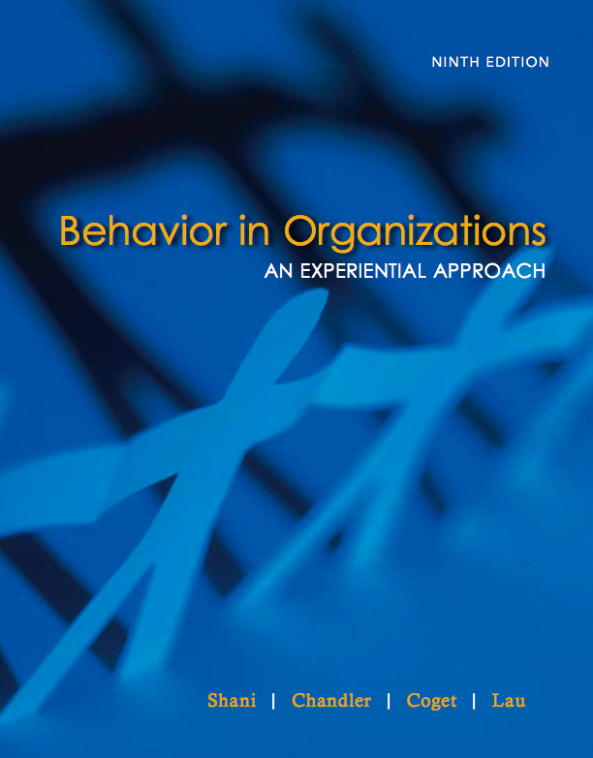
Module Five
Motivation

Slide 2
Agenda - Motivation
Introduction to motivation
Slade Plating Department Case
  Maslow and Herzberg – What would they say about the department’s motivation?
  Slade fishbowl exercise
Goal: To stimulate your thinking around what motivates others and how to utilize knowledge of motivation to be a more effective manager, executive, team player, family member, friend, etc.

Slide 3
Motivation
Motivation has both a psychological and a managerial connotation in the field of organizational behavior
The psychological meaning refers to the internal state of a person that relates to the initiation, direction, persistence, intensity, and termination of behavior
The managerial meaning refers to the activities managers can do to induce others to produce results desired by the organization

Slide 4
General Patterns of Managerial Approaches to Motivation
Traditional Model Human Relations Model Human Resources Model
Assumptions
1. Work is inherently distasteful to most people.
2. What they do is less important than what they earn for doing it.
3. Few want or can handle work which requires creativity, self-direction, or self-control.
1. People want to feel useful and important.
2. People desire to belong and to be recognized as individuals.
3. These needs are more important than money in motivating people to work.
1. Work is not inherently distasteful. People want to contribute to meaningful goals which they have helped to establish.
2. Most people can exercise far more creative, responsible self-direction and self-control than their present jobs demand.

Slide 5
General Patterns of Managerial Approaches to Motivation
Traditional Model Human Relations Model Human Resources Model
Policies
1. The manager’s basic task is to closely supervise and control subordinates.
2. He or she must break tasks down into simple, repetitive, easily learned operations.
3. He or she must establish detailed work routines and procedures, and enforce these firmly but fairly.
1. The manager’s basic task is to make each worker feel useful and important.
2. He or she should keep subordinates informed and listen to their objections to his or her plans.
3. The manager should allow subordinates to exercise some self-direction and self-control on routine matters.
1. The manager’s basic task is to make use of “untapped” human resources.
2. He or she must create an environment in which all members may contribute to the limits of their ability.
3. He or she must encourage full participation on important matters, continually broadening subordinate self-direction and self-control.
Theory X or Y? Theory X or Y? Theory X or Y?

Slide 6
Slade Company Examination
Question 1: Background Factors
External Factors Internal Factors
1. Sales volume high
2. Large recurrent orders
fluctuating with business
conditions
3. Higher pay scale outside than in company
1. Nonunion
2. Loose management
3. 12 hour day-7:00 to 7:00
4. Spatial arrangements in plating
room
5. Difficult working conditions

Slide 7
Slade Company Examination
Question 2: Frustration/Satisfactions From Required System
Potential Frustrations Potential Satisfactions
High potential
Few if any apparent opportunities
for self actualization
High potential
Low interaction requirement
Too noisy to talk
High potential
Routine and uncomfortable
working conditions
Low
Some skills requirements
Second highest prestige group in company
Low
Predictable working conditions
Steady job
Pay
SA
Esteem
Social
Safety
Physiological

Slide 8
Slade Company Examination
Question 3: Character of Actors
Sarto Subgroup
● Italians and relatives
● High skills and high training
● Functionally and spatially interrelated in work
● Mixed on age, education and marriage
Clark Subgroup
● Non-Italian, Anglo-Saxon
● Medium skills and training
● Functionally and spatially
interrelated in work
● 22-29 years of age
Mostly single
All high school graduates

Slide 9
Slade Company Examination
Question 4: Norms of the Emergent System
Make a complete list of the norms of the emergent role system that developed in this case. (Use the Sarto group norms, since they seem to determine the behavior of the other subgroups)
● Punch-in/punch-out system–“day's work”
● Stay until 7:00 p.m. when load is heavy
● High productivity
● Best place to work–security
● Did not want union
● Carry a guy like Herman Schell
● Hard work respected, e.g., Pearson
● Innovation, craftsmanship; train new people well
● Exclude nonconformist from group
● Socializing–lunches, outside gathering

Slide 10
Slade Company Examination
Hierarchy
Satisfaction of Need
Self Actualization
Esteem
Social
Safety
Physiological
(Innovations in their craft; high standards)
(Craftsman skills; productivity accomplishment; self directing work system, control over the system; high status of Sarto group, medium for Clark group)
Feelings of power can be assumed
(Well established and active socializing)
(Control over the work and the work system; best
place to work)
Feelings of power can be assumed
(Some control over pay; adequate pay)

Slide 11
Slade Plating Case
Fishbowl Exercise:
One representative from each group comes to the front of the class
  Other members of the team: Your goal is to help your representative when in trouble!)
The seven representatives will interact for us
We will stop them at key points and comment
GOAL: Discuss motivational implications of various solutions

Slide 12
What are some possible goals for the production manager (Mr. Porter)?
Stop the “shirking” (punching out early)
Reducing salary costs
Improving product quality (through work climate)
Prevent destructive reactions such as unionization or sabotage

Slide 13
What are some possible goals for the Sarto group?
Maximize salaries
Minimize hourly work/day
Preserve number of days worked (weekly salary)
Keep informal power
Neutralize or get rid of low performers and loners (e.g. Herman)

Slide 14
Some possible alternatives for Porter
Crack down on the Sarto group, confront them, and monitor them closely
Do nothing
Introduce individual piece rate based on “real” (if people weren’t punching out early) or official productivity
Get employees involved in a team to improve quality or work processes

Slide 15
Theories of Motivation
The many theories and models of motivation can be grouped into three clusters:
  Content – focus on the factors that arouse, start or initiate motivated behavior (i.e., Maslow, Herzberg, McClelland)
  Process – focus on how behavior change occurs, direction or choice of behavioral patterns (i.e., Expectancy, Equity, Goal-Setting)
  Reinforcement – focus on the factors that will increase the likelihood that described behavior will be repeated (i.e., Skinner)

Slide 16
Herzberg’s
Motivation-Hygiene Theory
Two sets of morale factors:
  1. Dissatisfiers
  2. Motivators
Hygiene factors

Slide 17
Comparison of Satisfiers (Motivators) and Dissatisfiers
Percentage Frequency
40
High
Low
30
Advancement
20
Responsibility
Achievement
Work itself
Recognition
10
0
10
Company. policy
and Administration
20
Supervision-Technical
Interpersonal
relations-Supervision
30
Salary
Working Conditions
40
Adapted from Herzberg, F.; Mausner, B.; and Snyderman B.,
The Motivation to Work, 2d ed. © 1959 by John Wiley & Sons. Reprinted by permission.

Slide 18
Two-Factor Continua
Degree of Degree of
dissatisfaction satisfaction
40 30 20 10 0 10 20 30 40
No satisfaction
Motivators
Highly satisfied
Highly dissatisfied
Dissatisfiers
(hygiene)
Not dissatisfied

Slide 19
McClelland’s
n Achievement & n Power
Contributions to Need Theory
Focused on needs for:
- achievement
- power
- affiliation

Slide 20
Pareek’s Extensions of
McClelland’s Work
Six Primary Needs or Motives:
1. Achievement
2. Affiliation
3. Influence
4. Control
5. Extension
6. Dependence

Slide 21
Expectancy Theory of Motivation
E-to-P
Expectancy
P-to-O
Expectancy
Outcomes and Valences
If I produce, what are my outcomes?
Work whole day
(100%)
at low hourly wage
Work part day (leave
early) (100%)
at low hourly wage
Effort
Performance:
# produced
If I expend effort at work, what is the likelihood that I will perform to my expectations (e.g., finish “plating” of
sufficient quality)?
Don’t work as hard and stay all day
Do I care about working harder
to get the same pay? Do I care
if I can go home early sometimes?
Notes:
This theory has research support – one of the best models for predicting and influencing employee behavior
People’s work behavior is directed toward achieving desired outcomes
Can I do the work? – will my effort lead to performance?
Willl my performance get me the reward I want? – Performance – outcome
Do I want the reward? – Outcome valence or value to you
Example – doing well in OB221
If I study hard, will I do well on the assignments?
Even if I perform well, will my teacher grade me fairly? – Performance to outcome
Do I care about grades or other outcomes I might get if my performance is high
Other outcomes from OB221 – good job, make new friends, have fun on a team, meet a future business partner
Outcomes are what you think about – what’s on your radar screen
You’re in the class of your dreams, you’ve studied hard for the first test, you’re sure you’ve done well, but you get 65/100 when 70 is a passing grade. What happens to your motivation? What does expectancy theory predict?

Slide 22
Expectancy Theory in Practice (E P O)
Increasing the E-to-P expectancy (increasing the expectation that effort will lead to performance)
  training, selection, resources, clarify roles, provide coaching and feedback
Increasing the P-to-O expectancy (increasing expectation that performance will lead to certain outcomes)
  Measure performance accurately, communicate outcomes
Increasing outcome valences (outcome attractiveness)
  Use valued rewards, individualize rewards

Slide 23
A Model of Self-Fulfilling Prophecy at Work
Manager expectations
Evaluation; attribution
5
1
Allocation
Work facilitation
Achievement
Leadership
7
Self-evaluation; attribution
4
6
2
Performance
Influence
Motivation
Subordinate
self-expectations
Effort
3
Source: Adapted from Don Eden, Pygmalion in Management: Productivity as Self-fulfilling Prophecy, 1990. Lexington, MA: Lexington Book. Reprinted by permission.

Slide 24
Equity Theory
Explains how people develop perceptions of fairness in the distribution and exchange of resources.
They consider the outcome/input ratio
  Inputs - what employee contributes (e.g. skill, effort, value to organization)
  Outcomes - what employee receives (e.g. pay)
They pick a comparison other (c.o.)
They look for equity
  Compare outcome/input ratio with the c.o.
  Decide if they’re over-rewarded or under-rewarded

Slide 25
Consequences of Inequity
Change inputs (e.g., put forth less effort)
Change outcomes (e.g., pilfer, complain, go home early)
Change perceptions (maybe this is not so bad)
Leave the company
Example: Professional actors and compensation contracts

Slide 26
Equity Theory of Motivation
Sarto
Work harder, finish earlier, leave early, creating more equity
Finish in, say, 10hrs
$240/10=
$24
No change in behavior and/or actions
Perceives equity
Slade
12hr X $20 =$240
Company B
8hr X $30 = $240
Individual “A” with certain
inputs receives certain outcomes
Compares
the total experience
to a
reference individual “B”
New behavior and/or actions
Perceives inequity
Tension within the individual
Motivation to reduce tension

Slide 27
Job Enlargement & Job Enrichment
How the design of jobs affects motivation
Job Enlargement Redesign of work tasks to change the number of tasks that a worker performs (e.g. job rotation, cross-training)
Job Enrichment Redesign of work tasks that make a job more interesting & involving by allowing workers to fulfill higher-order needs such as achievement & control

Slide 28
Goal-Setting as a Means of Motivating People
Goals – Good or not so good?
  I’m going to lose weight.
  I’m going to lose 30 lbs. in two weeks.
  I’m going to lose 30 lbs. in a year.
Feedback on performance is essential in order to satisfy employees’ growth needs (specific, sufficiently frequent)
Goal-setting is maximally effective if employees help set their goals

Slide 29
Some Key Ways of Thinking about Motivating Others
Human needs approaches to motivation
Motivating others through performance expectations
Motivating others through equity (fairness)
Motivating others through job design

Slide 30
Managerial Practice – Implications?
Dialogue with subordinates about their career goals, needs/motivators
Observe when employees seem most engaged (what are they doing, what needs might be satisfied by the activities)
Job design (i.e., enlargement, enrichment, rotation)
Think about others’ needs beyond financial benefits
Management by objectives (goal setting, participative decision-making, and feedback)
Profit-sharing plans
Skill-based pay

Slide 31
Hourly Versus Piece-Rate
Hourly:
10 hours a day X $15 an hour: $150 a day
  Number of piece produced irrelevant
Piece-rate:
100 “pieces” produced X $1.5 per piece = $150
  Pay varies based on how many pieces produced

