Slide 1



Slide 2
Unsung heroes, modern watchers of public safety.

Slide 3
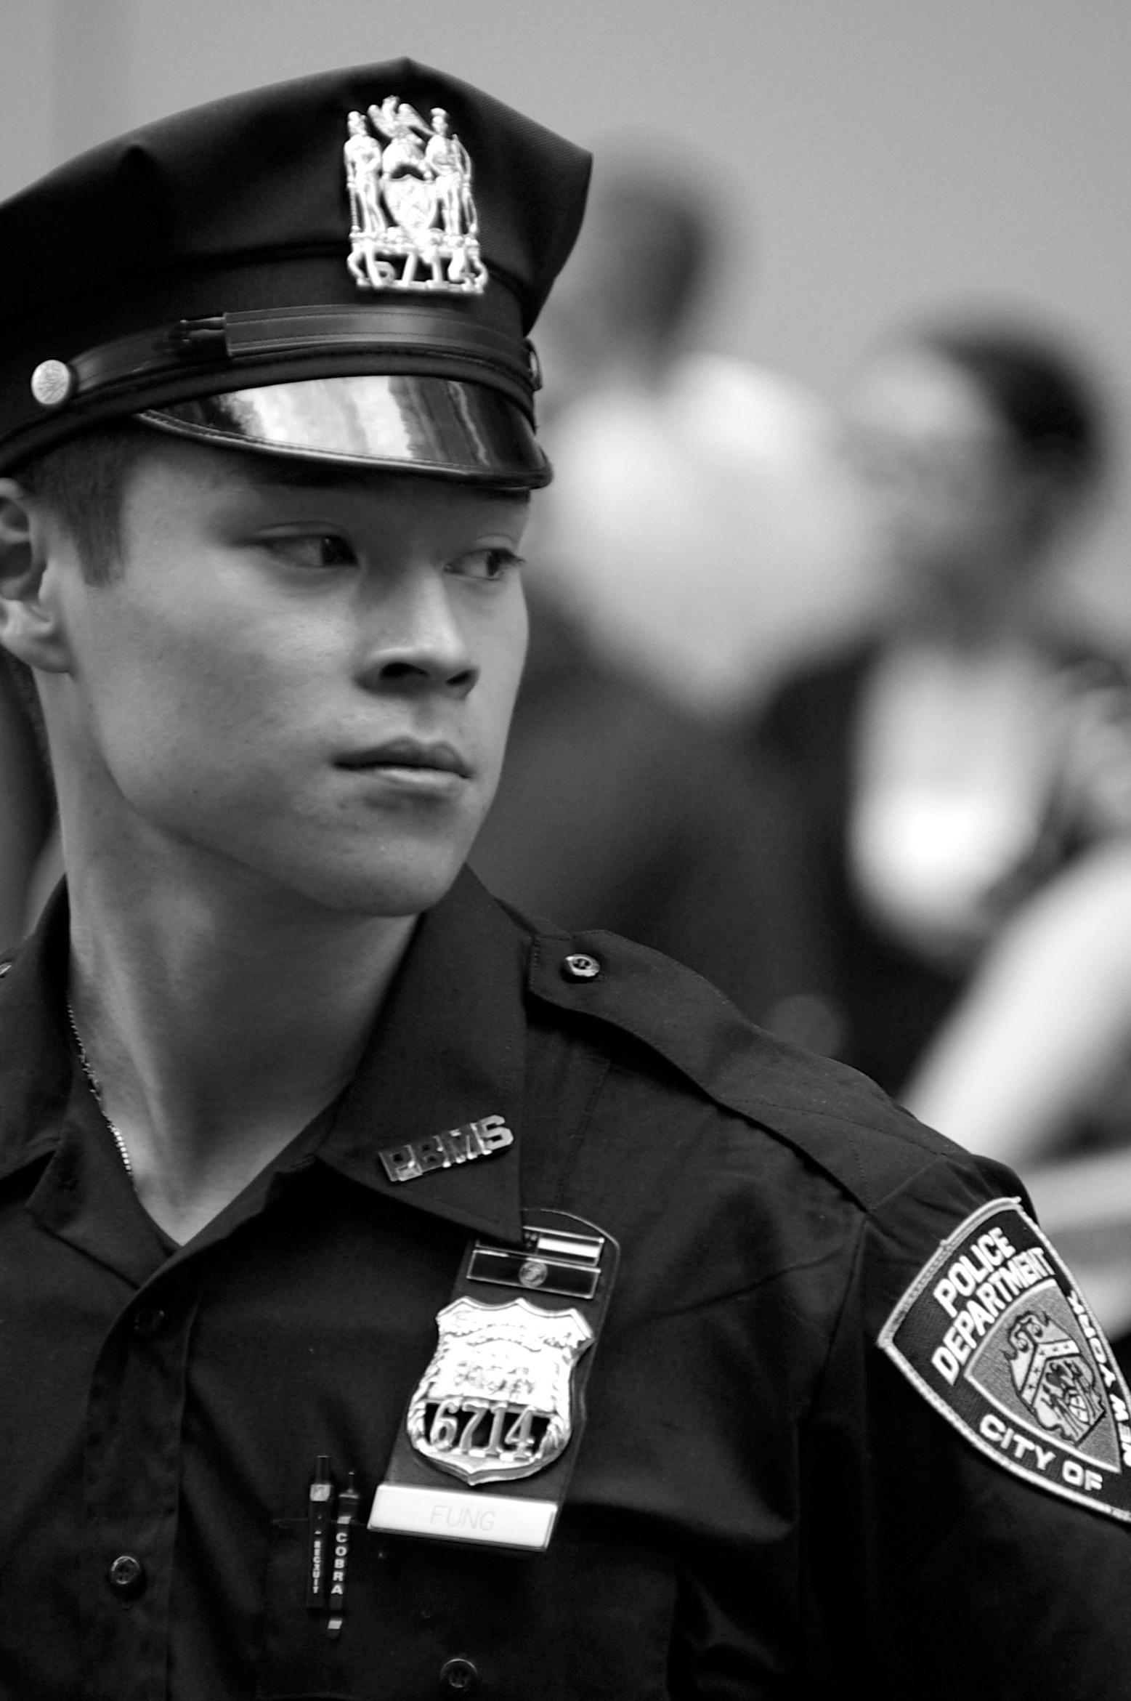
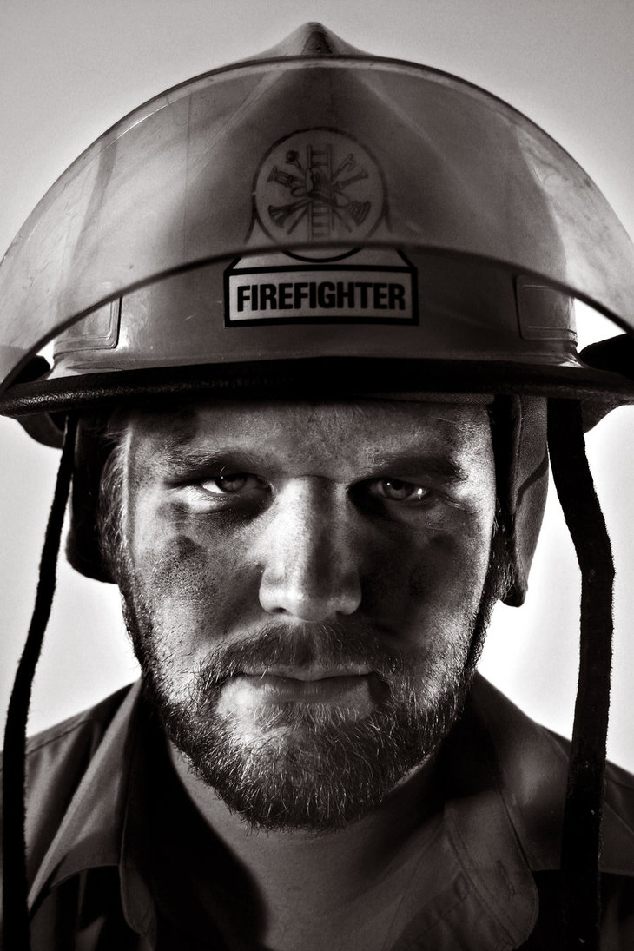


Alan,
NYPD
Arrested 17 serial
killers the past year
Joe, Firefighter
Went through 142 fires in 2013

Slide 4

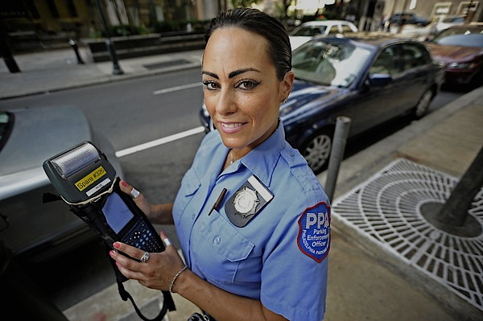
‘Tough’ Maria,
Parking Officer
Gave 7948 tickets since October
Made $516,000 for NYC
in 5 months

Slide 5

Ticket Issuers Patterns in NYC
Timothy Meyers
Christopher Fan
Emilie De Longueau
Thibault Duchemin
Christopher Fan
Timothy Meyers
Emilie de Longueau
Thibault Duchemin

Slide 6


Can we identify unique patterns in top performers?
?
Which parking officers issue
the most tickets?
>
What are some common traits
among them?
=
Do nature of ticket, time,
area have an influence?
*

Slide 7




Yes. Top performers behave in a unique way.
_
Specialize in certain violations.
Work on good days.
Have a timing.
Notes:
-> THibault

Slide 8
Identifying the top performers
Christopher Fan
Timothy Meyers
Emilie de Longueau
Thibault Duchemin
Notes:
<Tim –

Slide 9
Collecting the data
1
Parking Violations (NYC OpenData)
6.5M rows, 43 columns. Cleansed
Discarded faulty dates, entry errors
Imported CSV – P-SQL

Slide 10
Identifying top ticket issuers
1
Sum total tickets, total day worked
Filter the <50 day worked
Top issuers:
Avg ticket/day >1 SD from mean

Slide 11
Recognizing patterns
Christopher Fan
Timothy Meyers
Emilie de Longueau
Thibault Duchemin

Slide 12
2
Preparing cluster data
SQL queries on performers
prepare feature vector
Features: Day type (WD WE)
Time (AM/PM), Violation code
Python script to ready data
for SPSS clustering analysis
Notes:
- Tim

Slide 13
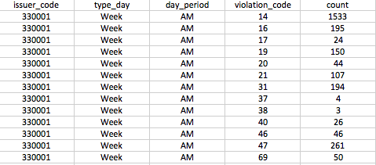
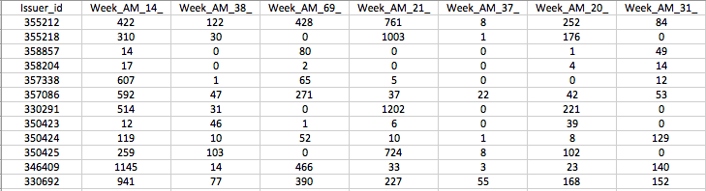
2
Preparing cluster data
2x2x15 = 60 combined features
Notes:
< Emilie -

Slide 14
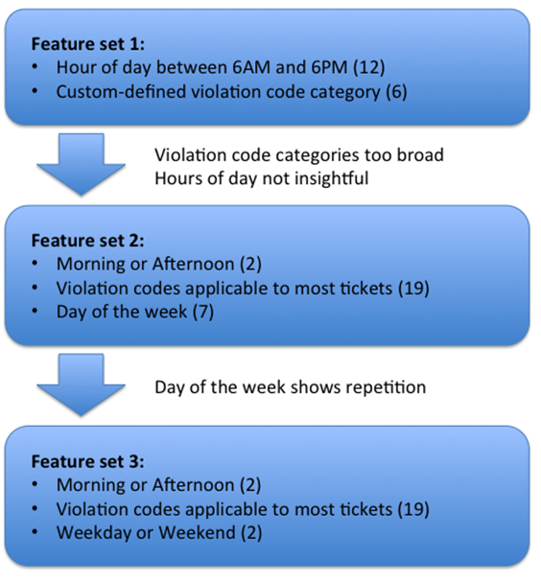
2
Feature Selection
Notes:
Emilie - >

Slide 15
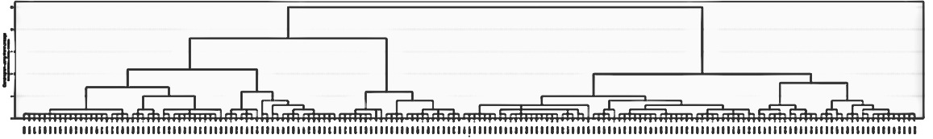
2
Grouping top performes
Hierachical clustering - Dendogram
1
2
3
4
5
Best # clusters: 5
Notes:
< - Chris

Slide 16
2
K-Means Clustering Analysis
Results
Cluster # | Total | %
1 | 21 | 12.14%
2 | 48 | 27.75%
3 | 43 | 24.86%
4 | 42 | 24.28%
5 | 19 | 10.98%
Notes:
- Chris ->

Slide 17
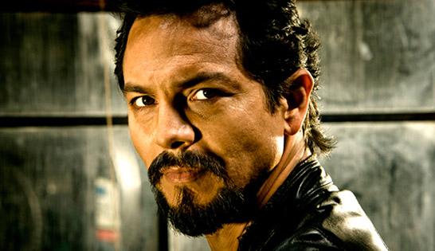
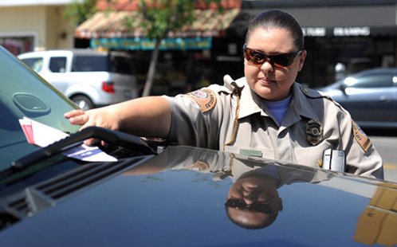

Butch
‘The Cleaner’
68% of street cleaning tickets
Targets them all day
12% of Cleaners out there
Knows where all the meters are
Chase you the weekends
27% of Curbside Terrors
‘Curbside Terror’
Terry
Gets her round done in mornings
‘Early-Birdie’
Rose
Generalist: load, receipts, street
25% of Early-Birdie.
Notes:
1) Street-cleaning: Meter people who issue “Street cleaning” tickets during
weekday mornings. (12.14% of issuers)
Butch ‘The Cleaner’
-> Targets street cleaning tickets
-> Favorite time: the morning
2) Curbside: Meter people who issue expired-meter, general no parking, and
general curbside parking tickets in the afternoon. Top weekend performers.
(27.75% of issuers)
‘Curbside Terror’ Terry
-> Knows where all the expired meters are
-> Performs best the weekends
-> Gets you the afternoon & the weekends
3) Morning generalists: Street-cleaning, general no standing or parking, time
violation in zone, fail to show receipt, parked in truck unloading zone, etc.
during weekdays (24.86% of issuers)
Early-bird Rose
-> Gets all her stuff done the morning
-> Multi-ticketer: load, receipts, time, parking
-> Keeps her weekends for her
4) Afternoon Commercial enforcers: No parking or standing, truck unloading
zone, and commercial metered zone tickets during weekdays. (24.28% of
issuers)
Mafioso Benetto
-> Focus mainly on commercial zones
-> Enforce only the afternoon
-> Works on the weekdays. He’s busy on the weekends
5) No standing in weekday mornings: Meter people who issue “General No
Standing: Standing or parking where standing is not allowed by sign, street
marking or; traffic control device.” tickets during weekday mornings.
(10.98% of issuers).
Joe The Shield
-> Operates in high-traffic areas
-> Protects commercial zones from unwanted parkings

Slide 18
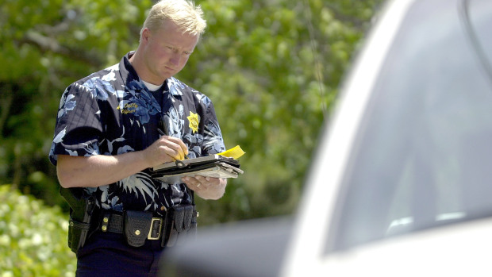
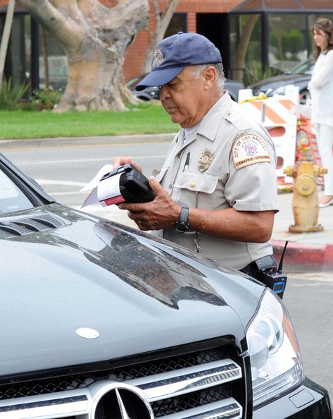
Shawn
‘The Shield’
Focus on commercial zones
Only work the afternoons
25% of Mafiosos out there
‘Mafioso’
Benetto
Operates in high-traffic area
Keep the morning delivery
activity working well
11% of Shields

Slide 19
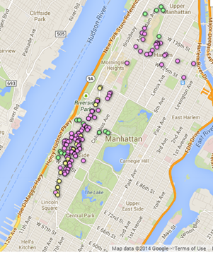
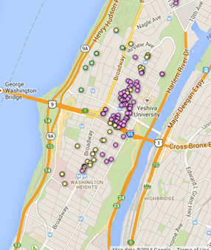
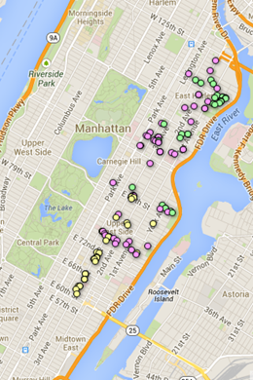
2
Pattern Similarity: Visuals
DEMO
Notes:
< - Chris - >

Slide 20
Comparing issuer groups
Christopher Fan
Timothy Meyers
Emilie de Longueau
Thibault Duchemin
Notes:
< - Emily

Slide 21
3
Top vs Middle performers
Performance per violation code
Middle performers: 152 issuers
Top performers: 174 issuers
Top performers
Middle performers

Slide 22
3
Top vs Middle performers
Week vs Weekend
Largest part of tickets during WE

Slide 23
3
Top vs Middle performers
AM vs PM
Largest part of tickets AM
Notes:
- Emilie ->

Slide 24
Going further
Christopher Fan
Timothy Meyers
Emilie de Longueau
Thibault Duchemin
Notes:
<- Chris

Slide 25
3
Exploring other leads
Can we build an optimal
to perform the best ?
route
ticket price
Could explain patterns?
Will I get more often a ticket if my is a Porsche, not a Honda?
car

Slide 26
Watch out with your Maserati
‘Curbside Terror’ Maria is here!
Notes:
Chris ->

Slide 27
Data Appendix
Data Source: NYC Open Data Parking Transactions
Issuer Aggregates: “Ticket_Aggregates_top.csv”
Feature Vector: “Cluster_Feature_Vector_top.cv”
SPSS Output File: “3FeatureCluster.spv”
Cluster Results: “Cluster_ Analysis_Kmeans_Agglomerative.xls”
Proximity Matrix
Dendrogram + Agglomeration Schedule
K Means Cluster Membership

