Slide 1
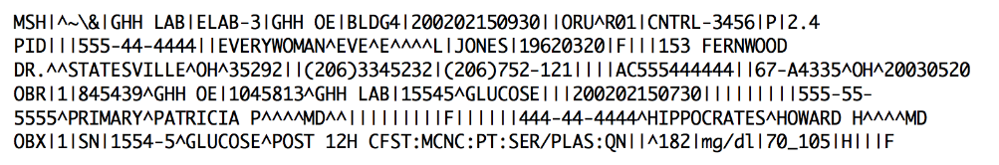

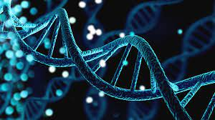
Medical Software Development
M.Sc. Medical Informatics
Team Habsburg – A Gene Service Project
Galli, Känel, Kruta, Stalder
Business Insider (2021). Megaspeicher DNA. Retrieved from link.

Slide 2
Index
Architecture
Build Procedure (Ant/Maven)
Changes I-III
Outlook
Conclusions
Questions

Slide 3
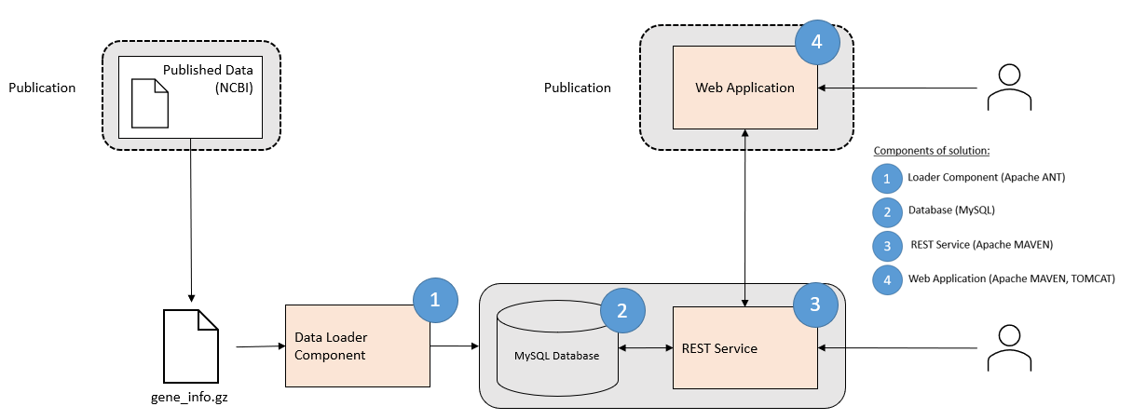
Architecture

Slide 4
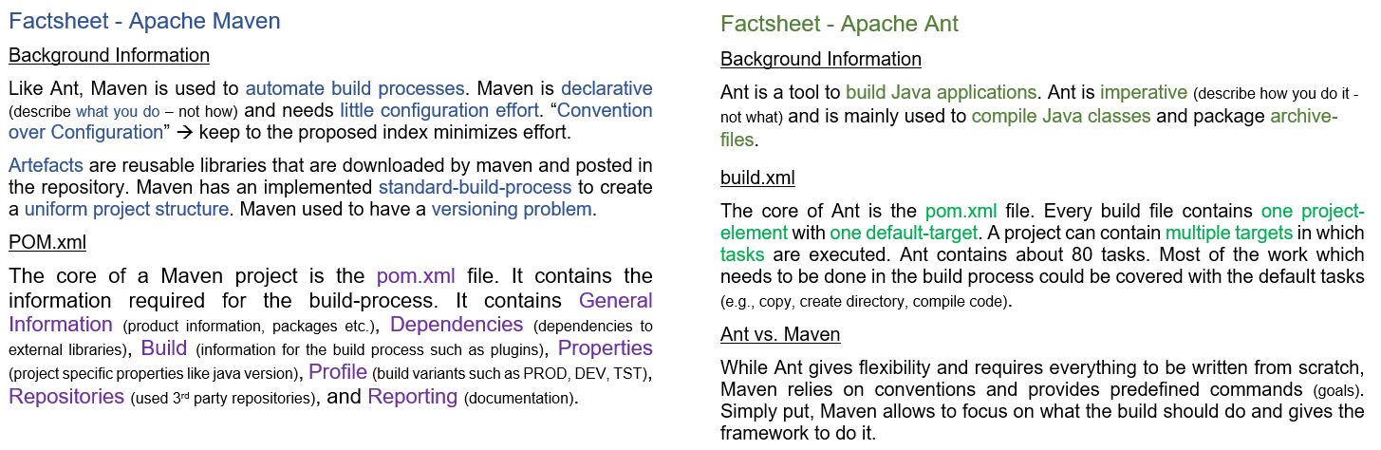
Build procedure

Slide 5


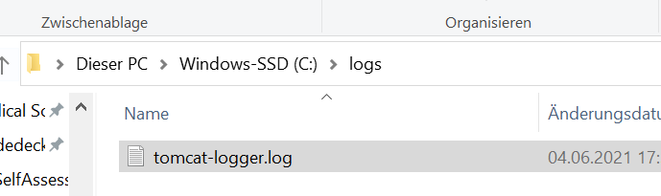
Changes I
Adding Logs
Step 1: Import (needed packages)
Step 2: Instantiate (in class)
Step 3: Use (within method)
Step 4: Collect (from drive)
Add dependencies in pom.xml (in case you want to use a different logger)

Slide 6
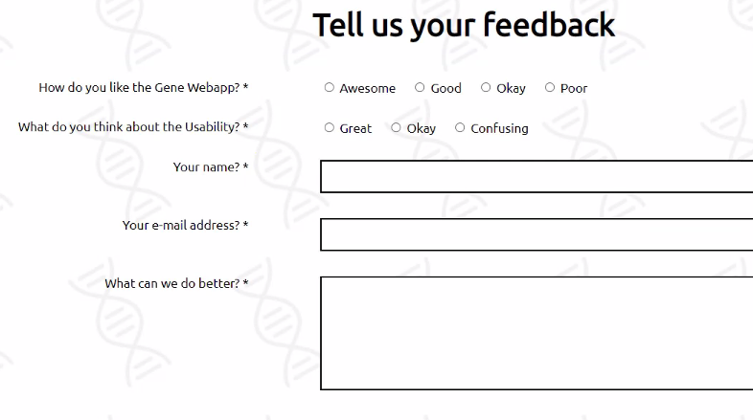
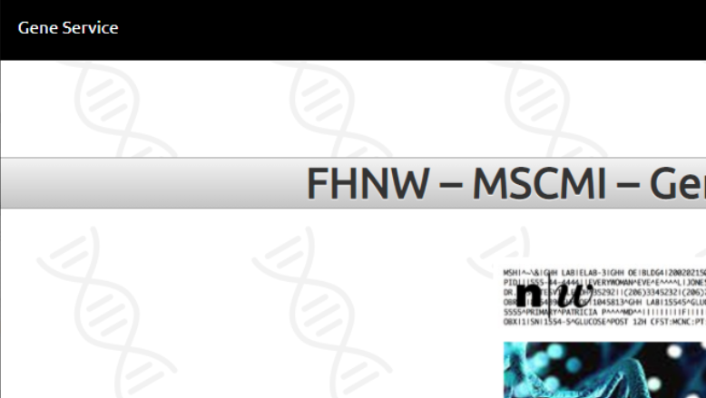
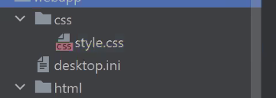
Changes II
Adding Feedback, Navigation, Style
Step 1: Feedback Form
Step 2: Navigation Bar
Step 3: Stylesheet

Slide 7
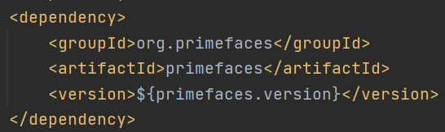

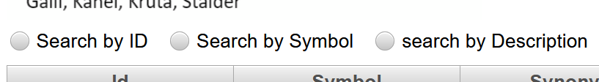

Changes III
Adding Looks
Look 1: Radiobuttons
Add dependencies (to the pom.xml)
Add radiobuttons (to the mainpage.xhtml)
Look 2: New Logo
Replace picture (in the mainpage.xhtml)

Slide 8
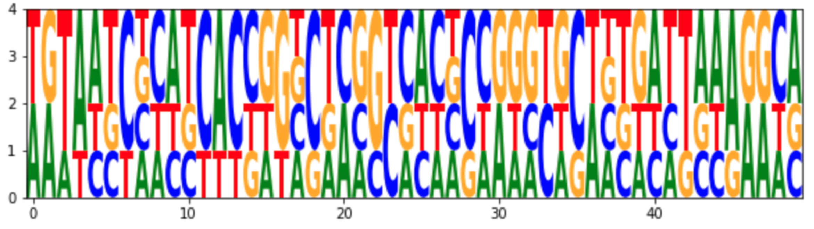
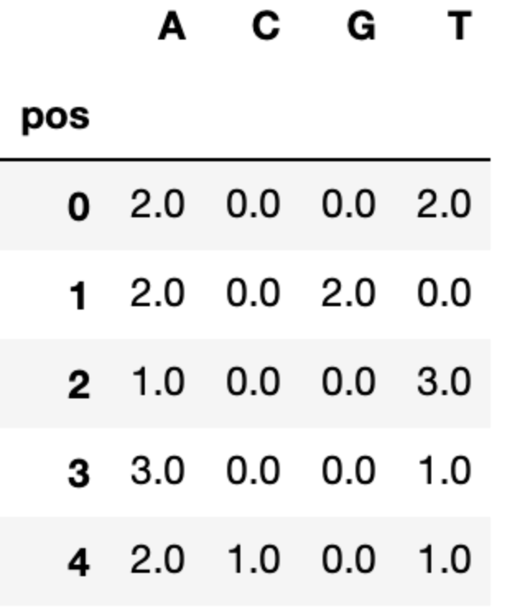
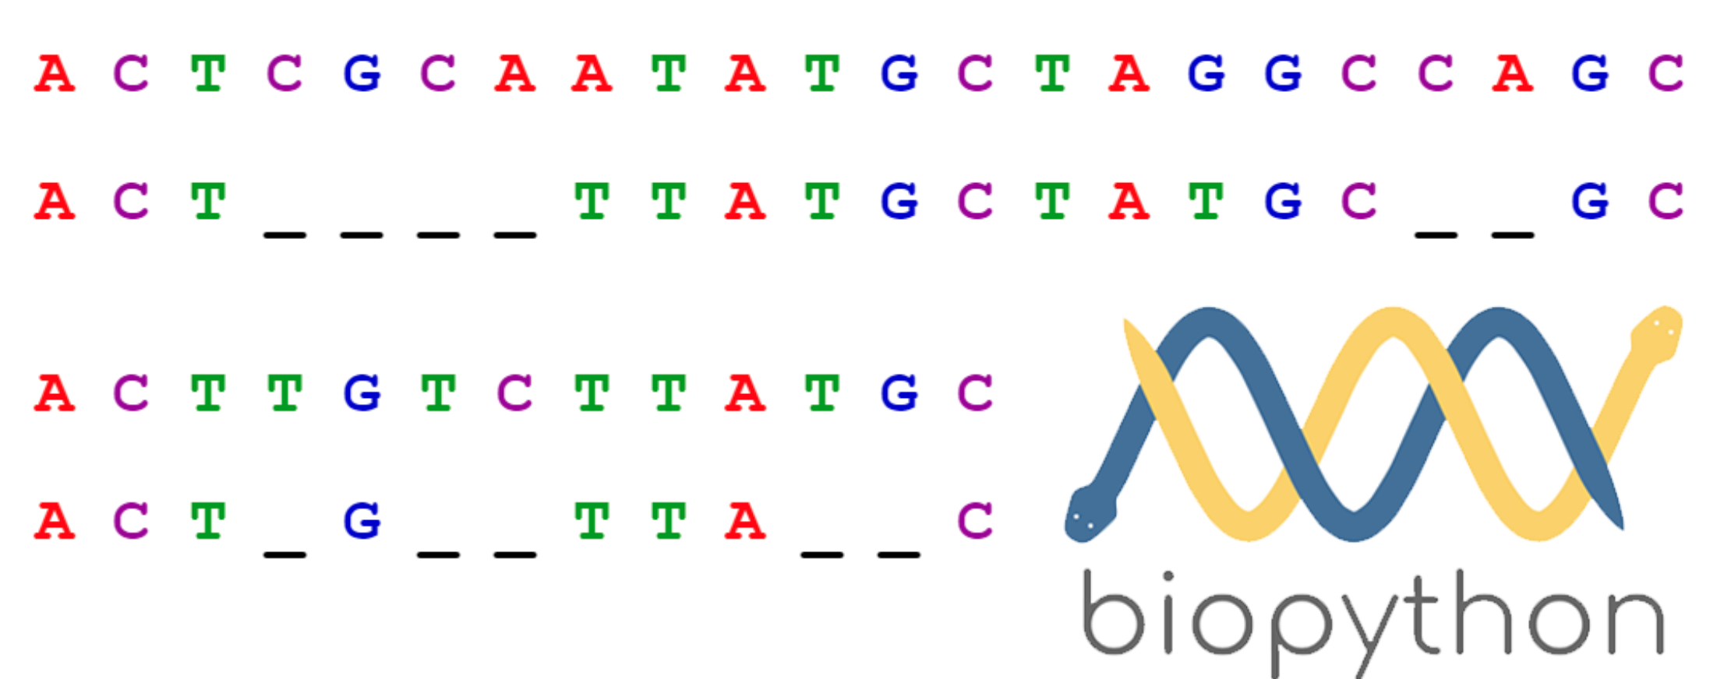
Outlook
Additional features for bioinformatics:
Enable Position weight matrix
Enable sequence alignment checks
Combine DNA analysis with other omics data
Going towards integromics (genomics, transcriptomics, proteomics etc.)

Slide 9
Conclusions
Chris says: Remember.
(Understand your goal | Abstract what you want to do | Pseudocode it)
Amun says: Google.
(because almost certainly, someone smarter already did what you have to do)
Jänu says: If you are not a good coder, look for one.
(The best coders sit in Eastern Europe... or Bangalore)
Ürsu says: Don’t be so focused on your shell.
(Use tools, if you’re not a coder)

Slide 10
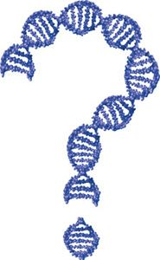
Questions
Pinterest (2021). Forensic DNA Training. Retrieved from link.

Slide 11
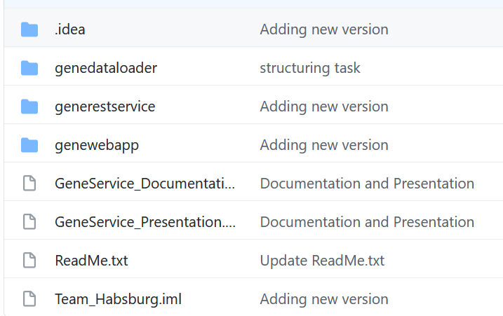
Git
https://github.com/christophergalli/Team_Habsburg.git

