Slide 1
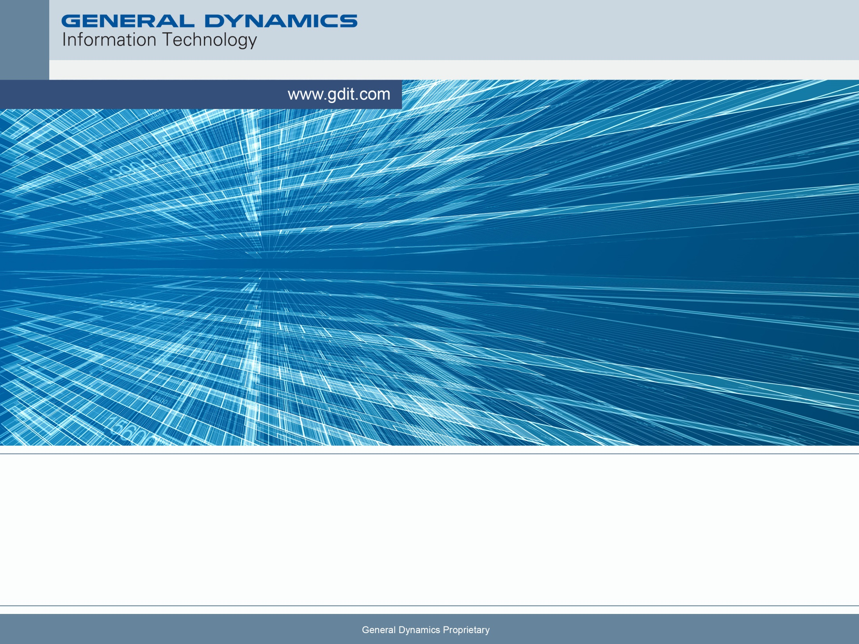
DoD STIG Coding Best Practices, a GDIT perspective
2017/03/01 (updated 2018/08/03)
Notes:
Notes level one
Notes level two
Notes level three
Notes level four

Slide 2
Security Technical Implementation Guide
There are STIG’s for:
DMZ, Web (in general), Web Server, Database, Application Server, Application Development, Authentication Brokerage Services, ESRI, etc.
OS and other STIG’s are fairly clear cut.
LOTS of ambiguity exists for the Application Security and Development STIG, mainly because you can solve a problem many different ways. On the OS it’s either turn on logging or not.
Versions to be concerned with:
v3 r10 (our historical reference) ~ 159 checks.
v4 r2 (2017/10/27) ~ 290 checks.
v4 r7 (2018/07/27) ~ 290 checks.

Slide 3
Software Development Targets
Target for NAVOCEANO ops is usually the latest (r4v7).
Intent is to have the development staff consider defense in depth before and while developing the application.
IA staff are not programmers so making compliance obvious goes a long way.
Use STIG ID’s in code comments and documents (Design Document attached).
Trust is HUGE, establish trust with the IA and you can more through the process more easily.
If you read the Application Development STIG and embrace it, you’ll be a better programmer in general.

Slide 4
STIG V3 vs V4
V4R7 Active
When GDIT completes its analysis details will be provided to all PBA-CC parties.
V3 ~ 158 rules.
V4 ~ 290 rules.
V4 is more discrete/granular in compliance requirements (upgraded for technology).

Slide 5
STIG V3 vs V4 Continued
v3
CAT 1 - 33
CAT 2 - 113
CAT 3 - 12
v4r7
CAT 1 – 31
CAT 2 – 237
CAT 3 – 22
Note that many STIG rules have a tendency to repeat. Having mastery over those rules ensures you’re not running around in circles.

Slide 6
AppDev STIG Focus
User management, passwords, and sessions.
Heavy on the web application focus.
Input validation.
Various attack profiles.
Making sure the developer has thought about defense and applied it to the system…in depth.

Slide 7
Categories, Profiles and Rules
STIG now supports the concept of a Profile. Right now it appears to do nothing using the STIG viewer.
http://iase.disa.mil/stigs/Pages/stig-viewing-guidance.aspx
All rules are codified and have Categories.
STIG viewer version 2.7 has limited filter capability and runs in Java.
STIG rules are packaged using an XML schema. Vim/grep helps sometimes.

Slide 8
Categories
CAT 1 – most severe, meaning lack of compliance is a non-starter at most DoD organizations.
CAT 2 – Must be addressed in a POA&M, in reality there should be minimal CAT 2’s.
CAT 3 – Roll the dice, it depends on who you talk to.
GDIT BSL has always attempted full compliance (architecture can influence compliance).

Slide 9
IA evaluation
Expectation is to load the STIG checklist into your STIG Viewer and answer each appropriate STIG item.
It is best to actually explain why you are compliant or not compliant versus just checking a box.
Box checking results in longer IA conversations.
Show the effort up front.

Slide 10
Should you be scared?
Know what a XSS is?
Know what direct SQL injection is?
Know what a CSRF attack is?
When is the last time you patched your software?
…do you know what software you have?
If you can’t answer these with confidence, you should be scared.

Slide 11
How to Win – Part 1
Bake security & compliance into the application first. I have worked in this environment for 20 years now and found the aforementioned technique to be the only viable way of being successful.
Reference STIG Id’s throughout your body of work, both code and documentation.
Understand how to use the STIG viewer and document results.

Slide 12
How to Win – Part 2
Tools exist in the public domain to help, just ensure you verify they are doing the right thing.
Ansible playbooks abound for STIG compliance and are an excellent tool for supporting repeatable compliant solutions.
OWASP is your friend, especially when trying to understand what some of major vulnerabilities are:
https://www.owasp.org/index.php/Main_Page
OWASP Top 10 is your friend:
https://www.owasp.org/index.php/Category:OWASP_Top_Ten_Project

Slide 13
How to Win – Part 3
Don’t manage passwords or authentication at all. DON’T DO IT!
Don’t create your own Session management system.
Watch for SQL injection by using an ORM, watch for XSS by scrubbing ALL input and output, watch for CSRF by ensuring you have an authentication schema in place and are using it.
Validate all input. Consider using pre-built libraries or OWASP regex solution.
Web apps – override the get() methods in your servlet to perform input validation, don’t trust your programmers.
Desktop apps – validate everything before a programmer can invoke it.

Slide 14
Gotta Haves
Design Document ~ 28 references v4 (Cat I, II)
Application Configuration Guide (ACG)
Diagrams ~ 4 References v4 (Cat II)
Input Validation ~ 3 References v4 (Cat II)
SQL Injection defense ~ 3 explicit references v4 (Cat I,II)
CSRF defense ~ 1 explicit reference (Cat II)

Slide 15
Concerns
Heavy focus on web services
Heavy emphasis on “older” web services standards such as SOAP.
How do we ensure we’re compliant when using Restful services.

