Slide 1


Your first Git Clone

Slide 2
Git Clone References
https://git-scm.com/docs/git-clone

Slide 3

Important
Once you have cloned to the master you are tracking to the central repository. When you push it pushes to the central repository.
Newly-cloned repositories can refer to the central repository as "origin", which is just a handy alias for the full ssh:// URL. During the initial cloning operation, any branches that exist in the origin repository are saved as "remote branches" in the clone. A branch named x in origin would be named remotes/origin/x on the clone. Remote branches are meant to represent the state of a remote repository, so you shouldn't commit to them directly.

Slide 4
Important
Hopefully you’re not pushing straight into master.
See the next presentation on branching.

Slide 5
Git Clone (all cmds, screenshots below)
git clone https://christopher.wood@bitbucket.di2e.net/scm/mdlops/modelopstestbed.git
cd modelopstestbed/
git diff
git help
git diff
date >> ./christopherwood.txt
git diff
git add ./christopherwood.txt
git commit -m "CSIPS-1 #comment Added date field in accordance with our standards."
git push
git diff

Slide 6
Git Clone – extra commands
#clone from upstream (your remote server)
git clone <my URI>
#bare repository, starting from scratch
git clone --bare -l /home/proj/.git /pub/scm/proj.git

Slide 7
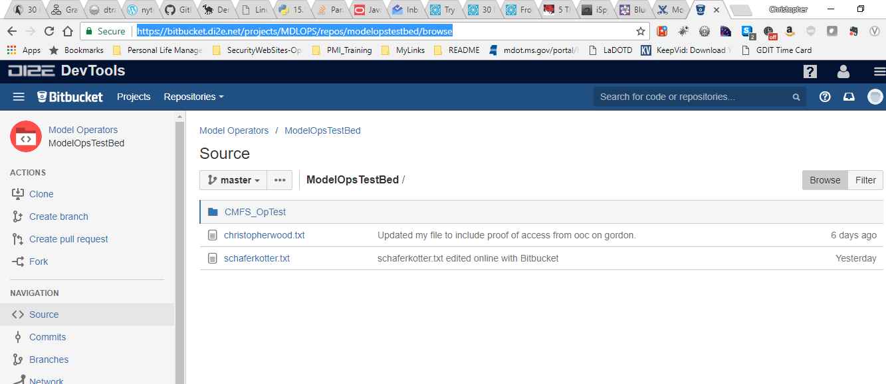
Example Repository on DI2E, visual display of repo contents. You can track down changes and see actual source code.

Slide 8
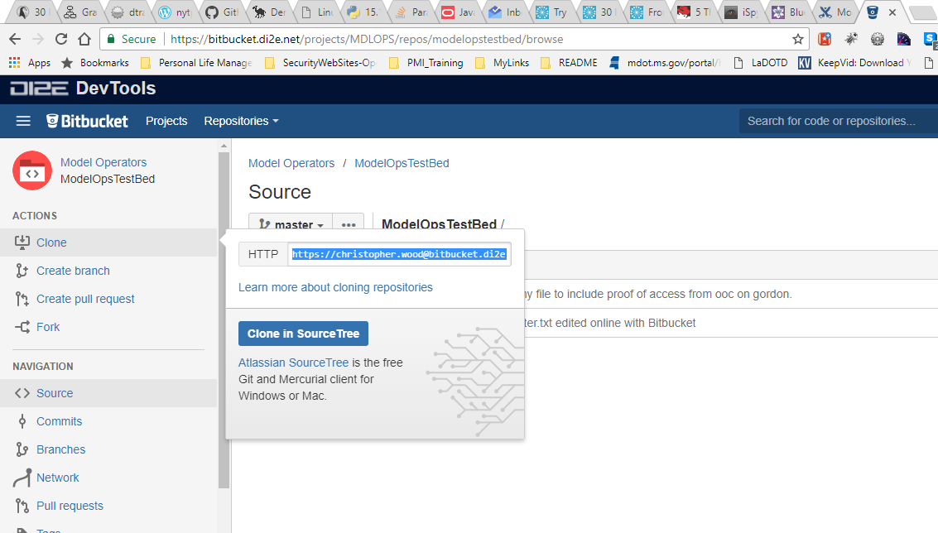
You can grab the download URI for any aspect of the repository via the web.

Slide 9
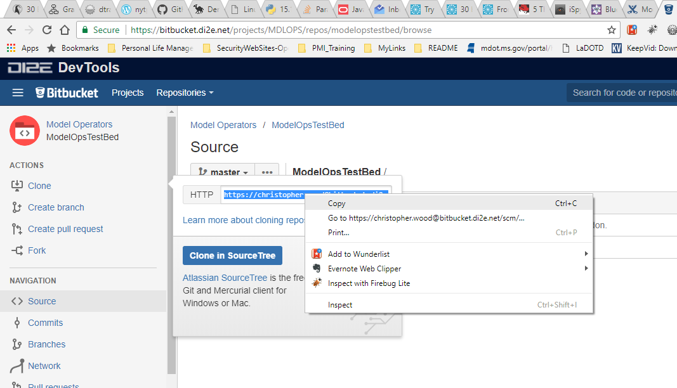
For command-line interfaces a simple copy/paste will work.

Slide 10
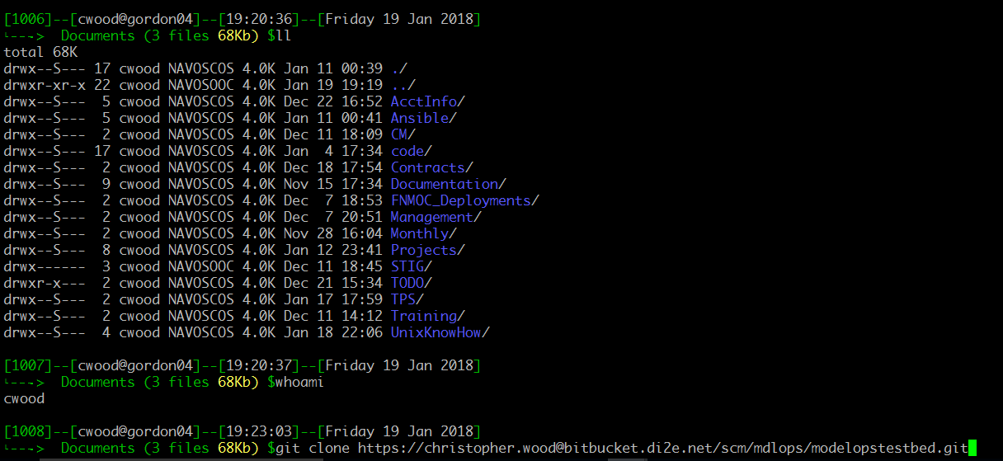
Git client executed on Command Line Interface (cli) to make a clone or “copy of” a repository to your local working file system.

Slide 11
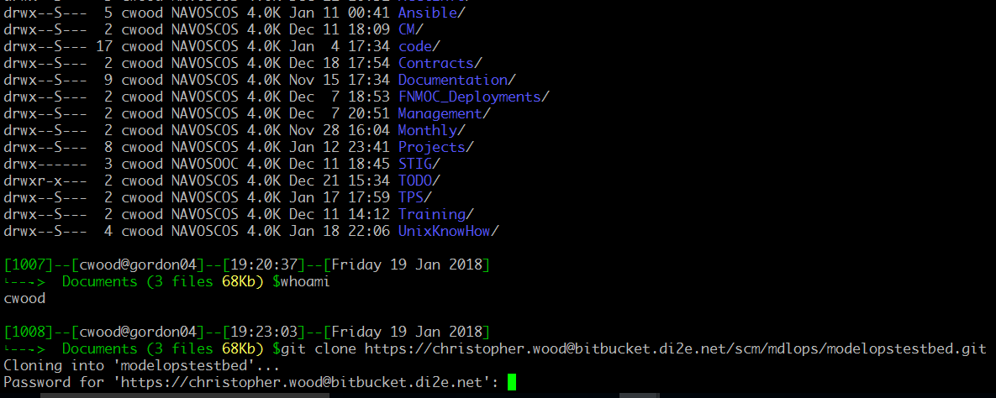
Authentication requirements are username / password.

Slide 12
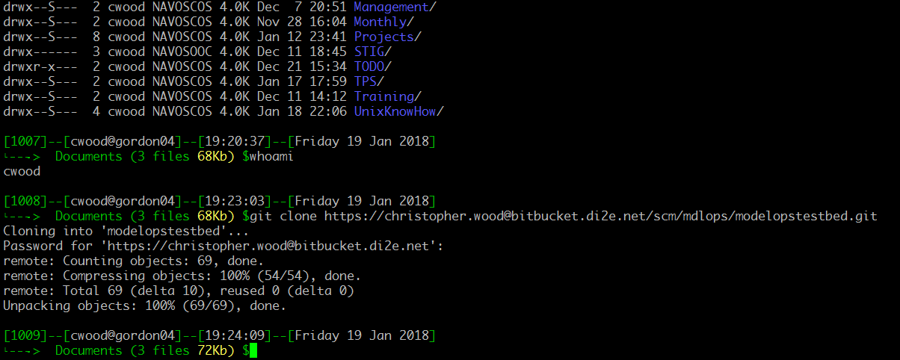
Example of completed clone to local working filesystem.

Slide 13
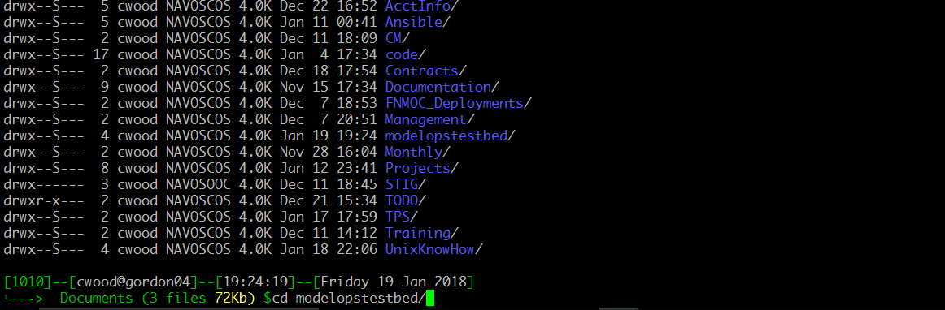
Local working directory equals the repository download name on the URI.

Slide 14
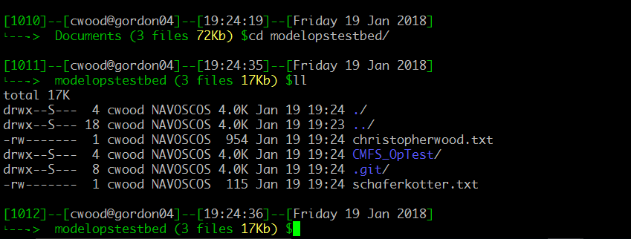
If populated the files for this repository (depending on the selection (branch, tag, or master) are accessible. Much like SVN a .git folder keeps track of local changes and is what is used for syncing with the remote repository.

Slide 15
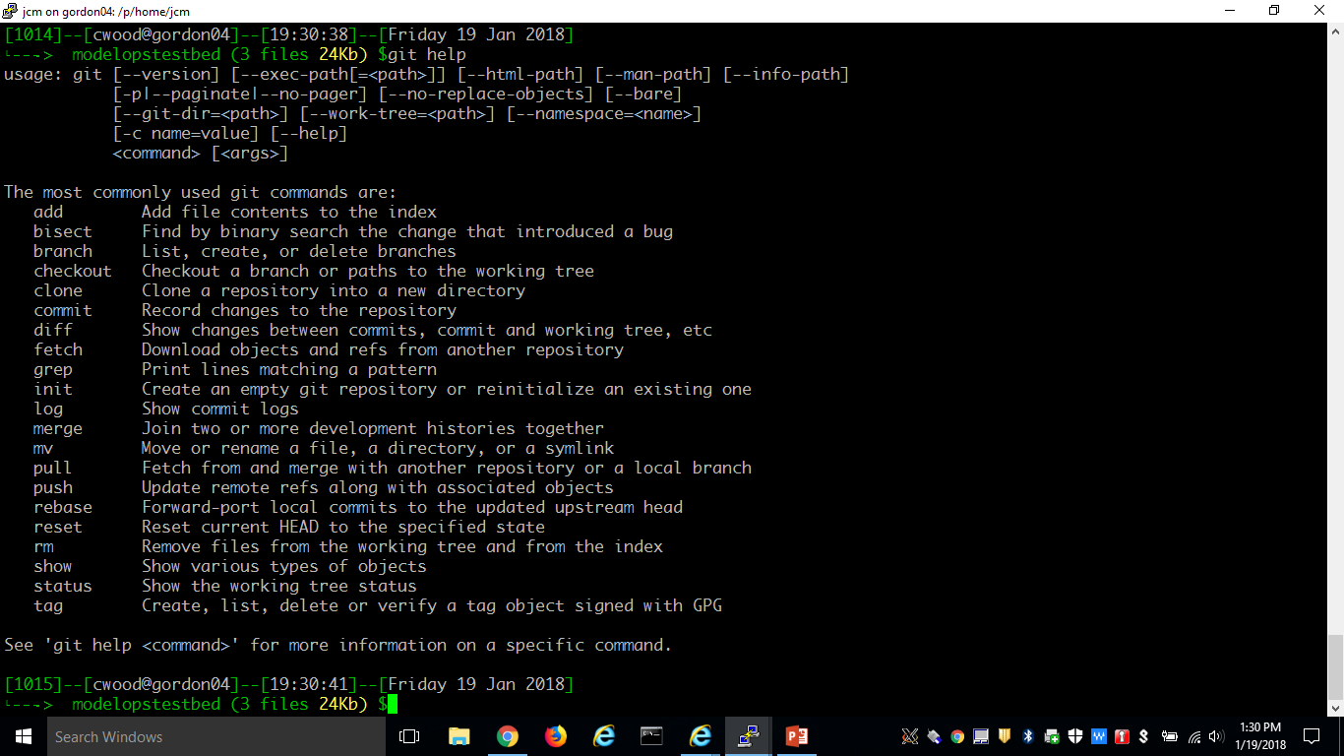
“git” or “git help” on the cli will result in a listing of commands.

Slide 16
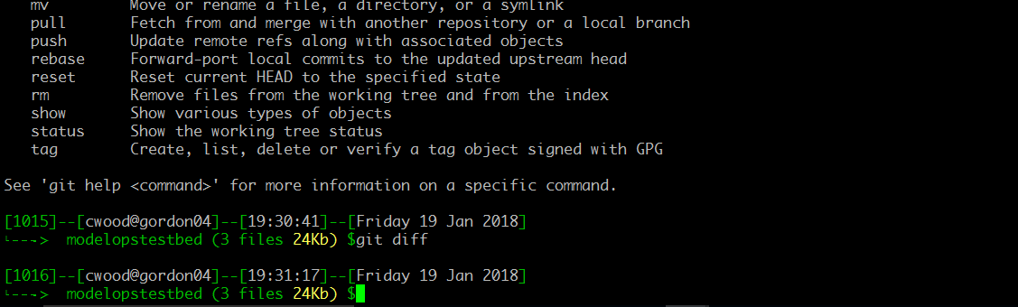
The “git diff” will show deltas between what’s remote and what you have locally.

Slide 17

“git diff” results in no changes for a newly downloaded repository.

Slide 18
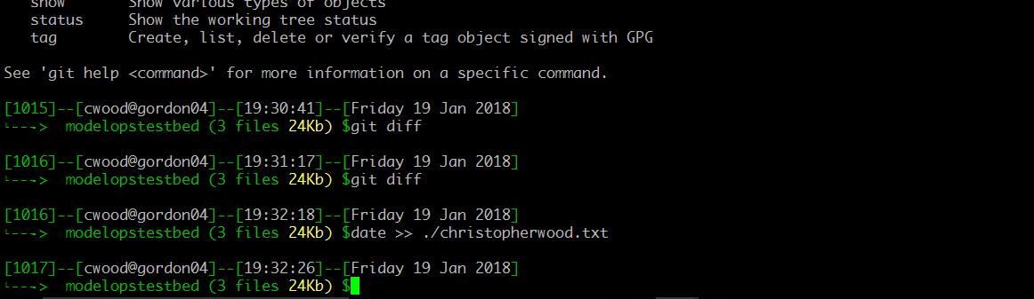
Make a change to any existing file in the cloned repository.

Slide 19
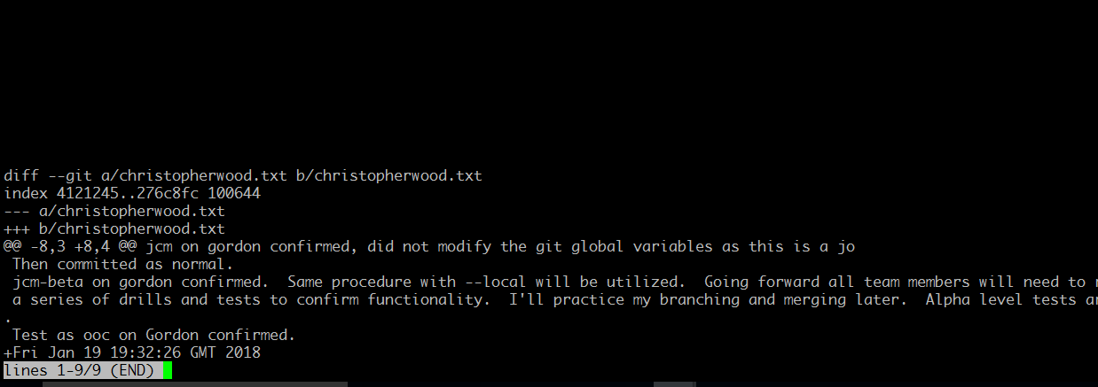
Now the “git diff” shows that the file in question was modified and provides insight into what those changes are.

Slide 20
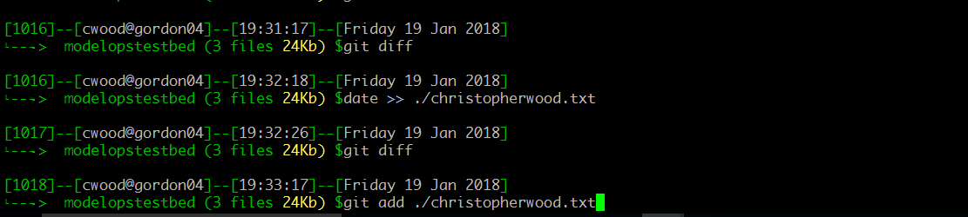
Add that recent change to the list of files (locally) that will be committed (retained).

Slide 21
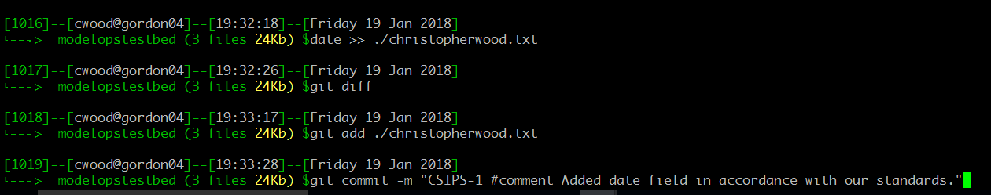
The actual “commit” is when the file system is written to (for the Git repo) and a further diff will result in zero deltas.
Note that your change is not committed to the centralized repository.

Slide 22
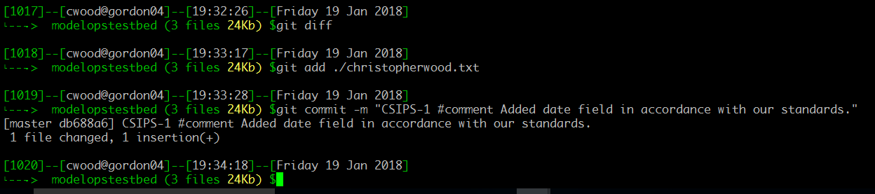
Results of localized commit.

Slide 23
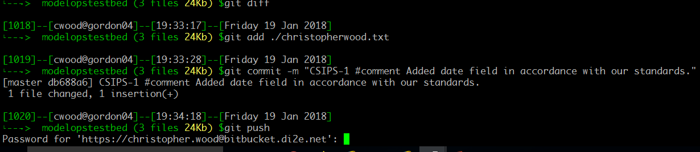
A “git push” actually pushes the commits, made locally, to the remote repository and is the final step towards ensuring changes are preserved.

Slide 24
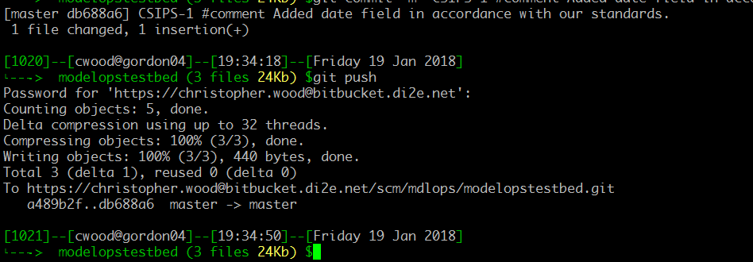
Example results of your push. In this case “master” or the “Trunk” have bee updated on the repository located on DI2E.

Slide 25

Do we see anymore deltas?

Slide 26

You’re 100% baselined with no discrepancies between what was committed versus recent changes.

