Slide 1


Branching

Slide 2
Git Branching References
https://git-scm.com/book/en/v2/Git-Branching-Basic-Branching-and-Merging
https://git-scm.com/book/en/v2/Git-Branching-Remote-Branches
http://toroid.org/git-central-repo-howto
https://pthree.org/2008/11/28/setup-a-git-repository/
https://git-scm.com/docs/git-commit

Slide 3


Important
Create a local branch that follows or tracks any remote branch you're interested in; and this is done automatically for the default branch, conventionally named master. After the clone, you will have a remote branch named remotes/origin/master, and a local branch named master, which is checked out already. The former represents the latest commit in origin. The latter follows along, but will include your own local commits too.
When you git commit, your master branch is updated to point to the new commit. When you git push, your master is used to update origin's master. When you git pull, origin's master is used to update your remotes/origin/master branch, which in turn is used to update your own master branch.

Slide 4
Important
You can create new local branches with git branch branchname and switch between branches with git checkout branchname. To push a new branch to the server, run git push origin branchname. This will create a branch named branchname in origin, and remotes/origin/branchname in your repository. Anyone who then runs git pull will get their own pair of remote-tracking and local branches of that name.
If you do not explicitly push your new local branches, they stay in your repository and are invisible to others. git push by default pushes only those branches that already exist on the server. This is why you have to explicitly git push origin master the first time you push to an empty central repository. In contrast, git pull will create local copies of any new branches on the server.

Slide 5
Remember!
When you want to share a branch with the world, you need to push it up to a remote that you have write access to. Your local branches aren’t automatically synchronized to the remotes you write to — you have to explicitly push the branches you want to share. That way, you can use private branches for work you don’t want to share, and push up only the topic branches you want to collaborate on.
git push <remote> <branch>

Slide 6
Git Branching (all cmds, screenshots below)
git branch 20180122_MyChanges
git checkout 20180122_MyChanges
ls
#you’ll see everything from master
touch 20180122_MyChanges.txt
git add ./20180122_MyChanges.txt
git commit –m “Added new file for something to do with programming.”
#make another change, add, commit then push.
git diff
#look on DI2E Bitbucket, do you see your changes or even your branch?
#No you don’t, remember you branch is local to your local git repository.

Slide 7
Git Branching continued.
#see your remote branches (those branches not on the server itself)
git ls-remote (or git remote show to see remote branches on the server itself)
#to see your local branches
git branch

Slide 8
Git Branching – Looking around
#now, ensure you’re in the newly made local branch
git branch
git checkout 20180122_MyChanges
#perform a ls and see the newly added files.
git checkout master
#perform a ls and see that only changes made in master are present.
#to publish your branch you have to push to the remote
git push origin 20180122_MyChanges

Slide 9
Git Branching – extra commands
#one line branch
git checkout –b <branch name>
#register all changes and push
git commit –a –m “Applying changes to the main routine to include security.”
#switch to a branch (if registered locally or pushed to the remote)
git checkout <branch name>
#show all local branches
git branch
#show ALL branches both local and remote
git branch --all
#delete branch locally
git branch –d <branch name>
#delete branch on remote
git push <remote_name> --delete <branch name>

Slide 10

While in a repository, create a new branch from the current location.

Slide 11
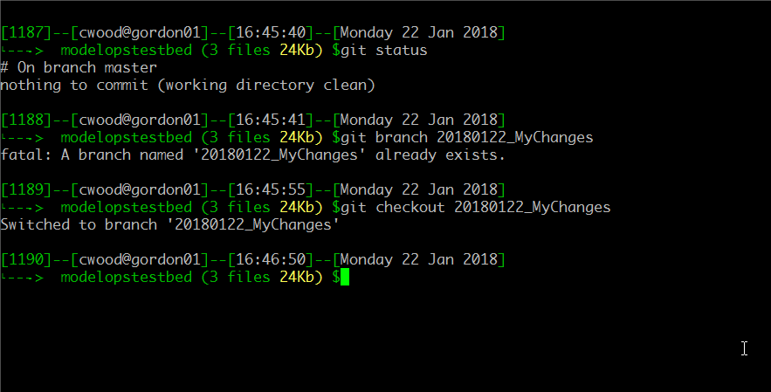
Change to the new branch of master named “20180122_MyChanges” which is stored on the local working copy. You will not see this branch in the remote until you PUSH it.

Slide 12
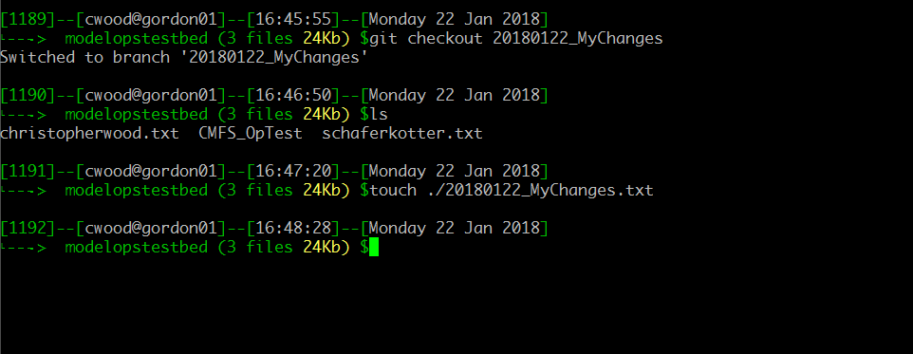
Make a modification to the branch you just created.

Slide 13
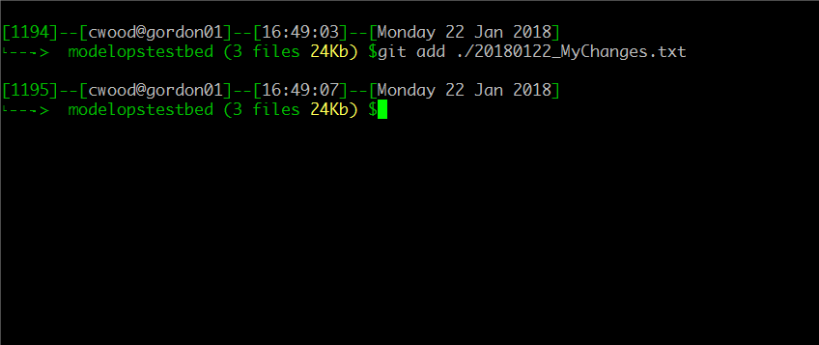
Don’t forget to add and then commit, see extra commands for a single line solution.

Slide 14
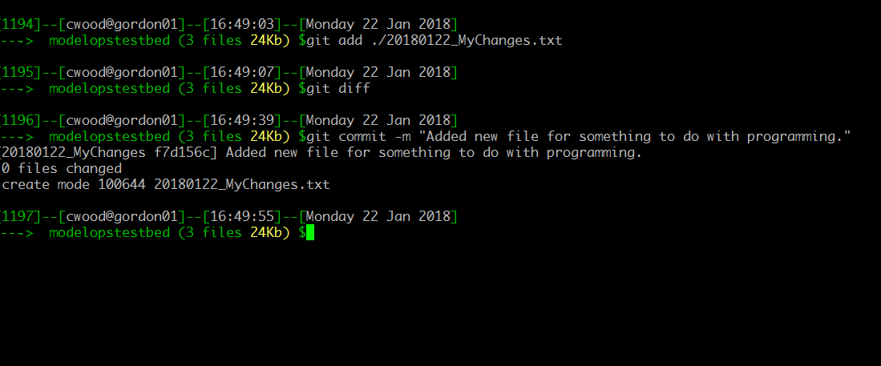
Commit with comments, they’re important, and the results.

Slide 15
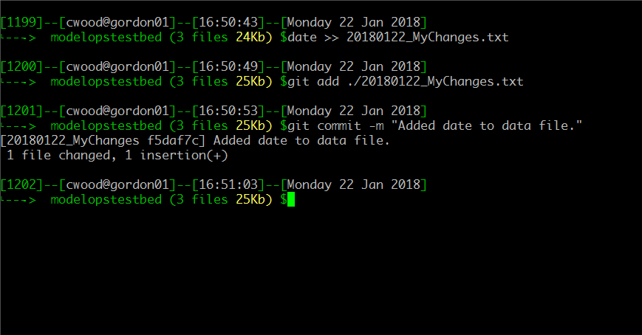
Change the contents of the new file and add / commit.

Slide 16
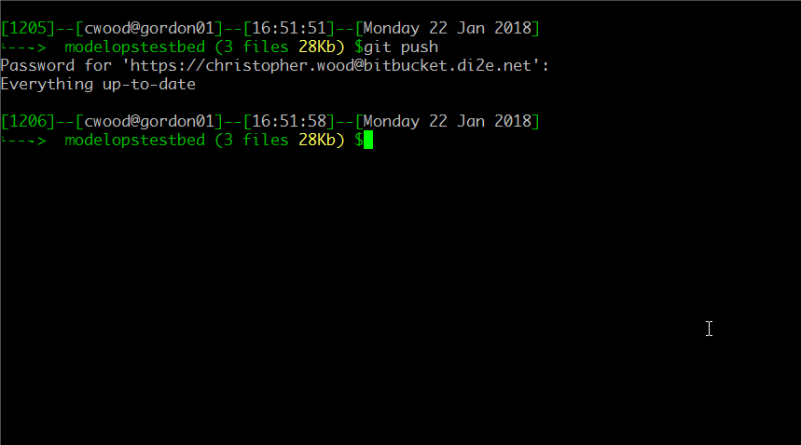
Push those changes, if this branch is configured for direct remote support you’re good, else remember that you’re working on a local working copy only.

Slide 17
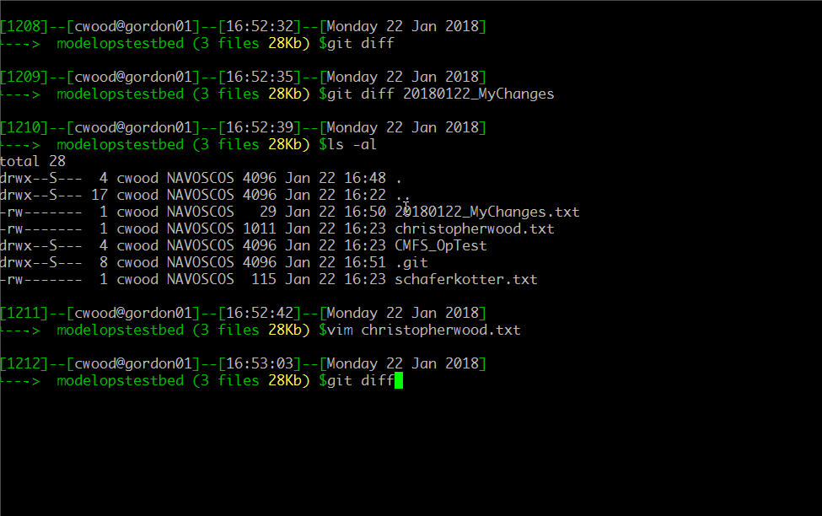
Make a change, do a diff to see the deltas displayed by Git.

Slide 18
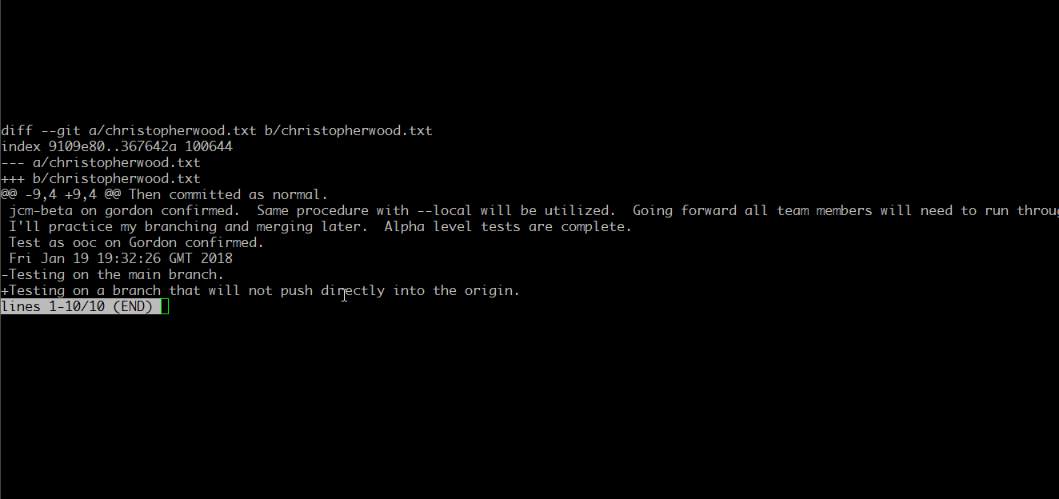
This shows that the modified file had the last line removed and a new line added.

Slide 19
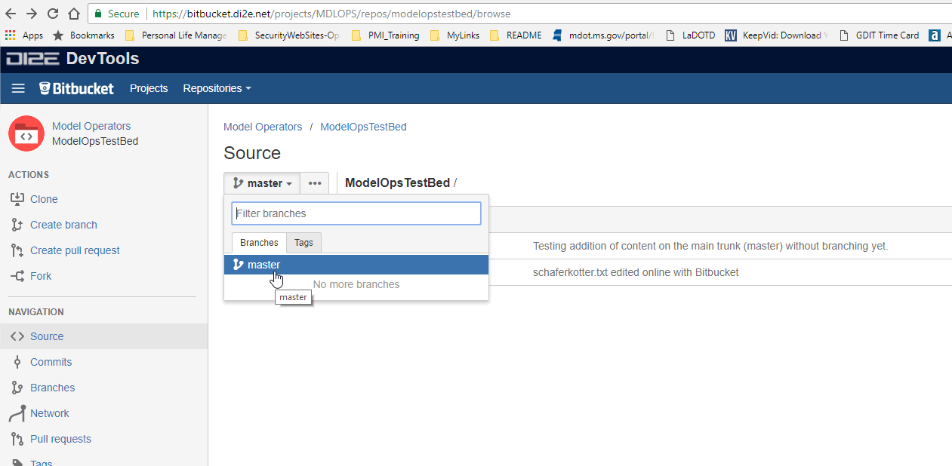
Where’s my branch!?!
Remember how you have to push to remote?
Let’s look at working copy versus remote.

Slide 20
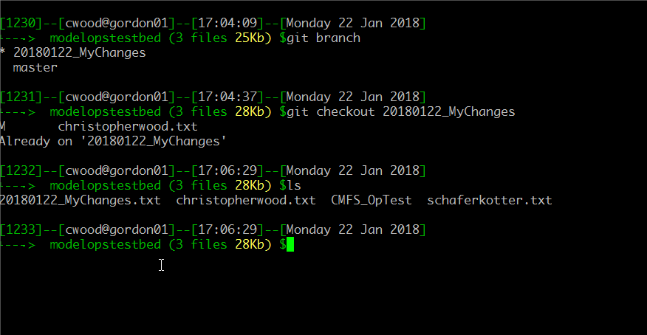
These are the files in the 2018*Changes branch.

Slide 21
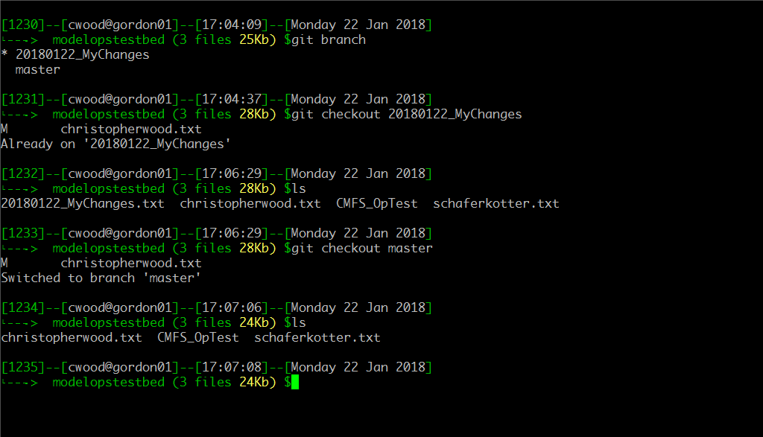
Notice that when changing to master (local copy) that a single file is missing. That means you changes haven’t been merged.

Slide 22
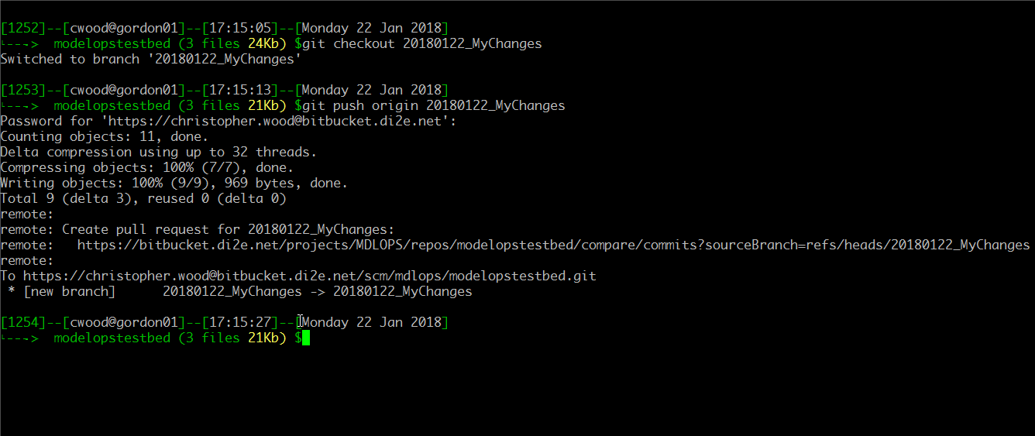
Before we merge let’s be paranoid and push our local branch to the repository to ensure we can get to it from anywhere.

Slide 23
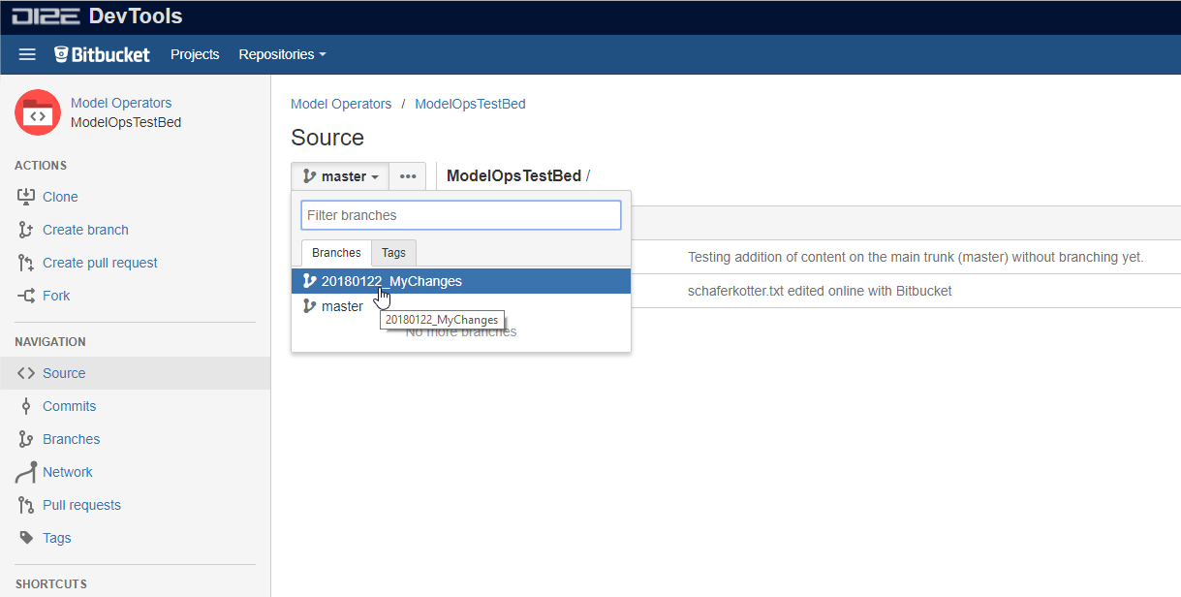
Now the branch is visible and can be potentially cloned by anyone.

Slide 24
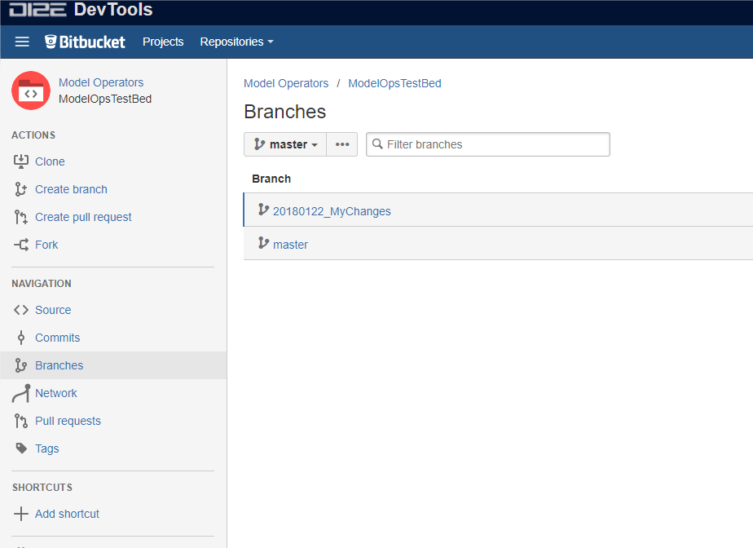
Both branches are shown:
master (git) == Trunk (subversion)
Developer commits:
20180122_MyChanges

Slide 25
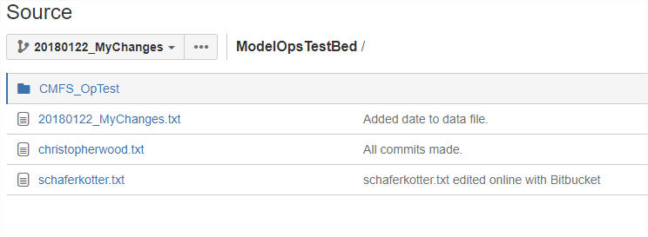
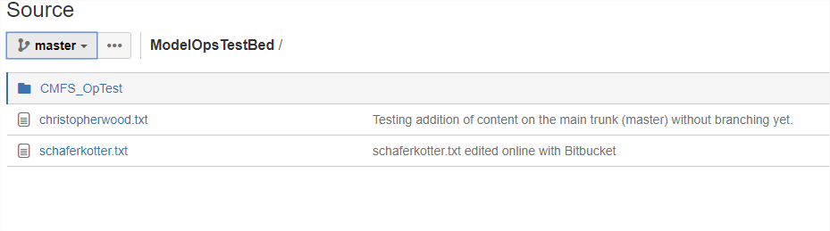
Before the merge a committed branch and the master shown in DI2E.

Slide 26
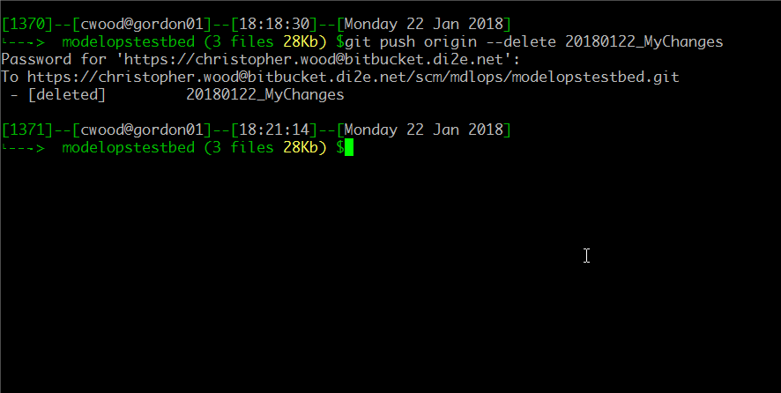
Need to remove a local branch?
git branch –d <branch name>
This is an example of a remote branch deletion. Likely something you would do after a successful merge and confirmation of functionality test.

