Slide 1


Merging

Slide 2
Git Merge References
https://git-scm.com/book/en/v2/Git-Branching-Basic-Branching-and-Merging
https://www.atlassian.com/git/tutorials/using-branches/git-merge
https://git-scm.com/docs/git-merge
https://git-scm.com/book/en/v2/Git-Tools-Advanced-Merging

Slide 3
Remember!
Warning: Running git merge with non-trivial uncommitted changes is discouraged: while possible, it may leave you in a state that is hard to back out of in the case of a conflict.
Before applying outside changes, you should get your own work in good shape and committed locally, so it will not be clobbered if there are conflicts. See also git-stash for more details. git pull and git merge will stop without doing anything when local uncommitted changes overlap with files that git pull/git merge may need to update.
To avoid recording unrelated changes in the merge commit, git pull and git merge will also abort if there are any changes registered in the index relative to the HEAD commit.

Slide 4
Git Merge
git checkout 20180122_MyChanges
#change something
git commit –a –m “Updating something.”
git push
git checkout master
git merge 20180122_MyChanges
git push
ls
#you changes will be visible on the Bitbucket server

Slide 5
Git Merge – extra commands
#while in the branch you want to merge into
git merge 20180122_MyChanges
#show merge tools available
git mergetool
#made a mistake and you want to start over
git reset –hard HEAD~

Slide 6
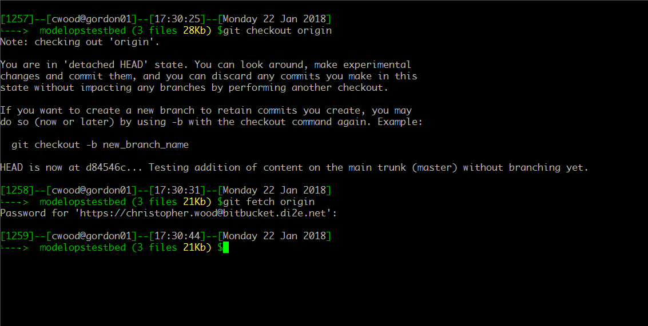
Ensure you have all the latest changes pushed by other users. Utilize “fetch” to get those changes from afar before you merge.

Slide 7
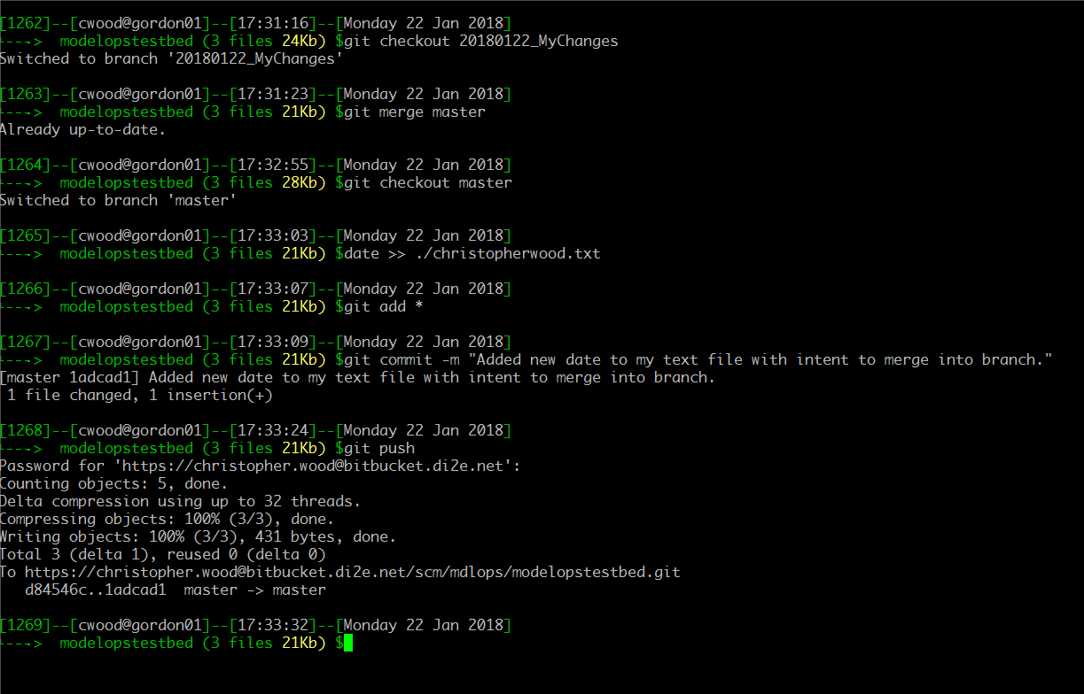
Modify the master and commit the change outside of changes made to your working branch.

Slide 8
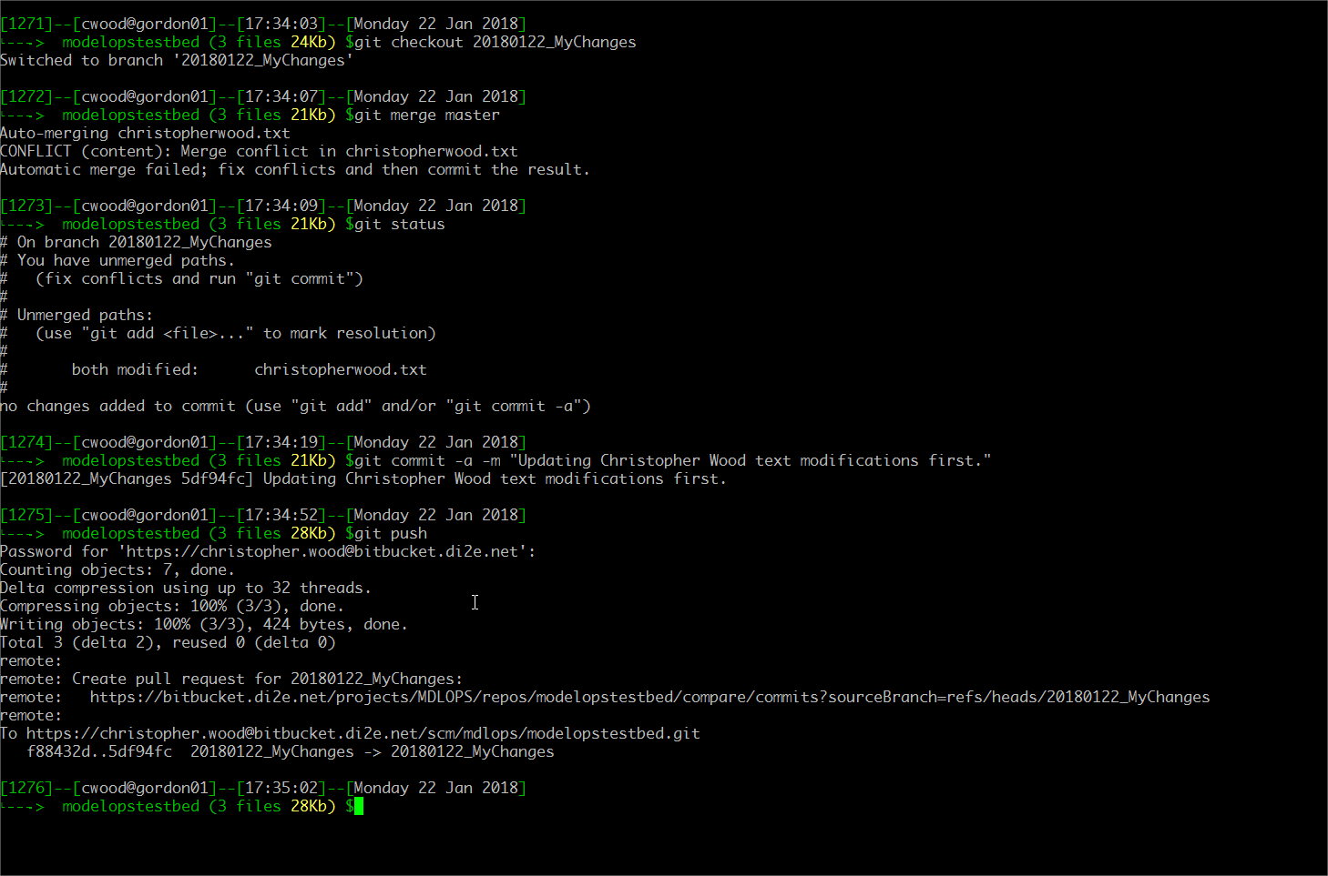
Notice trying to merge a “newer” master into a local branch. Inspect the file in conflict, resolve deltas and then push.

Slide 9
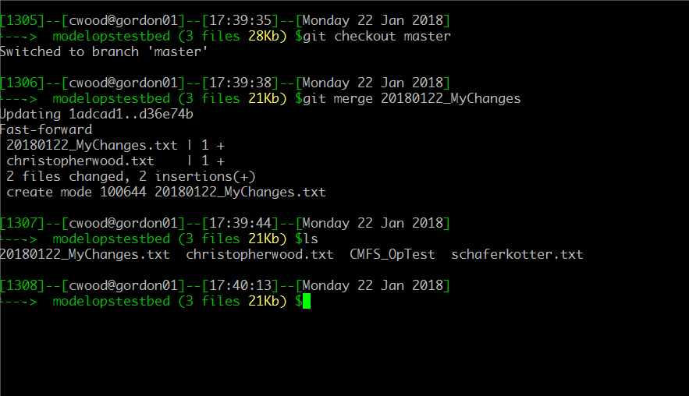
Now merge your branch into the master. Notice the informatics regarding what was merged.
Notice the newly added 20180122_MyChanges.txt file in master now. The changes show on the local copy but…are they on the remote repository?

Slide 10
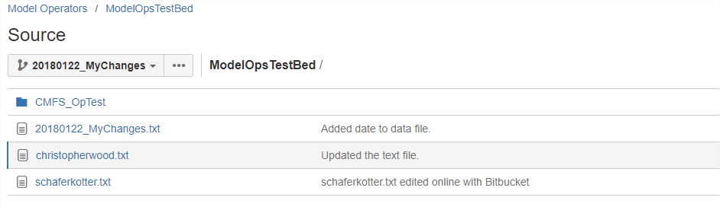
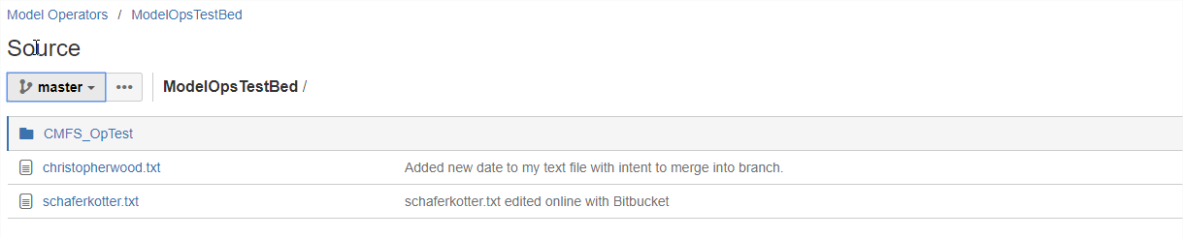
Specific branch, has more files than master.
Master on the remote repository is not updated, only the local copy is up to date.

Slide 11
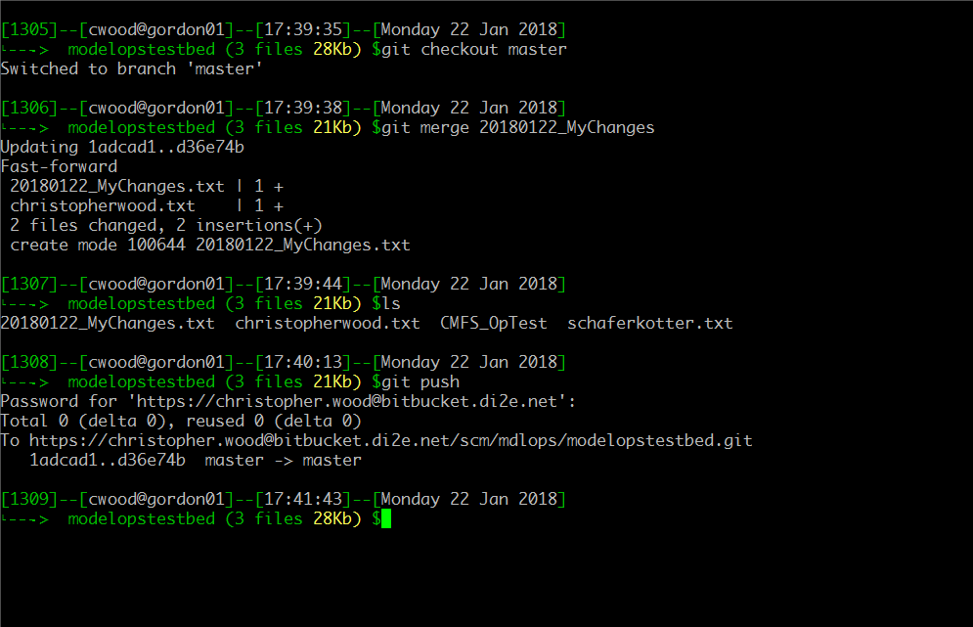
Now push your local master to the remote server. Notice the informatics regarding what was merged and see the commit Id.

Slide 12
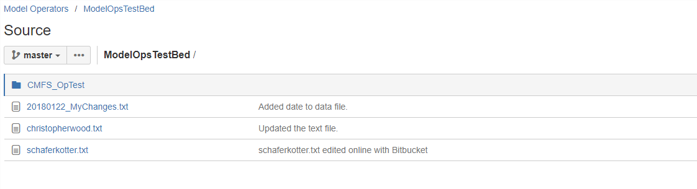
Master is not updated with the new files.

