Slide 1


Tagging

Slide 2
Git Tagging References
https://git-scm.com/book/en/v2/Git-Basics-Tagging
http://alblue.bandlem.com/2011/04/git-tip-of-week-tags.html

Slide 3
Remember!
Tagging is part of Configuration Management. Tag to show a discrete point of finality within your code base. Typically version releases and patches are tagged.
Anytime you want code that you can come back to guaranteed…use a tag.
Git has two flavors of tags; annotated and non-annotated. When using them, there is little difference between the two; both will allow you to refer to a specific commit in a repository.
An annotated tag creates an additional tag object in the Git repository, which allows you to store information associated with the tag itself. This may include release notes, the meta-information about the release, and optionally a signature to verify the authenticity of the commit to which it points.
You don’t have to commit a tag, you can use them internally just to track changes.

Slide 4
Git Tags
git clone https://christopher.wood@bitbucket.di2e.net/scm/mdlops/modelopstestbed.git
cd modelopstestbed/
git status
git tag -a v1.0 -m "v1.0 - Used to support the tutorial."
git push origin --tags
#show available tags
git tag

Slide 5
Git Tags – extra commands
#show available tags
git tag
#make a tag and commit it
git tag -a v1.0 -m "v1.0 - Used to support the tutorial."
git push origin --tags
#delete tags
git tag –d v1.0
#tag details
git show v1.0
#push one tag
git push origin v1.0
#push all of your tags
git push origin –tags
#checkout a tag
git checkout v1.0
#branch a tag
git checkout –b myNewTag_1.1 v1.0

Slide 6
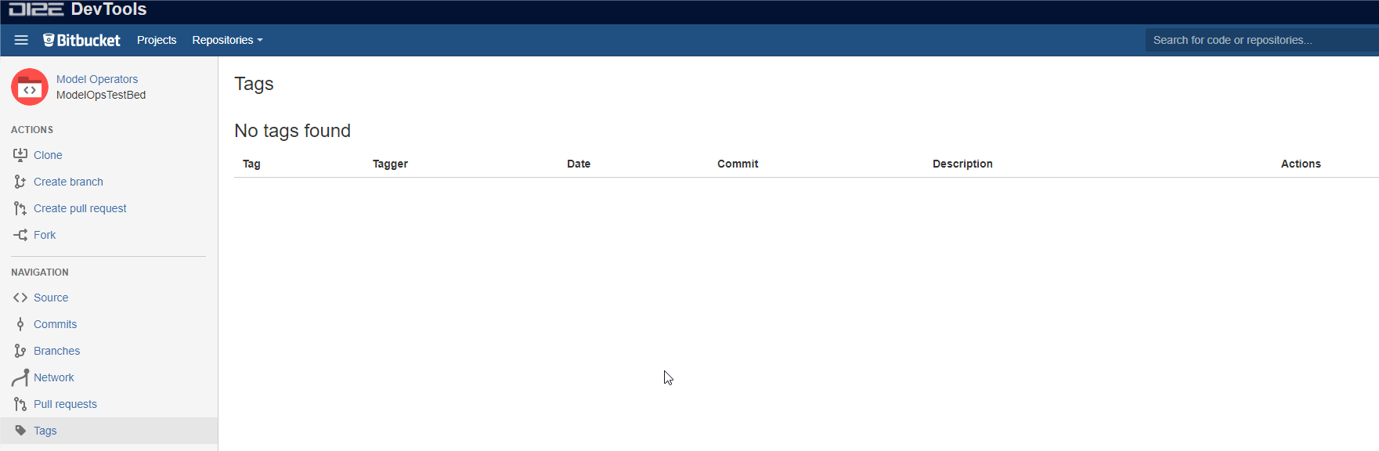
No tags have been declared against this repository yet. You can visually inspect repositories over the web.
Think of tags as the official stamp of what you want to persist over the spectrum of changes that will occur in your repository.

Slide 7
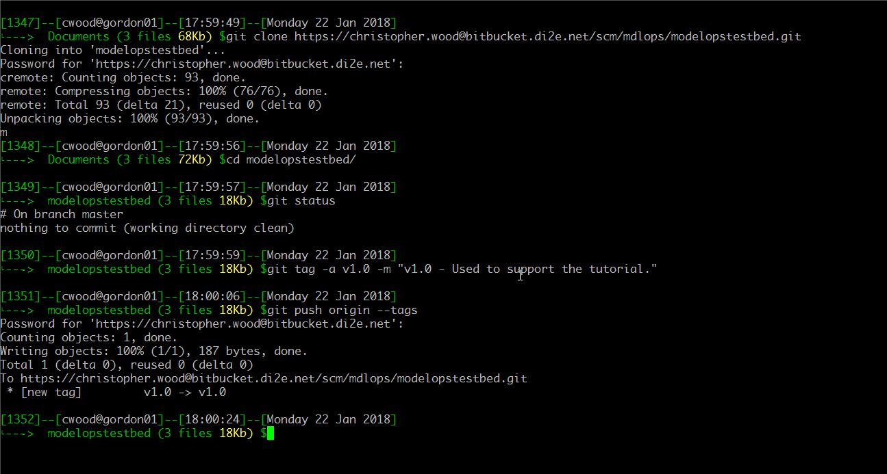
Clone a repo.
Get the status.
Make an advanced tag (with comments).
Push all tags to the remote repository.
Note that if you don’t push your tags are local only and will be lost if never pushed up.

Slide 8
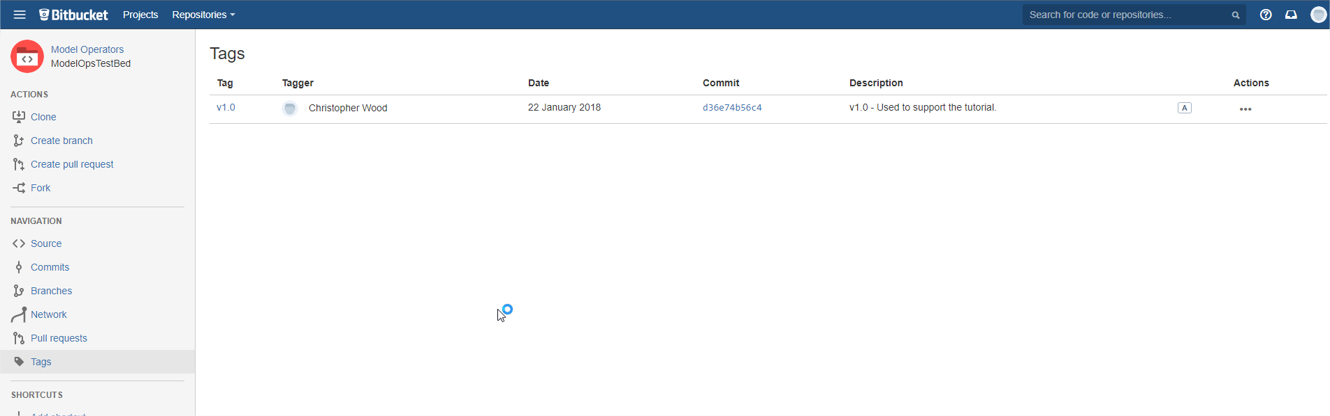
After pushing the tag you can now see it in the repository browser on DI2E.

Slide 9

Show all local tags in your working copy.

