Slide 1
Software Configuration Management
FLENUMMETOCCEN SSC
Software Configuration Management
Practices

Slide 2
Scope
The spectrum of projects that support model operations at FNMOC-SSC and near alignment with FNMOC-MRY practices, Department of Defense (DoD) and industry recognized “Best Practices”.
Active definition of:
Policy
Concept of Operations (CONOPS)
Implementation
are underway.

Slide 3
Definition
Software configuration management (SCM or S/W CM) is the task of tracking and controlling changes in the software, part of the larger cross-disciplinary field of configuration management.
SCM practices include:
identification of Configuration Items (CI's)
version management
revision control
establishment of baselines.
SCM ensures that the current design and build state of the system is known, good & trusted; and doesn't rely on the tacit knowledge of the development team. The ability to restore back to subject good & trusted state is directly related to the degree of consistent CM applied to the software application.

Slide 4
Have you ever asked or said this?
Why is this configuration file like this?...I thought it was setup like “X”.
Why does “system command” work one way on Gordon and another way on Conrad?
Which version of “software package X” are we using?
What is “software package X” made of?
Who changed this?
But it worked just last week.

Slide 5
Where are you?
What version is your software on?
When did it get there?
How did it get there?
Why did it get there?
Who helped it get there?
The intent of SCM is to have answers to these questions up front.

Slide 6
Information Assurance
ASPC-DV-002995
Ensure security patches are applied to the CM system.
ASPC-DV-003000
Review access privileges to the repository at least every three months.
ASPC-DV-003010
CM repository must exist and verify existence of the CM plan.
ASPC-DV-003020
CCB must exist.
ASPC-DV-003140
All code received must have a checksum.
ASPC-DV-003190
CM repository must exist or code reviews flaws must be captured (track software in defect tracking system).

Slide 7
What must be defined?
What
What is being configuration managed? Your CI’s.
When
When will you engage SCM?
How
How will you conduct SCM? Tools, techniques, etc.
Why
Will you know why changes are made?
Do you have requirements traceability?
Navy says so…
Who
Who is involved? What are the roles?

Slide 8
What?
What is being configuration managed?
Source code
Anything that executes in direct support of Model Operations.
Anything that is “operational”.
Anything you don’t want to spend all week rebuilding.
Configurations
Anything that executes in direct support of Model Operations.
Anything that is “operational”.
Anything you don’t want to spend all week rebuilding.

Slide 9
When?
Anytime you make a change that you expect to stay around.
Anytime you want to change operations.

Slide 10
How?
Policy, Plan, and Management support.
Define and write policy/plan.
Periodically inspect.
Expect defined Best Behavior
Easy to use tools that are DoD compliant and readily available, preferably with cross network interfaces.
Bitbucket, Fisheye, and Crucible via DI2E
Inspections
Code / peer review.
Receipt of deliverables.
Prior to acceptance of 3rd party solutions.

Slide 11
Why?
Too many things change without control.
Little to no repeatability.
Slow integration.
Slow to respond to change.
Your resources aren’t getting bigger.
Your requirements are…
DevOps – You’re in it now.
Pets are bad, cattle are good.

Slide 12
Who?
Everyone.
Roles
CCB
Are we going to change “X”?
Oversight / Control
Inspections of deliveries.
Peer / code review
Integrators
Line users / Operators

Slide 13
High level
Alpha → Beta → Staging → OPS
Use of DI2E
OPS and DEV repositories
Simple Workflow
Copy OPS to DEV
Developers branch and make changes to DEV
Developers test and then merge with DEV/master
Librarian takes DEV/master and merges with OPS/branch
Librarian merges OPS/branch with OPS/master and then tags
Ansible

Slide 14
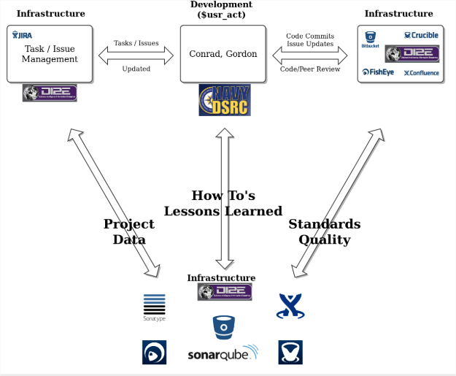
DI2E Interaction

Slide 15
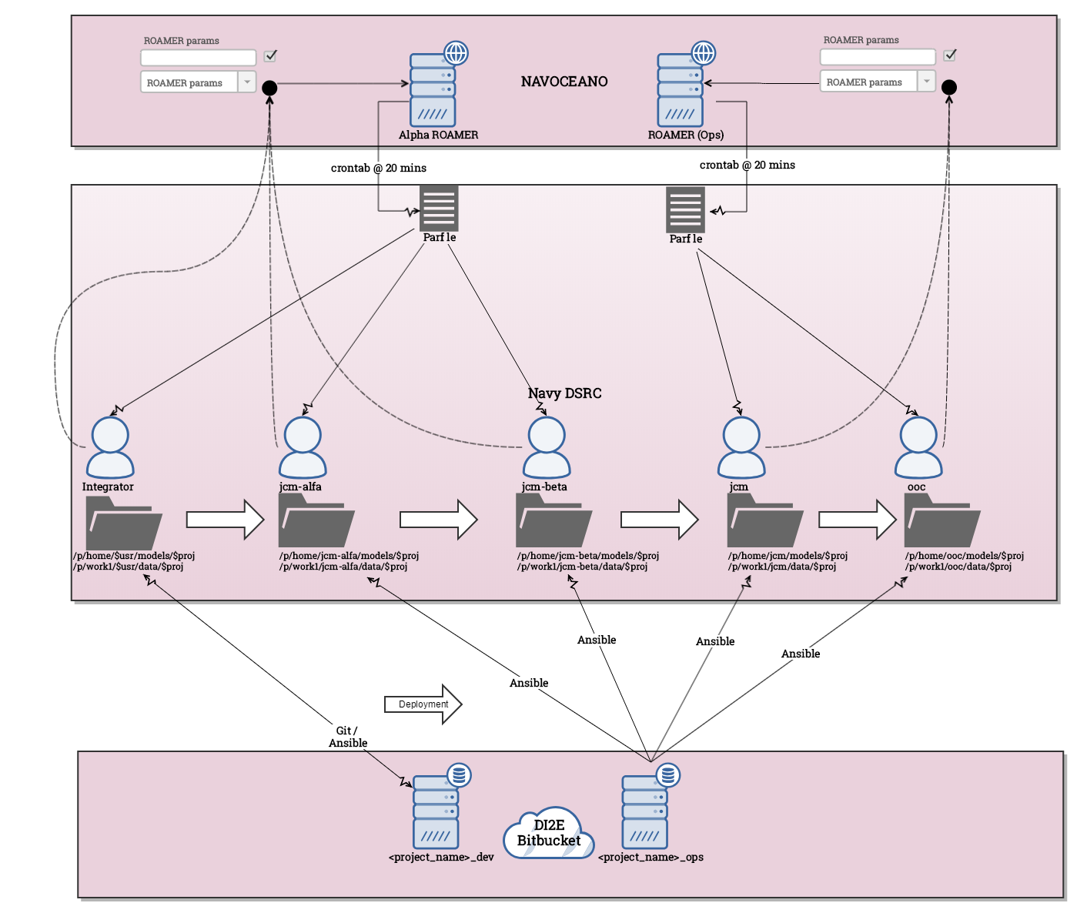
Workflow

Slide 16
References
FLENUMMETOCCEN MRY CM documentation
(DRAFT) Configuration Management Standards, FLENUMMETOCCEN SSC, 2018/01/22
Security Technical Implementation Guide (STIG)
Application Security and Development (ASD), v4r7, dated 2018/7/27
https://svn.apache.org/repos/asf/subversion/trunk/doc/user/svn-best-practices.html
https://git-scm.com/
https://www.git-tower.com/learn/git/ebook/en/command-line/appendix/best-practices
https://www.atlassian.com/git/tutorials/comparing-workflows
https://chriskottom.com/blog/2014/02/a-few-modest-best-practices-for-git/
https://www.di2e.net/display/DI2E
https://en.wikipedia.org/wiki/File_verification

Slide 17
Training
Git Clones
https://confluence.di2e.net/download/attachments/225828299/1_Git_StartwithClone.pptx
Git Branching
https://confluence.di2e.net/download/attachments/225828299/2_Git_Branching.pptx
Git Merging
https://confluence.di2e.net/download/attachments/225828299/3_Git_Merge.pptx
Git Tagging
https://confluence.di2e.net/download/attachments/225828299/4_Git_Tag.pptx
Git Transition from DEV to OPS
https://confluence.di2e.net/display/MDLOPS/Use+Case%3A+Transfer+of+Code+from+DEV+to+OPS+Repository

