Slide 1
Independent Components Analysis
An Introduction
Christopher G. Green
Image Processing Laboratory
Department of Radiology
University of Washington

Slide 2
What is Independent Component Analysis?
Statistical method for estimating a collection of unobservable “source” signals from measurements of their mixtures.
Key assumption: hidden sources are statistically independent
Unsupervised learning procedure
Usually just called “ICA”

Slide 3
What can we use ICA for?
Blind Source Separation
Exploratory Data Analysis
Feature Extraction
Others?

Slide 4
Brief History of ICA
Originally developed in early 1980’s by a group of French researchers (Jutten, Herault, and Ans), though it wasn’t called ICA back then.
Developed by French group.
Bell and Sejnowski, Salk Institute—the “Infomax” Algorithm

Slide 5
Brief History of ICA
Emergence of the Finnish school (Helsinki Institute of Technology)
Hyvärinen and Oja—“FastICA”
What else?

Slide 6
Blind Source Separation (BSS)
Goal: to recover the original source signals (and possibly the method of mixing also) from measures of their mixtures.
Assumes nothing is known about the sources or the method of mixing, hence the term “blind”
Classical example: cocktail party problem

Slide 7





Cocktail Party Problem
N distinct conversations, M microphones

Slide 8
Cocktail Party Problem
N conversations, M microphones
Goal: separate the M measured mixtures and recover or selectively tune to sources
Complications: noise, time delays, echoes

Slide 9
Cocktail Party Problem
Human auditory system does this easily. Computationally pretty hard!
In the special case of instantaneous mixing (no echoes, no delays) and assuming the sources are independent, ICA can solve this problem.
General case: Blind Deconvolution Problem. Requires more sophisticated methods.

Slide 10
Exploratory Data Analysis
Have: very large data set
Goal: discover “interesting” properties/facts
In ICA statistically independent is “interesting”
ICA finds hidden “factors” that explain the data.

Slide 11
Feature Extraction
Face recognition, pattern recognition, computer vision
Classic problem: automatic recognition of handwritten zip code digits on a letter
What should be called “a feature”?
Features are independent, so ICA does well. (Clarify)

Slide 12
Mathematical Development
Background

Slide 13
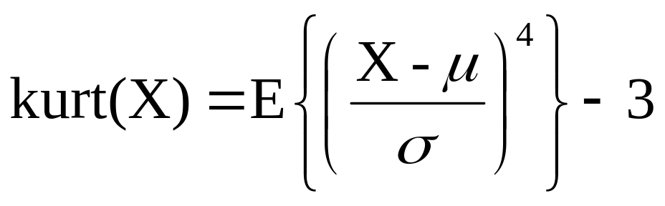
Kurtosis
Kurtosis describes the “peakedness” of a distribution

Slide 14
Kurtosis
Standard Gaussian distribution N(0,1) has zero kurtosis.
A random variable with a positive kurtosis is called supergaussian. A random variable with a negative kurtosis is called subgaussian.
Can be used to measure nongaussianity
Notes:
Can have nongaussian distribution with zero kurtosis, but relatively rare.
Sum of two Gaussian distributions with different means—-result is nongaussian but has zero kurtosis. (Check)

Slide 15
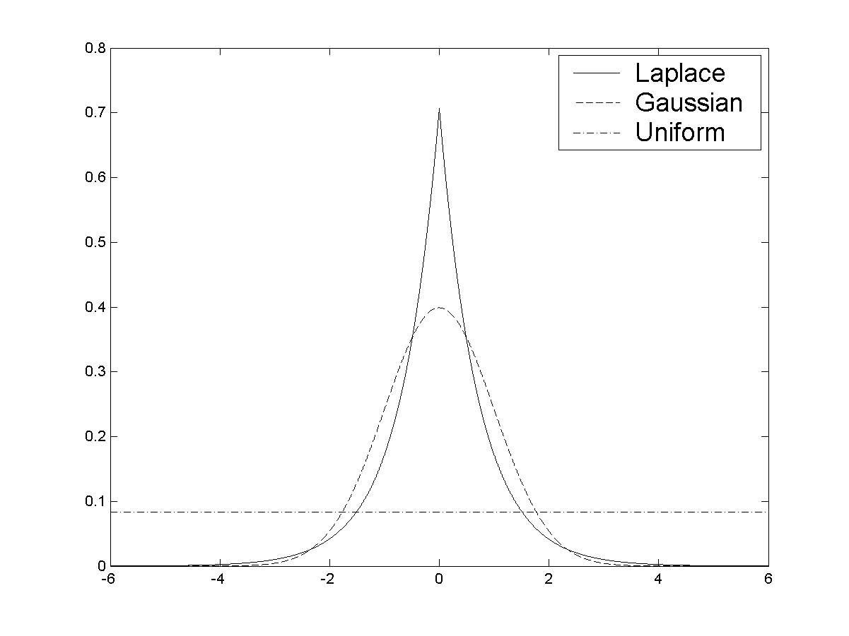
Kurtosis

Slide 16
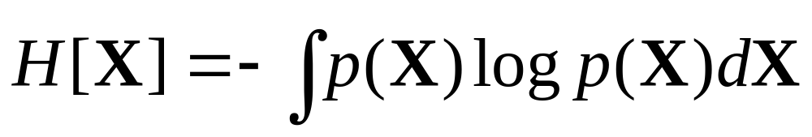
Entropy
Entropy measures the average amount of information that an observation of X yields.

Slide 17
Entropy
Can show: for a fixed covariance matrix Σ the Gaussian distribution N(0, Σ) has the maximum entropy of all distributions with zero-mean and covariance matrix Σ.
Hence, can use entropy to measure nongaussianity: negentropy

Slide 18
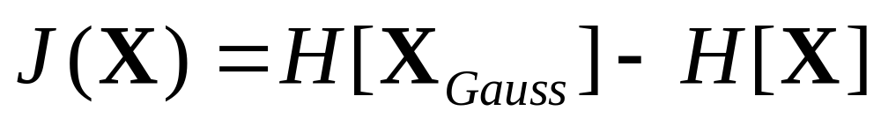
Negentropy
where X_{gauss} is a random variable having the same mean and covariance as X.
Fact: J(X) = 0 iff X is a Gaussian random variable.
Fact: J(X) is invariant under multiplication by invertible matrices.

Slide 19
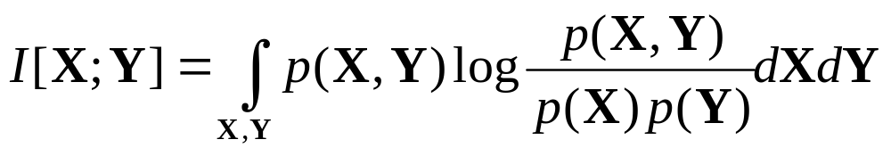
Mutual Information
where X and Y are random variables, p(X,Y) is their joint pdf, and p(X), p(Y) are the marginal pdf’s.

Slide 20
Mutual Information
Measures the amount of uncertainty in one random variable that is “cleared up” by observation.
Nonnegative, zero iff X and Y are statistically independent.
Good measure of independence.
Notes:
Agrees with our intuition—observation of either of a pair of random variables conveys no useful information about the other.

Slide 21
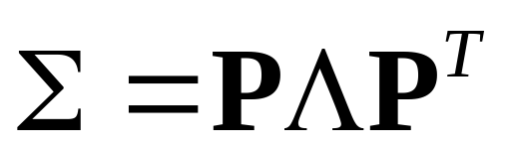
Principal Components Analysis
“PCA”
Computes a linear transformation of the data such that the resulting vectors are uncorrelated (whitened)
Covariance matrix Σ is real, symmetric—spectral theorem says we factorize Σ as
Λ= eigenvalues, P = corresponding unit-norm eigenvectors

Slide 22
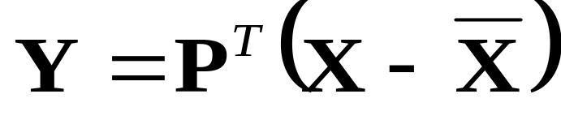
Principal Components Analysis
The transformation
yields a coordinate system in which Y has mean zero and cov(Y) = Λ, i.e., the components of Y are uncorrelated.

Slide 23
Principal Components Analysis
PCA can also be used for dimensionality-reduction—to reduce the dimension from M to L, just take the L largest eigenvalues and eigenvectors.

Slide 24
Mathematical Development
Independent Components Analysis

Slide 25
Independent Components Analysis
Recall the goal of ICA: Estimate a collection of unobservable source signals
S = [s₁ … s_{N}]^{T}
solely from measurements of their (possibly noisy) mixtures
X = [x₁ … x_{M}]^{T}
and the assumption that the sources are independent.

Slide 26

Independent Components Analysis
Traditional (i.e. easiest) formulation of ICA—linear mixing model
(M x V) = (M x N)(N x V)
where A, the mixing matrix, is an unknown M x N matrix.
Typically assume M >= N, so that A is of full rank.
M < N case: the underdetermined ICA problem.

Slide 27
Independent Component Analysis
Want to estimate A and S
Need to make some assumptions for this to make sense
ICA assumes that the components of S are statistically independent, i.e., the joint pdf p(S) is equal to the product of the marginal pdf’s p_{i}(s_{i}) of the individual sources.

Slide 28
Independent Components Analysis
Clearly, we only need to estimate A. Source estimate is then A⁻¹X.
Turns out it is numerically easier to estimate the unmixing matrix W = A⁻¹. Source estimate is then S = WX.

Slide 29
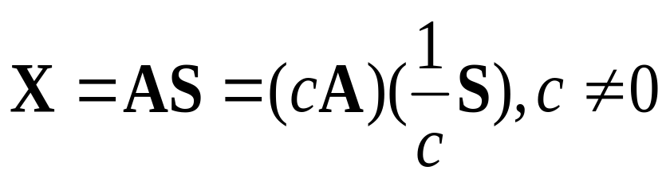

Independent Components Analysis
Caveat 1: We can only recover sources up to a scalar transformation:
Caveat 2: Cannot recover the order of the sources. Best we can hope for is
where P is a permutation matrix and D a diagonal matrix.

Slide 30
Independent Components Analysis
Big Picture: find an unmixing matrix W that makes the estimated sources WX as statistically independent as possible.
Difficult to construct good estimate of pdf’s
Construct a contrast function that measures independence, optimize to find best W
Different contrast function, different ICA

Slide 31
Infomax Method
Information Maximization (“Infomax”) Method
Nadal and Parga 1994—maximize amount of information transmitted by a nonlinear neural network by minimizing mutual information of its outputs.
Outputs independent ⇒ less redundacy, more information capacity

Slide 32
Infomax Method
Infomax Algorithm of Bell and Sejnowski Salk Institute (1997?)
View ICA as a nonlinear neural network
Multiply observations by W (“weights” of the network), feed-forward to nonlinear continuous monotonic vector-valued function g = (g₁, … g_{N}).
Notes:
Through its Taylor expansion, the nonlinearity g allows us to use higher order statistics of U.
We are now assuming that M = N.

Slide 33

Infomax Method
Nadal and Parga — we should maximize the joint entropy H[S] of the sources
where I[S] is the mutual information of the outputs.
Notes:
Thus to maximize the joint entropy we should maximize the individual marginal entropies while minimizing their mutual information.

Slide 34
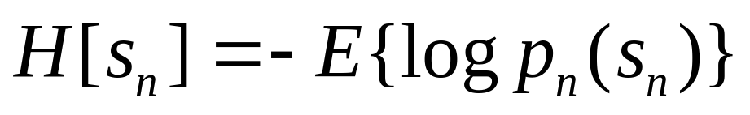
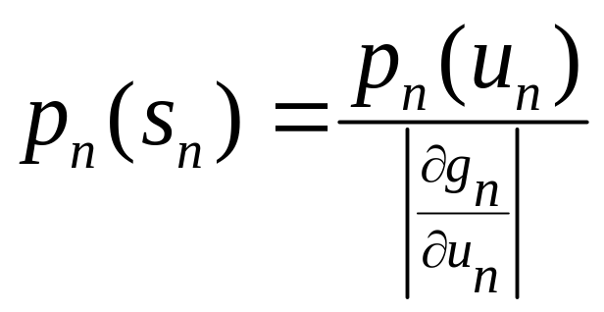
Infomax Method
Marginal entropy of each source:
g continuous, monotonic ⇒ invertible. Use change of variables formula for pdf’s:

Slide 35
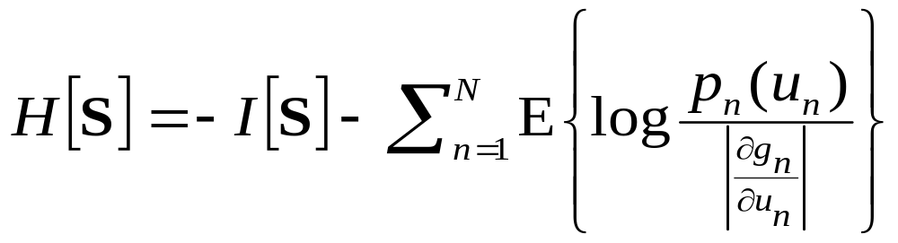
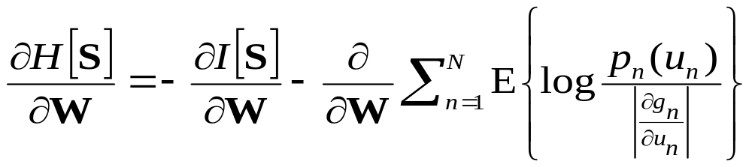
Infomax Method
take matrix gradient (derivatives wrt to W):

Slide 36
Infomax Method
From this equation we see that if the densities of the weighted inputs u_{n} match the corresponding derivatives of the nonlinearity g, the marginal entropy terms will vanish. Thus maximizing H[S] will minimize I[S].

Slide 37
Infomax Method
Thus we should choose g such that g_{n} matches the cumulative density function (cdf) of the corresponding source estimate u_{n}.
Let us assume that we can do this.

Slide 38
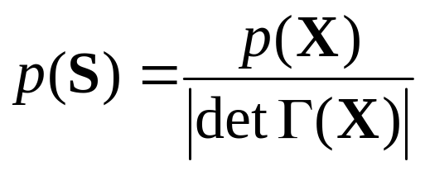
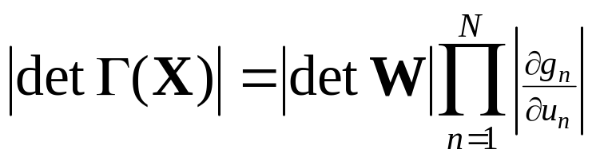
Infomax Method
change variables as before: Γ(X) is the Jacobian matrix of g(WX)
calculate:
joint entropy H[S] is also given by –E{log |p(S)|}

Slide 39
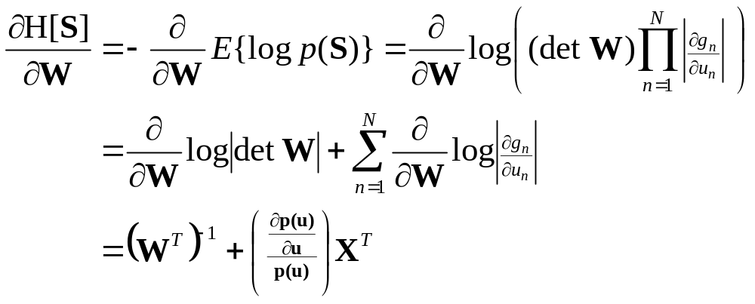
Infomax Method
Thus
Notes:
D log | det W | = D det W / | det W|
D det W = adj(W’)
p(u) is joint density of estimated sources

Slide 40
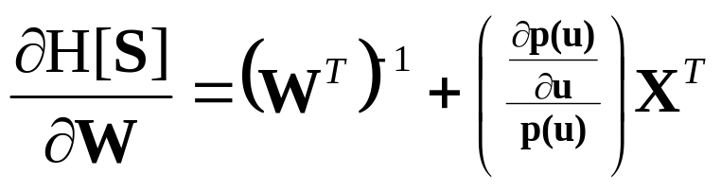
Infomax Method
Infomax learning rule of Bell and Sejnowski
Notes:
D log | det W | = D det W / | det W|
D det W = adj(W’)
p(u) is joint density of estimated sources

Slide 41
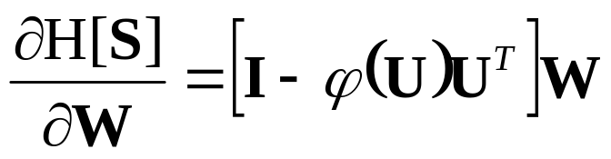
Infomax Method
In practice, we post-multiply this by W^{T}W to yield the more efficient rule
where the score function ϕ(U) is the logarithmic derivative of the source density.
This is the “natural gradient” learning rule of Amari et al.
Takes advantage of Riemannian structure of GL(N) to achieve better convergence.
Also called “Infomax Method” in literature.
Notes:
phi(u) = -(dp(u)/du)/p(u)

Slide 42
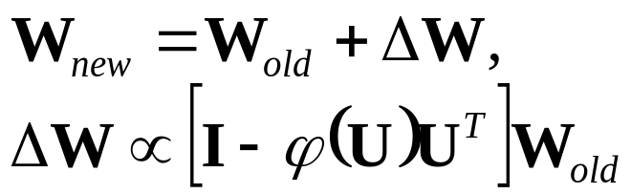
Infomax Method
Implementation
Typically use a gradient descent method.
Convergence rate is ???

Slide 43
Infomax Method
Score function is implicitly a function of the source densities and therefore plays a crucial role in determining what kinds of sources ICA will detect.
Bell and Sejnowski used a logistic function (tanh)—good for supergaussian sources
Girolami and Fyfe, Lee et al.—extension to subgaussian sources— “Extended Infomax”
Notes:
Extended Infomax—more robust. Adds a –uu’ term to update

Slide 44
Infomax Method
The Infomax Method can be derived by many other methods (Maximum Likelihood Estimation, for instance).

