Slide 1
CS 2160
Introduction to Assembly Programming and
Computer Organization
Fall 2026
Instructor: Himon Thakur
TA: Hassan Shakil
University of Colorado Colorado Springs (UCCS)
Himon Thakur (hthakur@uccs.edu); CC BY-NC-SA 4.0;
Special Thanks to Dr. Keith Paarpong and Dr. Xi Tan.

Slide 2
Today’s Agenda.
Introduction
Syllabus
Course Overview
Class logistics

Slide 3
Instructor & Teaching Assistant.
Instructor: Himon Thakur
Email: hthakur@uccs.edu
Website: himonthakur.github.io/
Hours: MoTuWeTh 3:00 PM – 4:30 PM (in-person)
Office: Osborne Center for Science & Engineering (OCSE A-340)
Teaching Assistant: Hassan Shakil
Email: hshakil@uccs.edu
TA Office Hour: Remote, by appointment

Slide 4
About me.
Himon (hee-mon) Thakur (tha-koor)
Master of Science in Computer Science, UCCS
Language and Information and Computation (LINC) Lab
Research:
Multi-Agent Systems, Reinforcement Learning, Metacognition
Thesis:
Metacognitive Multi-Agent Reinforcement Learning:
Latent Neuromodulation for Interpretable Agentic Coordination

Slide 5
About you, the students.

Slide 6
Goal of CS 2160.
Bridge the gap between computers and high-level languages
Introduction to computer architecture
Foundation of digital logic
Implementation of arithmetic in computers
Code and data representation in computer
Assembly language programming techniques
Develop an intuition and appreciation of computer design principle.

Slide 7
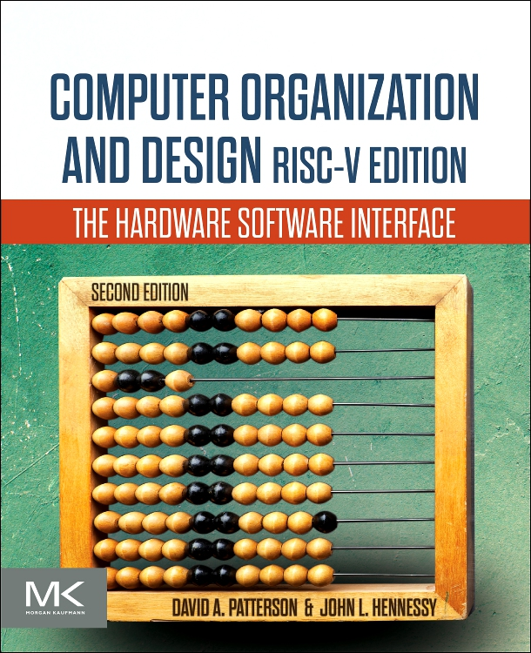
Textbook.
Computer Organization and Design RISC-V Edition. 2nd Edition; David Patterson & John Hennessy;
Elsevier. 2021; ISBN 9780128203316; E-book ISBN: 9780128245583;
https://github.com/vanisitor/Computer-Science-Textbooks/blob/master/Computer-Organization-and-Design-The-Hardware-Software-Interface-RISC-V-Edition.pdf.

Slide 8
Prerequires and Why.
CS 1450 or GDD 2200: Data Structures and Algorithms
Basic data structures (e.g., arrays, linked list)
Design and implement modular programs in high-level language (e.g., C, C++, Java, Python)
CS 2060: Programming with C
Using functions, arrays, string, pointers, etc. in C language.

Slide 9
Learning Objectives.
Learn basic composition of computer systems
Use Boolean algebra
Understand digital logic
Appreciate relationship between mathematics and computer
  data representation in computer systems
  implementation of arithmetic and logic operations
Understand and interact with computer at the machine level
  Assembly instruction
  Execution of instructions by processor
  Basic structure of assembly programs
  Construct programs using assembly

Slide 10
Grading.
~8 Homework assignments = 25%
Midterm Exam = 25%
4 Coding project assignments = 25%
Final Exam = 25%
Final curving will be applied to the final semester grade.
Grade | Percentage
A | >= 90%
B | >= 80% < 90%
C | >= 70% < 80%
D | >= 60% < 70%
F | < 60%

Slide 11
Deliverables.
Homework assignments
Projects

Slide 12
Exam.
One midterm exam
One final exam
Closed book
One Letter size font-and-back handwritten or printed sheet
No retakes. Rescheduling by notice.

Slide 13
Accommodations.
Disabilities
Religious practice
Military

Slide 14

Chapter 02:
Quiz Time

Slide 15
(Recap) Quiz
Computer? | Computer Components?
??? | ???
Computer Generations | High-level vs low-level programming language
??? | ???
Assembly programming language? | Hardware-Software Interface?
??? | ???
Notes:
single point of failure

Slide 16
(Recap) Quiz Answers
Computer? | Computer Components?
Can compute | ALU, CPU, memory.
Computer Generations | High-level vs low-level programming language
From vacuume tube to 0.7nm | Python vs Assembly
Assembly programming language? | Hardware-Software Interface?
Machine language | Kernel
Notes:
single point of failure

Slide 17
Thank you.

