Slide 1
CS 2160
Introduction to Assembly Programming and
Computer Organization
Lecture 07: Instruction Representations
Fall 2026
Instructor: Himon Thakur
TA: Hassan Shakil
University of Colorado Colorado Springs (UCCS)
Himon Thakur (hthakur@uccs.edu); CC BY-NC-SA 4.0;
Special Thanks to Dr. Keith Paarpong and Dr. Xi Tan.

Slide 2
Today’s Agenda.
Understand how instructions are represented
PC-relative addressing
Strings

Slide 3
RISK-V Integer Instructions.
Name | Mnemonic | Meaning
x0 | zero | always zero
x1 | ra | return address
x2 | sp | stack pointer
x3 | gp | global pointer
x4 | tp | thread pointer
x5 | t0 | temporary (alternate return address)
x6-7 | t1-2 | temporary registers
x8 | s0/fp | saved register / frame pointer
x9 | s1 | saved register
x10-11 | a0-1 | function arguments and return value
x12-17 | a2-7 | function arguments
x18-27 | s2-11 | saved registers
x28-31 | t3-6 | temporary registers

Slide 4
What Data Means.
What does this piece of data represent?
1000 0010 0000 0100 0000 1100 0110 0011

Slide 5
What Data Means.
What does this piece of data represent?
1000 0010 0000 0100 0000 1100 0110 0011
It depends on the data representation and context.
- Integer? Floating point?
- Alphanumeric character?
- A machine instruction?
- Other?

Slide 6
Humans Need Characters and Strings.
American Standard Code for Information Interchange (ASCII)
- Encode alpha-numeric symbols with 7 bits.
- Store in 8 bits, upper bit is reserved
- Can represent 128 characters.

Slide 7
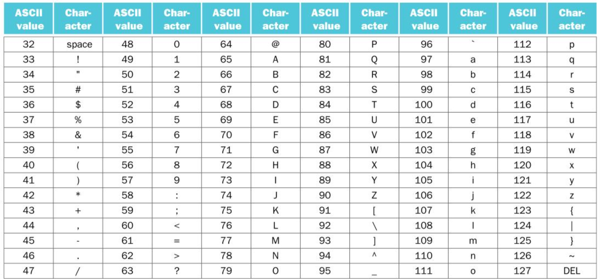
Each character represented with 8 bits (a byte)
ASCII.
0: Null character (marks the end of a string)

Slide 8
String Example.
Copy string y into string x
void strcpy(char x[], char y[])
{
int i = 0;
while ((x[i]=y[i]) != ‘\0’) i += 1;
}

Slide 9
String Example.
strcpy:
addi sp, sp, -4 sw s2, 0(sp) add s2, x0, x0
L1:
// save register value
// initialize i to 0
add | t0, | s2, | a1 | // | t0 | <- | addr | of | y[i]
lbu | t1, | 0(t0) |  | // | t1 | = y[i]
add | t2, | s2, a0 |  | // | t2 | <- addr |  | of | x[i]
sb t1, 0(t2) beq t1, x0, L2 addi s2, s2, 1 jal x0, L1 |  |  |  | // // | x[i] exit |  | = y[i] if y[i] |  | = NULL
L2:
lw s2, 0(sp) addi sp, sp, 4 jalr x0, 0(ra)
Assume base &x[0] and &y[0] are contained in the a0 and a1 registers, and I is contained in s3.

Slide 10
Instruction Representation.
Instructions are represented by numbers
add x9, x20, x21
This instruction is represented by the decimal numbers
What do these numbers mean?

Slide 11
Instruction Representation.
Instructions are represented by numbers
add x9, x20, x21
This instruction is represented by the decimal numbers
Each segment is a field
opcode fields

Slide 12
Instruction Representation.
Instructions are represented by numbers
add x9, x20, x21
This instruction is represented by the decimal numbers
Each segment is a field
Source registers
Destination register

Slide 13
Instruction Representation.
Instructions are represented by numbers
add x9, x20, x21
Binary representation of this instruction:
This layout is called an instruction format
ALL RISC-V instructions are 32 bits long

Slide 14
RISC-V Fields.
Opcode: basic operation of the instruction
rd: destination register
rs1: first source register
rs2: second source register
funct7: another opcode field
funct3: another opcode field

Slide 15
RISC-V Fields.
This is an R-type RISC-V instruction (add, sub)
We cannot describe immediate
type instructions (addi, lw, slli) with this format

Slide 16
RISC-V Fields.
This is an I-type RISC-V instruction (addi, lw, slli)
Opcode: basic operation of the instruction
rd: destination register
rs1: source register
immediate: a value in two’s complement
funct3: another opcode field

Slide 17



RISC-V Fields.
This is an I-type RISC-V instruction (addi, lw, slli)
Example:
lw x9, 32(x22)
What about store instructions?

Slide 18
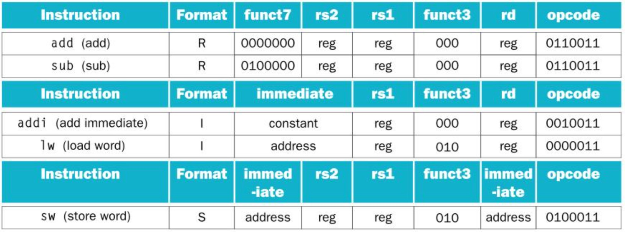
RISC-V Fields.
This is an S-type RISC-V instruction (sw, sb)

Slide 19
Instructions with Wide Immediate.
I-type instructions only handle 12-bit immediate field
2^12 = 4096.
This is a tiny number!
The load immediate (li) pseudoinstruction should be able to load any 32-bit value into a register.

Slide 20
Instructions with Wide Immediate.
Example: Load the constant 3,998,976 into register x19

Slide 21
Instructions with Wide Immediate.
Example: Load the constant 3,998,976 into register x19

Slide 22
Instructions with Wide Immediate.
Example: Load the constant 3,998,976 into register x19
00000000 00111101 00000101 00000000

Slide 23
Instructions with Wide Immediate.
Example: Load the constant 3,998,976 into register x19
00000000 00111101 00000101 00000000
First, load the upper 20 bits with load upper immediate
lui x19, 976 // 976 = 0000 0000 0011 1101 0000
// x19 has 00000000 00111101 00000000 00000000

Slide 24
Instructions with Wide Immediate.
Example: Load the constant 3,998,976 into register x19
00000000 00111101 00000101 00000000
First, load the upper 20 bits with load upper immediate
lui x19, 976 // 976 = 0000 0000 0011 1101 0000
// x19 has 00000000 00111101 00000000 00000000
Then, add in the least significant 12 bits
addi x19, x19, 1280 // 1280 = 00000101 00000000
// x19 has 00000000 00111101 00000101 00000000

Slide 25
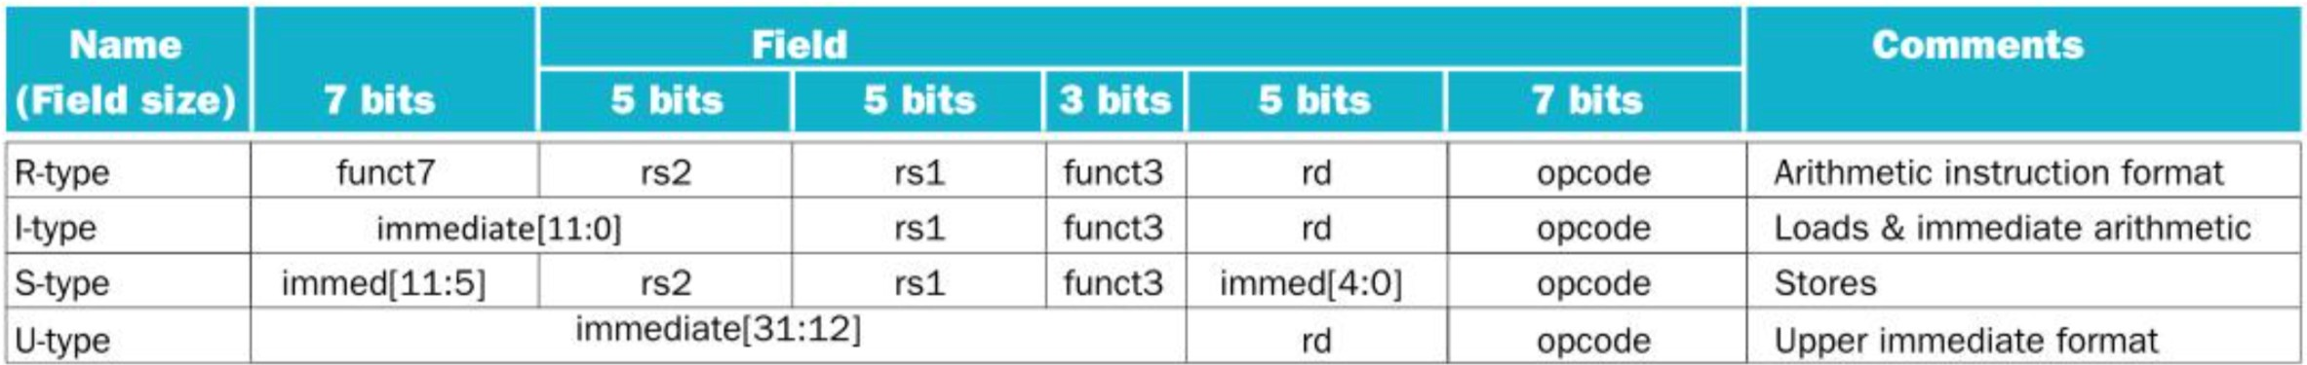
Instructions with Wide Immediate.
This is a U-type instruction

Slide 26
How Are Branch Instructions Encoded?
jal x0, 2000 // goto location 0111 1101 0000
This could be represented by a UJ-type instruction,
But 20 bits is far too small to specify all addresses!
Instead, one can use PC-relative addressing
Program Counter = Program Counter + Branch offset

Slide 27
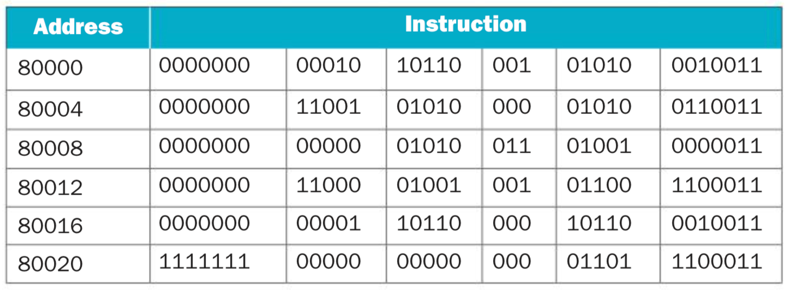
How Are Branch Instructions Encoded?
Example: Branch offsets in machine language
Loop:
slli x10, x22, 2 add x10, x10, x25 lw x9, 0(x10)
bne x9, x24, Exit addi x22, x22, 1 beq x0, x0, Loop
Exit:
Conditional branches are SB-type instructions

Slide 28

How Are Branch Instructions Encoded?
Example: Branch offsets in machine language
Loop:
slli x10, x22, 2 add x10, x10, x25 lw x9, 0(x10)
bne x9, x24, Exit addi x22, x22, 1
beq x0, x0, Loop
Exit:
imm[11:5]
rs2 rs1
imm[4:0] "goto PC + 12”

Slide 29






How Are Branch Instructions Encoded?
Example: Branch offsets in machine language
Loop:
slli x10, x22, 2 add x10, x10, x25 lw x9, 0(x10)
bne x9, x24, Exit addi x22, x22, 1 beq x0, x0, Loop
Exit:
imm[11:5]
rs2 rs1
imm[4:0]
"goto PC - 20”

