Slide 1
CS 2160
Introduction to Assembly Programming and
Computer Organization
Lecture 01: Arithmetic
Fall 2026
Instructor: Himon Thakur
TA: Hassan Shakil
University of Colorado Colorado Springs (UCCS)
Himon Thakur (hthakur@uccs.edu); CC BY-NC-SA 4.0;
Special Thanks to Dr. Keith Paarpong and Dr. Xi Tan.

Slide 2
Today’s Agenda.
- Understand RISC-V basic assembly arithmetic operations
  RV32I: Base Integer Instruction Set, 32-bit
How is a program made?
From source to executable, loading to the computer.
What is a processor?
PC, registers, memory (data, instruction)

Slide 3
What is RISC-V.
CISC: complex instruction set computing architecture
  For example, x86.
RISC: reduced instruction set computing architecture
  e.g., ARM (smartphones), MIPS (routers), RISC-V (edge computing and AI, embedded systems)
  RISC-V: fifth generation of RISC architecture developed at UC Berkeley.

Slide 4
RISC-V is a family of Instruction Sets .
Instruction set:
The vocabulary of commands, understood by a given architecture.
Instructions tell the processor what to do
  1 operation
  0+ operands

Slide 5
RISC-V is a family of Instruction Sets.
Many instruction sets with variants exist
  e.g., RV32I, RV64I, RV128I
We will focus on the RV32I instruction set:
  RV: RISC-V
  32: 32-bit registers
  I: Integer operations

Slide 6
Registers.
General-purpose registers are storage in the processor
  Typically numbered starting from 0
  Assembly prepends register number with a symbol (x# in RISC-V, $# in MIPS, r# in x86_64). For example, , x0, x1, x2...
  Registers usually have mnemonic names (pc for “program counter”, sp for “stack pointer”)
Processor
Processor
PC
PC
Registers
Registers

Slide 7
A few RISC-V Integer Registers by mnemonic.
Mnemonic | Meaning
zero | always zero
t0-t6 | temporary registers
a0-a7 | function arguments (a0, a1 also used for return value)
There are 32 general-purpose registers in RISC-V.

Slide 8
Instructions.
Arithmetic/Logic instructions manipulate register data
Load/store instructions move data in/out of registers
Conditional instructions check values in registers

Slide 9
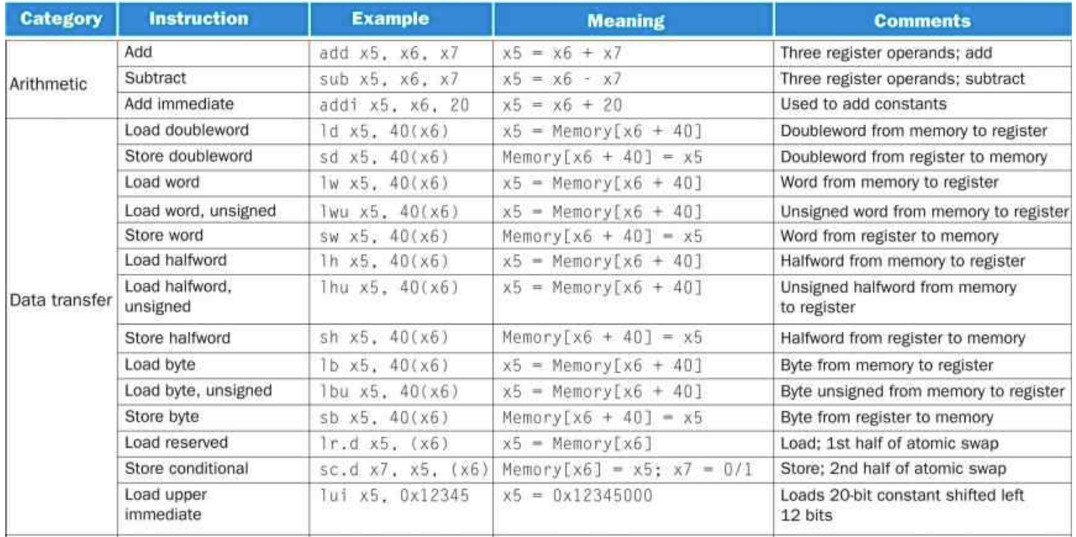
Instructions.

Slide 10

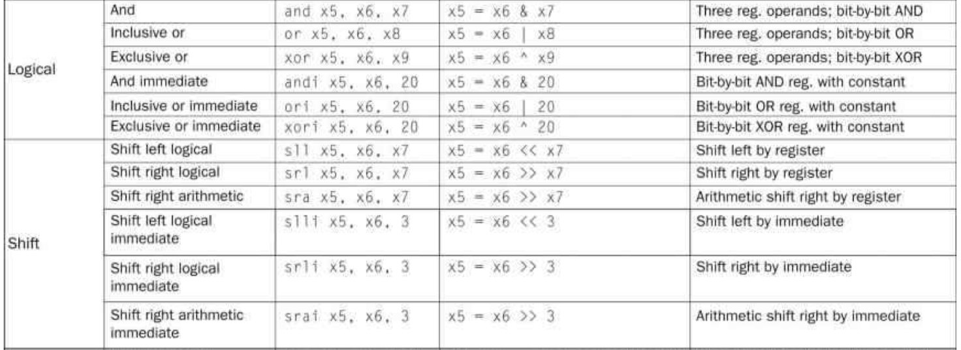
Instructions.

Slide 11
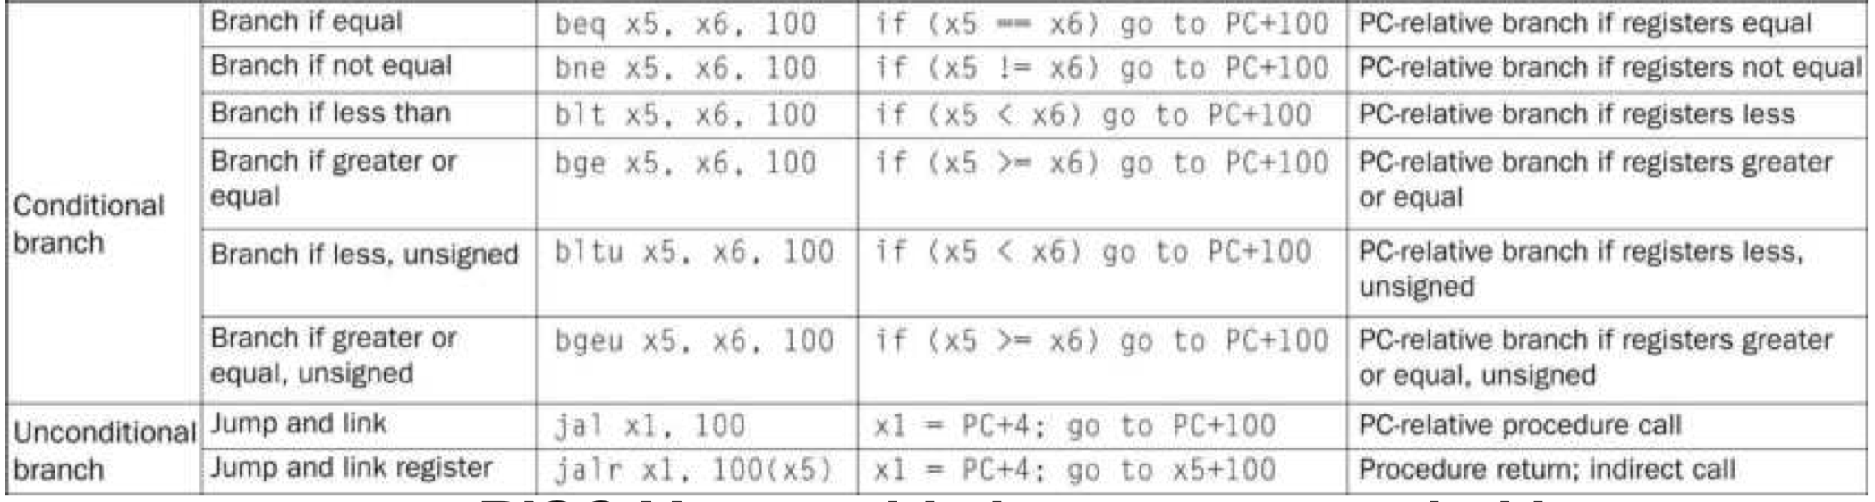
Instructions.

Slide 12

Chapter 01:
Course Overview

Slide 13
Let’s do some simple math!
C: High-Level Language
Assembly: Low-level Language
a = b + c;
add a, b, c

Slide 14
Let’s do some simple math!
C: High-Level Language
Assembly: Low-level Language
a = b + c;
add a, b, c
Operation
Output operand
Input operands

Slide 15
Let’s do some simple math!
Where are a, b, c?
C: High-Level Language
Assembly: Low-level Language
a = b + c;
add a, b, c
We need to know more context.

Slide 16
Let’s do some simple math!
Where are a, b, c?
C: High-Level Language
Assembly – RISC-V
a = b + c;
add a, b, c
add t1, a0, a1
For now, we’ll just make assumptions:
  b is in register a0
  c is in register a1
  a goes in register t1

Slide 17
Let’s do subtraction!
C: High-Level Language
Assembly
d = e - f;
sub d, e, f

Slide 18
Let’s do subtraction!
C: High-Level Language
Assembly – RISC V
d = e - f;
sub a1, t0, t5
Assume:
  e is in register t0
  f is in register t5
  d goes in register a1

Slide 19
Let’s multiply by a power of 2!
C: High-Level Language
Assembly
g = h * 256;
mul g, h, 256

Slide 20
Let’s multiply by a power of 2!
C: High-Level Language
Assembly
g = h * 256;
mul g, h, 256
RISC-V base integer instruction set (RV32I) does not have a multiply instruction!

Slide 21
Let’s multiply by a power of 2!
C: High-Level Language
Assembly
g = h * 256;
mul g, h, 256
Multiplication by 2^{x} is equivalent to shifting left by log₂(2^{x})

Slide 22
Memorize powers-of-2 and log₂ up to 1024!
2 = 2¹
4 = 2²
8 = 2³
16 = 2⁴
32 = 2⁵
64 = 2⁶
128 = 2⁷
256 = 2⁸
512 = 2⁹
1024 = 2¹⁰
Combine with SI prefixes for larger numbers.
Notes:
Draw figures on the whiteboard to explain why shift works

Slide 23
Multiplication
Multiplication by 2^{x} is equivalent to shifting left by log₂(x)
Example:
Multiplication by 8
  8 = 2³
  so log₂(8) = 3
  To multiply a number by 8, shift it left by 3 positions
Example with 6 (binary: 110):
  Multiply by 8: 6 * 8 = 48
  Left shift 110 by 3: 110000 (binary for 48)
Notes:
Draw figures on the whiteboard to explain why shift works

Slide 24
Let’s multiply by a power of 2!
High-Level Language – C
Assembly – RISC-V
g = h * 256;
mul g, h, 256
slli g, h, 8
Multiplication by 2⁸ is equivalent to shifting left by log₂(2⁸) = 8

Slide 25
Let’s multiply by a power of 2!
High-Level Language – C
Assembly – RISC-V
g = h * 256;
mul g, h, 256
slli g, h, 8
slli t4, t3, 8
Assume h is in t3, g goes in t4

Slide 26
Multiplication by other numbers.
High-Level Language – C
Assembly
g = h * 18;
mul g, h, 18

Slide 27
Multiplication by other numbers.
High-Level Language – C
Assembly
g = h * 18;
mul g, h, 18
h*18 = h*16 + h*2

Slide 28
Multiplication by other numbers.
h * 16
High-Level Language – C
Assembly
g = h * 18;
mul tmp1, h, 16
mul tmp2, h, 2
add g, tmp1, tmp2
h * 2
h*18 = h*16 + h*2

Slide 29
Multiplication by other numbers.
High-Level Language – C
Assembly – RISC-V
g = h * 18;
mul tmp1, h, 16
slli tmp1, h, 4
mul tmp2, h, 2
slli tmp2, h, 1
add g, tmp1, tmp2

Slide 30
Multiplication by other numbers.
High-Level Language – C
Assembly – RISC-V
g = h * 18;
mul tmp1, h, 16
slli t0, t3, 4
mul tmp2, h, 2
slli t1, t3, 1
add t4, t0, t1
Assume h is in t3, g goes in t4,
t0 and t1 available to use

Slide 31
Multiplication by other numbers.
High-Level Language – C
Assembly – RISC-V
g = h * 18;
mul tmp1, h, 16
slli t0, t4, t3, 4
mul tmp2, h, 2
slli t1, t3, 1
add t4, t0, t4, t1
Can be done using one less temporary register
by re-using t4 for the intermediate output.

Slide 32
Let’s do some simple math!
Category | Instruction | Example | Meaning | Comments
Arithmetic | Add | add x5. x6. x7 | X5 = x6 = x7 | Three register operands; add
 | Subtract | sub x5. x6. x7 | X5 = x6 – x7 | Three register operands; subtract
 | Add immediate | addi x5. x6. 20 | X5 = x6 + 20 | Used to add constants
Refer to Book Figure 2.1 for more info

Slide 33
Let’s do some simple math!
Operation | Format | Computation
addition | add | dest, src1, src2 | dest = src1 + src2
subtraction | sub | dest, src1, src2 | dest = src1 - src2
shift left | sll | dest, src1, src2 | dest = src1 << src2
  Also available with immediate versions (except sub):
    addi dest, src1, imm dest = src1 + Imm
    slli dest, src1, imm dest = src1 << Imm
Refer to Book Figure 2.1 for more info

Slide 34
Arithmetic Expression Example.
Carnegie Mellon
int arith(int x, int y, int z)
{
int t1 = x+y;
int t2 = z+t1;
int t3 = x;
int t4 = y * 48;
int t5 = t3 + t4;
int rval = t2 + t5;
return rval;
}
arith:
add t1, a0, a1
add t2, a2, t1
add t4, a1, a1
add t4, t4, a1
slli t4, t4, 4
add t5, a0, t4
add a0, t2, t5
ret
Notes:
Let’s put some of these instructions into context with a contrived example. Here’s a function that takes three 32-bit integer arguments, x y and z. It then calculates several arithmetic expressions, eventually returning (x+y+z) + (x + y*48). Here is one way to generate assembly for this function. We can see several interesting instructions. Let’s break it down.

Slide 35
Arithmetic Expression Example.
Carnegie Mellon
int arith(int x, int y, int z)
{
int t1 = x+y;
int t2 = z+t1;
int t3 = x;
int t4 = y * 48;
int t5 = t3 + t4;
int rval = t2 + t5;
return rval;
}
arith:
add t1, a0, a1
add t2, a2, t1
add t4, a1, a1
add t4, t4, a1
slli t4, t4, 4
add t5, a0, t4
add a0, t2, t5
ret
Register | Use(s)
a0 | Argument x
a1 | Argument y
a2 | Argument z
Notes:
Let’s put some of these instructions into context with a contrived example. Here’s a function that takes three 32-bit integer arguments, x y and z. It then calculates several arithmetic expressions, eventually returning (x+y+z) + (x + y*48). Here is one way to generate assembly for this function. We can see several interesting instructions. Let’s break it down.

Slide 36
Arithmetic Expression Example.
Carnegie Mellon
int arith(int x, int y, int z)
{
int t1 = x+y;
int t2 = z+t1;
int t3 = x;
int t4 = y * 48;
int t5 = t3 + t4;
int rval = t2 + t5;
return rval;
}
arith:
add t1, a0, a1
add t2, a2, t1
add t4, a1, a1
add t4, t4, a1
slli t4, t4, 4
add t5, a0, t4
add a0, t2, t5
ret
Register | Use(s)
a0 | Argument x
a1 | Argument y
a2 | Argument z
Notes:
Let’s put some of these instructions into context with a contrived example. Here’s a function that takes three 32-bit integer arguments, x y and z. It then calculates several arithmetic expressions, eventually returning (x+y+z) + (x + y*48). Here is one way to generate assembly for this function. We can see several interesting instructions. Let’s break it down.

Slide 37
Arithmetic Expression Example.
Carnegie Mellon
int arith(int x, int y, int z)
{
int t1 = x+y;
int t2 = z+t1;
int t3 = x;
int t4 = y * 48;
int t5 = t3 + t4;
int rval = t2 + t5;
return rval;
}
arith:
add t1, a0, a1
add t2, a2, t1
add t4, a1, a1
add t4, t4, a1
slli t4, t4, 4
add t5, a0, t4
add a0, t2, t5
ret
Register | Use(s)
a0 | Argument x
a1 | Argument y
a2 | Argument z
Notes:
Let’s put some of these instructions into context with a contrived example. Here’s a function that takes three 32-bit integer arguments, x y and z. It then calculates several arithmetic expressions, eventually returning (x+y+z) + (x + y*48). Here is one way to generate assembly for this function. We can see several interesting instructions. Let’s break it down.

Slide 38
Arithmetic Expression Example.
Carnegie Mellon
int arith(int x, int y, int z)
{
int t1 = x+y;
int t2 = z+t1;
int t3 = x;
int t4 = y * 48;
int t5 = x + t4;
int rval = t2 + t5;
return rval;
}
arith:
add t1, a0, a1
add t2, a2, t1
add t4, a1, a1
add t4, t4, a1
slli t4, t4, 4
add t5, a0, t4
add a0, t2, t5
ret
Register | Use(s)
a0 | Argument x
a1 | Argument y
a2 | Argument z
Notes:
Let’s put some of these instructions into context with a contrived example. Here’s a function that takes three 32-bit integer arguments, x y and z. It then calculates several arithmetic expressions, eventually returning (x+y+z) + (x + y*48). Here is one way to generate assembly for this function. We can see several interesting instructions. Let’s break it down.

Slide 39
Arithmetic Expression Example.
Carnegie Mellon
int arith(int x, int y, int z)
{
int t1 = x+y;
int t2 = z+t1;
int t3 = x;
int t4 = y * 48;
int t5 = x + t4;
int rval = t2 + t5;
return rval;
}
arith:
add t1, a0, a1
add t2, a2, t1
add t4, a1, a1
add t4, t4, a1
slli t4, t4, 4
add t5, a0, t4
add a0, t2, t5
ret
Register | Use(s)
a0 | Argument x
a1 | Argument y
a2 | Argument z
Notes:
Let’s put some of these instructions into context with a contrived example. Here’s a function that takes three 32-bit integer arguments, x y and z. It then calculates several arithmetic expressions, eventually returning (x+y+z) + (x + y*48). Here is one way to generate assembly for this function. We can see several interesting instructions. Let’s break it down.

Slide 40
Arithmetic Expression Example.
Carnegie Mellon
int arith(int x, int y, int z)
{
int t1 = x+y;
int t2 = z+t1;
int t3 = x;
int t4 = y * 48;
int t5 = x + t4;
int rval = t2 + t5;
return rval;
}
arith:
add t1, a0, a1
add t2, a2, t1
add t4, a1, a1
add t4, t4, a1
slli t4, t4, 4
add t5, a0, t4
add a0, t2, t5
ret
Register | Use(s)
a0 | Argument x
a1 | Argument y
a2 | Argument z
Notes:
Let’s put some of these instructions into context with a contrived example. Here’s a function that takes three 32-bit integer arguments, x y and z. It then calculates several arithmetic expressions, eventually returning (x+y+z) + (x + y*48). Here is one way to generate assembly for this function. We can see several interesting instructions. Let’s break it down.

Slide 41
Arithmetic Expression Example.
Carnegie Mellon
int arith(int x, int y, int z)
{
int t1 = x+y;
int t2 = z+t1;
int t3 = x;
int t4 = y * 48;
int t5 = x + t4;
int rval = t2 + t5;
return rval;
}
arith:
add t1, a0, a1
add t2, a2, t1
add t4, a1, a1
add t4, t4, a1
slli t4, t4, 4
add t5, a0, t4
add a0, t2, t5
ret
Register | Use(s)
a0 | rval
a1 | Argument y
a2 | Argument z
Notes:
Let’s put some of these instructions into context with a contrived example. Here’s a function that takes three 32-bit integer arguments, x y and z. It then calculates several arithmetic expressions, eventually returning (x+y+z) + (x + y*48). Here is one way to generate assembly for this function. We can see several interesting instructions. Let’s break it down.

Slide 42
Arithmetic Expression Example.
Carnegie Mellon
int arith(int x, int y, int z)
{
int t1 = x+y;
int t2 = z+t1;
int t3 = x;
int t4 = y * 48;
int t5 = x + t4;
int rval = t2 + t5;
return rval;
}
arith:
add t1, a0, a1
add t2, a2, t1
add t4, a1, a1
add t4, t4, a1
slli t4, t4, 4
add t5, a0, t4
add a0, t2, t5
ret
Register | Use(s)
a0 | Argument x
a1 | Argument y
a2 | Argument z
Notes:
Let’s put some of these instructions into context with a contrived example. Here’s a function that takes three 32-bit integer arguments, x y and z. It then calculates several arithmetic expressions, eventually returning (x+y+z) + (x + y*48). Here is one way to generate assembly for this function. We can see several interesting instructions. Let’s break it down.

Slide 43
Exercise: Convert to RISC-V.
int silly_math(int a, int b)
{
int k = (b – a) + 11;
return k*42;
}
Reminders:
  a in a0, b in a1
  Put return value in a0
  Can use temporary registers t0-t7

Slide 44
Exercise solution.
k*42 = k*(32+8+2) = 2*( 4*(4k+1k)+1k)
int= silly_math(int a, int b)
{
int k = (b – a) + 11;
return k*42;
}
silly_math:
sub t0, a1, a0 # (b-a)
addi t0, t0, 11 # (b-a)+11
slli t1, t0, 2 # 4*k
add t1, t1, t0 # 4*k+k
slli t1, t1, 2 # 4(4*k+k)
add t1, t1, t0 # 4(4k+k)+k
slli a0, t1, 1
ret

Slide 45
Summary.
Things you should know or go learn more about:
  RISC-V assembly programming straight-line code with basic arithmetic
    Addition, subtraction, multiplication (shifts and adds)
  Basic function call/return
    Function calls that don’t make nested function calls (leaf procedures)
Next up: basic data movement
Read chapter 2!

Slide 46
Thank you.

