Slide 1
CS 2160
Introduction to Assembly Programming and
Computer Organization
Lecture 02: Data Movement
Fall 2026
Instructor: Himon Thakur
TA: Hassan Shakil
University of Colorado Colorado Springs (UCCS)
Himon Thakur (hthakur@uccs.edu); CC BY-NC-SA 4.0;
Special Thanks to Dr. Keith Paarpong and Dr. Xi Tan.

Slide 2
Recap.
- Instruction tell the processor what to do
  1 operation
  0+ operands
  Many instruction set variants exit
  Our focus is on RV32I instruction set
  General-purpose registers are storage in the processor
  There are 32 general-purpose registers in RISC-V

Slide 3
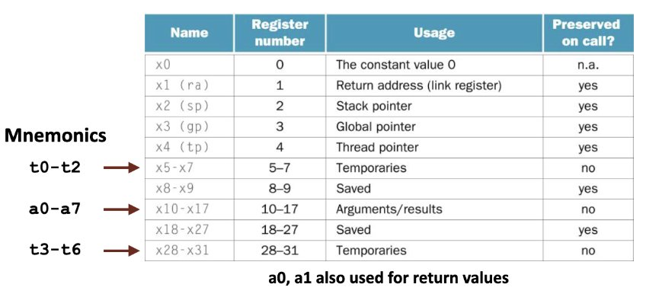
Recap.

Slide 4
Today’s Agenda.
- Understand how to move data using RISC-V basic Assembly operations

Slide 5
A mental model of program execution.
Each cycle processors
Fetch 1+ instructions
Decode 1+ instructions
Execute 1+ instructions
Instructions may
Do computation (calculations/logical)
Access I/O devices
Read/Write memory
Processor
Memory
PC
Addresses
Registers
Data
Code
Data
Stack
Instructions

Slide 6
Moving data withing the machine.
The processor has limited storage capacity
    Memory is also limited but we’ll ignore for now
We can’t keep all the data in the processor’s registers
Program starts in memory after it is loaded from disk
We must move instructions and data from memory to the processor
We must move data produced by the processor to the memory
We may have to move data around within the processor

Slide 7
Data movements vs machine operations.
Kind of data movement | Operation
Move instructions to the processor | Instruction Fetch
Move data from memory to the processor | Load Instructions
Move data from the processor to memory | Store instructions
Move data between registers | ALU instructions

Slide 8
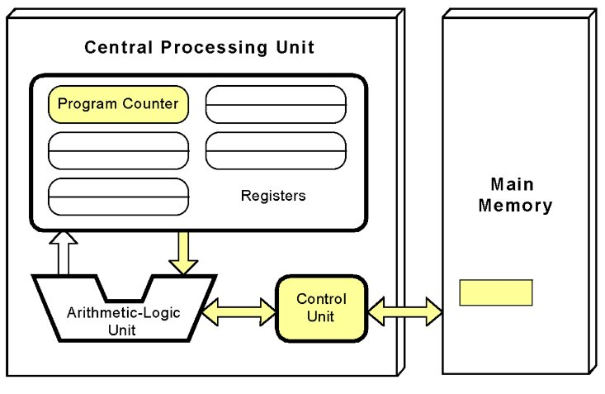
Fetch.
Instructions are
read from the
memory address contained in the program counter, a special-purpose
register

Slide 9
Let’s move data from memory!
High-Level: C | Low-Level: Assembly-ish
x = *p; | load x, *p

Slide 10
Let’s move data from memory!
High-Level: C | Low-Level: Assembly-ish
x = *p; | load x, *p
Operation

Slide 11
Let’s move data from memory!
High-Level: C | Low-Level: Assembly-ish
x = *p; | load x, *p
Operation
Input Operand

Slide 12
Let’s move data from memory!
High-Level: C | Low-Level: Assembly-ish
x = *p; | load x, *p
Operation
Output operand
Input Operand

Slide 13
Let’s move data from memory!
Where are x, p?
High-Level: C | Low-Level: Assembly-ish
x = *p; | load x, *p
We need to know more context.

Slide 14
Let’s move data from memory!
High-Level: C | Low-Level: RISC-V Assembly
x = *p; | load x, *p
 | lw t1, 0(a0)
Make some assumptions:
The address p is in register a0 and of type int*
x goes in register t1

Slide 15
Let’s move data from memory!
High-Level: C | Low-Level: RISC-V Assembly
x = *p; | load x, *p
 | lw t1, 0(a0)
lw ('load word') reads 4 bytes (a word) from memory
Make some assumptions:
The address p is in register a0 and of type int*
x goes in register t1
T1 is the output register that will get the loaded work
Load from the address a0 offset by the value 0

Slide 16
Brief Aside: Addressing Modes
Why 0(a0)?
Hint: think about how the data is stored in the memory

Slide 17
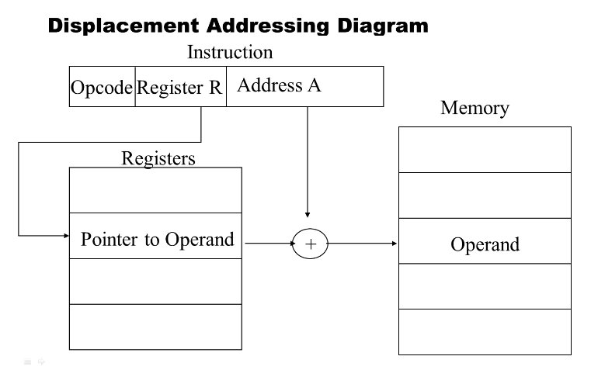
Brief Aside: Addressing Modes
0(a0) = a0 + 0
Base address + offset
Displacement addressing mode

Slide 18
Brief Aside: Addressing Modes
There are several ways to let instructions describe addresses.
RISC-V uses primarily two addressing modes:
Displacement (base + offset): Uses a register to provide a base address, and adds a constant-valued (immediate) offset to the base
PC-Relative: Uses the program counter (PC) as a base address register and adds an immediate or a register’s value to it.
Other addressing modes are possible.

Slide 19
Let’s move data from an array!
&A[0] == A
High-Level: C | Low-Level: RISC-V Assembly
x = A[1]; | lw t1, 4(a0)
Assumptions:
The address A[0] is in register a0 and of type int*
x goes in register t1

Slide 20
Arrays in C/C++.
An array data type is a sequence of identically sized elements stored in memory at sequential addresses
bytes
Example
int A[2]
0
1
2
3
4
5
6
7
…
value of A[0]
value of A[1]
…
&A[0]
&A[1]
Limited load/store sizes for common data types
li | Load immediate number | -
lb | Load byte | char
lh | Load half-word | short int
lw | Load word | int, long int
ld | Load double | long int, long long int

Slide 21
General-purpose register is an array of 32 bits.
Bit index
Bit 0 is the least significant bit (LSB)
Bit 31 is the most significant bit (MSB)
The instructions used so far treat the 32-bit register as in integer.
lh puts the loaded value in the least significant 16 bits
  The least significant 2 bytes
lb loads the value to the least significant byte (LSB)
31
30
29
28
…
3
2
1
0
…

Slide 22
Let’s move data to memory!
High-Level: C | Low-Level: Assembly-ish
x = *p; | store *p, x

Slide 23
Let’s move data to memory!
Beware: the input register comes first
High-Level: C | Low-Level: RISC-V Assembly
x = *p; | store *p, x,
 | sw t1, 0(a0)
sw ('store word') reads 4 bytes (a word) to memory
Make some assumptions:
The address p is in register a0 and of type int*
x goes in register t1
T1 is the input register with the value of the word to share
Store to the address a0 offset by the value 0

Slide 24
Let’s move data to an array!
&A[0] == A
High-Level: C | Low-Level: RISC-V Assembly
A[1] = x; | sw t1, 4(a0)
Store to the address in a0 offset by the value 4: sizeof(int)*1
Assumptions:
The address A[0] is in register a0 and of type int*
x goes in register t1

Slide 25
Introduction to endianness.
Can choose to store/load sequence of bytes of data elements:
by storing the least significant byte at the lowest address
by storing the most significant byte at the lowest address
Option A: Little endian, because the “little end” of the word comes first
Option B: Big endian, the “big end” comes first
RISC-V data can be little or big endian
RISC-V instructions are always two-byte, little endian.
This can be confusing since RV32I uses 4-byte instructions!

Slide 26
Not about the order of bits in the byte!
A visualization of endianness.
Register bits
31
30
29
28
27
26
25
24
23
22
21
20
19
18
17
16
15
14
13
12
11
10
9
8
7
6
5
4
3
2
1
0
Little Endian
Big Endian
0
1
2
3
0
1
2
3
Bytes in Memory
Bytes in Memory
Notes:
The figure below illustrates how each byte in a register becomes stored into memory with a sw instruction.

Slide 27
A programming view of endianness.
Assume &A[0] is in register a0
then sw t1, 0(a0) is roughly equivalent to:
Little Endian
sb t1, 0(a0)
srl t1, t1, 8
sb t1, 1(a0)
srl t1, t1, 8
sb t1, 2(a0)
srl t1, t1, 8
sb t1, 3(a0)
Big Endian
sb t1, 3(a0)
srl t1, t1, 8
sb t1, 2(a0)
srl t1, t1, 8
sb t1, 1(a0)
srl t1, t1, 8
sb t1, 0(a0)
bytes
bytes
0
1
2
3
0
1
2
3
LS
MS
MS
LS
&A[0]
&A[0]

Slide 28
Let’s move data between registers!
High-Level: C | Low-Level: Assembly-ish
y = x; | mov y, x

Slide 29
Let’s move data between registers!
Where are x, p?
High-Level: C | Low-Level: RISC-V Assembly (almost)
x = *p; | mov y, x
 | mv t1, a0
Make some assumptions:
X is in register a0 and of type int
y goes in register t1

Slide 30
Introduction to pseudo instructions.
The mv instruction in RISC-V is a pseudo instruction (as in, kind of an instruction).
It is converted to an addi instruction
mv t1, a0 ==> addi t1, a0, 0
Another handy data movement pseudo instruction is the poorly named “load immediate”. Puts the immediate (constant) into the output register
li t1, 1

Slide 31
Exercise: Convert to RISC-V.
int silly_math(int *a, int b)
{
*a = (b – *a) + 11;
return *a;
}
Reminders:
a in a0, b in a1
Put return value in a0
Can use temporary registers t0-t7

Slide 32
Exercise Solution: Convert to RISC-V .
int silly_math(int *a, int b)
{
*a = (b – *a) + 11;
return *a;
}
silly_math:
lw t1, 0(a0) # = *a
sub t0, a1, t1 # (b-*a)
addi t0, t0, 11 # (b-*a)+11
sw t0, 0(a0) # *a =
addi a0, t0, 0 # mv a0, t0
ret

Slide 33
Summary.
Things you should know or go learn more about:
  RISC-V assembly programming straight-line code with basic arithmetic
    Addition, subtraction, multiplication (shifts and adds)
    Loads and stores
  Basic function call/return
    Function calls that don’t make nested function calls (leaf procedures)
Next up: more complex arithmetic and logic.
Read chapter 2!

Slide 34
Thank you.

