Slide 1
CS 2160
Introduction to Assembly Programming and
Computer Organization
Lecture 05: Integer & Floating Point Arithmetic
Fall 2026
Instructor: Himon Thakur
TA: Hassan Shakil
University of Colorado Colorado Springs (UCCS)
Himon Thakur (hthakur@uccs.edu); CC BY-NC-SA 4.0;
Special Thanks to Dr. Keith Paarpong and Dr. Xi Tan.

Slide 2
Today’s Agenda.
Understand RISC-V basic Assembly integers and floating point representation in the hardware.
Integer & Floating point arithmetic
  Addition
  Multiplication

Slide 3
Recall: unsigned integer representation.
Given an n-bit number, x_{i} = 0 or 1
Range: 0 to +2^{n} – 1
Example
  0000 0000 … 0000 1011₂
  = 0 + … + 1×2³ + 0×2² +1×2¹ +1×2⁰
  = 0 + … + 8 + 0 + 2 + 1 = 11₁₀

Slide 4
Recall: 2's complement.
Bit 31 is sign bit
  1 for negative numbers
  0 for non-negative numbers
Non-negative numbers have the same unsigned and 2s-complement representation
Some specific numbers
  0: 0000 0000 … 0000
  –1: 1111 1111 … 1111
  Most-negative: 1000 0000 … 0000
  Most-positive: 0111 1111 … 1111

Slide 5
Recall: sign extension
Representing a number using more bits
  Preserve the numeric value
Replicate the sign bit to the left
  c.f. unsigned values: extend with 0s
Examples: 8-bit to 16-bit
  +2: 0000 0010 => 0000 0000 0000 0010
  –2: 1111 1110 => 1111 1111 1111 1110
In RISC-V instruction set
  lb: sign-extend loaded byte
  lbu: zero-extend loaded byte

Slide 6
Converting fractions between bases
Unlike integer values, fractions (in decimal) do not necessarily have exact representations under all radices.
But can be approximated in all base systems.
The quantity ½ is exactly representable in the binary and decimal systems, but is not in the ternary (base 3) numbering system.
Notes:
Since we are familiar with decimal, we will convert everything to decimal for understanding

Slide 7
Converting fractions between bases
Fractional decimal values have non-zero digits to the right of the decimal point.
Fractional values of other radix systems have non-zero digits to the right of the radix point.
Numerals to the right of a radix point represent negative powers of the radix:
  0.47₁₀ = 4 × 10 ⁻¹ + 7 × 10 ⁻²
  0.11₂ = 1 × 2 ⁻¹ + 1 × 2 ⁻²
  = ½ + ¼
  = 0.5 + 0.25 = 0.75
Notes:
Since we are familiar with decimal, we will convert everything to decimal for understanding

Slide 8
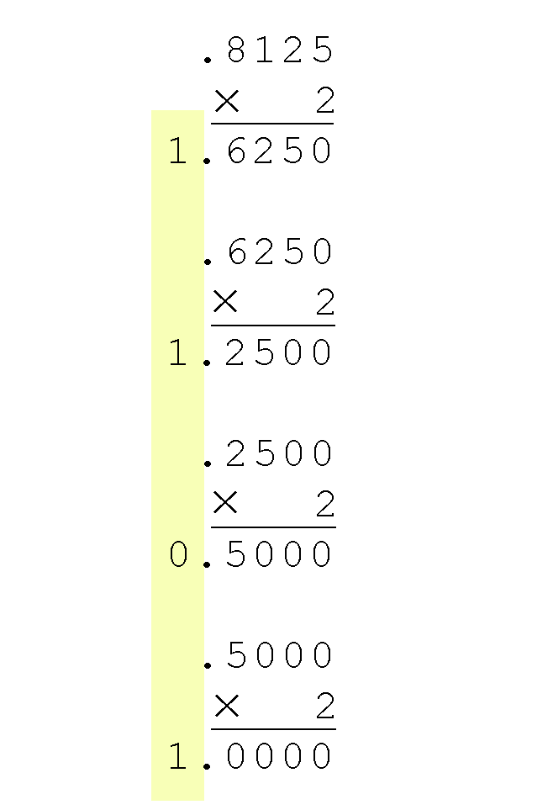
Converting fractions between bases.
Converting 0.8125 to binary . . .
You are finished when the product is zero, or until you have reached the desired number of binary places.
Our result, reading from top to bottom is:
0.8125₁₀ = 0.1101₂
This method also works with any base. Just use the target radix as the multiplier.
Notes:
Since we are familiar with decimal, we will convert everything to decimal for understanding

Slide 9
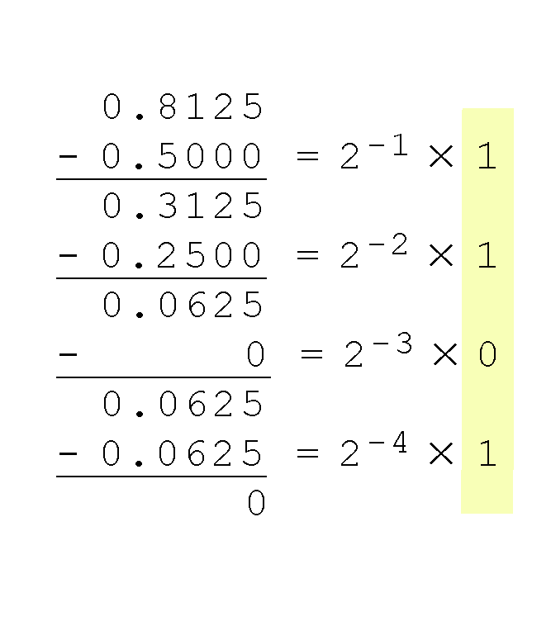
Converting fractions between bases.
The calculation to the right is an example of using the subtraction method to convert the decimal 0.8125 to binary.
Our result, reading from top to bottom is:
  0.8125₁₀ = 0.1101₂
Notes:
Since we are familiar with decimal, we will convert everything to decimal for understanding

Slide 10
Converting fractions between bases.
The binary numbering system is the most important radix system for digital computers.
However, it is difficult to read long strings of binary numbers -- and even a modestly-sized decimal number becomes a very long binary number.
  For example: 11010100011011₂ = 13595₁₀
For compactness and ease of reading, binary values are usually expressed using the hexadecimal, or base 16, numbering system.
Notes:
Since we are familiar with decimal, we will convert everything to decimal for understanding

Slide 11
Converting fractions between bases.
The hexadecimal numbering system uses the numerals 0 through 9 and the letters A through F.
  The decimal number 12 is C₁₆.
  The decimal number 26 is 1A₁₆.
It is easy to convert between base 16 and base 2, because 16 = 2⁴.
Thus, to convert from binary to hexadecimal, all we need to do is group the binary digits into groups of four.
A group of four binary digits is called a hextet

Slide 12
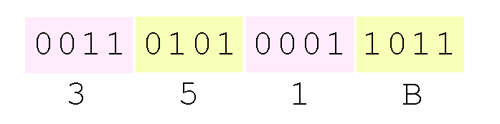
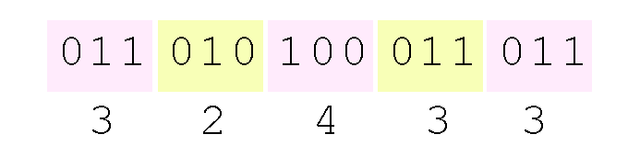
Hextets and Octets to bits.
Using groups of hextets, the binary number 11010100011011₂ (= 13595₁₀) in hexadecimal is:
Octal (base 8) values are derived from binary by using groups of three bits (8 = 2³):
If the number of bits is not a multiple of 4, pad on the left with zeros.
Octal was very useful when computers used six-bit words.

Slide 13
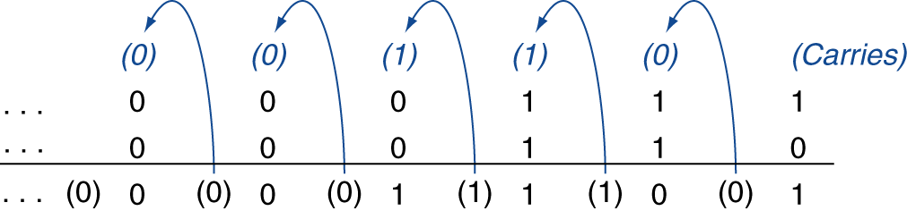
Integer addition.
Example: 7 + 6
Overflow if result out of range
Adding +ve and –ve operands, no overflow
Adding two +ve operands
  Overflow if result sign is 1
Adding two –ve operands
  Overflow if result sign is 0

Slide 14
Integer subtraction.
Add negation of second operand
Example: 7 – 6 = 7 + (–6)
  +7: 0000 0000 … 0000 0111
  –6: 1111 1111 … 1111 1010
  +1: 0000 0000 … 0000 0001
Overflow if result out of range
Subtracting two +ve or two –ve operands, no overflow
Subtracting +ve from –ve operand
  Overflow if result sign is 0
Subtracting –ve from +ve operand
  Overflow if result sign is 1

Slide 15
Z = X + Y.
X | Y | Z
0 | 0 | 0
0 | 1 | 1
1 | 0 | 1
1 | 1 | 0
What Boolean operator is this?

Slide 16
Z = X + Y.
X | Y | Z
0 | 0 | 0
0 | 1 | 1
1 | 0 | 1
1 | 1 | 0
What Boolean operator is this?
XOR (^)

Slide 17
Integer subtraction.
Some languages (e.g., C) ignore overflow
  Use MIPS addu, addui, subu instructions
Other languages (e.g., Ada, Fortran) require raising an exception
  Use MIPS add, addi, sub instructions
  On overflow, invoke exception handler
    Save PC in exception program counter (EPC) register
    Jump to predefined handler address
    mfc0 (move from coprocessor reg) instruction can retrieve EPC value, to return after corrective action

Slide 18
Overflow conditions from sign bit carry-in and carry-out.
Carry-in | Carry-out | Overflow
0 | 0 | 0
0 | 1 | 1
1 | 0 | 1
1 | 1 | 0
What Boolean operator is this?
XOR (^)

Slide 19
Recall: numbering systems.
The sequence 11001 in the binary system (Base = 2) is:
  1 × 2 ⁴ + 1 × 2 ³ + 0 × 2 ² + 0 × 2 ¹ + 1 × 2 ⁰
  = 16 + 8 + 0 + 0 + 1 = 25
Notes:
Since we are familiar with decimal, we will convert everything to decimal for understanding

Slide 20
Recall: numbering systems.
The sequence 11001 in the binary system (Base = 2) is:
The sequence 11.001 in the binary system (B = 2) is:
  1 × 2 ⁴ + 1 × 2 ³ + 0 × 2 ² + 0 × 2 ¹ + 1 × 2 ⁰
  = 16 + 8 + 0 + 0 + 1 = 25
  1 × 2 ¹ + 1 × 2 ⁰ + 0 × 2 ⁻¹ + 0 × 2 ⁻² + 1 × 2 ⁻³
  = 2 + 1 + 0 + 0 + 0.125 = 3.125
Notes:
Since we are familiar with decimal, we will convert everything to decimal for understanding

Slide 21
Recall: numbering systems.
+6.626 * 10⁻³⁴
sign
significand
base
exponent
Notes:
Planck’s constant h. (E = hv)

Slide 22
IEEE 754 Single Precision.
31 | 30 29 28 27 26 25 24 23 | 22 21 20 19 18 17 16 15 14 13 12 11 10 9 8 7 6 5 4 3 2 1 0
sign | exponent | fraction/mantissa
S | E | F/M
1 bit | 8 bit | 23 bits
(-1)^{s} * 1.M * 2^{(E-127)}
Normalized significand
biased exponent
sign
base
Designed for compromise between precision (F) and range (E)

Slide 23
IEEE 754 Single Precision.
31 | 30 29 28 27 26 25 24 23 | 22 21 20 19 18 17 16 15 14 13 12 11 10 9 8 7 6 5 4 3 2 1 0
sign | exponent | fraction/mantissa
S | E | F/M
1 bit | 8 bit | 23 bits
half: 5 bits
single: 8 bits
double: 11 bits
quad: 15 bits
half: 10 bits
single: 23 bits
double: 52 bits
quad: 112 bits
Designed for compromise between precision (F) and range (E)

Slide 24
IEEE 754 is the standard.
  Pros:
  Increases range at cost of precision
  Cons:
  Rounding error, e.g., 0.1 vs 0.10000000149…
  Loss of significance, e.g., subtraction of two large numbers that are very close to each other
  Exceptions
    Divide-by-zero
    Invalid (NaN)
    Overflow/Underflow
    Inexact

Slide 25
Floating-point example.
Represent –0.75
  –0.75 = (–1)¹ × 1.1₂ × 2^{–1}
  S = 1
  Significand = 1000…00₂
  Exponent = –1 + Bias
    Single(8-bit): –1 + 127 = 126 = 01111110₂
    Double(11-bit): –1 + 1023 = 1022 = 01111111110₂
Single(23-bit): 1011111101000…00
Double(52-bit): 1011111111101000…00

Slide 26
Floating-point example.
Represent 124.67
  integer part: 124 = 1111100₂, fraction: 0.67 = 0.101010…₂
  124.67= (–1)⁰ × 1. 111100101010…₂ × 2⁶
  S = 0
  Significand = 111100101010…₂
  Exponent = 6 + Bias
    Single(8-bit): 6 + 127 = 133 = 10000101₂
    Double(11-bit): 6 + 1023 = 1029 = 10000000101₂
Single(32-bit): 010000101111100101010…
Double(52-bit): 010000000101111100101010…

Slide 27
Floating-point example.
What number x is represented by the single-precision float
11000000101000…00?

Slide 28
Floating-point example.
What number x is represented by the single-precision float
11000000101000…00?
  S = 1
  Fraction = 01000…00₂
  Exponent = 10000001₂ = 129
x = (–1)¹ × (1 + 0.01₂) × 2^{(129 – 127)}
  = (–1) × 1.25 × 2²
  = –5.0

Slide 29
Single-precision range.
Exponents 00000000 and 11111111 reserved
Smallest value: 0 00000001 00000000000000000000000
  Exponent: 00000001
  ⇒ actual exponent = 1 – 127 = –126
  Fraction: 000…00 ⇒ significand = 1.0
  ±1.0 × 2^{–126} ≈ ±1.2 × 10^{–38}
Largest value: 0 11111110 11111111111111111111111
  Exponent: 11111110
  ⇒ actual exponent = 254 – 127 = +127
  Fraction: 111…11 ⇒ significand ≈ 2.0
  ±2.0 × 2⁺¹²⁷ ≈ ±3.4 × 10⁺³⁸

Slide 30
Double-precision range.
Exponents 0000…00 and 1111…11 reserved
Smallest value
  Exponent: 00000000001
  ⇒ actual exponent = 1 – 1023 = –1022
  Fraction: 000…00 ⇒ significand = 1.0
  ±1.0 × 2^{–1022} ≈ ±2.2 × 10^{–308}
Largest value
  Exponent: 11111111110
  ⇒ actual exponent = 2046 – 1023 = +1023
  Fraction: 111…11 ⇒ significand ≈ 2.0
  ±2.0 × 2⁺¹⁰²³ ≈ ±1.8 × 10⁺³⁰⁸

Slide 31
Overflow, underflow, precision.
Overflow: the exponent is too large to be represented in the exponent field, e.g. 10³⁹ (single precision)
Underflow: the negative exponent is too large to fit in the exponent field, may lead to divide-by zero, e.g. 10⁻³⁹ (single precision)
Not all numbers between the min and max can be represented precisely, e.g. 1.00…001 (= 1 + 2⁻²⁴)

Slide 32
Denormal numbers.
Denormal numbers are special values that fill the gap between 0 and the smallest normal (non-zero) floating-point number.
They are used to maintain gradual underflow instead of abruptly rounding to zero when results become extremely small.

Slide 33
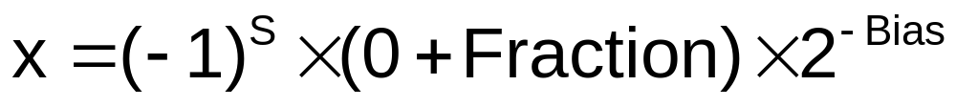
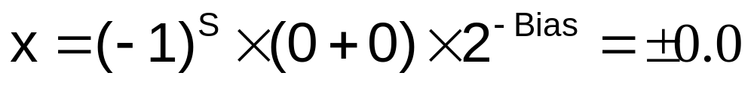
Denormal numbers.
Exponent = 000...0 ⇒ hidden bit is 0
  Smaller than normal numbers
Denormal with fraction = 000...0
Two representations of 0.0!

Slide 34
Denormal numbers.
Largest value
  Exponent: 00000000
  ⇒ actual exponent = 2046 – 1023 = +1023
  Fraction: 11111111111111111111111
  0.11111111111111111111111₂​×2⁻¹²⁶≈ (1 − 2⁻²³) × 2⁻¹²⁶

Slide 35
Infinites and NaNs.
Exponent = 111...1, Fraction = 000...0
  ±Infinity
  Can be used in subsequent calculations, avoiding need for overflow check
Exponent = 111...1, Fraction ≠ 000...0
  Not-a-Number (NaN)
  Indicates illegal or undefined result, e.g., 0.0 / 0.0
  Can be used in subsequent calculations

Slide 36
IEEE 754 special numbers.
(-1)^{s} * 1.M * 2^{(E-127)}
 | M = 0 | M ≠ 0
E = 0 | ±zero | Other non-normalized
0 < E < 254 | ±2^{E-127} | Regular floating point
E = 255 | ±∞ | Not-a-Number (NaN)

Slide 37
Floating-point addition.
Consider a 4-digit decimal example
  9.999 × 10¹ + 1.610 × 10^{–1}
1. Align decimal points
  Shift number with smaller exponent
  9.999 × 10¹ + 0.016 × 10¹
2. Add significands
  9.999 × 10¹ + 0.016 × 10¹ = 10.015 × 10¹
3. Normalize result & check for over/underflow
  1.0015 × 10²
4. Round and renormalize if necessary
  1.002 × 10²

Slide 38
Floating-point addition (and subtraction).
(±F1 × 2^{E1}) + (±F2 × 2^{E2}) = ±F3 × 2^{E3}
  Step 0: Restore the hidden bit in F1 and in F2
  Step 1: Align fractions by right shifting F2 by E1 - E2 positions (assuming E1 ≥ E2) keeping track of (three of) the bits shifted out in G R and S
  Step 2: Add the resulting F2 to F1 to form F3
  Step 3: Normalize F3 (so it is in the form 1.XXXXX…)
    If F1 and F2 have the same sign → F3 ∈[1,4) → 1 bit right shift F3 and increment E3 (check for overflow)
    If F1 and F2 have different signs → F3 may require many left shifts each time decrementing E3 (check for underflow)
  Step 4: Round F3 and possibly normalize F3 again
  Step 5: Re-hide the most significant bit of F3 before storing the result

Slide 39
Floating-point addition (and subtraction).
(non-limited bits of storge) 2.0 + (-0.0546875)
(2.0 = 1.0000 × 2¹) + (- 0.0546875 = - 1.1100 × 2⁻⁵)
Hidden bits restored in the representation above
  Step 0:
  Step 1:
  Step 2:
  Step 3:
  Step 4:
  Step 5:
Shift significand with the smaller exponent (1.1100) right until its exponent matches the larger exponent
Add significands
1.0000 - 0.00000111 = 0.11111001
Exponent = 1
Normalize the sum, checking for exponent over/underflow
0.11111001 x 2¹ = 1.1111001 x 2⁰, Exp. = 0
The sum is already rounded, so we’re done
Re-hide the hidden bit before storing

Slide 40
Floating-point operation with GRS bits.
(four bits of storage) 2.0 + (-0.0546875)
(2.0 = 1.0000 × 2¹) + (- 0.0546875 = - 1.1100 × 2⁻⁵)
These are extra bits used during floating-point arithmetic (particularly addition/subtraction) to help handle rounding more accurately.
Guard bit (G): An extra bit to the right of the fraction’s normal precision.
Round bit (R): Another bit beyond the guard bit.
Sticky bit (S): A single bit that indicates if any remaining bits (after R) are set to 1. If you shift in any 1s past R, the Sticky bit becomes 1.
These extra bits help the hardware correctly round the final result after the addition or subtraction is done

Slide 41
Floating-point operation with GRS bits.
(four bits of storage) 2.0 + (-0.0546875)
(2.0 = 1.0000 × 2¹) + (- 0.0546875 = - 1.1100 × 2⁻⁵)
Hidden bits restored in the representation above
  Step 0:
  Step 1:
  Step 2:
  Step 3:
  Step 4:
  Step 5:
Shift significand with the smaller exponent (1.1100) right until its exponent matches the larger exponent
−1.1100₂​ × 2⁻⁵ → −0.0000011100₂​ × 2⁺¹ → -0.00000(G)1(R)1(S) ₂​ × 2⁺¹
Add significands
1.0000 - 0.0000011 = 0.1111101
Exponent = 1
Normalize the sum, checking for exponent over/underflow
0.1111101 x 2¹ = 1.111101 x 2⁰, Exp. = 0
1.111101 is rounded as 1.1111. No need to renormalize.
Rehide the hidden bit before storing

Slide 42
Floating-point multiplication.
Consider a 4-digit decimal example
  1.110 × 10¹⁰ × 9.200 × 10^{–5}
1. Add exponents
  For biased exponents, subtract bias from sum
  New exponent = 10 + –5 = 5
2. Multiply significands
  1.110 × 9.200 = 10.212 ⇒ 10.212 × 10⁵
3. Normalize result & check for over/underflow
  1.0212 × 10⁶
4. Round and renormalize if necessary
  1.021 × 10⁶
5. Determine sign of result from signs of operands
  +1.021 × 10⁶

Slide 43
Floating-point multiplication.
(±F1 × 2^{E1}) x (±F2 × 2^{E2}) = ±F3 × 2^{E3}
  Step 0: Restore the hidden bit in F1 and in F2
  Step 1: Add the two (biased) exponents and subtract the bias from the sum, so
  E1 + E2 – 127 = E3
  also determine the sign of the product (which depends on the sign of the operands (most significant bits))
  Step 2: Multiply F1 by F2 to form a double precision F3
  Step 3: Normalize F3 (so it is in the form 1.XXXXX…)
    Since F1 and F2 come in normalized → F3 ∈[1,4) → 1 bit right shift F3 and increment E3
    Check for overflow/underflow
  Step 4: Round F3 and possibly normalize F3 again
  Step 5: Re-hide the most significant bit of F3 before storing the result

Slide 44
Floating-point multiplication.
(0.90625 = 1.1101 × 2⁻¹) x (-0.28125 = -1.0010× 2⁻²)
Hidden bits restored in the representation above
  Step 0:
  Step 1:
  Step 2:
  Step 3:
  Step 4:
  Step 5:
Add the exponents (not in bias would be -1 + (-2) = -3 and in bias would be (-1+127) + (-2+127) – 127 = (-1 -2) + (127+127-127) = -3 + 127 = 124
Multiply the significands
1.1101 x 1.001 = 10.0000101
Normalized the product, checking for exp over/underflow
10.0000101 x 2⁻³ = 1.00000101 x 2⁻², Exp. = -2
Round the product to 1.0000.
Re-hide the hidden bit before storing

Slide 45
Floating-point representations is an approximation.
No matter how many bits we use in a floating-point representation, our model must be finite.
The real number system is, of course, infinite, so our models can give nothing more than an approximation of a real value.
At some point, every model breaks down, introducing errors into our calculations.
By using a greater number of bits in our model, we can reduce these errors, but we can never totally eliminate them.
We must also be aware that errors can compound through repetitive arithmetic operations.

Slide 46
Floating-point operations are (not) math operations.
Because of approximation, floating point operations are not always commutative or distributive, i.e. we cannot assume:
(a + b) + c = a + (b + c) or a * (b + c) = ab + ac
If we were repetitively adding 0.000005 to 1000000.5, it would have been better to iteratively add 0.000005 to itself and then add 1000000.5 to this sum.
Floating-point errors can be reduced when we use operands that are similar in magnitude.

Slide 47
Testing a==b in floating-point.
To test a floating point value for equality to some other number, it is best to declare a “nearness to x” epsilon value.
For example, instead of checking to see if floating point x is equal to 2 as follows:
if x == 2,
then...
it is better to use:
if (fabs(x - 2) < epsilon)
then...
*assuming we have epsilon defined correctly!

Slide 48
0.5 + (-0.4375)
Convert to (-1)^{s} * 1.M * 2^{(E-127)}
Compare/match exponents
  (shift smaller significand right)
Add significands (including sign)
Normalize sum (to one leading 1)
Check for over/under flow
  (exponent too big/small?)
Round
Recheck normalization!

Slide 49
0.5 * (-0.4375)
Convert to (-1)^{s} * 1.M * 2^{(E-127)}
Add exponents and subtract bias
Multiply significands
Normalize
Check overflow/underflow
Round
Check normalization
Set sign

Slide 50
Thank you.

