Slide 1
CS 2160
Introduction to Assembly Programming and
Computer Organization
Lecture 06: Into to QT RV Simulator
Fall 2026
Instructor: Himon Thakur
TA: Hassan Shakil
University of Colorado Colorado Springs (UCCS)
Himon Thakur (hthakur@uccs.edu); CC BY-NC-SA 4.0;
Special Thanks to Dr. Keith Paarpong and Dr. Xi Tan.

Slide 2
Today’s Agenda.
Understand the QT RV Simulation Software
Integer & Floating point arithmetic
  Addition
  Multiplication

Slide 3
The QT RV Simulator
In this course, we will use the RISC-V simulator:
https://github.com/cvut/qtrvsim (local)
https://comparch.edu.cvut.cz/qtrvsim/app/ (browser)

Slide 4
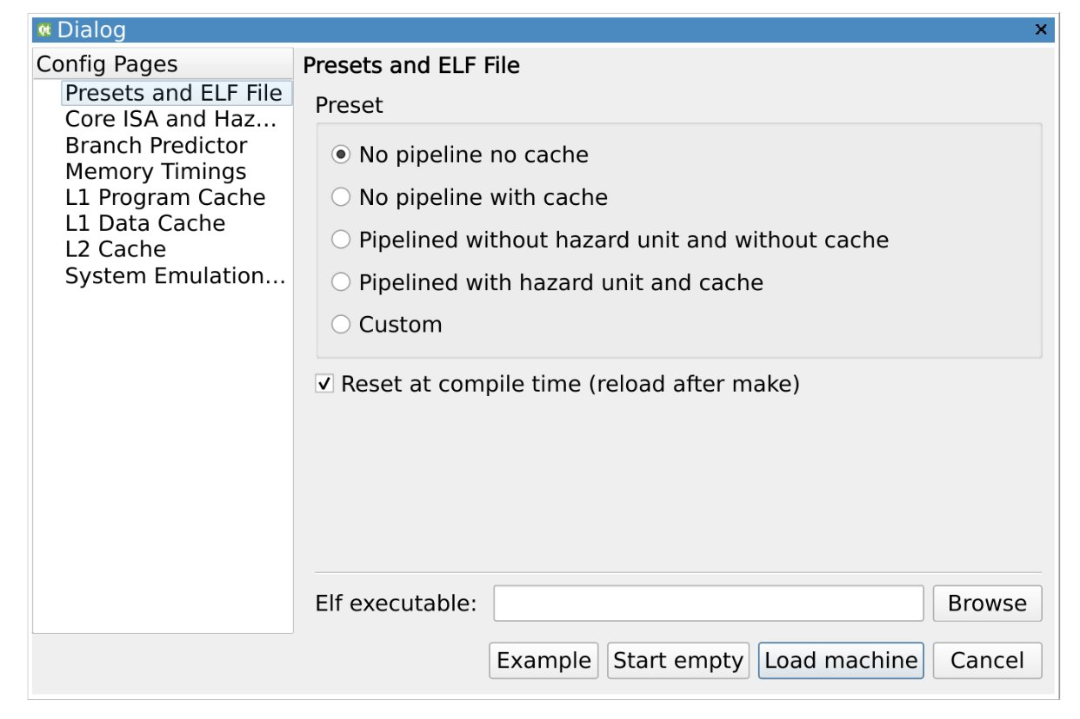
The QT RV Simulator
Check No pipeline no cache and press the Start empty button on the bottom of the window.
Under the File drop-down, you can select New Source to open up a blank program in the editor window.
Or, you can select Open Source and search for an existing source code.

Slide 5
Create New Source
// Preamble: define some constants here
// Start of Instructions section
.text
main:
// some instructions
// Collection of procedures
func:
// some instructions
func2:
// some instructions
// End of Instructions and start of Data section
.data
// Place some values here
The start of the instruction section is indicated by the .text directive. This is how the computer knows where to start the program.
Following the instructions section is the data section. Here, values like integers, strings, and characters are placed.
The start of the data section is indicated by the .data directive.

Slide 6
Example Code 1
.text
la t0 , x
lw t0 , 0(t0)
la t1 , y
lw t1 , 0(t1)
add t0 , t0 , t1
ebreak
.data
x: .word 2
y: .word 3
What is this program doing?
int x = 2;
int y = 3;
int c = x + y

Slide 7
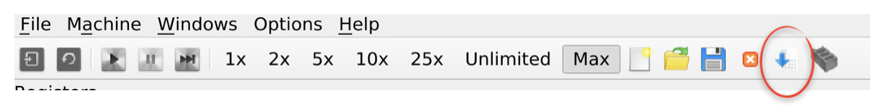
Compile and Run the Assembly Code
Find Compiler Source by going to the machine drop-down menu
or

Slide 8
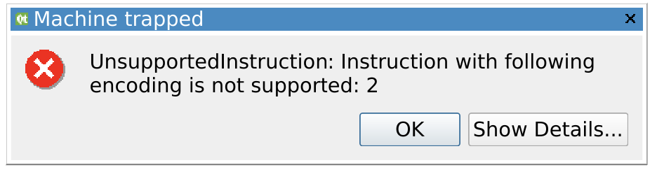
You may face…
What happened here is that the program execution went to the next memory address after the instructions section, and treated the first word in the data section as an instruction.
In particular, this is the value 0x00000002.
However, the value 0x00000002 does not correspond to any recognized RISC-V instruction, and thus the error.

Slide 9
Example Code 2
.text
la t0 , x
lw t0 , 0(t0)
la t1 , y
lw t1 , 0(t1)
add t0 , t0 , t1
j halt
halt:
ebreak
j halt
.data
x: .word 2
y: .word 3
Terminate a program: use ebreak in conjunction with a halt procedure
Here, the instruction j halt is actually just an unconditional branch instruction, i.e. go to halt.
It is equivalent to beq x0, x0, halt.

Slide 10
Storing Data Types Into the Data Section
There are many ways to store data In the data section. For example:
The x: label makes space in memory for five consecutive words (so, 20 bytes). The fourth item is the address of the label y:.
.data
x: .word 2, 3, 7, y, 0x1A5
y: .word 3

Slide 11
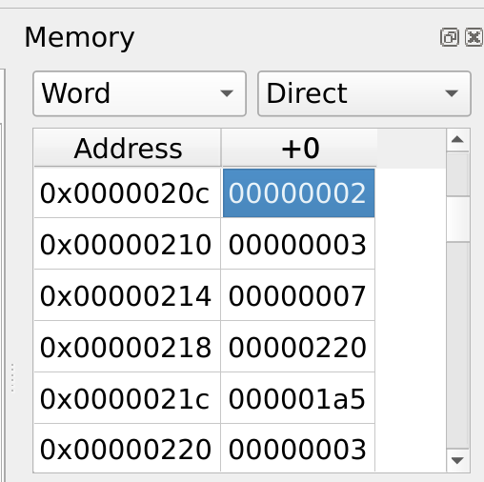
Storing Data Types Into the Data Section
And indeed, if we open up the Memory window in the simulator, we can see their values indexed at the addresses:

Slide 12
Storing Data Types Into the Data Section
You can also store pre-defined strings into the data section.
Recall that a string is a sequence of chars, and a single char is one byte of data. They also follow ASCII encoding, so that the character H is actually 72 in decimal, or 0x48 in hex.
.data
str: .ascii “Hello World!\n”

Slide 13
Storing Data Types Into the Data Section
Another useful technique is to allocate a pre-defined amount of memory. This comes in handy when we need a place in memory to store an array. For example,
.data
buf: .space 100, 5
buf_end:

Slide 14
Storing Data Types Into the Data Section
.data
buf: .space 100, 5
buf_end:
This piece of code assigns the label buf: to the start of a 100 byte space in memory, where all of these bytes are initialized to the value 0x05.
To make it all initialized to zero values, we simply omit the second argument of the .space directive, or replace the 5 with a 0.
  e.g.,: buf: .space 100, 0
The label buf_end: is the label corresponding the the byte address immediately following the end of this 100 byte space.

Slide 15
Hello World in RISC-V
We clearly would need a way to print characters to an output terminal. In C, this was simply printf. RISC-V does not have a single instruction that does this.
We will need our program to be able to access the output terminal of the simulator’s environment (essentially, its operating system).
The way this is done is through the ecall functionality.

Slide 16
Hello World in RISC-V
In order to access the system’s standard output (STDOUT), we need to place corresponding codes into specific registers.
Observe that to write to Terminal, we need to specify some values into the a0, a1, a2, and a7 registers.
.equ STDOUT, 1
.equ __NR_WRITE, 64
.equ __NR_EXIT, 93
.text
main:
# write the prompt to the terminal (stdout)
li a0, STDOUT
la a1, prompt
addi a2, zero, prompt_end – prompt
li a7, __NR_WRITE
ecall // write to Terminal
j halt
halt:
ebreak
j halt
.data
prompt: .ascii “Hello World!\n”
prompt_end;

Slide 17
Hello World in RISC-V
.equ STDOUT, 1
.equ __NR_WRITE, 64
.equ __NR_EXIT, 93
.text
main:
# write the prompt to the terminal (stdout)
li a0, STDOUT
la a1, prompt
addi a2, zero, prompt_end – prompt
li a7, __NR_WRITE
ecall // write to Terminal
j halt
halt:
ebreak
j halt
.data
prompt: .ascii “Hello World!\n”
prompt_end;
The code for STDOUT is the value 1. We place this value into the a0 register.
In the a1 register, we place the starting address of the string we would like to print out.
In the a2 register, we specify the length, in bytes, of the string to print out.
In the a7 register, we place the system call number for write. This happens to be 64.

Slide 18
Hello World in RISC-V
.equ STDOUT, 1
.equ __NR_WRITE, 64
.equ __NR_EXIT, 93
.text
main:
# write the prompt to the terminal (stdout)
li a0, STDOUT
la a1, prompt
addi a2, zero, prompt_end – prompt
li a7, __NR_WRITE
ecall // write to Terminal
j halt
halt:
ebreak
j halt
.data
prompt: .ascii “Hello World!\n”
prompt_end;
Note that we don’t need to (and generally shouldn’t) hard code the actual number of bytes in the Hello World string.
This is because we used the labels prompt and prompt end to index addresses in memory.
So, the length of the string is just the difference of their addresses.

Slide 19
Hello World in RISC-V
.equ STDOUT, 1
.equ __NR_WRITE, 64
.equ __NR_EXIT, 93
.text
main:
# write the prompt to the terminal (stdout)
li a0, STDOUT
la a1, prompt
addi a2, zero, prompt_end – prompt
li a7, __NR_WRITE
ecall // write to Terminal
j halt
halt:
ebreak
j halt
.data
prompt: .ascii “Hello World!\n”
prompt_end;
After executing this program, open up the Registers window. You’ll notice that the a0 register will now hold the value 0xd.
What happened here?
Didn’t we just put in the value 1?
Here, the write ecall had returned the length of the string that was printed to the terminal.
The value 0xd in hex is 14 in decimal.

Slide 20
Reading User Input
Let’s say we want to prompt the user to enter a string, and store that string into a place in memory.
For this functionality, we need to access the system’s standard input (STDIN), and use an ecall that corresponds to read.
Moreover, we also need to make sure we have indexed a place in memory to place the input string.

Slide 21
Reading User Input
.equ STDOUT, 1
.equ STDIN, 0
.equ __NR_READ, 63
.equ __NR_WRITE, 64
.equ __NR_EXIT, 93
.text
main:
# main() prologue
addi sp, sp, -100
# main() body
# write the prompt to the terminal (stdout)
li a0, STDOUT
la a1, prompt
addi a2, zero, prompt_end – prompt
li a7, __NR_WRITE
ecall
In the prolog of main, we are preparing the stack to store the user input string, and we are allocating 100 bytes for this.
In the first block in the main body, we are simply writing to Terminal a prompt for the user. It says “Enter a message: ”. Note that this string was stored in the data section under the label prompt.

Slide 22
Reading User Input
# read up to 100 characters from the terminal (stdin)
li a0, STDIN // STDIN code
mv a1, sp // memory addr to store the read-in data
addi a2, zero, 100 // # of bytes to be read
li a7, __NR_READ // NR_READ code
ecall
The second block in the main body is how we read in user input.
We place the value of the STDIN code (it happens to be 0) into register a0.
We place the memory address where we would like to store the user input into register a1. In this example, we are using the current address of the stack pointer.
In a2, we place the number of bytes we would like to be read-in.
In a7 we place the system call number for read. This happens to be 63.

Slide 23
Reading User Input
# write the just read characters to the terminal (stdout)
li a0, STDOUT
la a1, sp
addi a2, 0
li a7, __NR_WRITE
ecall
# main() epilogue
addi sp, sp, 100
j halt
halt:
ebreak
j halt
.data
prompt: .ascii “Enter a message: ”
prompt_end;
Notes:
Once you have this program compiled in the simulator, hit play once. You’ll notice that the program has stopped execution at the first ecall (the write). Open up the terminal window and you will see the prompt has been written. Now, type in a message into the input line. Then, hit play again. You’ll see the program has eaten up your input from the input line, and the execution has stopped at the second ecall. If you open up the Registers window at this point, you will also notice that the ecall has returned the length of your input string into the a0 register.
Press play again. You’ll see it has now just written the user’s input message back into the terminal. We used the return value from the read ecall to specify the length of the string into the a2 register. Now, execution has stopped at the third ecall. Pressing play again will terminate the program.

