Slide 1
CS 2160
Introduction to Assembly Programming and
Computer Organization
Lecture 03: Branching, Procedures, and Loops
Fall 2026
Instructor: Himon Thakur
TA: Hassan Shakil
University of Colorado Colorado Springs (UCCS)
Himon Thakur (hthakur@uccs.edu); CC BY-NC-SA 4.0;
Special Thanks to Dr. Keith Paarpong and Dr. Xi Tan.

Slide 2
Today’s Agenda.
Understand RISC-V basic assembly control flow and conditional statements.
Instructions for making decisions
Conditional statements: If, else structures
Loops: while, do while, for

Slide 3
Instructions for Making Decisions (§2.7)
Decisions are important for:
choosing between alternatives (found in conditional statements)
iterating a computation (found in loops)
The same assembly instructions are the building blocks for both cases

Slide 4
Instructions for Making Decisions (§2.7)
Branch instructions
Commonly represented by an if statement, combined with go to statement
> beq rs1, rs2, Label
Go to statement Label if the value in register rs1 equals value in register rs2.
> bne rs1, rs2, Label
Go to statement Label if the value in register rs1 is not equal value in register rs2.
> blt rs1, rs2, Label
Go to statement Label if the value in register s1 is less than value in register s2.
> bge rs1, rs2, Label
Go to statement called Label if the value in register s1 is greater or equal than value in register s2.

Slide 5
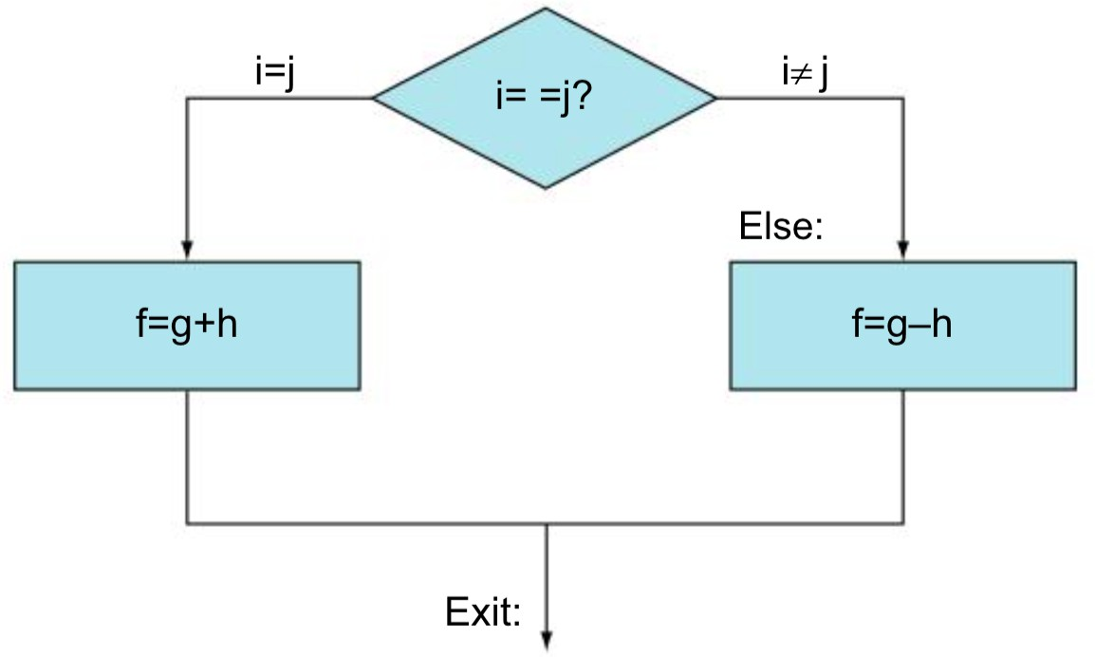
Example: if else conditional branching.
C Code
if(i == j){ f = g + h;
}
else{
f = g - h;
}
Registers
t0 | f
t1 | g
t2 | h
t3 | i
t4 | j

Slide 6
Example: if else conditional branching.
Example: if else conditional branching.
Example: if else conditional branching.
C Code
C Code: goto version 1
if(i == j){ f = g + h;
}
else{
f = g - h;
}
if (i==j) goto Then; f = g - h;
Then:
f = g + h; Exit:
C Code: goto version 2
if (i!=j) goto Else; f = g + h;
Else:
f = g - h; Exit:

Slide 7
Example: if else conditional branching.
Assembly code version 1
C Code
beq t3, t4, Then sub t0, t1, t2 beq x0, x0, Exit Then:
add t0, t1, t2 Exit:
if(i == j){ f = g + h;
}
else{
f = g - h;
}
Registers
Assembly code version 2
t0 | f
bne t3, t4, Else add t0, t1, t2 beq x0, x0, Exit Else:
sub t0, t1, t2 Exit:
t1 | g
t2 | h
t3 | i
t4 | j

Slide 8
If else conditional branching template.
C Code
Assembly code template 1
if(cond){
body_if
}
else{
body_else
}
if(cond)goto If
body_else
goto Exit If:
body_if
Exit:
Assembly code template 2
if(!cond)goto Else
body_if
goto Exit Else:
body_else
Exit:
body: {
statement1; statement2;
…
}

Slide 9
Example: if else.
10
C Code
int abs(int v)
{
int r;
if (v < 0)
r = -v;
else
r = v; return r;
}

Slide 10
Example: if else.
10
C Code
C Code: : goto version
int abs(int v)
{
int r;
if (v < 0)
r = -v;
else
r = v; return r;
}
int abs(int v)
{
int r;
int cond = v < 0;
if (cond) goto Then; r = v;
goto Done; Then:
r = -v; Done:
return r;
}

Slide 11
Example: if else.
10
C Code
C Code: : goto version
Assembly Code
int abs(int v)
{
int r;
if (v < 0)
r = -v;
else
r = v; return r;
}
int abs(int v)
{
int r;
int cond = v < 0;
if (cond) goto Then; r = v;
goto Done; Then:
r = -v; Done:
return r;
}
abs:
slt t0, a0, x0 bne t0, x0, Then j Exit
Then:
sub a0, x0, a0 Exit:
ret

Slide 12
Example: while.
C Code
Exercise
while(A[i] == k){ i += 1;
}
Registers
a0 | i
a1 | k
a2 | &A[0]
t0

Slide 13
Example solution: while.
C Code
Assembly Code (Example 2.6 in book
while(A[i] == k){ i += 1;
}
Loop:
slli |  | t0, | a0, | 2 | // | t0 | = | i*4
add t0, t0, a2 |  |  |  |  | // | t0 | = | &A[i]
lw t1, 0(t0) |  |  |  |  | // | t1 | = | A[i]
bne t1, a1, Exit addi a0, a0, 1 |  |  |  |  | // // | A[i] != k i = i + 1
beq x0, x0, Loop |  |  |  |  | // | go to Loop
Registers
Exit:
a0 | i
a1 | k
a2 | &A[0]
t0

Slide 14
General 'while' template #1.
C Code
while (Cond)
Body
goto version
Loop:
if (!Cond)goto Exit;
Body
goto Loop; Exit:

Slide 15
General 'while' template #1.
C Code
Assembly code
while (Cond)
Body
Loop:
slli t0, a0, 2
{
add t0, t0, a2 | // | t0 | = | &A[i]
lw t1, 0(t0) | // | t1 | = | A[i]
bne t1, a1, Exit addi a0, a0, 1
goto version
Loop:
if (!Cond)goto Exit;
Body
goto Loop; Exit:
beq x0, x0, Loop Exit:

Slide 16
General 'while' template #2.
"Jump-to-middle" translation​
C Code
while (Cond)
Body
goto version
goto Test; Loop:
Body
Test:
if (Cond)goto Loop; Exit:

Slide 17
General 'while' template #2.
"Jump-to-middle" translation​
C Code
while (Cond)
Body
Assembly code
beq x0, x0, Test Loop:
addi a0, a0, 1 Test:
slli t0, a0, 2
beq x0, x0, Test Loop:
addi a0, a0, 1 Test:
slli t0, a0, 2
goto version
// i = i + 1
goto Test; Loop:
Body
Test:
if (Cond)goto Loop; Exit:
// i = i + 1
{
{
// t0 = i*4
// t0 = &A[i]
// t1 = A[i]
// A[i] == k
// t0 = i*4
// t0 = &A[i]
// t1 = A[i]
// A[i] == k
add t0, t0, a2 lw t1, 0(t0)
beq t1, a1, Loop
add t0, t0, a2 lw t1, 0(t0)
beq t1, a1, Loop
Exit:
Exit:

Slide 18
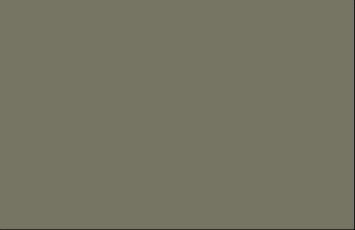
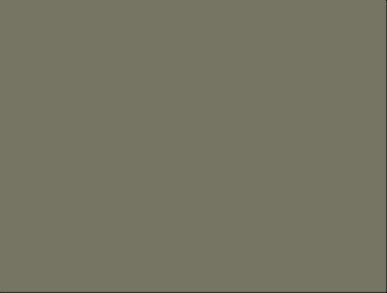
While loop: example #2
Count number of 1’s in argument x ('popcount')
C Code
goto version (template 2)
int pcount_while(unsigned int x) {
int result = 0; while (x) {
result += x & 1; x >>= 1;
}
return result;
}
int pcount_goto_jtm(unsigned int x) {
int result = 0; goto test;
loop:
result += x & 1; x >>= 1;
test:
if(x) goto loop; return result;
}

Slide 19
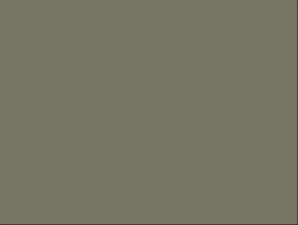
While loop: example #2
21
Count number of 1’s in argument x ('popcount')
goto version (template 2)
Assembly code
int pcount_goto_jtm(unsigned int x) {
int result = 0; goto test;
Loop:
result += x & 1; x >>= 1;
Test:
if(x) goto Loop; return result;
}
addi t0, x0, 0 beq x0, x0, Test
Loop:
andi t1, x0, 1 // x & 1
add t0, t0, t1 // result += t srli a0, a0, 1 // x >>= 1
Test:
bne x0, a0, Loop
addi a0, t0, 0 // return Exit:

Slide 20
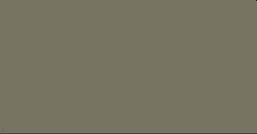

22
General 'do-while' template.
Goto Version
C Code
loop:
body
if (COND)
goto loop
do
body
while (COND);

Slide 21
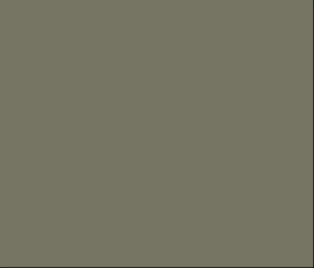
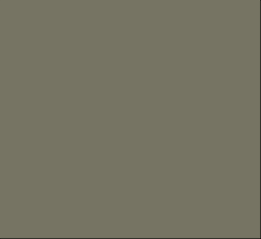
'do-while' for the previous example.
Count number of 1’s in argument x ('popcount')
C Code
Goto Version
int pcount_do (unsigned int x)
{
int result = 0; do {
result += x & 1; x >>= 1;
} while (x); return result;
}
int pcount_goto (unsigned int x)
{
int result = 0; loop:
result += x & 1; x >>= 1;
if(x) goto loop; return result;
}

Slide 22
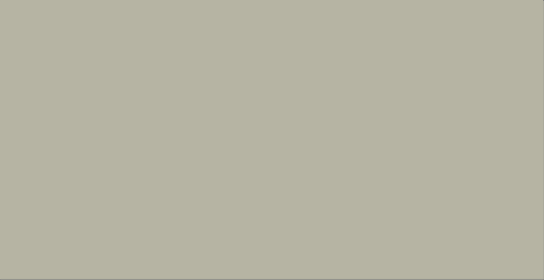
24
'do-while' loop compilation.
Goto Version Assembly code
int pcount_goto (unsigned int x)
{
int result = 0; loop:
result += x & 1; x >>= 1;
if(x) goto loop; return result;
}
addi | t0, | zero, |  | 0 | # |  |  | result = |  |  |  |  |  | 0
Loop: andi | t1, | a0, | 1 | # |  | # loop: t = x & |  |  |  |  | 0x1
add | t0, | t0, | t1 |  | # |  |  | result |  |  |  |  | += t
srli | a0, | a0, | 1 |  | # | x >>= |  |  |  | 1
bne | a0, | x0, | Loop |  | # |  | if |  | (x) |  |  | goto |  | loop
addi | a0, | t0, | 0 | # | return |  |  |  | result
ret

Slide 23
25
'for' loop template.
for(Init;Cond;Update)
Body
Init
r = 0, i = 0
Cond
#define WSIZE 8*sizeof(int) int pcount_for
(unsigned int x)
{
size_t i; int r;
for (r = 0, i = 0;
i < WSIZE; i++)
{
r += (x >> i) & 1;
}
return r;
}
i < WSIZE
Update
i++
Body
{
r += (x >> i) & 1;
}

Slide 24


'for' loop → 'while' loop conversion.
While loop version
Init;
while (Cond ) {
Body
Update;
}
for loop version
for(Init;Cond;Update)
Body

Slide 25
for-while loop conversion.
int pcount_for_while (unsigned int x)
{
size_t i; int r;
r = 0, i = 0;
while (i < WSIZE)
{
r += (x >> i) & 1; i++;
}
return r;
}
Init
r = 0,i =0
Cond
i < WSIZE
Update
i++
Body
{
r += (x >> i) & 1;
}

Slide 26













Nested procedures.
main()
func1a(..)
func1b(..)
func2a(..)
func2b(..)
func2c(..)
func2d(..)
leafa(..)
leafb(..)
leafn(..)

Slide 27
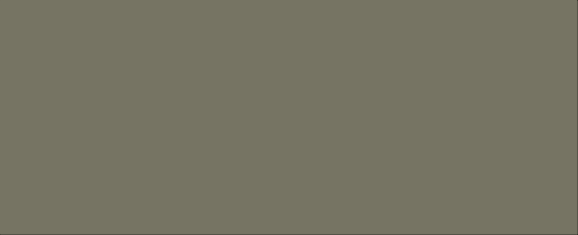
29
Nested procedures.
main()
_{fu} Multiple procedure calls will eventually conflict with register values.
nc1a(..) func1b(..)
func2b(..) func2c(..) fun
Need to use the stack to preserve data
return address
Saved variables
func2a(..)
c2d(..)
leafa(..)
leafb(..)
leafn(..)

Slide 28
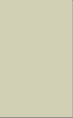
RISC-V stack.
Stack “Bottom”
Block of memory used by compiler as a stack data structure
The stack “grows down”
Increasing Addresses
Stack Pointer:
sp
Register sp contains the “lowest” stack address
Points to the “top” element
Stack “Top”
Decreasing Addresses

Slide 29
RISC-V stack.
addi sp, sp, -8
Stack “Bottom”
Decrement sp by 8 to make room on the stack
sw rs1, 4(sp)
sw rs2, 0(sp)
rs1
rs2
Increasing Addresses
Old stack pointer
Stack “Top”
Decreasing Addresses
New stack pointer sp

Slide 30
RISC-V stack.
lw dst2, 0(sp) lw dst1, 4(sp)
pop stack from the top
addi sp, sp, 8
Deallocate 8 bytes from top
Stack “Bottom”
rs1
rs2
Increasing Addresses
New stack pointer sp
Stack “Top”
Old stack pointer
Decreasing Addresses

Slide 31
Allocating and pushing to the stack.
Stack “Bottom”
Increasing Addresses
lw | dst1, | 0(sp)
lw | dst2, | 0(sp)
Stack Grows Down
Prev Stack Pointer: sp
Next Stack Pointer: sp
addi
sp, sp, -8
-4
Stack “Top”

Slide 32


Popping and freeing from the stack.
Stack “Bottom”
lw Dst, 0(sp)
Read value from top of stack at 0(sp)
This is optional in RISC-V (and most RISC ISAs)
addi sp, sp, 4
Deallocate 4 bytes from the top of the stack
Increasing Addresses
Stack Grows Down
Next Stack Pointer: sp
Prev Stack Pointer: sp
+4
Stack “Top”

Slide 33



Procedure control-flow: example.
int caller () {
return absadd(-1, 2);
}
int absadd (int x, int y) { int t0 = abs(x);
int t1 = abs(y) return t0+t1;
}
int abs (int v) {
int mask = v >> 4 * 8 - 1; return (v + mask) ^ mask;
}

Slide 34
Procedure control-flow: example.
int caller () {
return absadd(-1, 2);
}
caller:
400500: | addi | sp, | sp, -4
400504: | sw | ra, | 0(sp) | # | save | ret addr
400508: | addi | a0, | x0, -1 | # | arg0 | = -1
40050C: | addi | a1, | x0, 2 | # | arg1 | = 2
int absadd (int x, int y) { int t0 = abs(x);
int t1 = abs(y) return t0+t1;
}
400510: jal
400514: lw
400518: jalr
ra, absadd ra, 0(sp) x0, ra
# absadd(-1,2) # restore ra
# return
int abs (int v) {
int mask = v >> 4 * 8 - 1; return (v + mask) ^ mask;
}

Slide 35

Procedure control-flow: example.
int caller () {
return absadd(-1, 2);
}
absadd: 400540: addi
400544: sw
400548: sw
40054C: sw
sp, sp, -12
ra, 8(sp)
s0, 4(sp)
a1, 0(sp)
# Allocate stack # Save ret addr # Save s0 reg
# Save y
int absadd (int x, int y) { int t0 = abs(x);
int t1 = abs(y) return t0+t1;
}
40055C: | jal | ra, | abs | # | abs(x)
400560: | add | s0, | a0, x0 | # | s0 = abs(x)
400558: | lw | a0, | 0(sp) | # | a0 = y
40055C: | jal | ra, | abs | # | abs(y)
400560: | add | a0, | a0, s0 | # | a0 = |x|+|y|
400564: | lw | s0, | 4(sp) | # | Restore s0 reg
400568: | lw | ra, | 8(sp) | # | Restore ret
int abs (int v) {
int mask = v >> 4 * 8 - 1; return (v + mask) ^ mask;
}
addr
40056C: addi 400570: jalr
sp, sp, 12 x0, ra
# Free stack # ret

Slide 36

Procedure control-flow: example.
int caller () {
return absadd(-1, 2);
}
abs:
400570: sra
400574: add
400578: xor 40057C: jalr
t0, a0, 31
a0, a0, t0 a0, a0, t0 x0, ra
# mask = v >> 31 # v + m
# a0=(v + m) ^ m # return a0
int absadd (int x, int y) { int t0 = abs(x);
int t1 = abs(y) return t0+t1;
}
int abs (int v) {
int mask = v >> 4 * 8 - 1; return (v + mask) ^ mask;
}

Slide 37


A closer look.
•
•
•
0x120
0x11C
0x118
0x114
0x110
caller:
•
•
400510: jal ra, absadd
400514: lw ra, 0(sp)
•
•
sp
0x11C
absadd: 400540: addi
400544: sw
sp, sp, -12
ra, 8(sp)
pc
0x400510
•
•
ra
0x400514
40055C: jal
ra, abs
ra, 8(sp) sp, sp, 12 x0, ra
•
•
400568: lw
40056C: addi 400570: jalr

Slide 38

A closer look.
•
•
•
0x120
0x11C
0x118
0x114
0x110
Caller:
•
•
400510: jal
400514: lw
ra, absadd ra, 0(sp)
•
•
sp
0x110
absadd:
400544: sw ra, 8(sp)
400540: addi sp, sp, -12
pc
0x400540
•
•
ra
0x400514
40055C: jal
ra, abs
ra, 8(sp) sp, sp, 12 x0, ra
•
•
400568: lw
40056C: addi 400570: jalr

Slide 39
A closer look.
•
•
•
0x120
0x11C
0x118
0x114
0x110
caller:
•
•
400510: jal
400514: lw
ra, absadd ra, 0(sp)
00400514
•
•
sp
0x110
absadd:
400540: addi sp, sp, -12
pc
0x400544
400544: sw ra, 8(sp)
•
•
ra
0x400514
40055C: jal
ra, abs
•
•
400568: lw
40056C: addi 400570: jalr
ra, 8(sp) sp, sp, 12 x0, ra

Slide 40
A closer look.
•
•
•
0x120
0x11C
0x118
0x114
0x110
caller:
•
•
400510: jal
400514: lw
ra, absadd ra, 0(sp)
00400514
•
•
•
•
sp
0x110
absadd: 400540: addi
400544: sw
sp, sp, -12
ra, 8(sp)
pc
0x40055C
•
•
ra
0x400560
40055C: jal ra, abs
•
•
400568: lw
40056C: addi 400570: jalr
ra, 8(sp) sp, sp, 12 x0, ra

Slide 41
A closer look.
•
•
•
0x120
0x11C
0x118
0x114
0x110
caller:
•
•
400510: jal
400514: lw
ra, absadd ra, 0(sp)
00400514
•
•
•
•
sp
0x110
absadd: 400540: addi
400544: sw
sp, sp, -12
ra, 8(sp)
pc
0x400568
•
•
ra
0x400514
40055C: jal
ra, abs
•
•
400568: lw ra, 8(sp)
40056C: addi 400570: jalr
sp, sp, 12 x0, ra

Slide 42

A closer look.
•
•
•
0x120
0x11C
0x118
0x114
0x110
caller:
•
•
400510: jal
400514: lw
ra, absadd ra, 0(sp)
00400514
•
•
•
•
sp
0x11C
absadd: 400540: addi
400544: sw
sp, sp, -12
ra, 8(sp)
pc
0x40056C
•
•
ra
0x400514
40055C: jal
ra, abs
ra, 8(sp)
•
•
400568: lw
40056C: addi sp, sp, 12
400570: jalr x0, ra

Slide 43
A closer look.
•
•
•
0x120
0x11C
0x118
0x114
0x110
caller:
•
•
400510: jal
400514: lw
ra, absadd ra, 0(sp)
00400514
•
•
•
•
sp
0x11C
absadd: 400540: addi
400544: sw
sp, sp, -12
ra, 8(sp)
pc
0x400570
•
•
ra
0x400514
40055C: jal
ra, abs
ra, 8(sp) sp, sp, 12
•
•
400568: lw
40056C: addi
400570: jalr x0, ra

Slide 44
Summery.
Things you should know or go learn more about:
  RISC-V assembly programming straight-line code with basic arithmetic
    Addition, subtraction, multiplication (shifts and adds)
  Basic function call/return
    Function calls that don’t make nested function calls (leaf procedures)
Next up: Logical operations.
Read chapter 2!

Slide 45
Thank you.

